Slide 1
RUBIX INNOVATORS

Slide 2
We have created a chatbot for ecommerce website.
Which will help the customer service
It will help the business by reducing the work force at customer service
As the Chatbot will take of customer service department

Slide 3
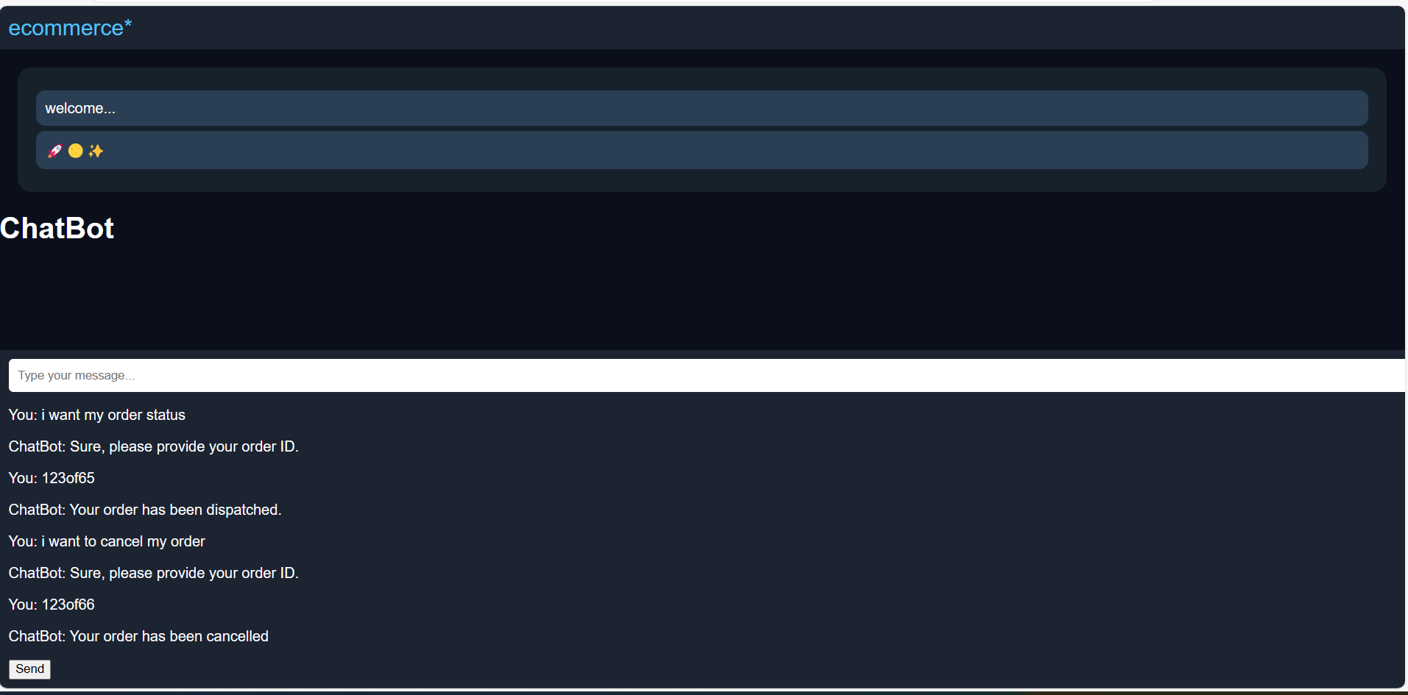

Slide 4
THANK YOU

