Slide 1
Delayed departures at Newark Airport
Neil Allan
11 March 2021

Slide 2
What do we want to know?
Which weather factors are important?
Are any non-weather factors important?
How does Newark compare to other NYC airports?
What investments could Newark make to reduce delays?

Slide 3
Project scope
Covers the period Jan - Dec 2017
Delayed departure = 15 minutes or more late
Includes data for three New York airports:
EWR - Newark Liberty International Airport
JFK - John F Kennedy International Airport
LGA - La Guardia Airport
A full report with more detail is available to accompany this presentation

Slide 4
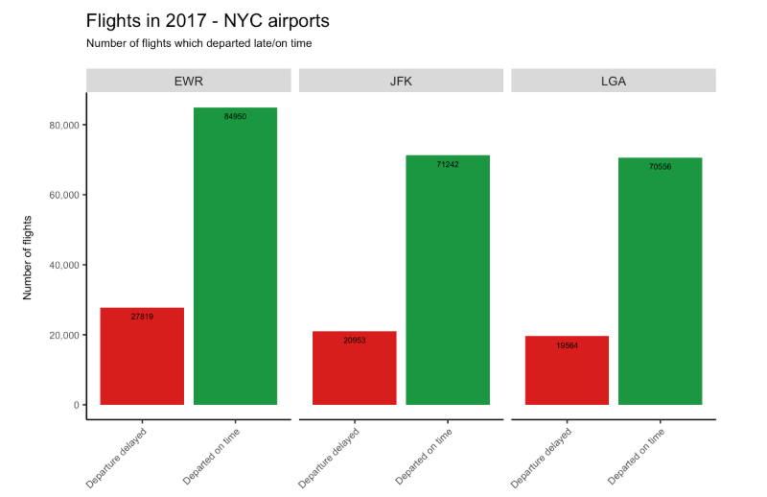
Overview - number of flights delayed/on time

Slide 5
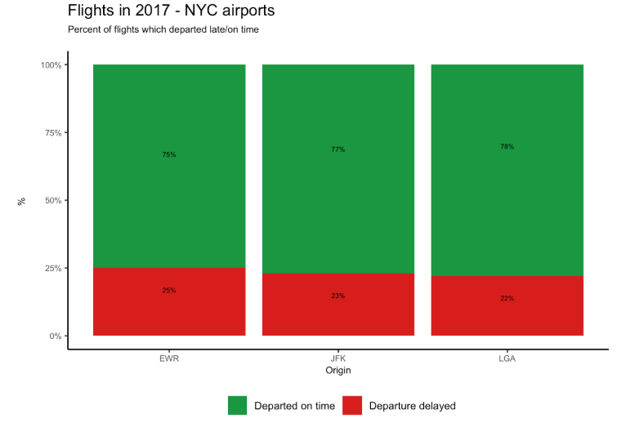
Overview - percentage of flights delayed/on time

Slide 6
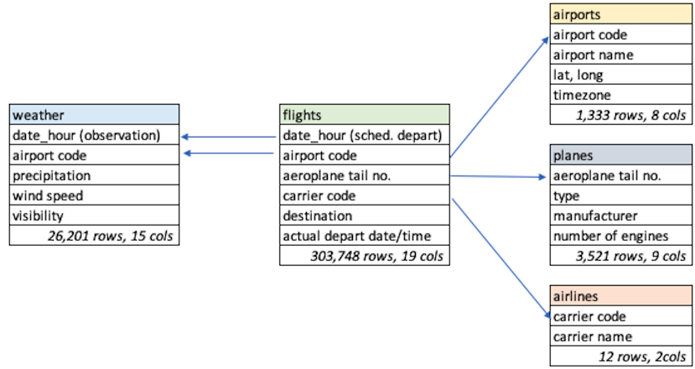
What factors were considered in this analysis?

Slide 7
Which factors have an impact on flight delays?
Analysis of the available data showed that the following are statistically significant:
number of departures in scheduled departure hour
visibility (miles)
wind speed (mph)
wind direction cardinal (N, S, E, W)
precipitation daily total (inches)
snowfall daily total (inches)
temperature daily maximum (Fahrenheit)
Note only one of these is a non-weather factor
Modeling produced similar results with and without this variable

Slide 8
How good is the model at explaining delayed departures?
Short answer: “OK, but not great!”
Statistical analysis was used to test the “fit” of the model
Although significant, factors in previous slide didn’t do a great job of predicting variance in departure delays
Could there be important factors which are not included in the data?

Slide 9
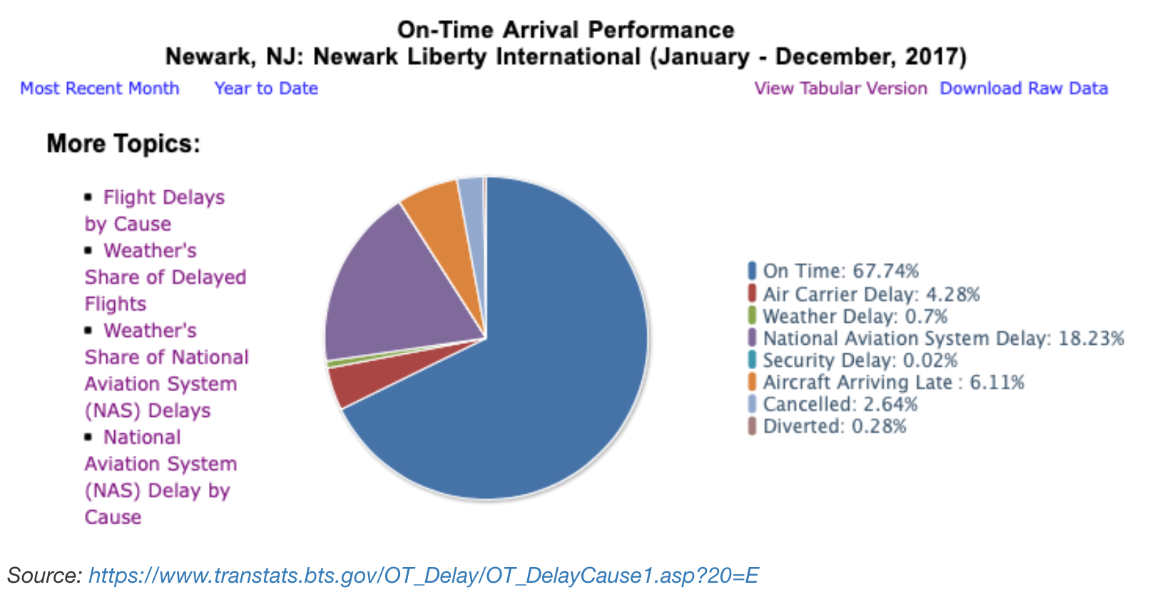
Which factors missing from the model could be important?
Other reports show delays to previous flights are a factor

Slide 10
Conclusions and next steps
A number of weather variables have a significant effect on delayed departures
The number of flights leaving in the scheduled hour of departure is also significant
However, the data which was in scope for this report is not sufficient to make business decisions on future investment at Newark - important factors (such as the knock-on effect of earlier flight delays) could not be assessed
Further analysis required - perhaps using reporting on causes of delays collated by the US Bureau of Transportation Statistics since 2003:
https://www.transtats.bts.gov/OT_Delay/OT_DelayCause1.asp

