Slide 1
Where AI data centers get built locks in their carbon, water, and costs for decades
“New Yorkers have expressed legitimate concerns regarding the potential impacts of the siting and operation of data centers on energy use, water use, water quality…”
New York Executive Order 62, July 2026
A campus built today will run for 20 to 30 years.
Grid carbon varies about fourfold between the counties we scored.
Data from Lawrence Berkeley National Laboratory, 2024 United States Data Center Energy Usage Report, and New York Executive Order 62 (July 2026). Grid carbon range from research/impact.md. Links in docs/deck/sources.md.
1
Notes:
AI is driving a boom in data center construction. Lawrence Berkeley National Lab found that data
centers used 4.4 percent of US electricity in 2023, and it expects 6.7 to 12 percent by 2028.
Communities are pushing back on where these go. This summer New York paused state permits for
large data centers over energy and water. A campus built today runs for 20 to 30 years, so the
county you choose sets its carbon, its water, and its power bill for decades.
Where the numbers come from. [[CHECK]] marks a number that could change tonight.
- US data center share of electricity in 2023, 4.4% (176 TWh), published source (LBNL 2024 report, Executive Summary p. 5)
- Projected share in 2028, 6.7% to 12.0%, published source (LBNL 2024 report, Executive Summary p. 6)
- Grid carbon varies about fourfold across candidate counties, 242 to 911 lb/MWh [[CHECK]] (research/impact.md, dry cooling table)
Outside sources
- LBNL 2024 United States Data Center Energy Usage Report (Shehabi et al.), https://eta-publications.lbl.gov/sites/default/files/2024-12/lbnl-2024-united-states-data-center-energy-usage-report_1.pdf
- New York Executive Order No. 62, https://www.governor.ny.gov/executive-order/no-62-establishing-temporary-moratorium-data-centers-new-york-while-state-develops

Slide 2
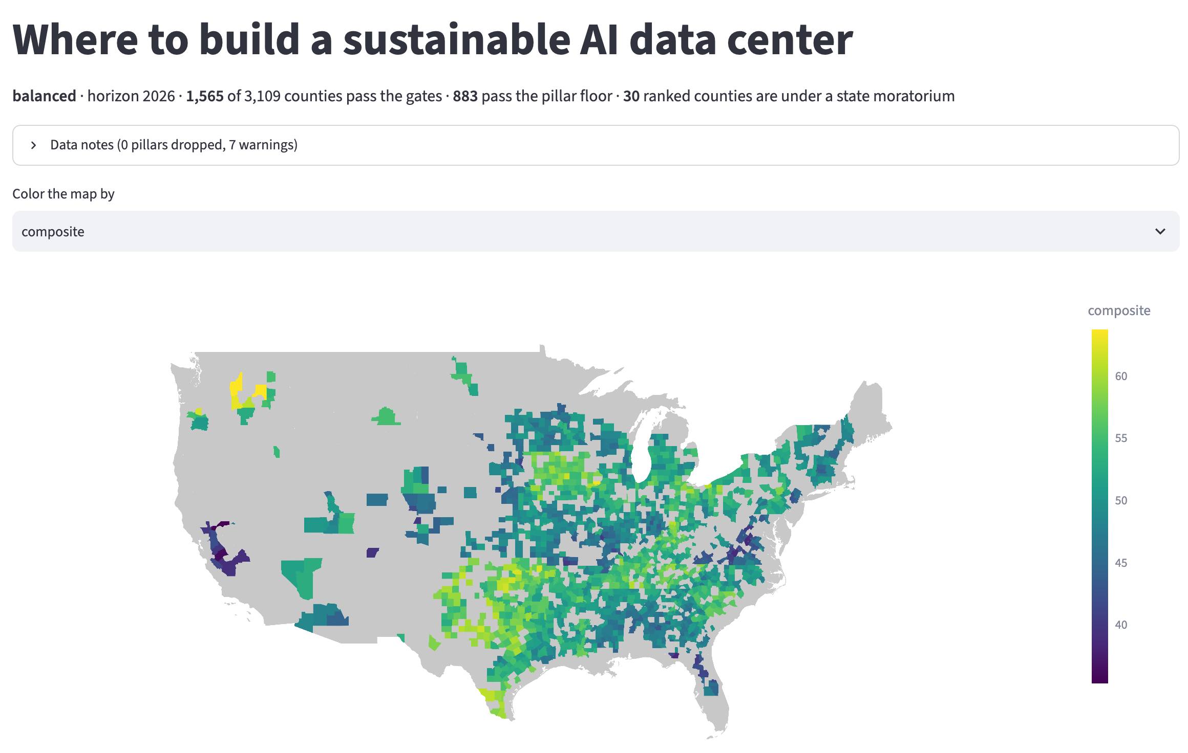
Our tool ranks all 3,109 counties for the project you describe
3,109 counties in the lower 48
1,565 pass hard limits like flood risk and fiber
883 have no weak spot across eight factors
Shortlist ranked, with the reasons behind each rank
Eight factors, weighted however you choose. These are our balanced weights.
Energy and carbon
15%
Water
12%
Climate
12%
Grid
15%
Land
7%
Community
9%
Permitting
15%
Cost of power
15%
Screenshot from the team's Streamlit app (app/app.py) with the balanced preset. Counts from docs/figures/facts.json. Weights from engine/conditions/balanced.yaml.
2
Notes:
So we built a tool for that choice. You describe the project, meaning its size, how it's cooled,
the limits you won't cross, and how much each factor matters to you. The tool screens all 3,109
counties in the lower 48. Hard limits like flood risk, wildfire, fiber, and the wait for a grid
connection rule out about half. Eight factors then score the rest against the nation, and a
county that's weak on any one of them drops below the others. You get a ranked shortlist, and
every rank comes with its reasons.
If someone asks whether this is machine learning, it isn't. The weights are stated and anyone
can change them. The only model we built was for permitting, and we dropped it because it failed
out of sample.
Where the numbers come from. [[CHECK]] marks a number that could change tonight.
- Counties, 3,109 [[CHECK]] (docs/figures/facts.json, balanced.counties)
- Counties that pass the hard limits, 1,565 [[CHECK]] (docs/figures/facts.json, balanced.passed)
- Counties with no weak factor (pillar floor), 883 [[CHECK]] (docs/figures/facts.json, balanced.floor_ok)
- Balanced weights, energy_carbon 0.153, water 0.119, climate_resilience 0.119, grid_infrastructure 0.153, land 0.068, community 0.085, permitting 0.153, cost 0.150 [[CHECK]] (docs/figures/facts.json, weights.balanced)

Slide 3
It now accounts for protected land, farmland, and wetlands
Protected land, farmland, and built-up land lower the land score.
Forests and wetlands mean more permits, which lowers permitting.
Users can also rule out protected or tribal land entirely.
Building on farmland spares wild habitat but uses up cropland. The tool lets you weigh both.
Protected land from USGS PAD-US 4.1, land cover from NLCD 2021 through IPUMS NHGIS, tribal land from Census TIGER 2024. Grant's scores from docs/figures/facts.json and research/sensitive_land.md.
3
Notes:
The challenge asks about proximity to sensitive areas and ecosystems, so we added it. The tool now
reads how much of each county is protected for wildlife, how much is farmed, how much is built up,
and how much is forest or wetland, and each one now counts in the score. Grant shows the trade.
It's 43 percent cropland and 13 percent protected, so its land score fell from 75 to 53. It has
almost no forest or wetland, so permitting rose from 53 to 63.
If someone asks about farmland, large campuses often land on it because developers want flat,
big parcels near roads and transmission. That's a habit, not a need. Soil quality does nothing
for a data center, and old power plant sites or industrial parks can work as well. The tool
measures land cover, not prime soil. Building on farmland usually harms habitat less than wild
land does, but it uses up farmland, so we leave the balance to the user. In our opposition
dataset farmland comes up in 7 of 100 cases with stated reasons, mostly inferred from text. The
top reasons are zoning process, water, and grid strain.
If someone asks whether one input drives Grant's rank, scored alone protected land would drop
Grant to 4th and cropland alone to 2nd. Together, as designed, they offset. The protected and
tribal land limits are off in every preset.
Where the numbers come from. [[CHECK]] marks a number that could change tonight.
- Grant land score before and after, 75.0 to 52.8 [[CHECK]] (docs/figures/facts.json and research/sensitive_land.md, featured.pillars.land)
- Grant permitting score before and after, 53.2 to 63.2 [[CHECK]] (docs/figures/facts.json and research/sensitive_land.md, featured.pillars.permitting)
- Grant cropland share, 42.9% [[CHECK]] (research/sensitive_land.md, County shares table)
- Grant protected share (GAP 1-2), 12.8% [[CHECK]] (research/sensitive_land.md, County shares table)
- Grant rank with protected land alone or cropland alone, 4th or 2nd [[CHECK]] (research/sensitive_land.md, Effect on the balanced ranking)
- Farmland in opposition cases with stated reasons, 7 of 100 [[CHECK]] (data/processed/opposition_seed_labels.csv, reasons column)

Slide 4
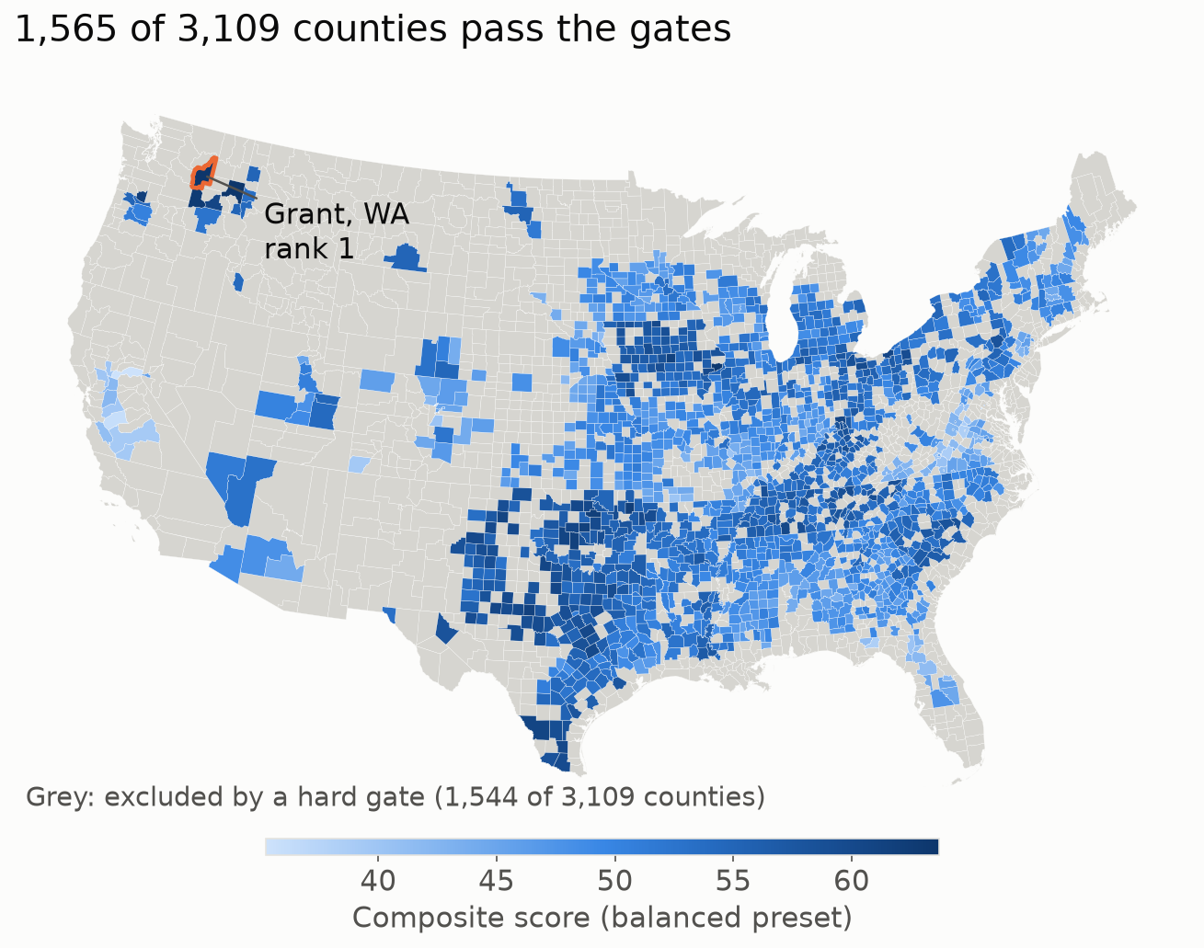
With balanced weights, two counties in eastern Washington tie for first
Grant and Whitman circled
Our example is Grant. It works only if the campus is sited next to hydro, powered by new clean supply the project funds.
Grant scores 63.70 and Whitman 63.69 out of 100.
Under equal weights Whitman comes first and Grant second.
Grant already hosts the Quincy data center cluster.
Grey counties fail a hard limit
Team engine, balanced preset (results/balanced.csv, docs/figures/facts.json). Map from docs/figures/map_composite.png. Grant PUD data center FAQ, August 2026.
4
Notes:
With balanced weights, Grant and Whitman counties in eastern Washington come out level, 63.70 to 63.69. Under equal weights Whitman
comes first and Grant second. We use Grant as our worked example because it already hosts the
Quincy data center cluster, and its power timeline and tax status are documented. It comes with a
condition. The campus has to be sited next to hydro, powered by new clean supply the project
funds, because none of the utility's existing hydro is spare.
If someone asks why not Whitman, it's a fair alternative with almost no protected land and no
water stress. We don't have the same site research for it yet.
Where the numbers come from. [[CHECK]] marks a number that could change tonight.
- Counties that pass the hard limits, 1,565 [[CHECK]] (docs/figures/facts.json, balanced.passed)
- Grant composite, 63.70 [[CHECK]] (results/balanced.csv, composite)
- Whitman composite, 63.69 [[CHECK]] (results/balanced.csv, composite)
- Rank under equal weights, Grant 2nd, Whitman 1st [[CHECK]] (docs/figures/facts.json, weights.equal_weights_featured_rank)
Outside sources
- Grant PUD data center FAQ, 2026-08-28, https://www.grantpud.org/blog/data-center-faqs

Slide 5
Different weights favor different counties, so the tool shows the spread
No county makes the top 10 under most weightings.
Near our chosen weights, Grant stays in the top 10 (99.95%).
Energy and carbon drive most cost differences between counties.
We didn't tune weights to get an answer. We tested how much it depends on them.
Top 10 shares from 5,000 random weightings of the eight factors (docs/figures/facts.json, computed by docs/figures/make_figures.py). Cost shares from the 25-year dollar model in docs/weighting.md.
5
Notes:
The obvious question is whether we picked weights that make our example win. So we stopped
choosing. We drew 5,000 random weightings and counted how often each county makes the top 10.
Whitman does most often, at 43.9 percent, and Grant sits in a close group
around 36 percent. Near our own weights Grant stays in the top 10 almost every time. When we priced
every county in dollars, energy and carbon drove most of the differences. We didn't tune the weights to get an answer. We tested
how much the answer depends on them.
If someone asks why these weights, we compared five methods. A 25-year dollar model, random
weightings, two data-driven methods, and where industry has already built. Energy and carbon carry
67 to 88 percent of the dollar differences, depending on the carbon price. Our balanced weights give
them about 30 percent.
Where the numbers come from. [[CHECK]] marks a number that could change tonight.
- Top 10 share, Whitman, WA, 43.9% [[CHECK]] (docs/figures/facts.json, weights.uniform_weightings_top10_share)
- Top 10 share, Cuyahoga, OH, 36.9% [[CHECK]] (docs/figures/facts.json, weights.uniform_weightings_top10_share)
- Top 10 share, Clark, WA, 35.9% [[CHECK]] (docs/figures/facts.json, weights.uniform_weightings_top10_share)
- Top 10 share, Grant, WA, 35.8% [[CHECK]] (docs/figures/facts.json, weights.uniform_weightings_top10_share)
- Top 10 share, Hutchinson, TX, 35.2% [[CHECK]] (docs/figures/facts.json, weights.uniform_weightings_top10_share)
- Grant in the top 10 near balanced weights, 99.95% [[CHECK]] (docs/figures/facts.json, featured.robustness (2,000 small perturbations))
- Energy and carbon share of 25-year cost differences, 67% to 88%, published source (docs/weighting.md, Variance shares, with sales tax)
- Energy and carbon weight in the balanced preset, about 30% [[CHECK]] (docs/weighting.md, Variance shares)

Slide 6
A dry-cooled campus in Grant would use 87% less water
“The direct water requirements of data centers can be substantial, depending on the size and type of cooling system used.”
Washington Data Center Workgroup, Dec. 2025
Carbon depends on the clean power the project brings online.
Modeled with etl/impact.py (300 MW IT, load factor 0.8, PUE and WUE after Lei and Masanet) using eGRID2023. Quote from the Washington Data Center Workgroup preliminary report, December 2025.
6
Notes:
Against Loudoun County, Virginia, where much of the industry builds today, the example holds up
well on water. An evaporatively cooled campus in Grant would use about
210 million gallons of water a year. Dry cooling brings that to about
28 million, an 87 percent cut, for about 2 percent more
energy. Carbon depends on the power that serves the campus. Before its own clean supply comes
online, it's 236 to 700 thousand tons a year, against Loudoun's
675 thousand. Washington law then requires fully clean retail power by 2045.
If someone asks why not zero carbon, the utility's hydro rate of zero describes its existing
customers. None of that hydro is spare for a new load, so we don't claim it. If someone asks
whether 2045 is an edge over Virginia, it isn't. Virginia's Clean Economy Act also sets 2045 for
Dominion (not verified for this deck). The difference is the new supply the project funds.
Where the numbers come from. [[CHECK]] marks a number that could change tonight.
- Grant water, evaporative, 210.2 million gallons a year [[CHECK]] (docs/figures/facts.json, impact['Grant, WA'].water_million_gal_evap)
- Grant water, dry, 27.8 million gallons a year [[CHECK]] (docs/figures/facts.json, impact['Grant, WA'].water_million_gal_dry)
- Loudoun water, evaporative, 322.8 million gallons a year [[CHECK]] (docs/figures/facts.json, impact['Loudoun, VA'].water_million_gal_evap)
- Water cut, dry against evaporative, 87% [[CHECK]] (computed from the two Grant values)
- Grant CO2 at BPA's mix, 235,547 t a year [[CHECK]] (docs/figures/facts.json, grant_ranges.co2_tonnes.bpa)
- Grant CO2 at the regional average, 700,390 t a year [[CHECK]] (docs/figures/facts.json, grant_ranges.co2_tonnes.nwpp_table)
- Loudoun CO2, dry, 675,455 t a year [[CHECK]] (docs/figures/facts.json, impact['Loudoun, VA'].co2_tonnes_dry)
- Dry cooling energy penalty, about 2% [[CHECK]] (research/risk.md, Water stress row)
- Washington clean power dates, 2030 neutral, 2045 fully clean, published source (research/implementation.md, Carbon over 30 years)
Outside sources
- Washington Clean Energy Transformation Act, RCW 19.405.040 and 19.405.050, https://app.leg.wa.gov/RCW/default.aspx?cite=19.405
- Washington Data Center Workgroup, Preliminary Report, Finding 19, p. 13, https://dor.wa.gov/sites/default/files/2025-12/2025DataCntrWrkgrpPrelimReport.pdf

Slide 7
Power is the biggest risk, so the project has to bring its own
Power. The dams are spoken for, and 800 MW of requests wait in line.
High
Heat. Days above 95°F rise from 14 to 36 by 2050.
Medium
Land. No protected land within 5 km, and tribal consultation starts early.
Low
The example holds only if full power arrives by about late 2029, near today's price.
Grant PUD data center FAQ, August 2026. Risk ratings from research/risk.md. Land check from research/sensitive_land.md (PAD-US 4.1, Census TIGER 2024). Timing from docs/weighting.md.
7
Notes:
For our example, one risk stands out, and it's power. Grant PUD's share of its dams averages about
633 average megawatts, already below its 757 megawatt load. The
campus would add 279, and about 800 megawatts of requests are ahead of it. So the
project funds new supply and phases in behind the 2027 and 2029 transmission lines. Heat is a medium
risk. Land is low, with no protected land within 5 kilometers of Quincy, and tribal consultation
starts early. The example holds only if full power arrives by about late 2029, near today's price.
If someone asks about price, a new load this size doesn't get today's average rate. If we reprice
only Washington at BPA's new-load rate of $80 a megawatt-hour, Grant falls to 77th, and
Whitman falls with it. No other state's new-load rate is sourced, so that comparison is lopsided.
If someone asks about timing, each month of delay is priced at $25 million in the dollar model, which
is an assumption. Grant breaks even with Clark at about 10 months past a two-year baseline and with
Franklin at about 12.
If someone asks about tribal land, there's none in Grant County and the nearest is about 75 km away.
Quincy appears to sit in the Yakama Nation's 1855 ceded area, but that's our reading of the treaty
text, not an official map. A federal connection, like a federal permit or a BPA interconnection,
triggers Section 106 consultation, and state funding triggers Washington Executive Order 21-02 review.
Washington's data center workgroup also notes that new load on hydropower competes with tribal and
state fisheries efforts, which is one more reason we don't claim existing hydro.
Where the numbers come from. [[CHECK]] marks a number that could change tonight.
- Grant PUD share of its dams, about 633 aMW, published source (research/risk.md (Grant PUD FAQ), Power availability row)
- Grant PUD 2025 load, 757 aMW, published source (research/risk.md (Grant PUD FAQ), Power availability row)
- Campus average load, 279 aMW [[CHECK]] (research/risk.md and etl/impact.py, Power availability row)
- Large-load requests queued, about 800 MW, published source (research/risk.md (Grant PUD FAQ), Power availability row)
- Days above 95°F, 14.5 today, 35.9 by 2050 [[CHECK]] (docs/figures/facts.json, featured.horizon_2050_raw.days_above_95f_hist)
- Nearest protected land to Quincy, 5.8 km [[CHECK]] (research/sensitive_land.md, Grant County table)
- Nearest tribal land to Quincy, 74.7 km [[CHECK]] (research/sensitive_land.md, Grant County table)
- Grant rank with only WA at BPA's $80 and $132 per MWh, 77 and 1,151 [[CHECK]] (docs/deck_build_log.md, step 4 price rerun)
- Delay cost, $25M a month (assumption) [[CHECK]] (docs/weighting.md, Time to power)
- Grant break-even with Clark and Franklin, 10.2 and 12.1 months past a 2-year baseline [[CHECK]] (docs/weighting.md, Grant's row)
Outside sources
- Grant PUD data center FAQ, 2026-08-28, https://www.grantpud.org/blog/data-center-faqs
- Washington Data Center Workgroup, Preliminary Report, Findings 6 and 19c, https://dor.wa.gov/sites/default/files/2025-12/2025DataCntrWrkgrpPrelimReport.pdf

Slide 8
The campus would grow with new transmission and new clean power
2027
2029
2030
2030s
2045
Quincy transmission upgrade, first phase online
Wanapum to Quincy line, grow toward 300 MW
State law requires carbon-neutral utility sales
Firm clean power such as pumped storage
State law requires 100% clean retail power
Power
About 1 GW of new solar to match yearly use
Cooling
Liquid cooling with dry coolers, about 28 million gallons a year
Heat
Warm return water heats a neighboring food processor
“Large power users, including data centers, are responsible for paying the costs of additional generation, transmission, and distribution infrastructure needed specifically to serve their loads.”
Grant County PUD, Aug. 2026
Plan from research/implementation.md (Columbia Basin Herald, Rye Development, RCW 19.405, ASHRAE liquid cooling classes, Ramboll on Odense). Quote from Grant PUD's data center FAQ, August 2026.
8
Notes:
So the build starts small, behind the utility's queue. A first phase
comes online after Quincy's 2027 transmission upgrade, and the campus grows toward 300 megawatts
after the 2029 line, only as new supply it pays for comes online. About a gigawatt of new solar
matches its yearly use, though not every hour, so firm clean power like pumped storage follows in
the 2030s. Liquid cooling with dry coolers handles hotter 2050 summers, and the warm return water
heats a food processor next door.
Where the numbers come from. [[CHECK]] marks a number that could change tonight.
- Transmission milestones, 2027 Quincy upgrade, 2029 Wanapum to Quincy line, published source (research/implementation.md, The queue and the caps)
- New solar to match yearly use, about 1 GW (1,030 MW at 27% capacity factor) [[CHECK]] (research/implementation.md, Where new clean supply comes from)
- Goldendale pumped storage, 1.2 GW, 2031 to 2032, published source (research/implementation.md, Where new clean supply comes from)
- Dry cooling water, 27.8 million gallons a year [[CHECK]] (docs/figures/facts.json, impact['Grant, WA'].water_million_gal_dry)
- Liquid cooling return water, 45 to 65°C, published source (research/implementation.md, Cooling and water, Heat reuse)
Outside sources
- Grant PUD Data Center FAQs, Q5, https://www.grantpud.org/blog/data-center-faqs

Slide 9
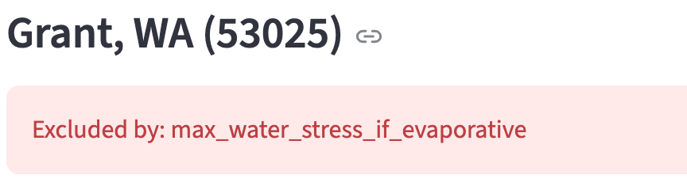
Change one assumption and the tool gives a new answer with its reasons
Evaporative cooling adds a limit on water stress.
Grant drops out, and the app shows which limit it failed.
Whitman, with almost no water stress, moves to first.
You set the conditions. The tool ranks every county and explains each result.
Screenshot from the team's Streamlit app (app/app.py), balanced preset with evaporative cooling. Counts rerun with the engine (docs/deck_build_log.md step 4). Water stress from WRI Aqueduct 4.0.
9
Notes:
That brings us back to the tool. Watch what one change does. Switch the cooling from dry to
evaporative, and the tool adds a limit on water stress. The counties that pass drop from
1,565 to 826. Grant scores 3.6 out of 5 for water stress, so it drops out,
and the app tells you exactly which limit it failed. Whitman, with almost no water stress, moves to
first. Same data, a new answer, with its reasons. Let us show you. [Hand over to the live demo.]
If someone asks about the other presets, speed to power puts Mayes, Oklahoma first, and
sustainability first keeps Whitman first with Grant fourth.
Where the numbers come from. [[CHECK]] marks a number that could change tonight.
- Counties that pass, dry cooling, 1,565 [[CHECK]] (docs/figures/facts.json, balanced.passed)
- Counties that pass, evaporative cooling, 826 [[CHECK]] (docs/deck_build_log.md step 4 and docs/demo_script.md, evaporative cooling step)
- Counties with no weak factor, evaporative, 502 [[CHECK]] (docs/deck_build_log.md step 4 and docs/demo_script.md, evaporative cooling step)
- Grant water stress, 3.6 of 5 [[CHECK]] (docs/figures/facts.json, featured.horizon_2050_raw.water_stress_bws.today)
- First place under evaporative cooling, Whitman, WA [[CHECK]] (docs/deck_build_log.md step 4)
- Preset leaders, speed_to_power Mayes OK, sustainability_first Whitman WA with Grant 4th [[CHECK]] (docs/figures/facts.json and docs/deck.md, presets)

Slide 10
How our pick changed as we fixed the inputs
Rank at each step, log scale
Massachusetts closed a tax break, and Berkshire fell to 27th.
Adding the cost of power moved Grant to first.
Repricing only Washington at BPA's rate drops Grant to 77th.
We also tested a machine-learning model of permitting and dropped it. Out of sample it did no better than chance.
Ranks from docs/figures/facts.json (pick_story). Price rerun in docs/deck_build_log.md step 4. Permitting model results in research/permitting_model.md.
A1
Notes:
With seven factors, Berkshire County, Massachusetts ranked first and Grant seventh. Massachusetts closed the tax break Berkshire relied on, and it fell to
27th. When we added the cost of power as its own factor, Grant rose to first and Berkshire fell
to 1,164th. Then the price check cut against us. A new load this size won't get today's
average price, and if only Washington pays BPA's new-load rate, Grant falls to 77th.
We also tested a machine-learning model of permitting outcomes and dropped it, because out of
sample it did no better than chance.
Where the numbers come from. [[CHECK]] marks a number that could change tonight.
- Berkshire ranks by step, 1 / 27 / 1164 [[CHECK]] (docs/figures/facts.json, pick_story.ranks['Berkshire, MA'])
- Grant ranks by step, 7 / 7 / 1 [[CHECK]] (docs/figures/facts.json, pick_story.ranks['Grant, WA'])
- Grant rank with only WA at BPA's $80 per MWh, 77 [[CHECK]] (docs/deck_build_log.md, step 4 price rerun)
- Grant energy cost at BPA's new-load rate, $196M to $323M a year [[CHECK]] (docs/figures/facts.json, grant_ranges.energy_cost_musd)
- Permitting model AUC without facility counts, 0.48 to 0.585, below a 0.60 bar [[CHECK]] (research/permitting_model.md)

Slide 11
Why we also check the leaders in dollars and tons
Their carbon scores are 80 and 70, only 10 points apart.
Dollars show what the scores flatten, so the two views check each other.
Pillar scores from the engine on main c239868 (docs/deck_build_log.md step 4). CO2 from research/impact.md at eGRID2023 regional rates. Cost shares from the 25-year dollar model in docs/weighting.md.
A2
Notes:
Scores out of 100 can hide physical differences. At regional grid rates, Franklin County, New York
emits 2.7 times less CO2 than Grant, yet their carbon scores are 80.4 and 70.4, the
99th and 94th percentiles. So for the leaders we also price everything in dollars and
tonnes over 25 years. In that model energy and carbon carry 67 to 88 percent of the cost differences
between counties, depending on the carbon price. Our balanced weights give them about 30 percent.
If someone asks, with BPA-like supply Grant drops to about 236 thousand
tons, below Franklin.
Where the numbers come from. [[CHECK]] marks a number that could change tonight.
- Carbon score, Grant, 70.4 (93.6th percentile) [[CHECK]] (docs/deck_build_log.md, step 4)
- Carbon score, Franklin, 80.4 (98.7th percentile) [[CHECK]] (docs/deck_build_log.md, step 4)
- CO2, Grant at the regional average, 700,390 t a year [[CHECK]] (docs/figures/facts.json, grant_ranges.co2_tonnes.nwpp_table)
- CO2, Franklin, 262,168 t a year [[CHECK]] (research/impact.md, dry cooling table)
- Energy and carbon share of cost differences, 67%, 78%, 88% at $0, $190, $300 per ton, published source (docs/weighting.md, Variance shares)

Slide 12
Clark WA and Franklin NY are the alternatives, each with a condition
County | 25-year cost | Wins if | Land check
Grant, WA | $4.452B | Full power arrives within about a year of baseline | Nearest protected land is 5.8 km from Quincy
Clark, WA | $4.405B | Its parcel avoids the transit tax and power comes in 2.25 years | Avoid the Gorge Scenic Area and the Ridgefield lowlands
Franklin, NY | $4.454B | New York's data center tax exemption applies | Malone sits 6.1 km outside the Adirondack Park
States that exempt all equipment look cheaper, but that is unverified.
25-year costs at $190 per ton CO2 with sales tax, at today's average prices (docs/weighting.md). Land checks from research/sensitive_land.md.
A3
Notes:
In the 25-year dollar model, Clark, Grant, and Franklin land within 1.1 percent of each other at
today's prices, so the model can't separate them. Grant wins if its power arrives within about a year
of a two-year baseline. Clark wins if its parcel avoids the transit district's higher sales tax and it
gets power in about two and a quarter years. Franklin wins if New York's data center tax exemption
applies, which probably doesn't cover an AI training campus. None of the three has a land conflict
at its reference site.
If someone asks about cheaper states, with sales tax the states that exempt all equipment price
cheaper, but those flags in our state table aren't verified.
Where the numbers come from. [[CHECK]] marks a number that could change tonight.
- 25-year cost, Clark, WA, $4.405B [[CHECK]] (docs/weighting.md, Recommendation table)
- 25-year cost, Grant, WA, $4.452B [[CHECK]] (docs/weighting.md, Recommendation table)
- 25-year cost, Franklin, NY, $4.454B [[CHECK]] (docs/weighting.md, Recommendation table)
- Grant break-even with Clark and Franklin, 10.2 and 12.1 months [[CHECK]] (docs/weighting.md, Grant's row)
- Franklin share inside the Adirondack Park, 68% [[CHECK]] (research/sensitive_land.md, Franklin County)
- Malone distance to the Blue Line, 6.1 km [[CHECK]] (research/sensitive_land.md, Franklin County)

Slide 13
Every county is scored from public data, and proxies are labeled
Factor | Sources
Energy and carbon | eGRID2023 subregions, LBNL interconnection queue, NREL WIND Toolkit, eGRID plants within 100 km
Water | US Drought Monitor, FEMA NRI, WRI Aqueduct 4.0, CMRA
Climate resilience | FEMA NRI loss rates, CMRA projections (LOCA-downscaled CMIP5)
Grid and infrastructure | LBNL queue, FCC fiber, FracTracker, EIA-860
Cost of power | EIA-861 state industrial prices
Land | Census TIGER, USGS PAD-US 4.1 protected areas, NLCD 2021 land cover via IPUMS NHGIS
Community | ACS, BLS LAUS, BEA 1969 employment, Census history since 1950
Permitting | EPA Green Book, state policy tables, NLCD forest and wetland cover
Context and optional limits | Census TIGER 2024 tribal boundaries
Sources and versions in data/processed/county_features.manifest.json. Column definitions in docs/schema.md and engine/pillars.yaml.
A4
Notes:
All 3,109 counties are scored from public sources joined into one county table. This round
added USGS protected areas, NLCD land cover, and Census tribal boundaries. Four inputs are proxies,
and we say so. Home fiber stands in for backbone fiber, plants within 100 kilometers stand in for
power a new load can actually get, a state average price stands in for what a new load pays, and a
heat-demand score stands in for heat reuse. 39 of
45 planned columns have data, so coverage across the top 10 is
84 to 87 percent.
Where the numbers come from. [[CHECK]] marks a number that could change tonight.
- Counties, 3,109 [[CHECK]] (docs/figures/facts.json, balanced.counties)
- Columns with data, of those planned, 39 of 45 [[CHECK]] (docs/figures/facts.json, limitations.scored_columns_present and scored_columns_mapped)
- Coverage across the top 10, 0.84 to 0.87 [[CHECK]] (docs/figures/facts.json, limitations.coverage_top10)

Slide 14
The tool screens counties. Choosing a parcel still takes site work.
Land shares are county screens, not parcel checks.
National percentiles stretch gaps, like 0.2% against 12.8% protected.
Grant leads Whitman by 0.01 points, which is a tie.
What the tool uses | What it stands in for
Home fiber coverage | Backbone fiber
Plants within 100 km | Power a new load can get
State average price | New-load rate
Heat-demand score | Heat reuse
County protected share | Protected land near a site
State permitting values | Local permitting risk
From docs/deck.md (Limitations), docs/figures/facts.json, research/sensitive_land.md, research/risk.md, and docs/conditions.md.
A5
Notes:
Three limits matter most. First, protected land, tribal land, and land cover are county shares. They're
a screen, not a siting check. A 150-acre campus can avoid protected land inside a county, so parcel
checks belong in feasibility. Second, scoring against the nation stretches small gaps. Whitman is 0.2
percent protected and Grant 12.8 percent, and that ends up about 89 percentile points apart. Third,
Grant leads Whitman by 0.01 points, which is a tie. The engine also sees installed
generation and average prices, which a new 300 megawatt load won't get.
Where the numbers come from. [[CHECK]] marks a number that could change tonight.
- Grant lead over Whitman, 0.01 points [[CHECK]] (results/balanced.csv, composite)
- Protected share, Whitman and Grant, 0.2% and 12.8%, about 89 percentile points apart [[CHECK]] (research/sensitive_land.md, County shares in the engine)
- Plant capacity within 100 km of Grant, 16,193 MW [[CHECK]] (docs/figures/facts.json, limitations.featured_plant_capacity_mw_100km)
- Loudoun VA, fails the queue age limit (max_queue_median_age_years) [[CHECK]] (docs/figures/facts.json, limitations.loudoun_va)

Slide 15
The same engine works for other regions and other questions
196 countries, 83 pass the limits
Rank | Country | Score | Weak spot
1 | Sweden | 81.6 | none
2 | Switzerland | 81.1 | none
3 | Norway | 80.8 | none
4 | Finland | 78.8 | none
5 | Denmark | 77.8 | none
58 | United States | 59.5 | climate
Economic need isn't evidence of community support.
Global run from docs/global.md and results/global_balanced.csv. Boone County jobs from docs/demo_script.md (BLS QCEW private manufacturing). Stage 2 described in docs/industrial_reuse.md.
A6
Notes:
Two extensions. The same engine ranked 196 countries after about 40 lines of change, and
83 pass the limits, led by Sweden, Switzerland, and Norway. That shows the method carries to
another region. It isn't a country recommendation, because there's no open global power price. The
second extension adds unscored context after the ranking. Boone County, Illinois lost almost three
quarters of its manufacturing jobs after the Belvidere plant went idle. Economic need isn't evidence
of community support, so local engagement is still required.
Where the numbers come from. [[CHECK]] marks a number that could change tonight.
- Countries, passing, and with no weak factor, 196, 83, 55 [[CHECK]] (docs/figures/facts.json, global)
- US global rank, 58 of 83 [[CHECK]] (docs/figures/facts.json, global.us)
- Boone IL manufacturing jobs, 7,761 in 2015 to 2,070 in 2024 [[CHECK]] (docs/demo_script.md, Stage 2 table)

