Slide 1
Data Analysis on Tweets
Team1
ZheLiu, JingZhou

Slide 2
1. Goals of the project
Process Twitter datasets ✔️
Utilize Twitter API ✔️
Extract Meaningful Data ✔️
Using NLP ✔️
Perform Sentiment Analysis ✔️

Slide 3
2.Use case
User Input
Nothing
A Keyword
Two Keywords
System Output
Top Hashtags
Sentiment of the keyword and top hashtags related to it
Compare sentiment score of two words

Slide 4
3.Methodology
Parse tweets (JSON format)
Cleaning ( text field into words)
Filtering ( by keyword)
Calculating ( NLP Sentiment)
Mapping/Reducing( Spark )
Visualization ( Apache Zeppelin)

Slide 5
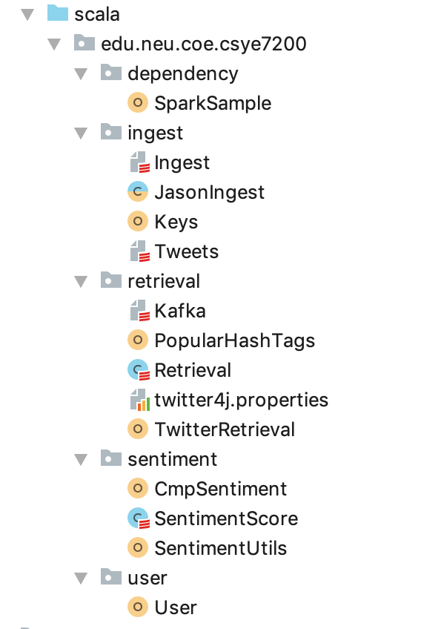
4. Programming in Scala
Tweets:
Ingest.scala
JasonIngest.scala
Tweet.scala
PopularHashTags.scala
TwitterRetrieval.scala
Sentiments:
CmpSentiment.scala
SentimentScore.scala
SentimentUtils.scala
Use case:
User.scala

Slide 6
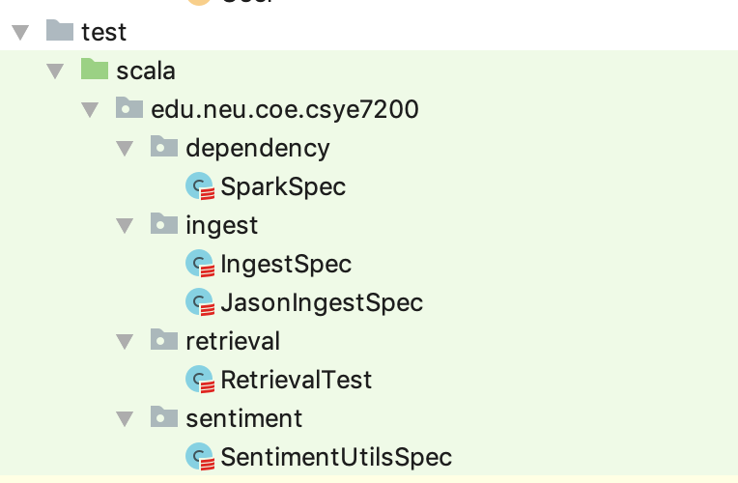
4. Programming in Scala – Unit Test

Slide 7


5. Acceptance criteria
Verify analysis results with test tweets (created by ourselves).
The accuracy should reach 90%
Verify analysis results with input like “APPLE” is “bad” on a certain date (check against stock market).
The accuracy should above 60%
Response time with input like “APPLE”
The response time should less than 5 seconds
The response time: 10 seconds

Slide 8
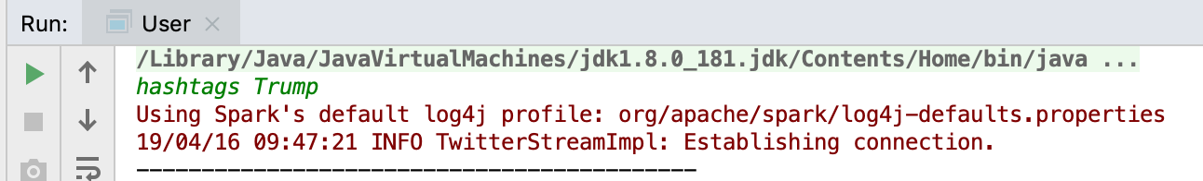
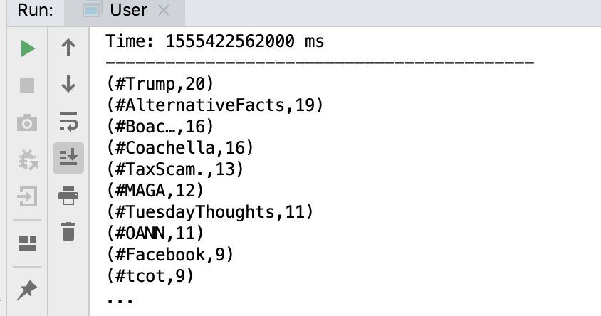
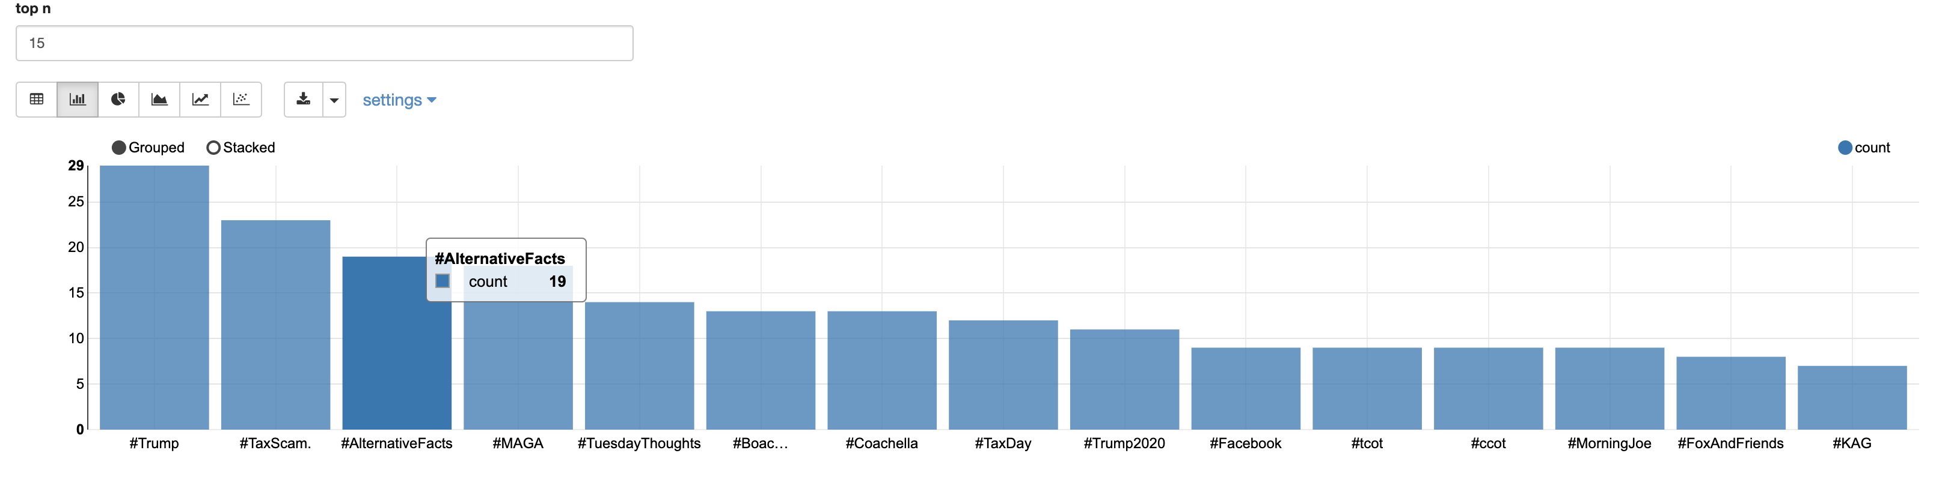
6.Use Case
1. Top Hashtags with Keyword(Trump)
Visualization with Zeppelin

Slide 9
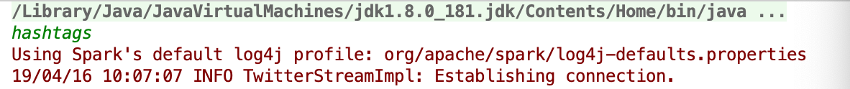
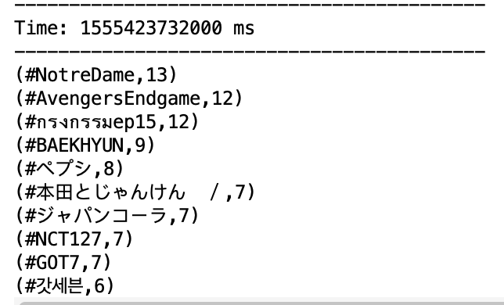
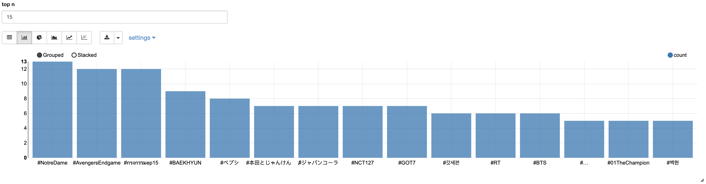
6.Use Case
2. Top Hashtags without Keyword
Visualization with Zeppelin

Slide 10
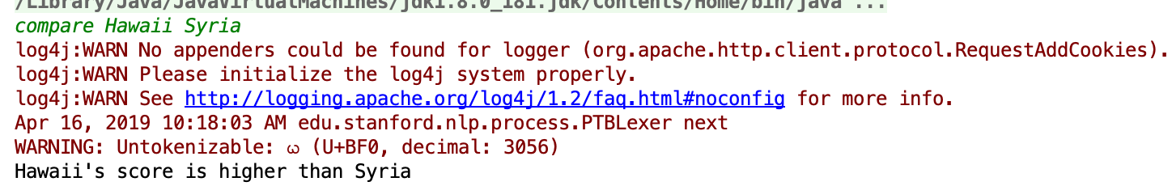

6.Use Case
3. Sentiment Compare with tow Keywords
Hawaii vs Syria
Blackhole vs Notre Dame

Slide 11
Thank you!

