Slide 1
COM741
MVC-2 – Creating a UI
Aiden McCaughey
Senior Lecturer
School of Computing Engineering and Intelligent Systems

Slide 2
Learning Outcomes
Understand how to develop an MVC project and in particular
Use of View layouts
Use of View Imports
Implementation of Controllers
Creation of Views
Adding view links and tag helpers
Use of Forms and difference in GET/POST actions
Model Validation

Slide 3
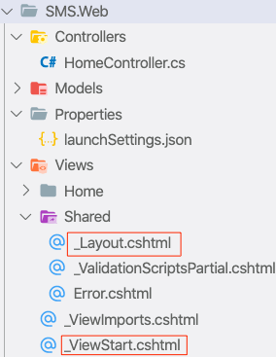
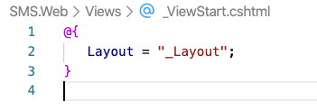
_ViewStart/_Layout .cshtml
_ViewStart by default initialises Layout property with _Layout.cshtml file
Ensure it is enabled (we commented it out in last lecture)

Slide 4
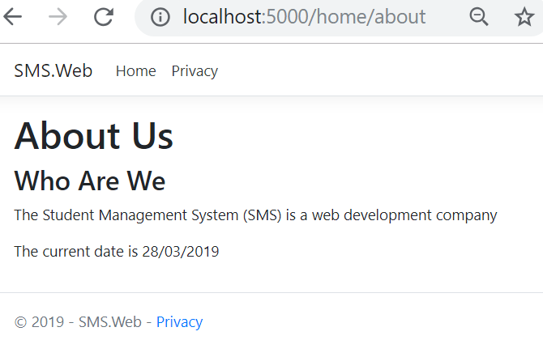
_Layout.cshtml
Defined in (Views folder) and is wrapped around each of our views to give them a common style/appearance
Uses bootstrap to provide styling, page menu and footer

Slide 5
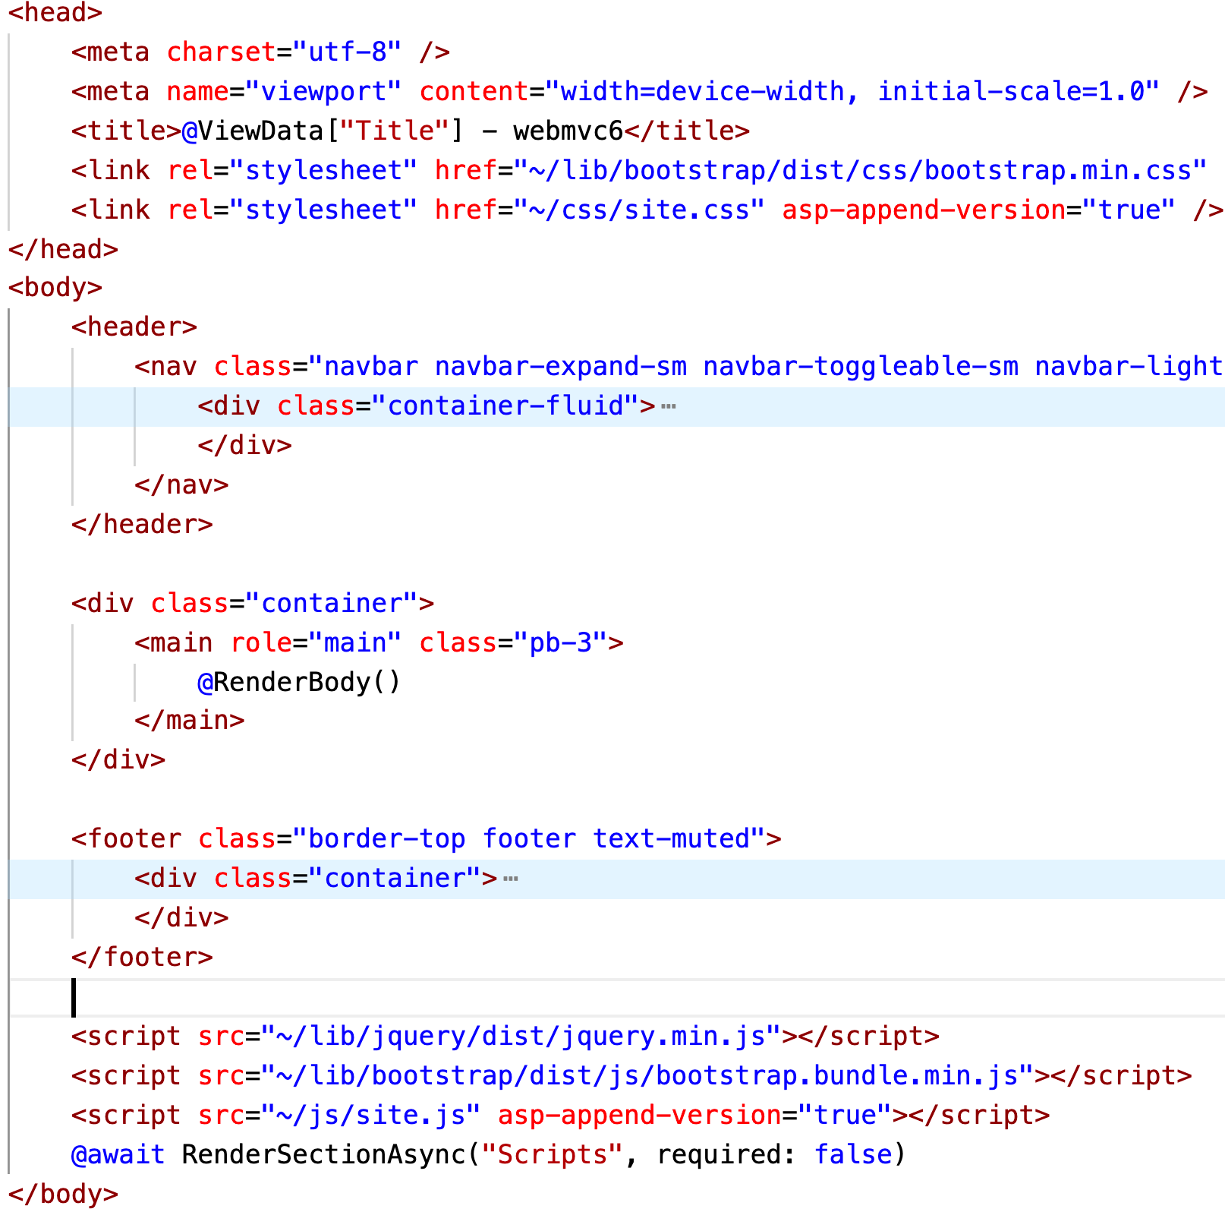
_Layout.cshtml
Head meta tags
& css imports
Header with Navbar
Body (view) rendered here
Footer
JS imports

Slide 6
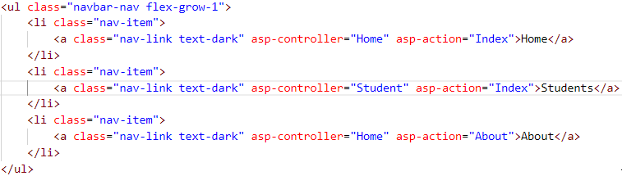
_Layout – Nav Menu
Menu items are defined as <li>..</li> items with a bootstrap css class of nav-item
Custom MVC tags asp-controller and asp-action define the controller and action to be executed via the link
Execute the About Action in the Home controller

Slide 7
Controllers
Reside in the project Controllers folder
Extend Microsoft.AspNetCore.Mvc.Controller
Are suffixed with the word ‘Controller’
using Microsoft.AspNetCore.Mvc.Controller;
namespace SMS.Web.Controllers
public class StudentController : Controller
{
...
}

Slide 8
Student Controller
public class StudentController : Controller
{
// GET /student/index
public IActionResult Index()
{
// handle returning list of students
}
// GET /student/details/{id}
public IActionResult Details(int id)
{
// handle viewing student with id
}
...

Slide 9
Controller Action - Decoupling
The action methods must carry out the business logic associated with the action
For example – for Index action this means
retrieve a list of Students and then render them in a view
It’s a good design practice to delegate the business logic to a Service class
This de-couples the controller which carries out a very specific function, from the application specific business logic

Slide 10
Controller Decoupling
Create Service class instance in constructor
using SMS.Data.Services;
public class StudentController : Controller
{
private readonly IStudentService svc;
public StudentController()
{
svc = new StudentService();
}
...
Later we will see how we can reduce coupling using “dependency injection”

Slide 11
Controller Index Action
The service method GetStudents carries out the work of returning students in a list
...
// GET /students/index
public IActionResult Index()
{
// call the service method
var list = svc.GetStudents();
// now render Index view with the list
return View(list)
}
...
Simple – isn’t it ☺

Slide 12
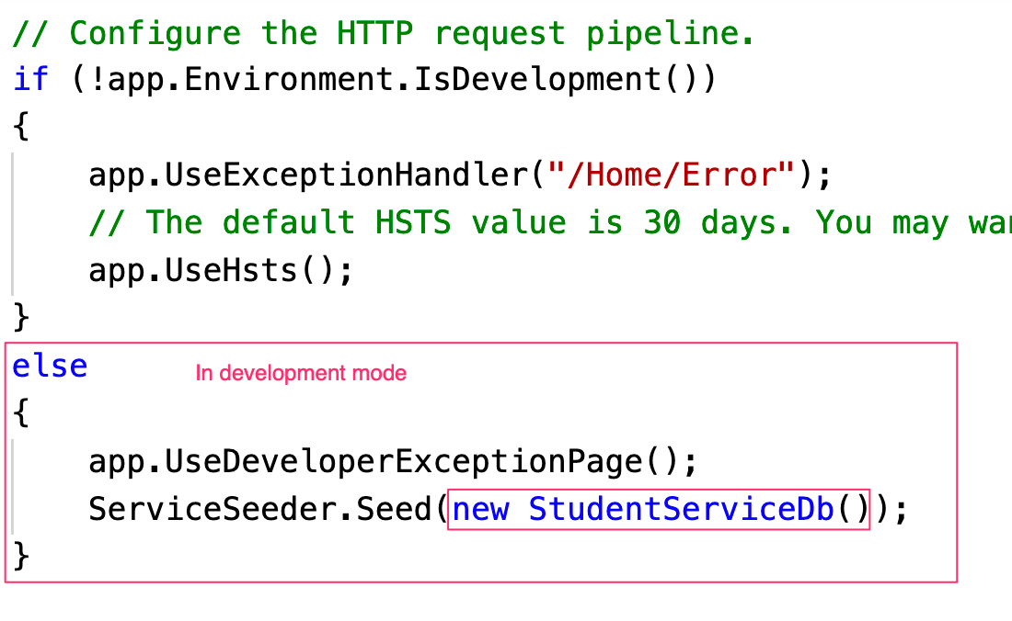
Calling the Seeder
We can call our seeder to provide test data when in development mode only
We can do this in the Program.cs file

Slide 13

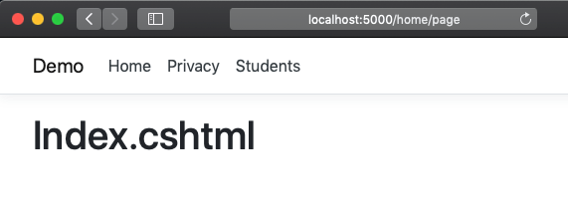
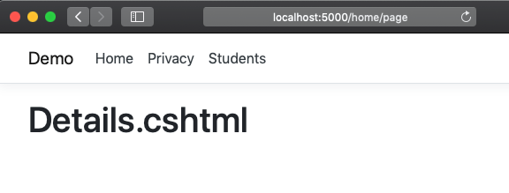
MVC View Locations
When a controller action returns a view, the view engine will
Look for view in folder with same name as controller
And for a .cshtml file with same name as the action.
StudentController.cs
Views\Student Folder
return View(list)
GET Index
return View(s)
GET Details

Slide 14
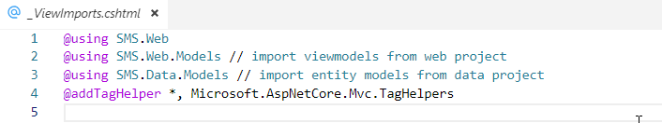
View Imports
Views are strongly typed and thus will be referring to Models or ViewModels.
We need to add our SMS.Data.Models namespace to the view imports
The TagHelpers provide additional attributes in html tags (see links later)

Slide 15
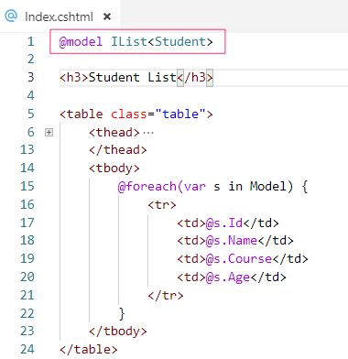
Index View – Index.cshtml
Strongly typed Model - an IList<Student>
The view renders the List of Student in a bootstrap table using @foreach( .. ) {
.. }

Slide 16
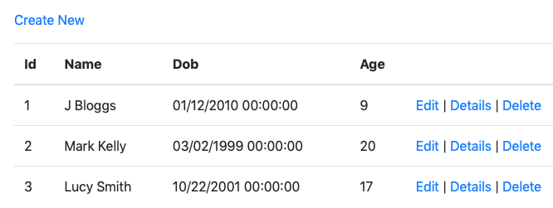
Index Links
Index view provides links for each student in the table to edit, details or delete views
A Separate link above the table can provide ability to create a student

Slide 17
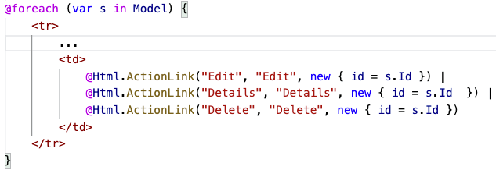
HTML Helpers (don’t use)
Originally helper classes were used to generate Html elements for display, input and links as demonstrated below
These have been replaced by tag helpers

Slide 18
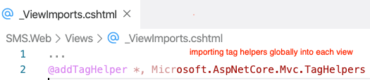
Tag Helpers – Html Friendly
Tag Helpers enable server-side code to participate in creating and rendering HTML elements in Razor files
For the most part, Razor markup using Tag Helpers looks like standard HTML.
Front-end designers conversant with HTML/CSS/JavaScript can edit Razor without learning C# Razor syntax.

Slide 19
Link Tag Helpers
Tag helpers provide html elements with additional asp-xxx attributes
The <a> tag has following attributes
asp-controller=“xx” specifies the controller (if not defined - defaults to current controller)
asp-action=“xx” specifies the action
Optional asp-route-id can provide an id parameter via the url
<a asp-controller=“Student” asp-action=“Details”
asp-route-id=1>View</a>
url route => /student/details/1

Slide 20
Index.shtml - Table Links
@foreach( var student in Model) {
...
<td>
<a asp-action="Details"
asp-route-id=@student.Id>Details</a> |
<a asp-action=”Edit"
asp-route-id=@student.Id>Edit</a> |
<a asp-action=”Delete"
asp-route-id=@student.Id>Delete</a>
</td>
}

Slide 21
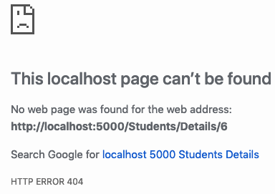
Controller Details Action
Display student with the specified id
// GET /student/details/{id}
public IActionResult Details(int id)
{
// call the service method
var student = svc.GetStudent(id);
// if student not found return Http 404
if (student == null)
return NotFound();
// render student view
return View(student)
}

Slide 22
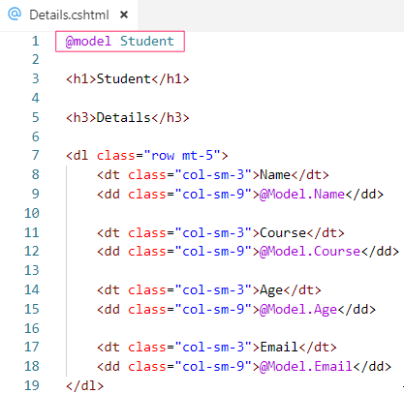
Details View – Details.cshtml
Strongly typed Model
Details displayed in a bootstrap description list

Slide 23
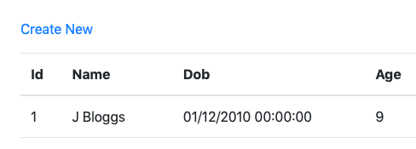

Student Creation Link
We can place a link to create a Student above the table and optionally add css tag class=“btn btn-primary btn-sm” for styling
<div class="mt-4 mb-4">
<a asp-action="Create">Create New</a>
</div>
<table>
...
Without and with styling

Slide 24
Controller Create Action GET
When creating a student we firstly need to display a blank form to collect student details
// GET /student/create
public IActionResult Create()
{
// render blank form
return View();
}

Slide 25
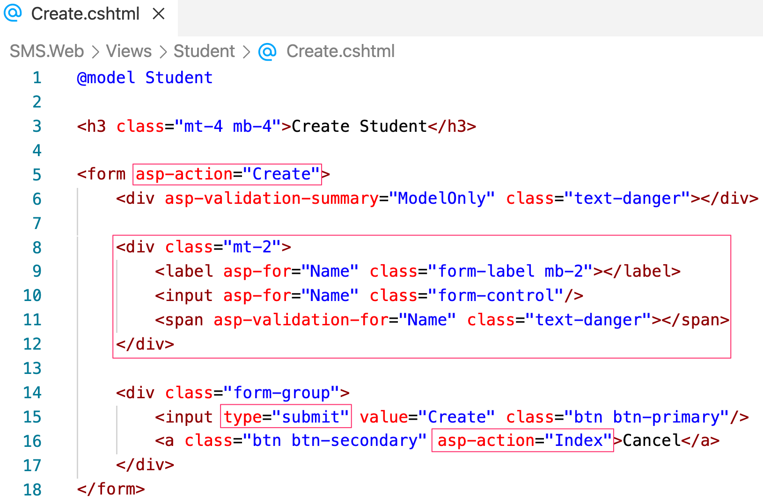
Create.cshtml View

Slide 26
Create.cshtml View
Key points
The form asp-action defines the action to handle the form submission (http post)
Each form element is wrapped in a <div> with a <label> and <input> tag and uses bootstrap styling
The final <div> contains an <input type=“submit”> which calls the url defined in the form asp-action
The cancel link allows user to cancel creation and navigate to the Index asp-action

Slide 27
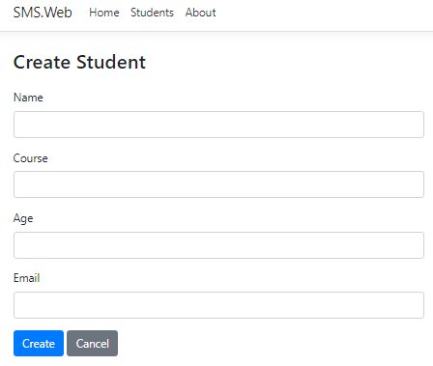
Create.cshtml View

Slide 28
Controller Create Action POST
Most controller actions are invoked via HTTP GET urls (queries that read data)
Actions that create, update or delete data involve HTTP POST commands
When our form is submitted we need an action to handle saving the form data and it is marked with the [HttpPost] annotation
// POST /students/create
[HttpPost]
public IActionResult Create(Student s) {
// create student
}

Slide 29
Controller Create Action POST
// POST /students/create
[HttpPost]
public IActionResult Create(Student s) {
// verify that the form data is valid
if (ModelState.IsValid) {
// pass data to service to store
svc.AddStudent(s);
// redirect to Index url
return RedirectToAction(nameof(Index));
}
// redisplay the form for editing
return View(s);
}

Slide 30
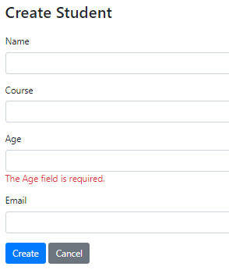
Default Validation
If we submit a blank form default validation prevents submission
Student Age is an int and cannot be blank!
Each form group contains a span to display validation errors
<span asp-validation-for="Age" class="text-danger"></span>

Slide 31
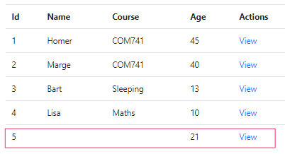
Form Submitted
When new Student is created the action redirects to the Index view
The new Student has a blank name, email and course – this should not be permitted and thus we need further validation

Slide 32
Model Validation (SMS.Data.Models)
By default form inputs are converted to relevant types and additional validations are applied using [Attributes]
using System.ComponentModel.DataAnnotations;
public class Student
{
...
[Required]
public string Name { get; set; }
[Required]
public string Course { get; set; }
[Required]
public DateTime Dob { get ; set; }
[Required]
[EmailAddress]
public string Email { get; set; }
}
Validation attributes

Slide 33
Form Validation Error Display
We display form validation errors as below
We are using bootstrap css class attributes
<form asp-action="Create"> <div asp-validation-summary="ModelOnly" class="text-danger”/>
<div class="form-group"> <label asp-for="Name" class="control-label"></label> <input asp-for="Name" class="form-control"/> <span asp-validation-for="Name" class="text-danger"></span> </div>
...
</form>
Span displaying Name validation errors

Slide 34
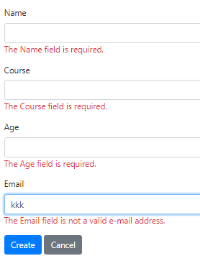
Using Model Validation
Validation attributes ensure the form is correctly completed
The [EmailAddress] attribute ensures a valid email address is entered

Slide 35
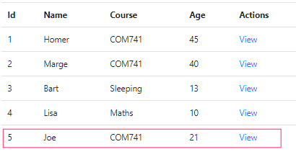
Form Submission
Our form passed the validation and a completed student was submitted and saved by the Service

Slide 36
Default Controller Actions
public class StudentsController : Controller
{
public IActionResult Index()
public IActionResult Details(int id)
public IActionResult Create()
[HttpPost]
public IActionResult Create(Student s)
public IActionResult Edit(int id)
[HttpPost]
public IActionResult Edit(int id, Student s)
public IActionResult Delete(int id)
[HttpPost]
public IActionResult DeleteConfirm(int id)
}
GET /students/index
GET /students/details/1
GET /students/create
POST /students/create
GET /students/edit/1
POST /students/edit/1
GET /students/delete/1
POST /students/delete1

Slide 37
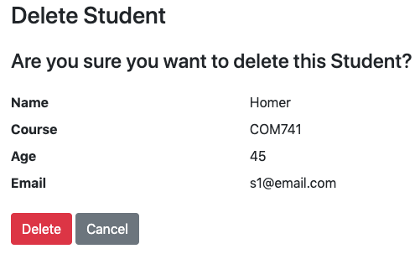
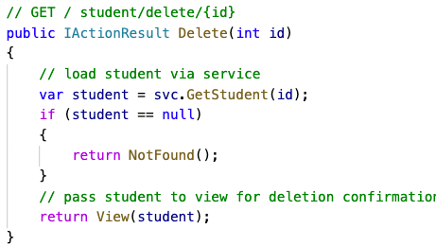
Deleting a Student
To carry out a delete action in our application we need to issue a POST request (browsers don’t support DELETE)
The delete button needs to be wrapped in a form that calls the controller DeleteConfirm action

Slide 38
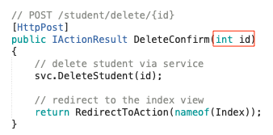
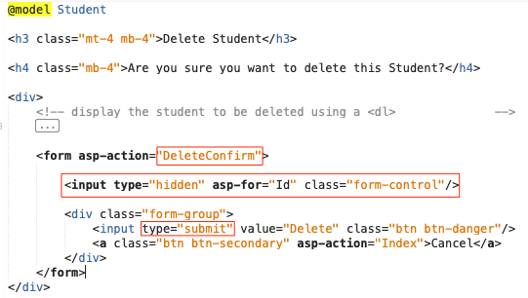
Delete.cshtml – hidden input
Form includes hidden Id, needed as a parameter to DeleteConfirm POST action

Slide 39
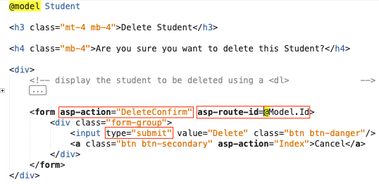
Delete.cshtml – asp-route-id
Alternatively we can use the asp tag library extensions to specify the form route parameters

Slide 40
Summary
In this lecture we learned about
Use of view Layouts/ Imports
Implementation of Controllers
Creation of Views
Adding view links and tag helpers
Use of Forms (POST actions)
Creating a student
Deleting a student
Model Validation

Slide 41
References
Tutorial providing overview of creating a simple MVC Web Application
https://docs.microsoft.com/en-us/aspnet/core/tutorials/first-mvc-app
For information on Tag Helpers visit:
https://docs.microsoft.com/en-us/aspnet/core/mvc/views/tag-helpers/intro

