Slide 1
Condensed Matter Physics: Bloch’s Theorem
By: Neil Mitra

Slide 2
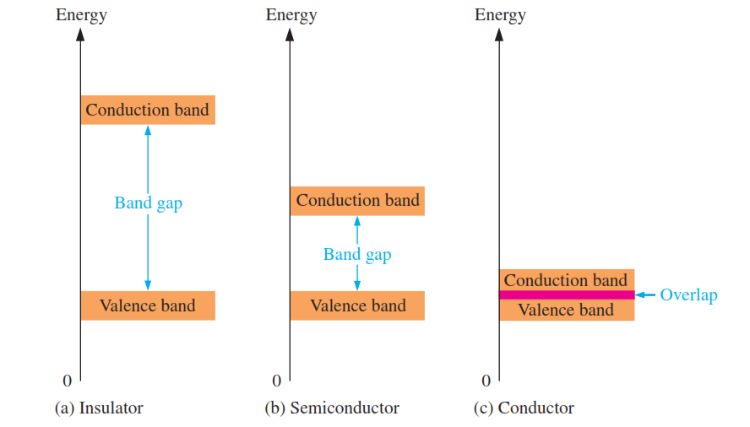

Band Gap Theory and Electronic Structure

Slide 3
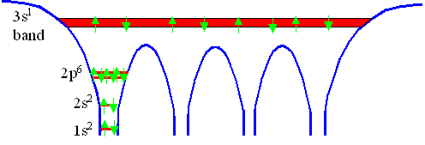
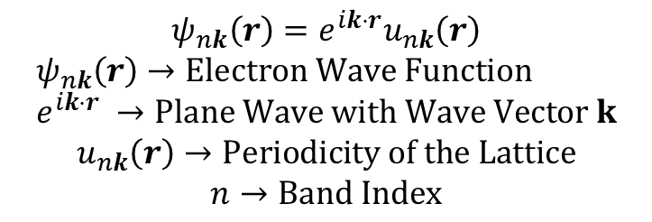
Quantum Mechanics and Bloch’s Theorem
$$ψ_{nk}\left(r\right)=e^{ik⋅r}u_{nk}\left(r\right)$$
$$ψ_{nk}\left(r\right)→Electron Wave Function \\ e^{ik⋅r} →Plane Wave with Wave Vector k$$
$$u_{nk}\left(r\right)→Periodicity of the Lattice$$
$$n→Band Index$$
Image Source: https://www.tf.uni-kiel.de/matwis/amat/semi_en/kap_2/backbone/r2_1_4.html

