Slide 1
Molecular Mechanics Force Fields
By: Neil Mitra

Slide 2
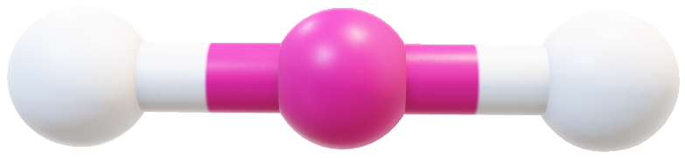


Molecular Mechanics – The Fundamentals: Bond Stretching
$$b$$
$$U(b)=k_{b}{\left(b−b_{0}\right)}^{2}$$

Slide 3
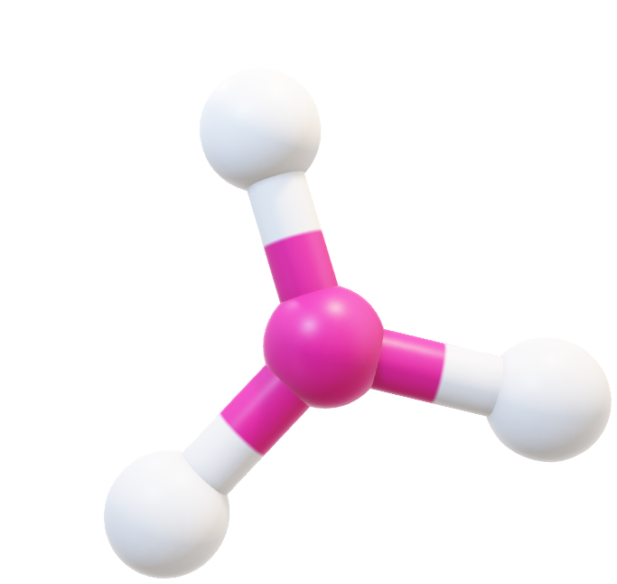

Molecular Mechanics – The Fundamentals: Bond Angle Bending
$$θ$$
$$U\left(θ\right)=k_{θ}{\left(θ−θ_{0}\right)}^{2}$$

Slide 4
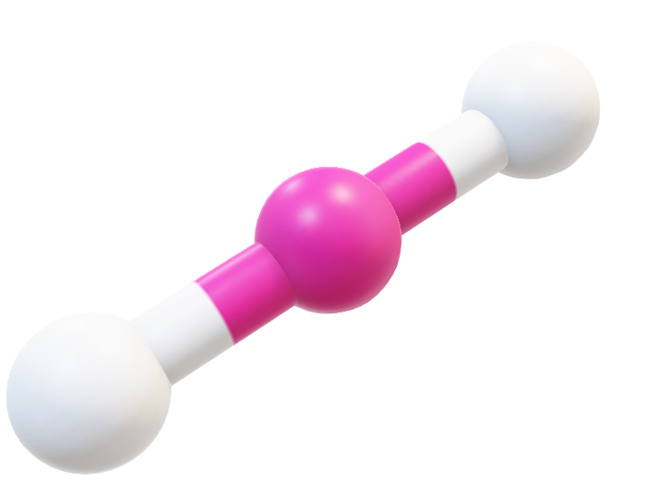


Molecular Mechanics – The Fundamentals: Torsional Angle Twisting
$$θ$$
$$U(ϕ)\sum_{n}{k_{ϕ,n}\left[1+\cos\left(nϕ−ϕ_{n}\right)\right]}$$

Slide 5



Molecular Mechanics – The Fundamentals: Electrostatic Interactions
$$r$$
+
+
$$r$$
-
+
$$U\left(r\right)=\frac{q_{i}q_{j}}{r}$$

Slide 6


Molecular Mechanics – The Fundamentals: Van der Waals Interaction
$$r$$
$$U\left(r\right)=\left(\frac{A_{ij}}{r^{12}}−\frac{B_{ij}}{r^{6}}\right)$$

Slide 7
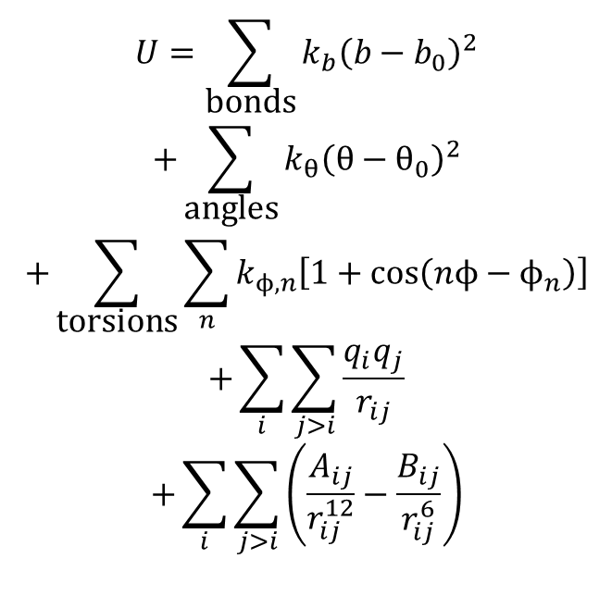
Molecular Mechanics Force Field
$$U=\sum_{\text{bonds}}{k_{b}{\left(b−b_{0}\right)}^{2}}$$
$$+\sum_{\text{angles}}{k_{θ}{\left(θ−θ_{0}\right)}^{2}}$$
$$+\sum_{\text{torsions}}{\sum_{n}{k_{ϕ,n}\left[1+\cos\left(nϕ−ϕ_{n}\right)\right]}}$$
$$+\sum_{i}{\sum_{j>i}{\frac{q_{i}q_{j}}{r_{ij}}}}$$
$$+\sum_{i}{\sum_{j>i}{\left(\frac{A_{ij}}{r_{ij}^{12}}−\frac{B_{ij}}{r_{ij}^{6}}\right)}}$$

Slide 8
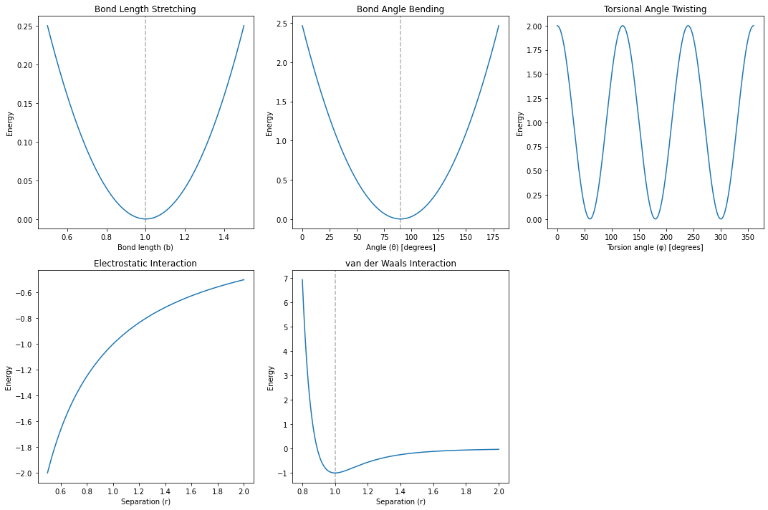
Molecular Mechanics Force Field

Slide 9
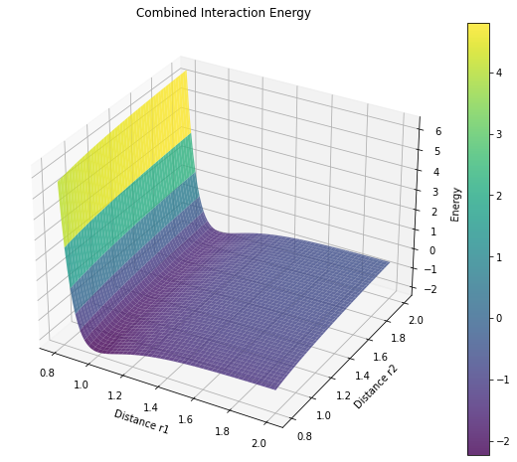
Molecular Mechanics Force Field – Combined Electrostatics and Van der Waals Interaction Energy Model

