Slide 1
Probabilistic Pharmacokinetics
By: Neil Mitra

Slide 2
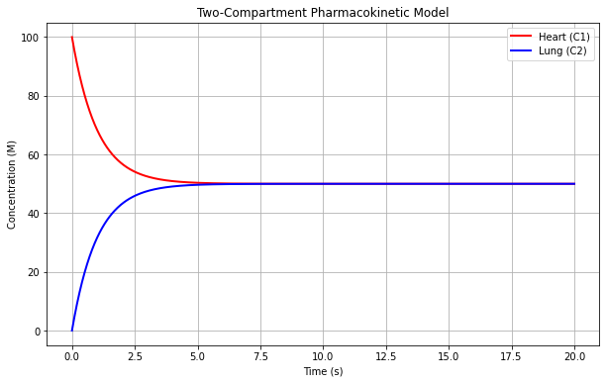
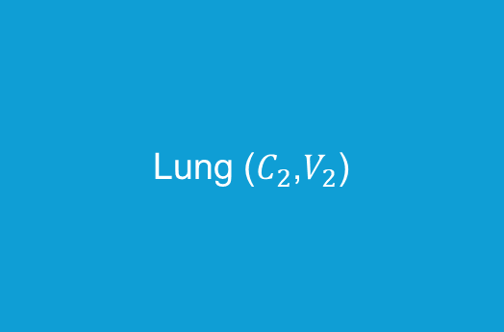
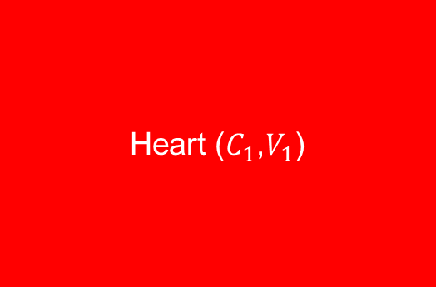
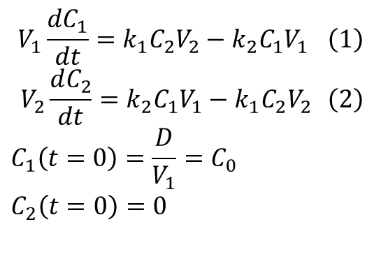


Pharmacokinetics – The Fundamentals
Heart ($C_{1}$,$V_{1}$)
Lung ($C_{2}$,$V_{2}$)
$$k_{1}$$
$$k_{2}$$
$$\begin{aligned}V_{1}\frac{dC_{1}}{dt}=k_{1}C_{2}V_{2}−k_{2}C_{1}V_{1} \#\left(1\right)\end{aligned}$$
$$\begin{aligned}V_{2}\frac{dC_{2}}{dt}=k_{2}C_{1}V_{1}−k_{1}C_{2}V_{2} \#\left(2\right)\end{aligned} \\ C_{1}\left(t=0\right)=\frac{D}{V_{1}}=C_{0} \\ C_{2}\left(t=0\right)=0$$

Slide 3
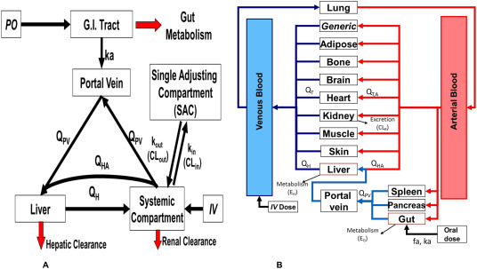
Chetty, M., Johnson, T. N., Polak, S., Salem, F., Doki, K., & Rostami-Hodjegan, A. (2018). Physiologically based pharmacokinetic modelling to guide drug delivery in older people. Advanced Drug Delivery Reviews, 135, 85-96.

Slide 4
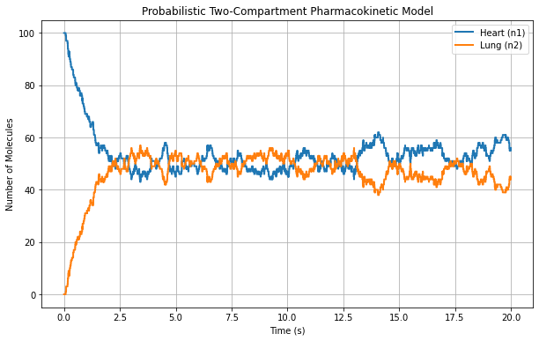
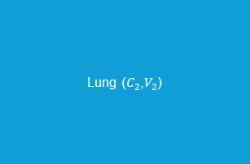
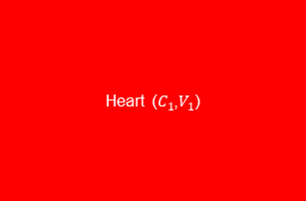


Pharmacokinetics – Probabilistic Modelling
Heart ($C_{1}$,$V_{1}$)
$$k_{1}$$
Lung ($C_{2}$,$V_{2}$)
$$k_{2}$$
$$\frac{dP\left(n_{1},n_{2},t\right)}{dt}=k_{2}\left(n_{1}+1\right) P\left(n_{1}+1,n_{2}−1,t\right)+k_{1}\left(n_{2}+1\right) P\left(n_{1}−1,n_{2}+1,t\right)−\left[k_{2}n_{1}+k_{1}n_{2}\right] P\left(n_{1},n_{2},t\right)$$

Slide 5
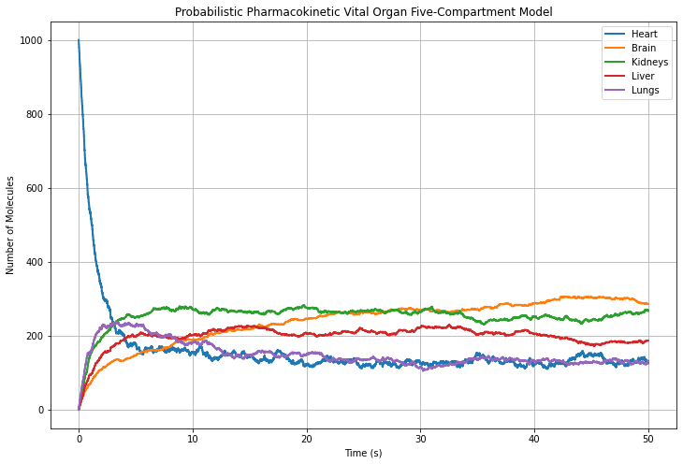
Probabilistic Pharmacokinetics for Vital Organ System (5 Compartment Model)

