Slide 1
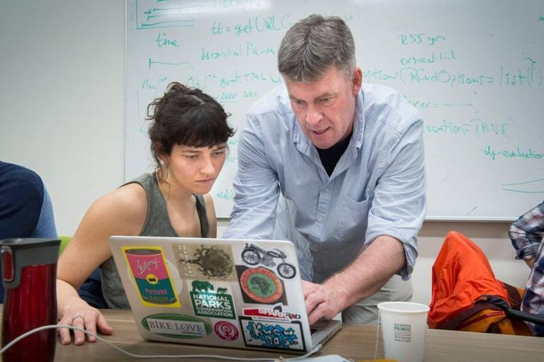
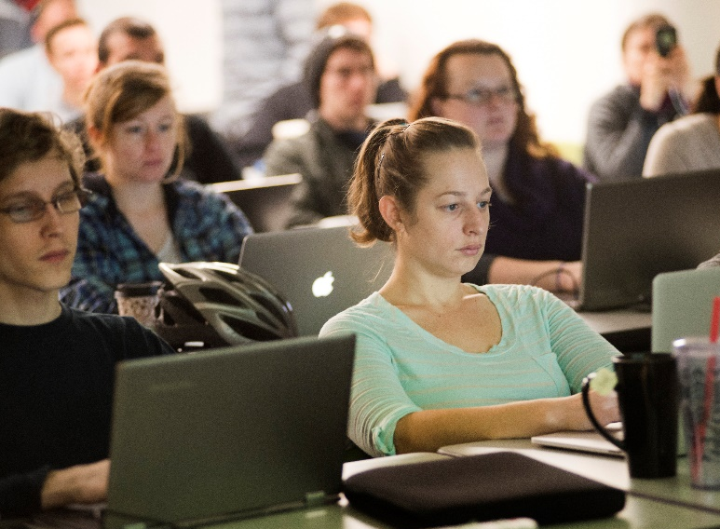
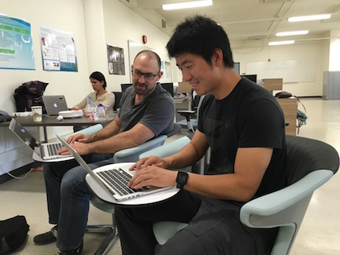
Strategy
RESEARCH
TRAINING
● Collaborations ● Consultations
● Development
● Workshops ● Hackathons
● Internships
COMMUNITY
● Affiliates program ● Un-Seminars
● Symposia
“I secured external research funding in large part because of my partnership with the DSI. I could not do the research without them.” - Jacob Hibel, Assoc. Professor
“DSI has provided me with skills that have increased my research productivity.” - Nick Bowden, PhD student
“The DSI has given me the space and network to go further in my data science investigations than I could have on my own.” - Ryan Phillips, PhD student
Notes:
Other quotes:
“The DSI was absolutely instrumental in furthering my research.” - Mairaj Syed, Assoc. Professor
“The DSI has broadened my horizons beyond my academic department. It's a true interdisciplinary space.” - Clark Fitzgerald, PhD student
“Collaborating with the Data Science Initiative has made it possible to push my research program in innovative directions. I was able to secure external research funding in large part because of my partnership with the DSI’s data science experts – I could not do the research without them.” Jacob Hibel, Associate Professor

Slide 2
Engagement
Departments
Core Facilities
Data Science Initiative
Research Labs
Centers
Notes:
Other quotes:
“The DSI was absolutely instrumental in furthering my research.” - Mairaj Syed, Assoc. Professor
“The DSI has broadened my horizons beyond my academic department. It's a true interdisciplinary space.” - Clark Fitzgerald, PhD student
“Collaborating with the Data Science Initiative has made it possible to push my research program in innovative directions. I was able to secure external research funding in large part because of my partnership with the DSI’s data science experts – I could not do the research without them.” Jacob Hibel, Associate Professor
The DSI has been instrumental in helping me set up a new research project, from supporting my team as we frame our research questions and methodology to assisting in data analysis. Since I am a humanities scholar with no training in data science, my work simply would not have been possible without this collaboration. - Gina Bloom

