Slide 1

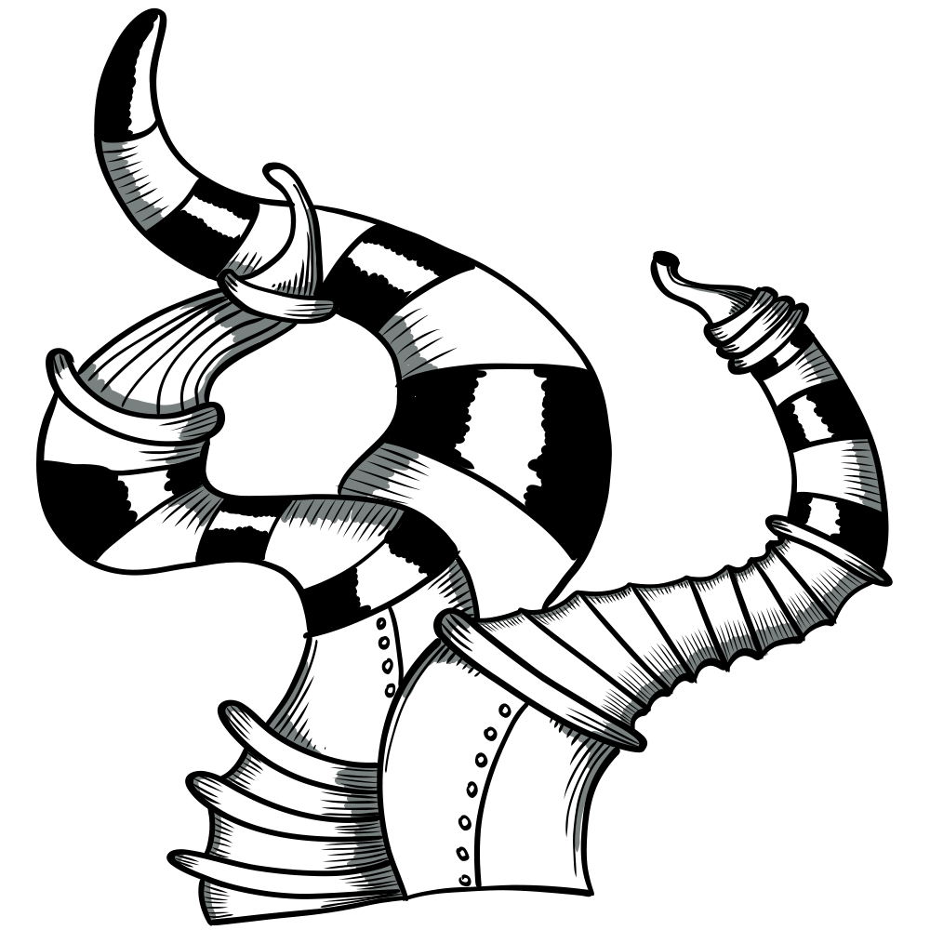

Microsoft Dynamics 365
and Power Platform Community Conference
MAY 25 – 27, 2026
Portorož, Slovenia, Europe
ARCHITECTING ERP
IN THE AGE OF AI
Which skills still matter — and which new ones must we build?
DynamicsMinds 2026 | D365 F&O Track | Session V4.0
NEILL RIORDAN
JOSÉ AZEVEDO
COE Lead D365 F&O | KPMG UK
MVP AI ERP | KPMG UK

Slide 2
OUR JOURNEY SO FAR
Three years, one through-line: what does a great Solution Architect actually do?
2023
2024
2026
V2.0
V3.0
V4.0
The Holistic View
Azure Synergy
The AI Era
We introduced the Wheel — Technical, Functional, Industry, Method, Commercial, Engagement. Six spokes that define the role.
We layered the Wheel into the broader Microsoft stack — integration, OneLake, BI, and the multi-instance reality.
The Wheel still holds. The contents inside every spoke are being rewritten by AI. Today we explore how.

Slide 3

01
Pop-Up Quiz
SESSION
Where the room sits on the AI adoption curve
AGENDA
02
The Wheel Holds, the Contents Don't
45 minutes | Q&A at the end
Same six spokes — what's inside each one has changed
03
Three Spotlights
Technical, Functional, Method — what AI looks like up close
04
Where Architects Add Value Now
Feedback, tailoring, translation, visualization
05
Microsoft's Part & a Framework
Implementation agents, plus 5 gates to use AI safely
06
Roadmap, Take-Aways & Q&A
Your next 90 / 180 / 365 days — and your questions

Slide 4
POP-UP QUIZ
A quick read of the room before we begin.
1
What is your role on D365 implementations?
2
How often do you use AI tools in your daily work?
3
Has AI changed how you gather requirements?
4
Have you written a prompt as part of a design decision?
5
Do your clients ask about AI governance?
6
Is "AI literacy" on your team's development plan?
Scan the QR code on screen to submit your answers anonymously — results appear live.

Slide 5

THE NEW REALITY
In 12 months AI moved from a demo to a working tool on every implementation we touch.
∞
3×
100%
Copilots
Faster drafts
Of clients
across F&O, BC, Power Platform, Azure, Microsoft 365 — all production-grade now
requirements, FDDs, configuration notes — but quality is now the bottleneck
have an AI question on the table before the contract is signed
The question is no longer "should we use AI?" — it is "where, how, and who is accountable?"

Slide 6
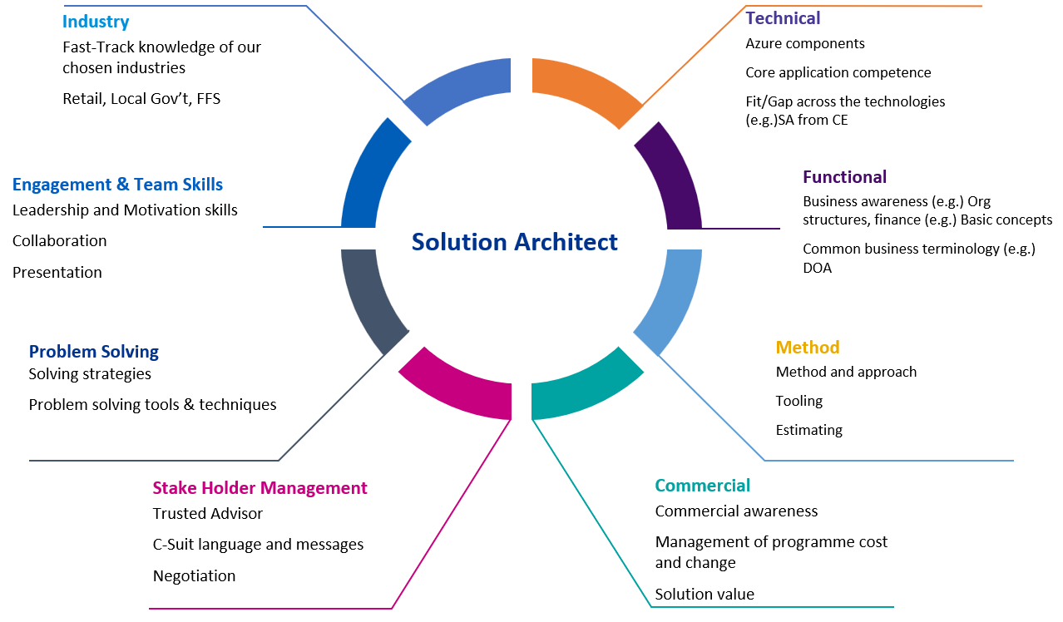
THE WHEEL HOLDS — THE CONTENTS DON'T
Same eight spokes. Every one of them is being filled with new tools, new tradeoffs, new craft.
SAME FRAMEWORK
The Wheel from V2.0 is unchanged. All six spokes still required for a great Solution Architect.
NEW CONTENTS
What lives INSIDE each spoke — the tools, the language, the daily craft — is being rewritten by AI.
THE QUESTION
Not "do we drop spokes?" — but "what does each spoke now demand?"
Next: OLD vs NEW across all six spokes.

Slide 7
OLD vs NEW — ALL SIX SPOKES
The spoke name is the same. The componentry inside it has changed.
SPOKE
OLD CONTENT
NEW CONTENT
TECHNICAL
Hand-built integrations, manual code, deep manuals.
GitHub Copilot, Copilot Studio, Azure AI Foundry.
FUNCTIONAL
Manual fit-gap, BPM authoring, feature-by-feature design.
Vibe coding, 1st/3rd-party productivity & delivery agents.
INDUSTRY
Domain experts holding context in their head.
Vertical AI models, industry copilots, accelerator data.
METHOD
Phase gates with hand-crafted documents at each step.
Same outputs — radically different journey through phases.
COMMERCIAL
Classic SOWs, T&M, value cases written by hand.
AI value cases, outcome-based pricing, agent ROI models.
ENGAGEMENT
Workshops then slow synthesis into deliverables.
Real-time co-creation; transcripts become first drafts.
We'll zoom into three of these next: Technical, Functional, and Method.

Slide 8
SPOTLIGHT · TECHNICAL
TECHNICAL — STACK STAYS, BUILD CHANGES
The architect still owns the stack — but the daily craft of building on it is unrecognisable.
YOUR EXAMPLE
COMPLEMENTARY
Pair-programmer for X++, AL, PowerFx, C#, KQL.
Custom copilots and AI services grounded in your D365 data.
GitHub Copilot
Copilot Studio + Azure AI Foundry
First-draft code, refactors, and tests in seconds.
Build copilots over F&O / BC data with retrieval grounding.
Architect spends more time reviewing intent, less time typing.
Azure AI services for classification, summarisation, OCR, search.
Trivial bugs caught earlier; harder ones still need you.
New architect skill: choosing where intelligence belongs in the stack.
The technical decision is no longer "build vs. buy" — it is "build, buy, prompt, or agent".

Slide 9
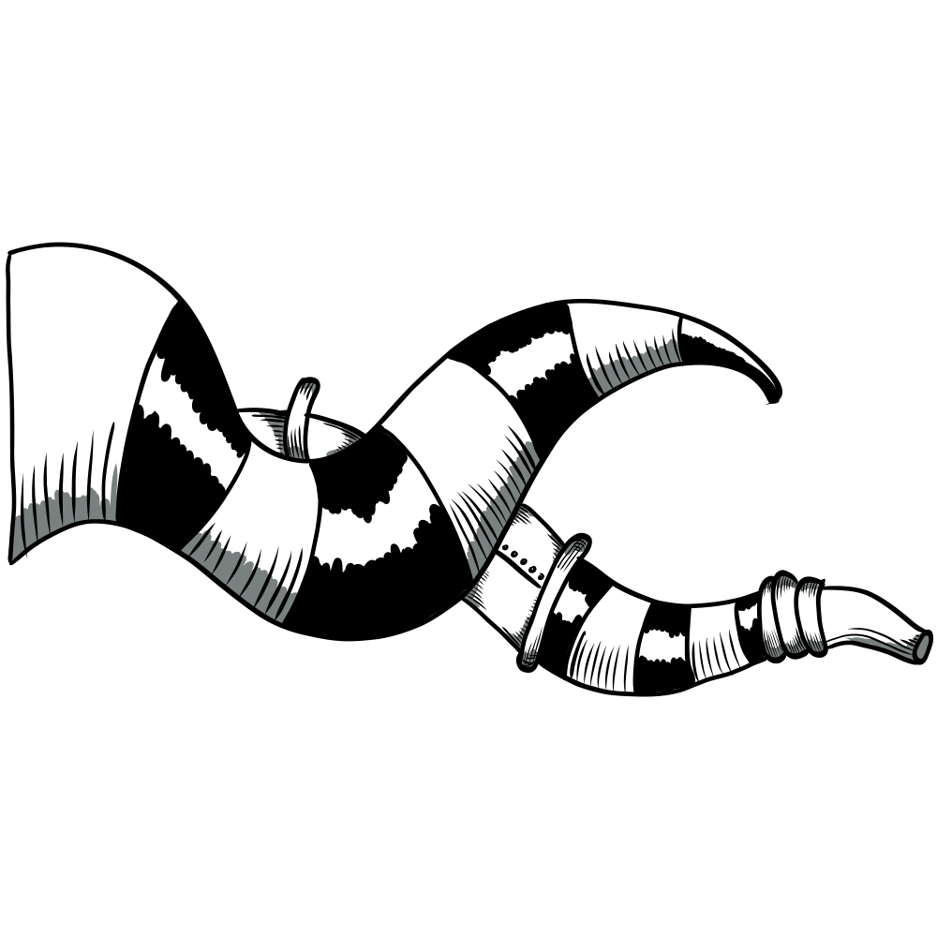
SPOTLIGHT · FUNCTIONAL
FUNCTIONAL — FIT-GAP MEETS VIBE CODING
From hand-written features to spoken intent and agents that act on it.
YOUR EXAMPLE
COMPLEMENTARY
Describe the change in plain English. See it scaffolded. Iterate fast.
First-party productivity agents + third-party delivery agents.
Vibe Coding
Agents — 1P & 3P
First-draft forms, flows, and configurations from a short prompt.
Microsoft 365 / Sales / Service Copilots for end-user productivity.
Speed unlocks more options explored before commitment.
Power Platform & ISV agents for delivery, test, and operations.
Functional consultants need new vocabulary, not new degrees.
Microsoft Implementation Agent Templates — covered later in this deck.
Functional skill is now: pick the right agent, give it the right job, keep it on the rails.

Slide 10
SPOTLIGHT · METHOD
METHOD — SAME OUTPUTS, DIFFERENT JOURNEY
The gates and deliverables don't move. The path between them is unrecognisable.
YOUR EXAMPLE
COMPLEMENTARY
BPMs, FDDs, configuration notes, test scripts, cutover plans. All still required.
Hours replace weeks; transcripts replace memos.
Same Outputs
New Journey
Quality bar for sign-off is unchanged — arguably higher.
Workshops → transcripts → first-draft user stories & FDDs.
Audit trail, traceability, and intent must still hold up.
Continuous co-creation in tools, not async doc swaps.
Clients still want to see the same artefacts at the same gates.
ALM, testing, and release cadence speed up — pressure-tests governance.
The Method spoke doesn't collapse — it accelerates. Architects pace the team and the client.

Slide 11
DOUBLE DOWN ON THESE
The skills AI does NOT replace — and that matter more, not less, in the AI era.
01
Business Knowledge
02
Stakeholder Management
AI does not know your client's P&L, their auditors, their year-end. You do. Domain depth is the moat.
Steering committees do not want a model — they want a person they trust. Earning that trust is still entirely human work.
03
Systems Thinking
04
Judgement on Trade-Offs
AI is excellent at the next step. Architects are responsible for the whole. End-to-end thinking across modules, integrations, and time.
Cost vs. complexity, in-app vs. extension, standard vs. customisation. AI surfaces options; the architect chooses.

Slide 12
WHERE THE ARCHITECT NOW ADDS VALUE
AI does the typing. You do the thinking, tailoring, translating — and showing.
FEEDBACK
TAILORING
Reviewing, challenging, and curating AI output before it touches the client. The first reader, not the first writer.
Adapting generic AI output to a specific industry, client, and team. The model knows ERP — you know THIS ERP.
TRANSLATION
VISUALIZATION
Explaining the decision in the language the CFO, the CIO, and the end user each need to hear.
Showing — not just telling — what the solution will look like. As we go faster, clients must SEE it to absorb it.

Slide 13

WHAT THE ARCHITECT STILL OWNS
The role does not shrink. It sharpens. These four things stay yours — by name.
1
2
DECISIONS
ACCOUNTABILITY
Trade-offs across cost, complexity, and risk. AI lays out options. You decide which one ships.
Sign-off, audit trail, and what reaches production. AI does not get called at 2am. You do.
3
4
INTENT
TRUST
The "why this, not that" behind every design. Models optimise; architects choose what to optimise for.
The relationship with the client and the team. Steering committees buy people, not models.
AI proposes. The architect disposes — and signs.

Slide 14
THE SPEED PROBLEM
We can now design faster than clients can absorb. That is a new risk — and a new job.
THE ARCHITECT'S NEW JOB
THE GAP
Pace the client, not just the team.
DAYS
Show, don't send
to design.
Walk through configs and screens live. A 30-min demo beats a 30-page doc.
WEEKS
Visualise decisions
Diagrams, swim-lanes, before/after screens — the architect's new deliverables.
to align, approve, and adopt.
Stage the absorption
Break big designs into client-sized chunks. Sign-off in slices, not in bricks.
Adoption — not build — is the new bottleneck.
Coach the change
AI accelerates build. The change team needs the architect at the table earlier.
As we go faster, the architect's ability to EXPLAIN and SHOW becomes the limiting factor.

Slide 15
SPEED vs. QUALITY & TRUST
AI accelerates delivery. The architect is now the brake — and the conscience.
WHAT AI GIVES YOU
WHAT YOU MUST PROTECT
SPEED
QUALITY & TRUST
•
First-draft FDDs in minutes, not days
•
Hallucinations in design docs and configs
•
Auto-generated test scripts and data
•
Drift between AI draft and client intent
•
Configuration diffs across environments
•
Over-confidence — "the AI said so"
•
Faster onboarding of new consultants
•
Lost institutional memory if no one reviews
•
Real-time meeting summaries and action items
•
Client relationships built on you, not the tool

Slide 16
SOFT SKILLS — DEAD OR ESSENTIAL?
A common claim: "AI does the hard thinking — we just need prompt jockeys now." We disagree.
"The faster machines write, the more valuable it becomes to know what should be written, by whom, for whom, and why — and to SHOW it."
1
2
3
4
LISTENING
FRAMING
VISUALIZING
INFLUENCING
Hearing what is NOT being said in a steering committee — AI can't.
Turning ambiguous problems into the right question, before any model runs.
Showing decisions live so clients can absorb them at AI-era pace.
Bringing CFOs, CIOs, and end users to a shared decision under pressure.

Slide 17
A PRACTICAL FRAMEWORK
Five gates to integrate AI without losing quality, IP, or client trust.
STEP 1
STEP 2
STEP 3
STEP 4
STEP 5
INTENT
GROUND
GENERATE
CHALLENGE
COMMIT
What decision are we trying to support? Never "use AI for AI's sake".
Which authoritative data does the model see — client docs, configs, code?
Use AI for the first draft, structured outputs, options exploration.
Human review by a named architect. Trade-offs, risks, edge cases.
Sign-off, audit trail, and rollback path before it touches the client.
Step 4 is non-negotiable. AI proposes — the architect disposes.

Slide 18
MICROSOFT'S PART · WHAT WE EXPECT FROM THE PLATFORM
IMPLEMENTATION AGENT TEMPLATES
Microsoft is shipping the tooling for implementation teams. Cross-functional. Architect-grade.
Source: Microsoft Learn — D365 Guidance · Implementation Agent Templates Overview (updated Mar 2026)
PLANNING
DIAGNOSTICS
Release Planner Helper Agent
Trace Parser Agent
Automated discovery, analysis, and work-item creation for D365 release waves.
Performance trace analysis from hours to minutes via conversational AI.
FOR THE ARCHITECT
FOR THE ARCHITECT
Architects: faster impact assessment of every wave; less manual ticket triage.
Architects: faster root-cause on production incidents; better post-mortems.
What we should expect — and ask for
More agents across the lifecycle (design, test, cutover, hypercare). Open templates we can extend. A clear line between Microsoft's job (platform) and ours (judgement).

Slide 19
YOUR ROADMAP
Where to invest your next 90, 180, and 365 days.
Crawl
Walk
Run
Get hands dirty
Get structured
Lead the conversation
Use Copilot for every FDD, BPM, and config note
Run the 5-gate framework on one live workstream
Own the AI governance section of an SOW
Try one MS Implementation Agent on a live workstream
Define AI acceptance criteria with your QA lead
Speak publicly about an AI-enabled delivery
Build one internal prompt library you re-use
Coach one consultant on prompt + judgement
Mentor two SAs into AI-era competence

Slide 20
KEY TAKE-AWAYS
Five sentences. Steal them, share them, argue with them.
1
The Wheel holds. All six spokes still define the Solution Architect.
2
The contents inside every spoke are being rewritten — GitHub Copilot, vibe coding, agents, new method journeys.
3
The architect's value shifts to feedback, tailoring, translation, and visualization — not typing.
4
Decisions, accountability, intent, and trust still belong to the architect — by name.
5
Microsoft is shipping the tooling. Our job is to use it with judgement and pace the clients absorbing it.

Slide 21
THANK YOU
Q & A
Let's argue about it.
NEILL RIORDAN
JOSÉ AZEVEDO
COE Lead D365 F&O | KPMG UK
COE Lead D365 BC | KPMG UK
neill.riordan@kpmg.co.uk
maique00@gmail.com
linkedin.com/in/neillriordan
linkedin.com/in/josemiguelazevedo

