Slide 1
MISSION FASTTRACK
Charting the Course to Recognised Solution Architect
Panel Discussion | DynamicsMinds 2026

Slide 2
THE FTRSA DESIGNATION
The pinnacle of Solution Architecture in Dynamics 365 Finance & Operations. Not a technical certification — a recognition of holistic design leadership, customer impact, and delivery excellence. Only 54 architects worldwide hold this designation today.

Slide 3
SESSION AGENDA
01 Opening: FastTrack Engineering
Program foundations, nomination criteria, and what Microsoft looks for in top-tier D365FO Solution Architects
02 Panel: Three FTRSA Journeys
Three partner panelists share pivotal customer moments, architectural patterns, and leadership behaviours
03 Audience Q&A
Your questions answered by the panel

Slide 4
WHAT MICROSOFT LOOKS FOR
Solution Architecture Excellence — designing end-to-end solutions across complex D365FO transformations
Holistic Design Leadership — guiding teams, aligning stakeholders, and making trade-offs that serve the business
Customer Impact — demonstrated outcomes on real engagements, not theoretical knowledge
Delivery Excellence — a track record of delivering complex, multi-workload implementations

Slide 5
MEET THE PANEL
Tommy Skaue | Microsoft FastTrack
Moderator — FastTrack Engineering
Neill Riordan | KPMG
FastTrack Recognised Solution Architect
Gustav Sundblad | Engage Group
FastTrack Recognised Solution Architect
Gertjan van der Linden | Avanade
FastTrack Recognised Solution Architect

Slide 6

Director & Executive Architect at KPMG UK, driving architectural excellence across high-complexity D365 programmes. 16 years with Dynamics 365, 10 years as a Solution Architect, and 4 FastTrack engagements spanning financial services, retail, logistics, and telecommunications.
NEILL RIORDAN FastTrack Recognised Solution Architect | KPMG

Slide 7
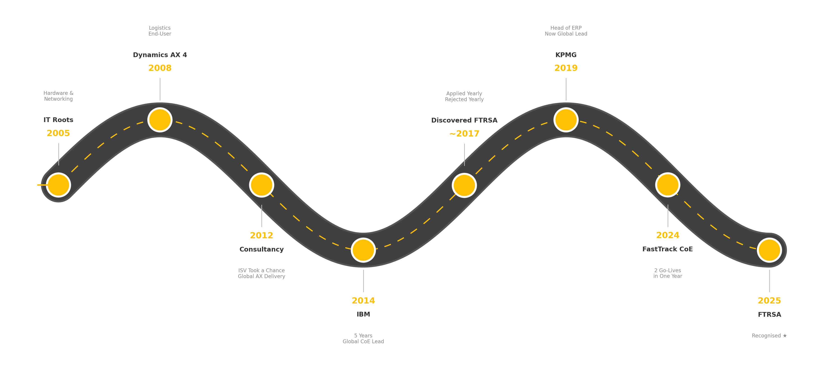
MY FTRSA JOURNEY Neill Riordan | KPMG

Slide 8
Technical Solution Architect at Engage Group, Sweden. 17 years with Dynamics 365, 11 years as a Solution Architect, and 3 FastTrack engagements. Specialises in commerce, trade, and logistics — bridging business operations with ERP architecture to ensure solutions align with real-world needs.
GUSTAV SUNDBLAD FastTrack Recognised Solution Architect | Engage Group

Slide 9
18 years with Dynamics 365 ERP solutions, 13 years as a Solution Architect, and 10 FastTrack engagements. The preeminent expert on the D365 ERP portfolio at Avanade's Centre of Excellence — guiding architects and championing solutions that maximise platform capabilities while avoiding unnecessary customisations.
GERTJAN VAN DER LINDEN FastTrack Recognised Solution Architect | Avanade

Slide 10
PANEL DISCUSSION TOPICS
Pivotal Customer Moments
The defining engagements that shaped each architect’s trajectory
Architectural Patterns
Design approaches and decisions that set great solutions apart
Leadership Behaviours
How recognised architects lead teams, influence outcomes, and drive alignment
Milestones to Recognition
Key career moments that propelled each panelist toward FTRSA designation

Slide 11
LEARNING OBJECTIVES
Understand why the FTRSA designation focuses on Solution Architecture excellence, not pure technical depth
Learn the nomination and evaluation criteria directly from the FastTrack team
Hear three diverse, real-world journeys to achieving one of only 54 recognitions globally
Gain practical guidance for strengthening architectural thinking, leadership behaviours, and customer impact

Slide 12
KEY TAKEAWAYS
FTRSA is about how you architect solutions, not how deeply you know the code
Customer impact and delivery outcomes matter more than credentials
There is no single path — every FTRSA journey is unique
Start building your case today: lead, design holistically, and deliver for your customers

Slide 13

THANK YOU!
Q&A

