Slide 1





Hackathon Orientation: Materials & Methods
Co-creating AI Solutions for Douala General Hospital
11 Jully, 2025|FOMAZOU TCHINDA CYRILLE BRICE
Bridging data gaps, strengthening data systems, and enhancing collaboration for data-driven decision-making in Africa

Slide 2
Overview of Tools
Concern | Python | Java | PHP
Service Framework | FastAPI (async, auto‑docs) | Spring Boot (standalone JARs) | Laravel Lumen (micro‑framework)
Dependency Mgmt | pip / Poetry | Maven / Gradle | Composer
Containerization | Docker | Docker | Docker
Local Orchestration | Docker Compose | Docker Compose | Docker Compose
Database | PostgreSQL, MongoDB | PostgreSQL, MongoDB | PostgreSQL, MongoDB
API Gateway / Proxy | Traefik | Traefik | Traefik
CI / CD | GitHub Actions | GitHub Actions | GitHub Actions

Slide 3
Materials Provided
GitHub Organization & Starter Repositories
Deployment Accounts on Vercel, Netlify, Heroku
Access to Cloud Resources (APIs, Storage)
Documentation & Starter Templates

Slide 4
Methods & Workflow
• Fork & Clone Repositories
• Branching Strategy: Feature Branches & Pull Requests
• Automated Deployments via CI/CD Pipelines
• Monitoring & Logging Setup

Slide 5
Synthetic Dataset Overview
• Files: patient_feedback, clinical_summaries, blood_bank_records (CSV)
• Record Count: 50,000 entries each (12-month period: Jul 2024–Jun 2025)
• Variables: Demographics, vitals, wait/resolution times, department/sites, hemoglobin levels, etc.
• Data Quality: 10% missing values injected randomly
• Outliers: 1% extreme values in numeric fields
• Formats: CSV files with JSON metadata descriptor

Slide 6
Checkpoints Schedule
Module 1 (Patient Feedback Analytics): Due Fri, 18 July 2025
Module 2 (LLM Chatbot Integration): Due Fri, 25 July 2025
Module 3 (Blood Bank Dashboard): Due Fri, 1 August 2025
Minimum requirements per module must be met
Non-compliance => Disqualification

Slide 7
Next Steps & Q&A
Confirm repository access & team formation
Download & inspect synthetic dataset
Plan feature engineering & modeling approach
Prepare deliverables for first checkpoint

Slide 8

Presentation outline
01
Background and Problem Statement
05
Perspectives and Next Steps
02
Research Questions and Objectives
06
Conclusion
03
Methodology and Available/Potential
07
References
04
Summary of Progress So Far

Slide 9
Global Health Challenges:
Malaria, tuberculosis (TB), and anemia are major health challenges in low-resource settings.
In 2023, malaria alone accounted for approximately 597,000 deaths worldwide (WHO, 2023).
TB caused about 1.5 million deaths in 2020 (WHO, 2021).
Anemia affects roughly 1.62 billion people globally (24.8% of the population), with prevalence as high as 42% in children under five and 30% in women of reproductive age (WHO, 2021).
Diagnostic Limitations:
Current methods require specialized equipment and trained personnel, which are often lacking in resource-limited settings.
Introduction
AI in Healthcare:
Deep learning models show promise but are typically disease-specific.
Integrated approaches for multi-disease diagnosis are lacking.
Co-occurrence and Complications:
Malaria and anemia frequently co-occur, with malaria being a leading cause of anemia in endemic regions.
Co-infection with TB further complicates clinical presentations and treatment strategies.
Notes:
Problem statement and outlines
Global Health Challenges: Malaria, tuberculosis (TB), and anemia are prevalent in low-resource settings, contributing significantly to morbidity and mortality.
Diagnostic Limitations: Current diagnostic methods are resource-intensive, requiring specialized equipment and trained personnel, which are often scarce in these regions.
AI in Healthcare: While deep learning models have shown promise in disease detection, existing solutions typically focus on single diseases, lacking integrated approaches for simultaneous multi-disease diagnosis
Global Health Challenges:
Malaria, tuberculosis (TB), and anemia are major health challenges in low-resource settings.
In 2023, malaria alone accounted for approximately 597,000 deaths worldwide (WHO, 2023).
TB caused about 1.5 million deaths in 2020 (WHO, 2021).
Anemia affects roughly 1.62 billion people globally (24.8% of the population), with prevalence as high as 42% in children under five and 30% in women of reproductive age (WHO, 2021).
Diagnostic Limitations:
Current methods require specialized equipment and trained personnel, which are often lacking in resource-limited settings.
AI in Healthcare:
Deep learning models show promise but are typically disease-specific.
Integrated approaches for multi-disease diagnosis are lacking.
Co-occurrence and Complications:
Malaria and anemia frequently co-occur, with malaria being a leading cause of anemia in endemic regions.
Co-infection with TB further complicates clinical presentations and treatment strategies.

Slide 10

Rresearch Question & Objectives
Rresearch Question
Can a unified deep learning framework accurately diagnose malaria, TB, and anemia from medical images in resource-limited settings?
Primary Objective
Develop an integrated deep learning framework that diagnoses malaria, TB, and anemia using multi-task learning and synthetic data augmentation.
Specific Objectives
Develop and optimize a multi-task learning model that integrates detection of malaria, TB, and anemia using microscopy and radiographic images.
Enhance feature extraction and localization by integrating transformer-based architectures (e.g., RT-DETR).
Generate high-fidelity synthetic blood smear images using GANs, VAEs, and Diffusion Models to address anemia data scarcity.
Implement federated learning and fairness-aware AI strategies for privacy preservation and bias mitigation.
Deploy and evaluate the framework in real-world settings, benchmarking against state-of-the-art models with clinical validation
Notes:
Research Questions and Objectives
Malaria Module: Include parasite detection, stage classification, and species identification.

Slide 11
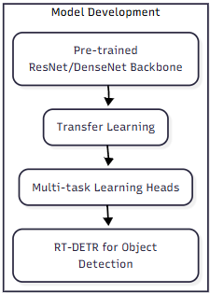
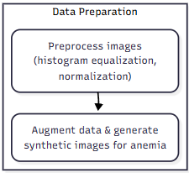
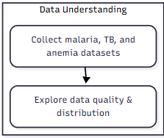
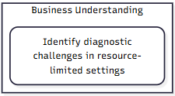
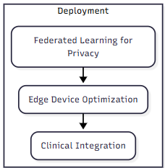
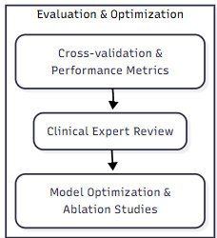
Methodology: CRISP-DM
(Cross-Industry Standard Process for Data Mining)
Bridging data gaps, strengthening data systems, and enhancing collaboration for data-driven decision-making in Africa
Notes:
Methodology and Available/Potential Datasets

Slide 12
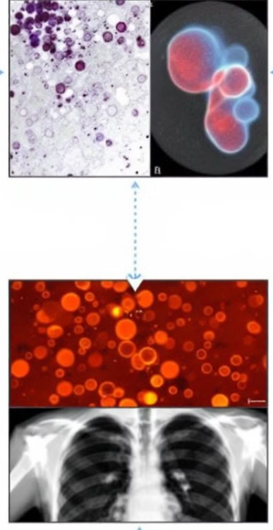
Potential Datasets
Dataset | Description | Source / Access
NIH Malaria Dataset | Microscopy images of thick and thin blood smears showing parasitized and uninfected red blood cells; includes parasite detection and, when available, stage and species annotations. | National Library of Medicine (NLM): NIH Malaria Project
Shenzhen Chest X-ray Dataset | Chest X-ray images, including normal and TB-positive cases, with annotations indicating TB-related abnormalities. | Publicly available; often sourced from Kaggle or institutional repositories.
Montgomery County Chest X-ray Dataset | A smaller dataset with annotated chest X-rays from a U.S. county, including TB-positive and normal images. | Publicly available; accessible via platforms such as Kaggle.
Synthetic Anemia Dataset | Synthetic blood smear images generated using GANs, VAEs, and Diffusion Models to simulate anemia conditions. | To be generated as part of this project; validation through clinical Turing tests and quantitative metrics (FID, SSIM, Dice).
Bridging data gaps, strengthening data systems, and enhancing collaboration for data-driven decision-making in Africa
Notes:
Methodology and Available/Potential Datasets

Slide 13
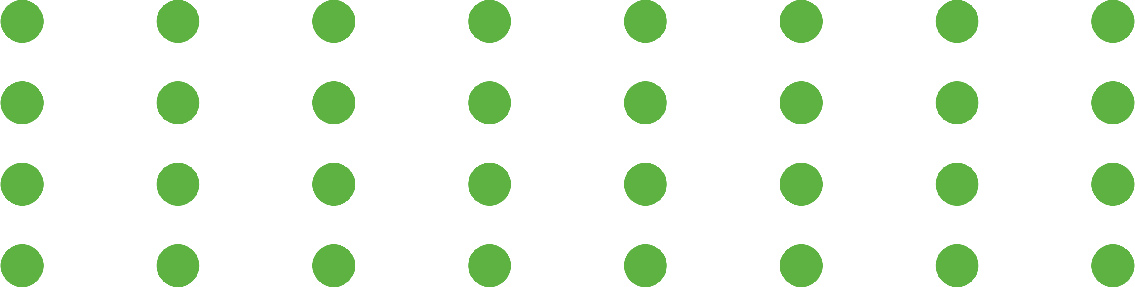

Summary of Progress So Far
Malaria Module Development:
Multi-task model for malaria detection—including parasite detection, stage classification, and species identification—is nearly complete, with initial testing showing promising accuracy.
Literature Review
Preliminary reviews for tuberculosis (TB) and anemia diagnosis have been conducted, identifying key methodologies and research gaps.
Dataset Exploration
Malaria and TB datasets have been collected and preprocessed.
Exploration for synthetic data generation for anemia is ongoing to address data scarcity.
Model Prototyping
Early prototypes of the multi-task learning framework have been implemented, with CNN-based feature extraction successfully integrated.
Integration with transformer-based architectures (RT-DETR) is in progress.
Notes:
Summary of Progress So Far

Slide 14



Perspectives and Next Steps
Short-Term Goals
Mid-Term Goals
Long-Term Goals
Deploy the complete diagnostic framework on edge devices for real-time, point-of-care applications.
Iteratively refine the system using an active learning loop with continuous clinician feedback.
Pursue large-scale clinical trials to benchmark the framework against existing diagnostic methods and secure regulatory approvals.
Finalize and integrate the TB and synthetic anemia modules with the existing malaria module.
Complete and validate the synthetic data generation pipeline for anemia using GANs/VAEs/Diffusion Models.
Enhance transformer-based model integration (RT-DETR) for improved localization and feature extraction.
Conduct further internal testing and ablation studies to fine-tune model components.
Implement federated learning protocols to enable collaborative training across multiple healthcare centers while preserving privacy.
Expand dataset exploration and preprocessing to include additional clinical data for TB and anemia.
Initiate pilot testing in collaboration with clinical partners to gather real-world feedback.
Notes:
Perspectives and Next Steps

Slide 15
Conclusion
This research introduces a next-generation AI diagnostic framework that combines RT-DETR (transformer-based architectures), synthetic data generation, and multi-task learning to enable real-time, simultaneous diagnosis of malaria, tuberculosis (TB), and anemia. By tackling critical challenges such as data scarcity, ethical AI deployment, and real-world scalability, this framework has the potential to transform global health diagnostics, particularly in resource-limited settings. Its innovative approach not only enhances diagnostic accuracy but also ensures accessibility, privacy, and fairness, paving the way for more equitable and effective healthcare solutions worldwide.
Bridging data gaps, strengthening data systems, and enhancing collaboration for data-driven decision-making in Africa
Notes:
Conclusion

Slide 16
References
Reference | Description
Gao, X., et al. (2020) Multi-task learning for diagnosing multiple diseases from a single chest X-ray image. IEEE Access, 8, 55588–55599. | Demonstrates a multi-task approach for integrated disease diagnosis from X-rays.
Rajpurkar, P., et al. (2020) CheXpedition: Investigating generalized deep learning for chest X-ray diagnosis. arXiv:2002.11379. | Explores generalized deep learning for chest X-ray analysis, supporting transfer learning strategies.
Carion, N., et al. (2020) End-to-end object detection with transformers (DETR). ECCV Proceedings. | Introduces transformer-based object detection, forming the basis for RT-DETR integration.
Dosovitskiy, A., et al. (2020) An image is worth 16×16 words: Transformers for image recognition at scale. arXiv:2010.11929. | Establishes the potential of Vision Transformers for complex image recognition tasks.
Dhariwal, P., & Nichol, A. (2021) Diffusion models beat GANs on image synthesis. Advances in Neural Information Processing Systems, 34, 8780–8794. | Provides evidence that diffusion models can generate high-fidelity synthetic images, crucial for augmenting scarce datasets (e.g., for anemia).
Mehrabi, N., et al. (2021) A survey on bias and fairness in machine learning. ACM Computing Surveys, 54(6), 1–35. | Addresses bias and fairness challenges in AI, essential for ethical, equitable model deployment.
Kairouz, P., et al. (2021) Advances and open problems in federated learning. Foundations and Trends® in Machine Learning, 14(1–2), 1–210. | Discusses federated learning techniques for privacy-preserving collaborative model training.
Rieke, N., et al. (2020) The future of digital health with federated learning. NPJ Digital Medicine, 3(1), 1–7. | Demonstrates practical applications of federated learning in healthcare, ensuring data privacy during collaborative training.
Subtitle Here
Subtitle Here
Bridging data gaps, strengthening data systems, and enhancing collaboration for data-driven decision-making in Africa
Notes:
References

Slide 17









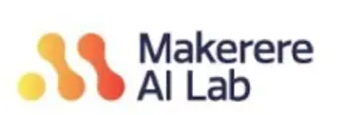
Partners

Slide 18
Thank You
Notes:
Why malaria?
What is the advantage
Motivation of the choice
Scope (can it be narrow?)
Tranfert learning
Different
Consider a case study which better align with the analysis. Cancer pathology

