Slide 1

Riiid AIEd Challenge 2020 (5DMACP03)
 | Team D-1
Sumit Kumar Singh | 01FE18BCS231 | 438
Sneha Majjigudda | 01FE18BCS211 | 419
Swati S Mugda | 01FE18BCS237 | 444
Naveen Kumar | 01FE19BCS426 | 460
Team Leader - Sumit Kumar Singh Team Name - D1_5D_2020_SoCSE_KLETech Team Number - 1 | Course Instructor - Shashidhar Vyakarnal Course Code - 18ECSC301
School of Computer Science, KLETech

Slide 2

Introduction
Riid Labs launched Santa in 2017, to help students better prepare for the TOEIC test.
EdNet, the dataset, contains 131,441,538 interactions from 784,309 students
Personalized education to understand how a student fares when faced with a new concept is helpful for teaching them.
School of Computer Science, KLETech

Slide 3
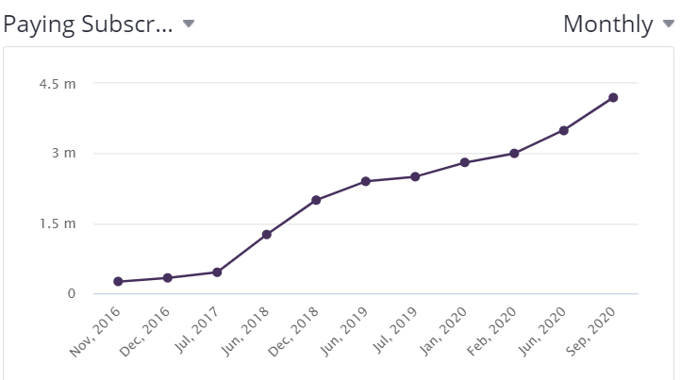
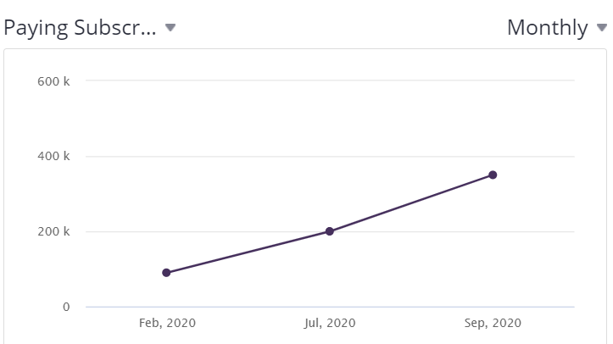
Motivation
EdTech is booming and has potential for a lot of research as well.
BYJU
Unacademy
Fig 1.
Increase in paying subscribers
for BYJU and Unacademy
Fig 2.
Source : craft.co
School of Computer Science, KLETech

Slide 4

Problem Statement
The challenge is to create an algorithm for "Knowledge Tracing," the modeling of student knowledge over time. The goal is to accurately predict how students will perform on future interactions.
Predictions should be made based on the student’s performance history, the performance of other students on same question, metadata about the questions and lectures, and more.
School of Computer Science, KLETech

Slide 5
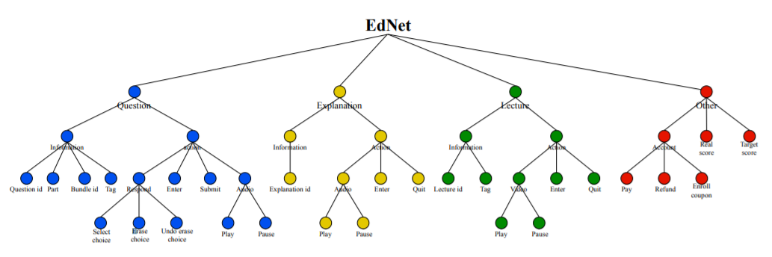
Literature Survey
EdNet: A Large-Scale Hierarchical Dataset in Education [1]
EdNet is a dataset consisting of all student-system interactions collected by Santa, a multi-platform AI tutoring service. It aims to prepare students for the TOEIC (Test of English for International Communication R ) Listening and Reading Test.
Figure 3: Hierarchical structure of EdNet
School of Computer Science, KLETech

Slide 6
LightGBM: A Highly Efficient Gradient Boosting Decision Tree [4]
Gradient Boosting Decision Tree (GBDT) is a popular machine learning algorithm.GBDT is an ensemble model of decision trees, which are trained in sequence.LightGBM, which contains two novel techniques: Gradient-based One-Side Sampling and Exclusive Feature Bundling to deal with large numbers of data instances and large number of features respectively.
It is more efficient than other gradient boosting algorithms as it reduces the optimal bundling problem to a graph coloring problem, and solving it by a greedy algorithm with a constant approximation ratio
School of Computer Science, KLETech

Slide 7
A Self-Attentive model for Knowledge Tracing[2]
A self-attention based knowledge tracing model(SAKT), it models a student’s interaction history and predicts his performance on the next exercise by considering the relevant exercises from his past interactions.The relevance between the knowledge concepts is identified using self-attention based approach.
Since predictions are made based on relatively few past activities, it handles the data sparsity problem which is the case in most real world data.
School of Computer Science, KLETech

Slide 8
Methodology
Visualize available data
Try to find out main characteristics
and relationships between given attributes
Create Temporal features for users and content
Create TrueSkill Feature
Make bias variance graphs and reevaluate the selection of models
EDA
Pre Processing
Feature
Engineering
Model Selection
Performance Evaluation
Changing Variable data types
Convert categorical to numerical variables using label or one hot encoding
Train a model on available features
EDA
School of Computer Science, KLETech

Slide 9
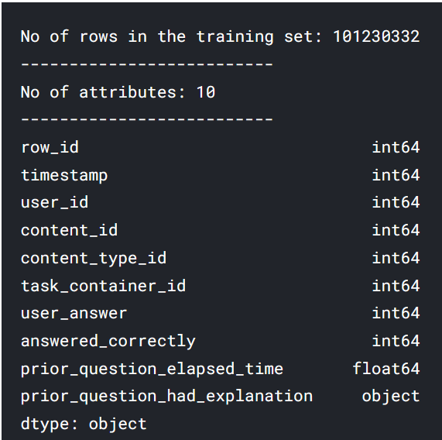
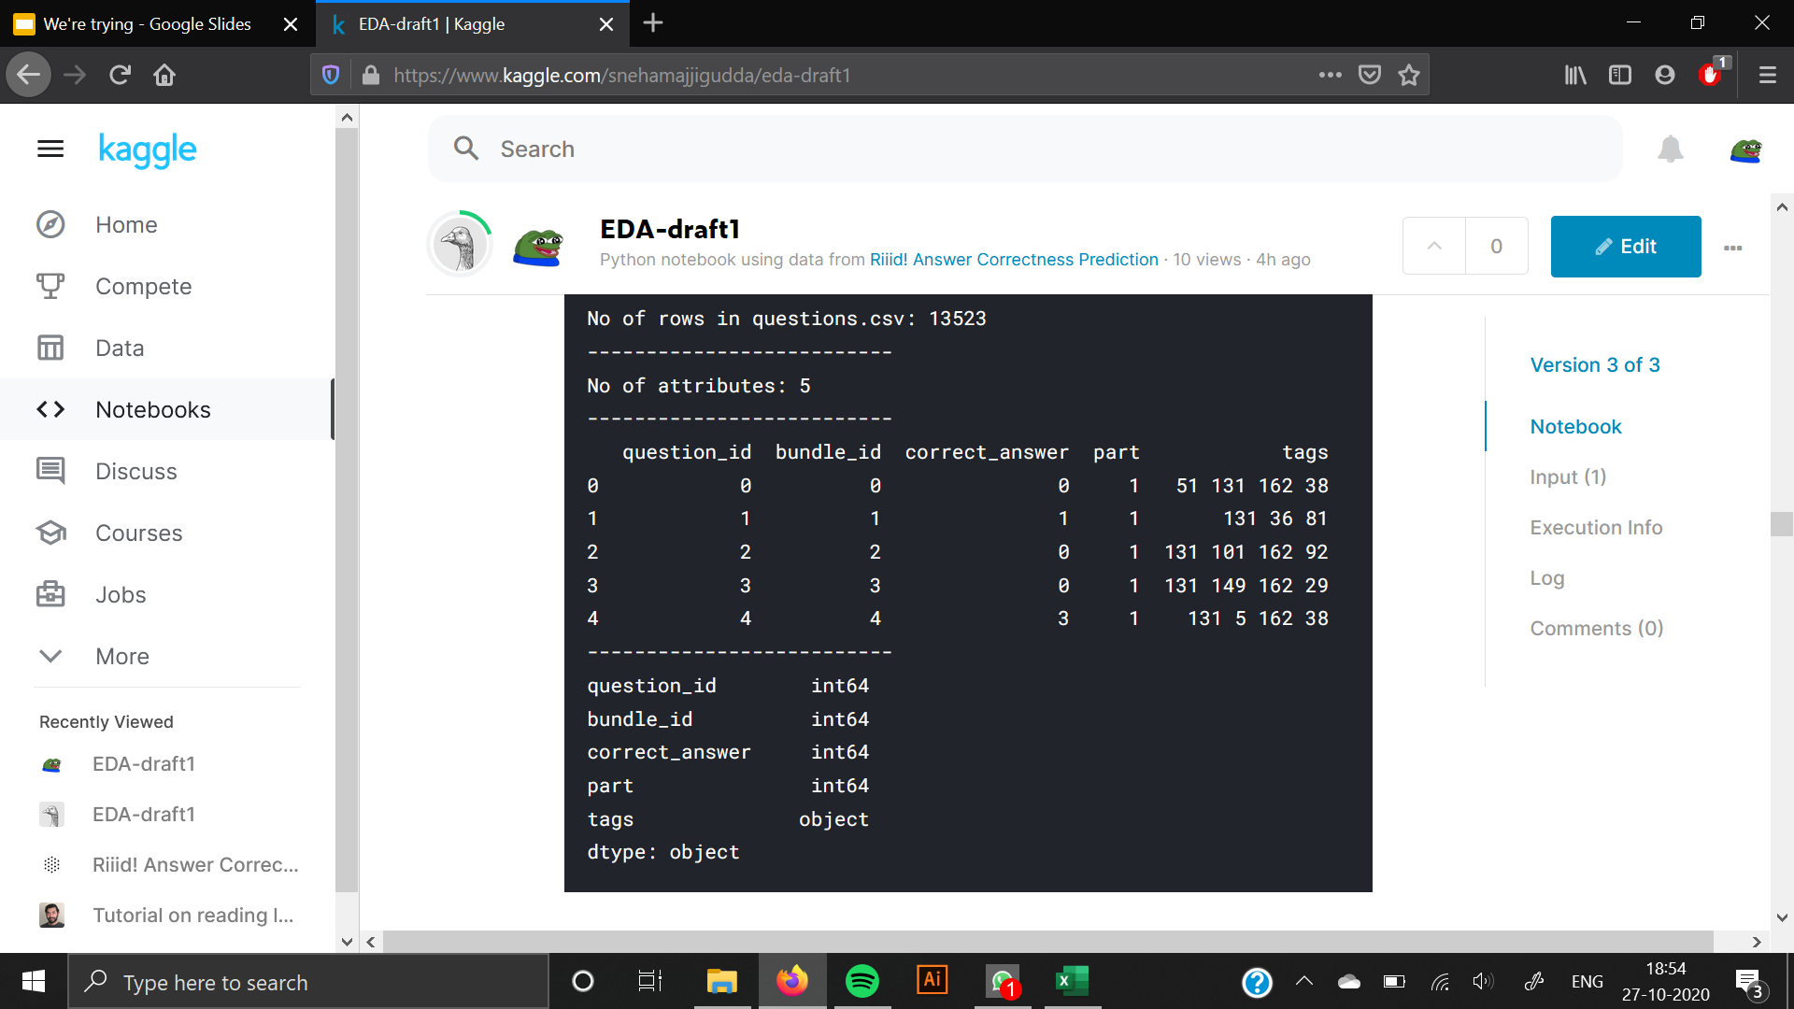
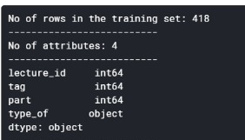
Dataset
Fig 5. questions.csv
Fig 6. lectures.csv
Fig 4. Train.csv
School of Computer Science, KLETech

Slide 10
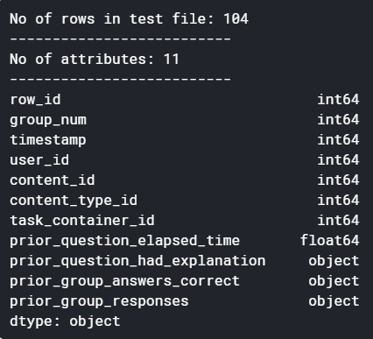
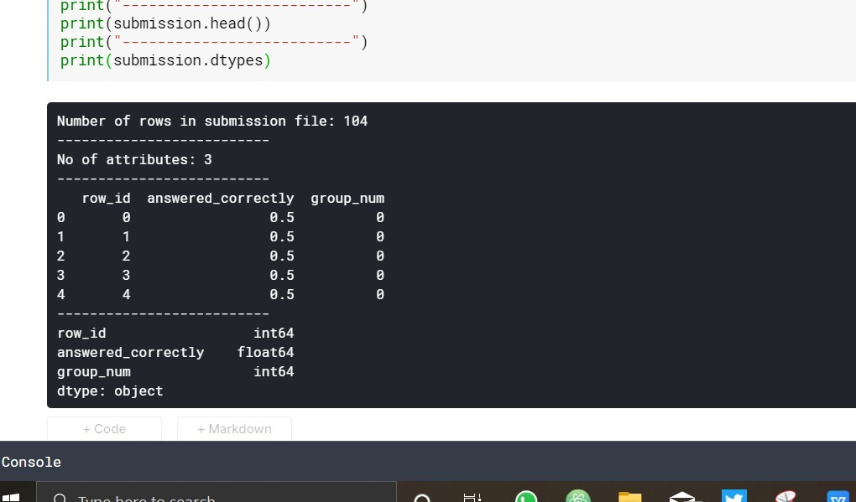
Dataset
Fig 8. example_sample_submission.csv
Fig 7. Test.csv
School of Computer Science, KLETech

Slide 11
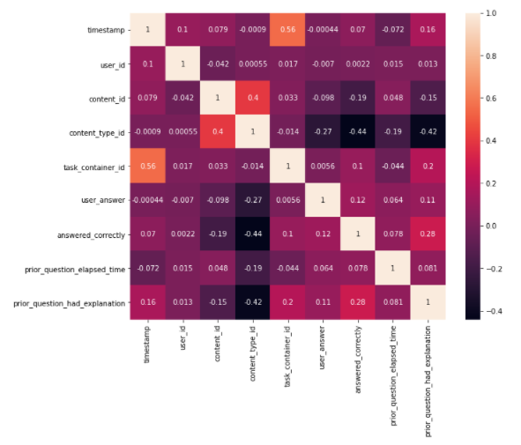
EDA
Correlation heat map helps to decide which attributes affect target variable the most.
Fig 9. Correlation Heat Map

Slide 12
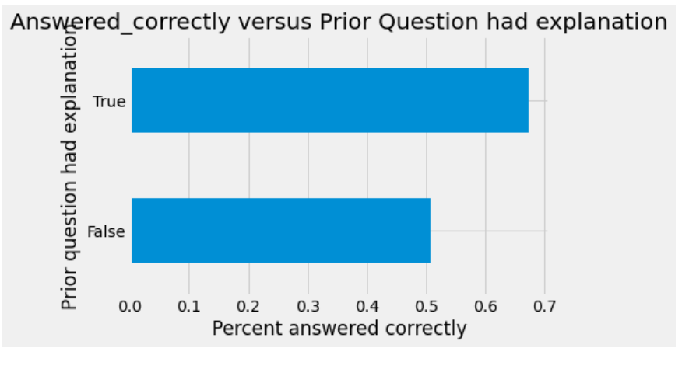
EDA (cont.)
Student has seen explanation of previous questions
Student is more likely to answer next questions correctly.
Fig 10. Answered_correctly vs Prior_question_had_explanation
School of Computer Science, KLETech

Slide 13
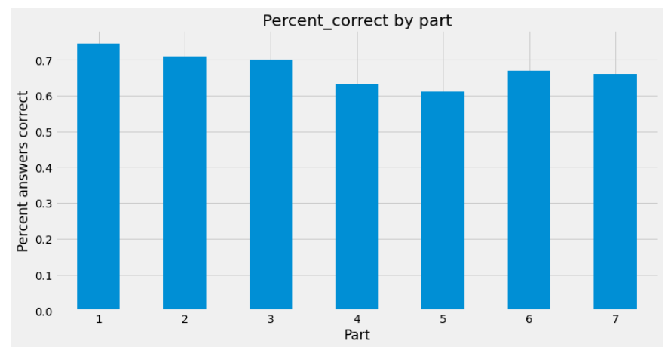
EDA (cont.)
Part 1 in TOEIC is most correctly answered part
Helps to analyse difficulty of parts based of number of times they have been answered correctly.
Fig 11. Percentage of answered_correctly for each part
School of Computer Science, KLETech

Slide 14
Pre-Processing
Data Cleaning
I. Handling the Null Values
Inserting ‘0’ for numeric attributes
Inserting ‘False’ for categorical attributes
II. Dropping Irrelevant Attributes
Dropping attributes like ‘row_id’ that are redundant.
Data Transformation
I. Label Encoding
Categorical variables are converted to numerical variables using Label Encoder
II. Data Type Conversion
Converting the data types of attributes to optimize memory.
School of Computer Science, KLETech

Slide 15
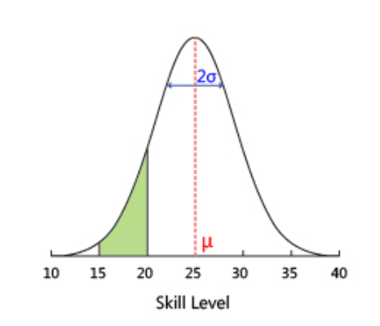
Feature Engineering
Lagtime - The time a user takes between answering 2 questions.
User_interaction_count - The number of times a user interacts with content ids.
User_lecture_sum - The Number of lectures a user has seen
User_Correctness - The number of question a user has answered correctly over all the questions attempted.
Attempt_no - The count value of the attempt of a user on a particular content id.
Correct_Probability - derived from the TrueSkill library that implements Microsoft TrueSkill Ranking System
Fig 12. TrueSkill Graph
School of Computer Science, KLETech

Slide 16
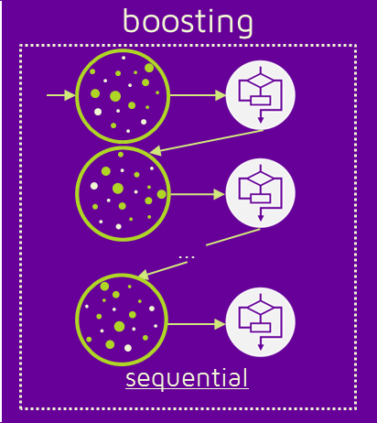
Model Selection
Boosting is an ensemble meta-algorithm for primarily reducing bias, and also variance in supervised learning.
A family of machine learning algorithms that convert weak learners to strong ones.
LGBM is a powerful boosting algorithm.
Ensembling can also be used when pairing up two models to give one output.
LGBM and SAKT have been paired for our challenge.
Fig 13. Boosting
School of Computer Science, KLETech

Slide 17
Results
Learning Model | Best AUC score obtained
Decision Tree | 0.5968
Logistic Regression | 0.6570
LGBM | 0.7568
Random Forest | 0.6640
K-Nearest Neighbour Classifier | 0.6121
SVM | 0.6720
Naive Bayes Classifier | 0.6581
CatBoost | 0.7489
LGBM + SAKT | 0.7830
Table 1
School of Computer Science, KLETech

Slide 18
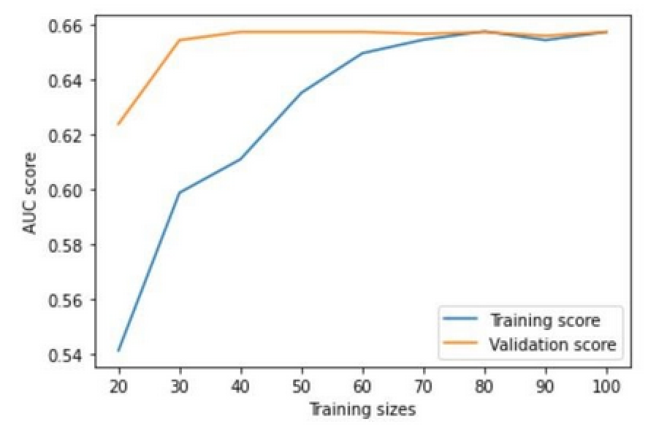
Performance Evaluation using Learning Curves
The learning curve shows high bias, low variance.
Training AUC is lower than Validation AUC suggesting Underfitting.
Fig 14. Logistic Regression
School of Computer Science, KLETech
Notes:
High bias low variance - Underfit
High error - not learning anything from training data
Training AUC is low
High variance low bias - Overfit
Overfits towards training data so much that it is too sensitive to changes in training data
Training AUC is very high

Slide 19
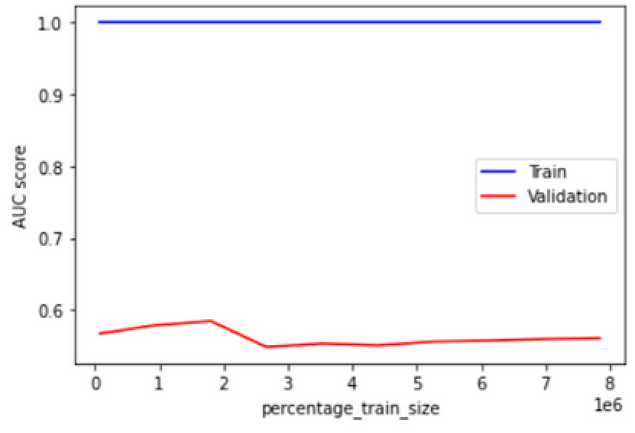
Performance Evaluation using Learning Curves
The learning curve shows low bias, high variance.
Training AUC is higher than Validation AUC suggesting Overfitting.
Fig 15. Decision Tree
School of Computer Science, KLETech

Slide 20
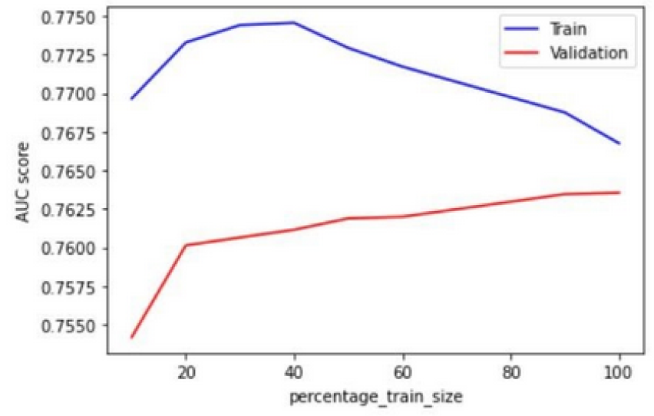
Performance Evaluation using Learning Curves
LGBM model shows low variance , low bias suggesting that it is a proper fit for the data.
The model generalizes well for unseen data.
Fig. 16 LGBM
School of Computer Science, KLETech

Slide 21
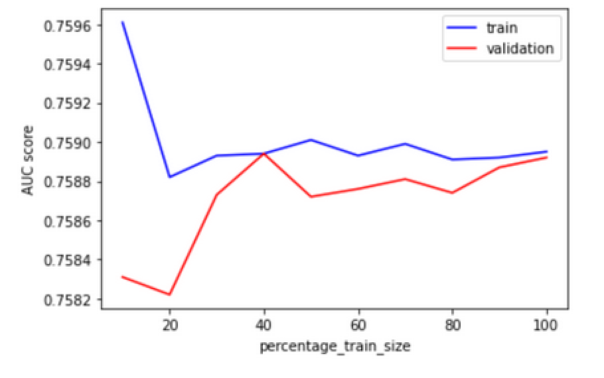
Performance Evaluation using Learning Curves
The learning curve shows low bias, low variance.
Training AUC and Validation AUC converges with increase in training size.
The model generalizes well for unseen data.
Fig. 17 CatBoost
School of Computer Science, KLETech

Slide 22
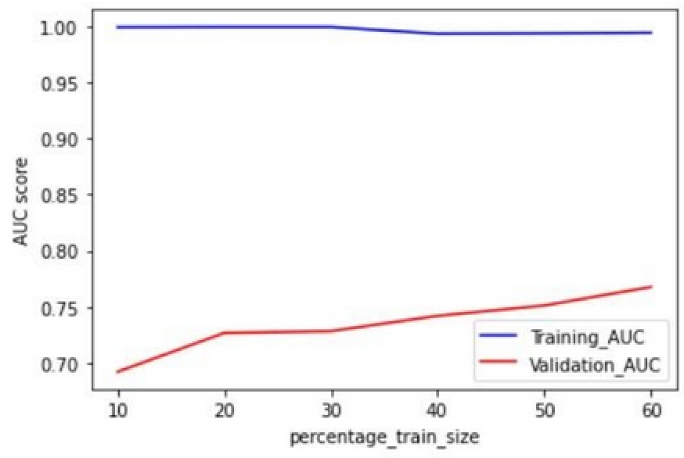
Performance Evaluation using Learning Curves
The learning curve shows low bias, high variance.
Training AUC is higher than Validation AUC suggesting Overfitting.
Fig. 18 Random Forest
School of Computer Science, KLETech

Slide 23
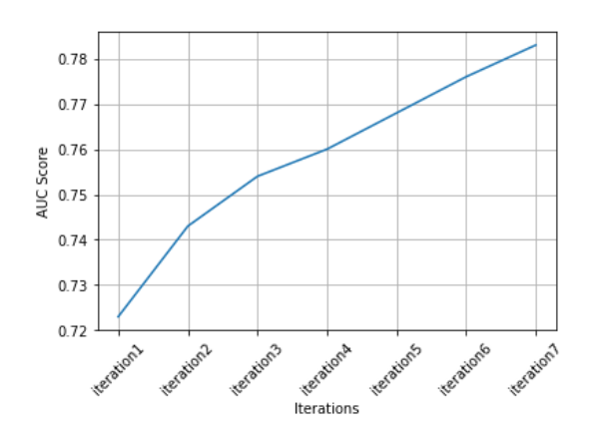
KDD Iterations
Fig. 19 Score Increase after every KDD iteration
School of Computer Science, KLETech

Slide 24
Features Added in KDD Iterations
Questions Mean
Hmean, User Correctness
Temporal user correctness, Content correctness, Lagtime
Bundle Correctness, First Tag
Explanation mean, task_content_correctness, Attempt_No
True Skill
LGBM + SAKT
School of Computer Science, KLETech

Slide 25
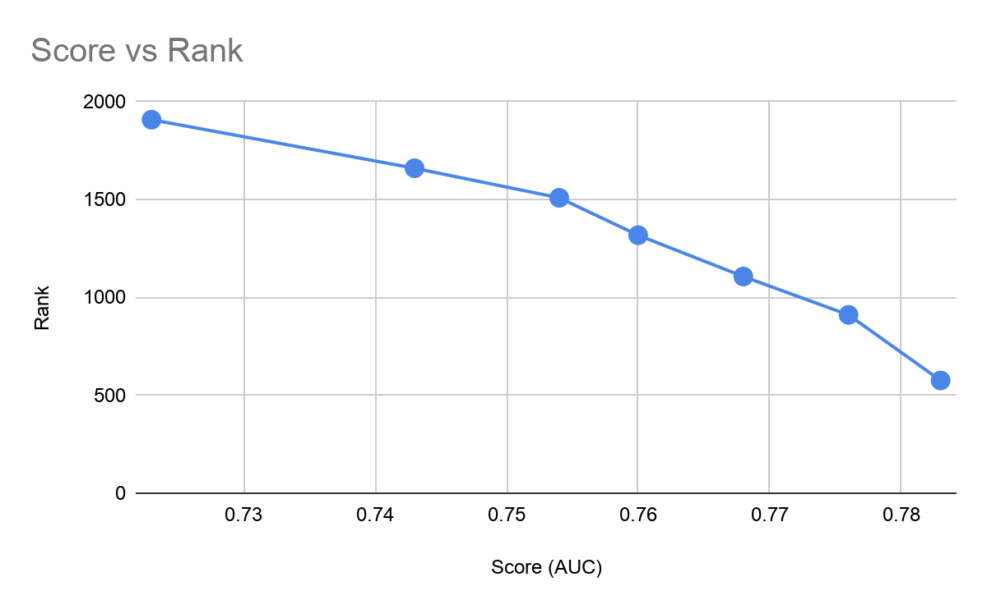
Ranking Trend
Fig. 20 Ranking Trend
School of Computer Science, KLETech

Slide 26
Conclusion
Temporal Features increase the capability of knowledge tracing algorithms.
Self attention based Transformer models performed better than boosting algorithms like LGBM.
However with better parameter tuning and feature generation LGBM can give competitive results to deep learning techniques like SAKT
School of Computer Science, KLETech

