Slide 1
WORKSHOP 7 ~ File I/O, Strings & Struct

Slide 2
Outline
Strings
Struct
Exercises

Slide 3
Exercise 1
i) Create a string array and an integer array with size 100
ii) Read the student records from the file students.txt. Count the number of records (the number must be smaller than or equal to 100). Store the student name and corresponding score. Each line contains one student record. The student name (without space) and score are separated by ‘\t’ character. Here is an example of student records:
Amy_Cheng 99
Iris_Ao 100
iii) Calculate the average score among these students
iv) Output the names of the students with the score above average and their scores (separated by ‘\t’ character similar to input file) to a file called good.txt.

Slide 4
Sample run
students.txt

Slide 5
Sample run
good.txt

Slide 6
Strings
#include <string>
Functions provided:
length()
empty()
substr()
find()

Slide 7
Exercise 2
“A palindrome is a word that can be read the same way from either direction, be it forwards or backwards.”
References: http://examples.yourdictionary.com/palindrome-examples.html
Write a program to ask the user to input a word and then output whether it is a palindrome or not.

Slide 8

Sample Runs

Slide 9
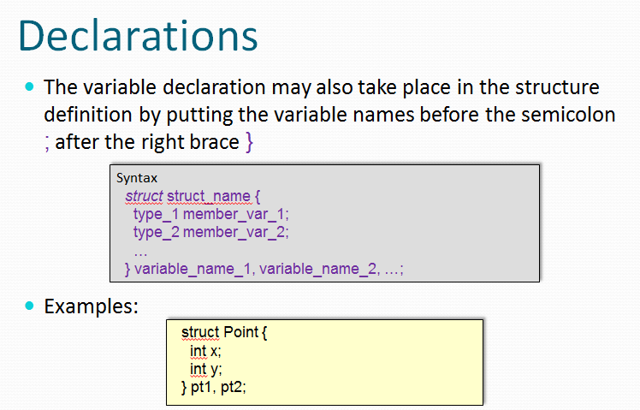
Complex Data Type
Structure (Lecture notes Page 6)

Slide 10
Exercise 3
Create a structure to store the student name and the corresponding marks.
Read the data in good.txt and sort the name according to the score.
Assume that there are not more than 100 students.

Slide 11
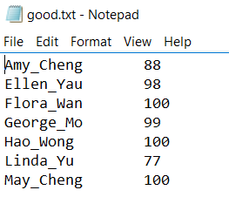
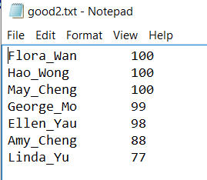
Sample run
Input file
Output file

Slide 12
Thanks!

