Slide 1
WORKSHOP 8 ~ Strings & Struct

Slide 2
Outline
Strings
Struct
Exercises

Slide 3

Exercise 1
Write a program “month.cpp” to ask the user to input a string. In this string, it contains a date in the format day/month/year. Print out the month of this date.
Hints: Search for the first and second ‘/’ symbols. Print the contents in between these two symbols. You may also need to use the substring function.
Sample Run:

Slide 4
substring
find()
1st and 2nd “/”
substr()

Slide 5
Exercise 2
Write a struct Num as follows:
struct Num { int value; int count; };
Write a program to ask the user to input 10 numbers and use this structure array to store the distinct number and the corresponding frequency of occurrence.

Slide 6
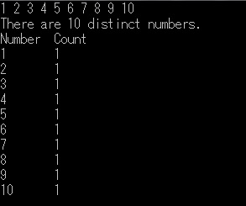
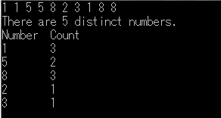
Sample runs

Slide 7
Sorting an array
Sorting (e.g. in ascending order)
Given an array a of n numbers, rearrange the numbers in the array such that
a[0] ≤ a[1] ≤ a[2] ≤ … ≤ a[n-1].
Many different sorting algorithms
Selection sort

Slide 8
Selection Sort
Let a[i..j] denote the "subarray" a[i], a[i+1], a[i+2],…,a[j].
For example, a[2..5] is the subarray a[2], a[3], a[4], a[5].
Sort array a[0..n-1] as follows:
Scan a[0..n-1] to find the max-index m of a[0..n-1].
Swap a[m] and a[n-1].
Scan a[0..n-2] to find the max-index m of a[0..n-2].
Swap a[m] and a[n-2].
Scan a[0..n-3] to find the max-index m of a[0..n-3].
Swap a[m] and a[n-3].
…
Scan a[0..1] to find the max-index m of a[0..1].
Swap a[m] with a[1].

Slide 9
Selection Sort
Let a[i..j] denote the "subarray" a[i], a[i+1], a[i+2],…,a[j].
For example, a[2..5] is the subarray a[2], a[3], a[4], a[5].
Sort array a[0..n-1] as follows:
i=n-1; Scan a[0..i] to find the max-index m of a[0..i].
Swap a[m] and a[i].
i=n-2; Scan a[0..i] to find the max-index m of a[0..i].
Swap a[m] and a[i].
i=n-3; Scan a[0..i] to find the max-index m of a[0..i].
Swap a[m] and a[i].
…
i=1; Scan a[0..i] to find the max-index m of a[0..i].
Swap a[m] with a[i].

Slide 10
Selection Sort (con't)
void swap(int& x, int& y)
{
int t;
t = x;
x = y;
y = t;
}
int main()
{
int a[1000], i, j, m, n;
cout << “The size of array:”;
cin >> n;
for (i = 0; i < n; i++)
cin >> a[i];
for (i = n-1; i > 0; i--)
{
find the max-index m of a[0..i];
swap(a[i], a[m]);
}
for (i = 0; i < n; i++)
cout << a[i] << endl;
return 0;
}

Slide 11
Selection Sort
Example
Input array (n = 5):
i = 4
8
2
7
9
1
8
2
7
9
1
8
2
7
9
1
8
2
7
9
1
8
2
7
1
9
8
2
7
9
1
8
2
7
9
1

Slide 12
Selection Sort
i = 3
8
2
7
1
9
8
2
7
1
9
8
2
7
1
9
8
2
7
1
9
8
2
7
1
9
1
2
7
8
9

Slide 13
Selection Sort
i = 2
1
2
7
8
9
1
2
7
8
9
1
2
7
8
9
1
2
7
8
9
1
2
7
8
9

Slide 14
Selection Sort
i = 1
Sorted array:
1
2
7
8
9
1
2
7
8
9
1
2
7
8
9
1
2
7
8
9

Slide 15
Exercise 3
Repeat Workshop 5 Exercise 2 (café.cpp)
Sort the product array according to the product name by selection sort
Remember to swap the price accordingly when you are swapping the product

Slide 16
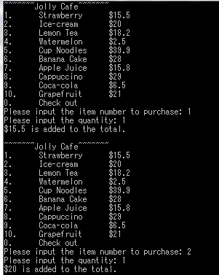
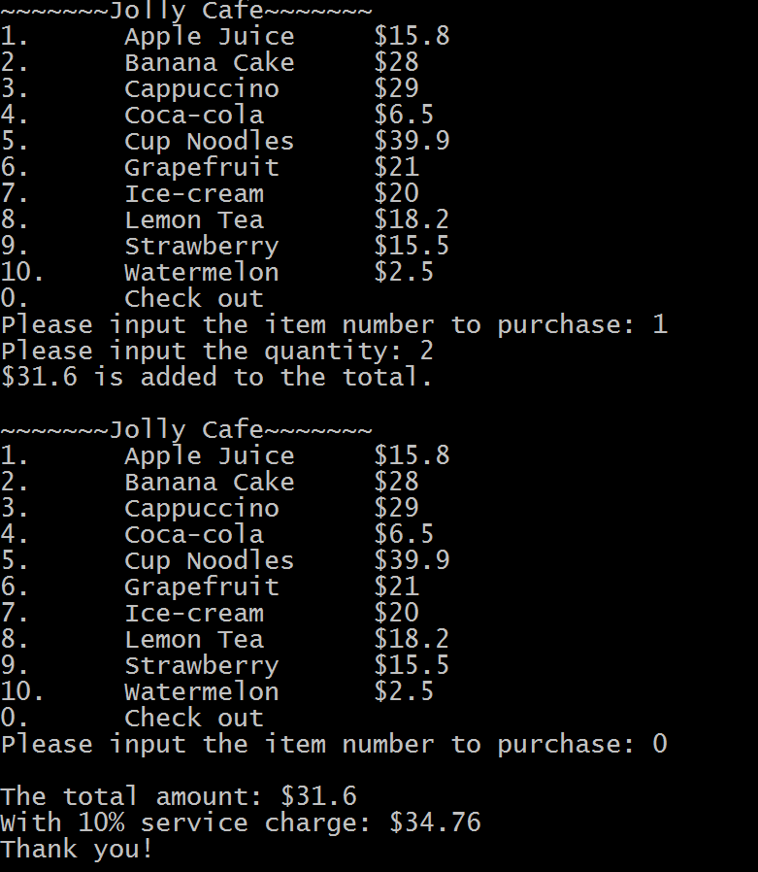
Sample run
Original:
With sorting:

Slide 17
Thanks!

