Slide 1
WORKSHOP 9 ~ Class

Slide 2
Outline
Class
Exercises

Slide 3
CLASS
3
A class is data type whose variables are objects.
It can be considered as an expanded concept of a structure.
It consists of both member variables and member functions that operate on its member variables.

Slide 4
CLASS
class DayOfYear
{
public:
void output();
int month;
int day;
};
void DayOfYear::output()
{
cout << “month = ”<< month
<< “, day = “ << day
<< endl;
}
struct DayOfYear{
int month;
int day;
};
void output(DayOfYear d)
{
cout << “month = ”<<
d.month << “, day =
“ << d.day << endl;
}
scope resolution operator for member function
4

Slide 5
CLASS
5
Public and Private Members
Keywords: public & private
Private : cannot be directly accessed in the program except within the member functions of the same class
Public: can be accessible from anywhere where the object is visible

Slide 6
CLASS
6
Constructors
A special member function with the same name as the class
automatically called whenever an new object of that class is created
Used for initialization
Cannot have any return type

Slide 7
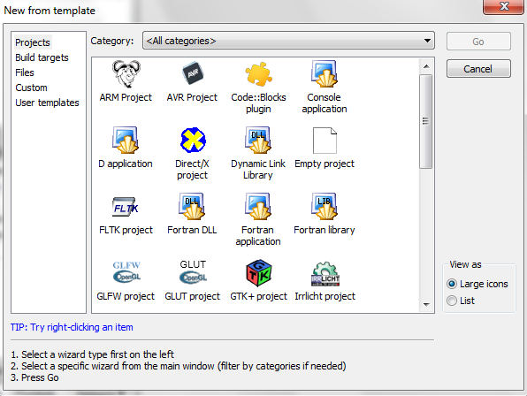
Create Project in Code::Blocks
7
New → Project
Select “Empty project”

Slide 8
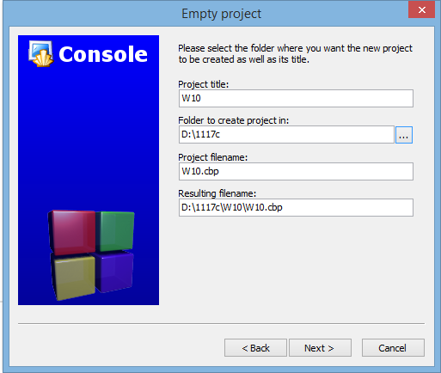
Create Project in Code::Blocks
8
Click “Next”
Give a project name
To add file in the project:
File → New →
Empty file

Slide 9
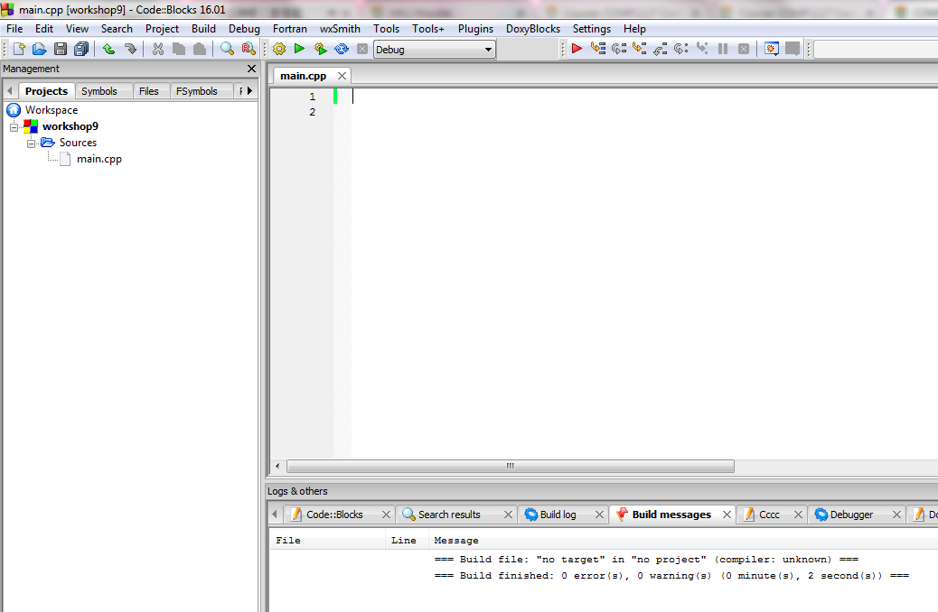
AN EXAMPLE: COUNTER
Let’s create a counter class!
Create 3 files:
main.cpp,
counter.cpp and
counter.h
9

Slide 10
Counter.h
It is a private member and can
only be accessed by
the public member functions above.
10
#ifndef COUNTER_H
#define COUNTER_H
class counter
{
public:
//Member functions
counter(); //constructor
void increment(); //increment counter
void decrement(); //decrement counter
int value(); //return current value
private:
//Data Members (attributes)
int counter_value;
};
#endif // COUNTER_H

Slide 11
Counter.cpp
#include "counter.h"
#include <iostream>
using namespace std;
counter::counter() {
counter_value = 0;
}
void counter::increment() {
if (counter_value < 10000)
counter_value++;
else
cout << "Counter overflow.\n";
}
void counter::decrement() {
if (counter_value > -10000)
counter_value--;
else
cout << "Counter underflow.\n";
}
int counter::value(){
return counter_value;
}
Constructor
11

Slide 12
Main.cpp
#include <iostream>
#include "counter.h"
using namespace std;
int main()
{
//Local data
counter Acounter, Bcounter;
//Test various functions
for (int i = 0; i < 10; i++)
{
Acounter.increment();
cout << "Acounter = " << Acounter.value() << endl;
}
for (int i = 5; i > 0; i--)
{
Bcounter.decrement();
cout << "Bcounter = " << Bcounter.value() << endl;
}
// Print result
cout << "The final value of Acounter = " << Acounter.value() << endl;
cout << "The final value of Bcounter = " << Bcounter.value() << endl;
return 0;
}
COUNTER.H
12

Slide 13
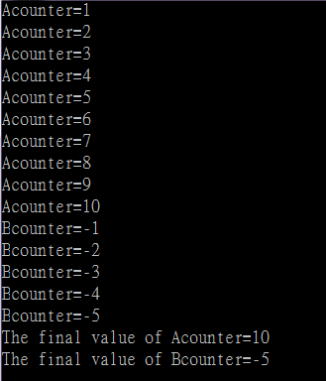
An example: Counter
Outputs
13

Slide 14
Exercise 1
Modify this counter class to add three more functions:
Add one more constructor for the user to initialize the counter value with a specific number
Add a bool member function “equal” to compare two counters’ values
bool equal (counter);
Add another member function called “add” to add two counters’ values
counter add (counter);

Slide 15
Main.cpp
#include <iostream>
#include "counter.h"
using namespace std;
int main()
{
//Local data
counter Acounter;
//Test various functions
for (int i = 0; i < 10; i++)
{
Acounter.increment();
cout << "Acounter = " << Acounter.value() << endl;
}
counter Bcounter(10);
if (Bcounter.equal(Acounter))
cout << "Bcounter's value is equal to Acounter's value.\n";
else
cout << "Bcounter's value is not equal to Acounter's value.\n";

Slide 16
Main.cpp
for (int i = 5; i > 0; i--)
{
Bcounter.decrement();
cout << "Bcounter = " << Bcounter.value() << endl;
}
if (Bcounter.equal(Acounter))
cout << "Bcounter's value is equal to Acounter's value.\n";
else
cout << "Bcounter's value is not equal to Acounter's value.\n";
counter Ccounter = Acounter.add(Bcounter);
// Print result
cout << "The final value of Acounter = " << Acounter.value() << endl;
cout << "The final value of Bcounter = " << Bcounter.value() << endl;
cout << "The final value of Ccounter = " << Ccounter.value() << endl;
return 0;
}

Slide 17
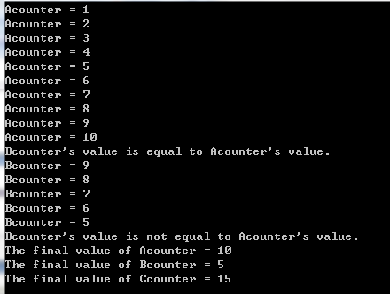
Sample Run

Slide 18
EXERCISE 2
18
Write a program employee_records.cpp to store the employees’ information. Create Employee class as follows:
class Employee
{
public:
void setName (string n);
void setPosition (string p);
void setBasicSalary (double s);
void showInfo();
private:
string Name;
string Position;
double BasicSalary;
};

Slide 19
EXERCISE 2
Name | Position | BasicSalary
Raymond | Manager | 60000
Tiffy | Waiter | 10000
19
Step 1: In the main program, try to use the Employee class. Let’s input the following records:

Slide 20
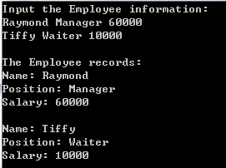
SAMPLE RUN
20

Slide 21
EXERCISE 2
21
Step 2: Let’s input 6 employees’ information and then sort the data according to the salary in descending order.
Hints: You may need to add a member function

Slide 22
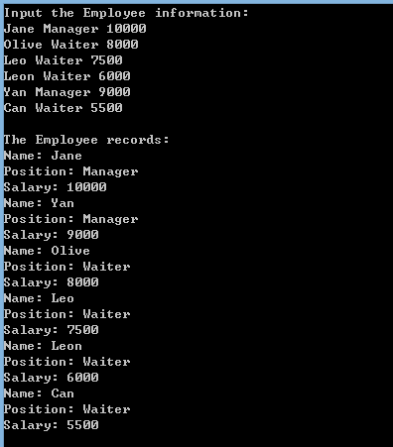
Sample run

Slide 23
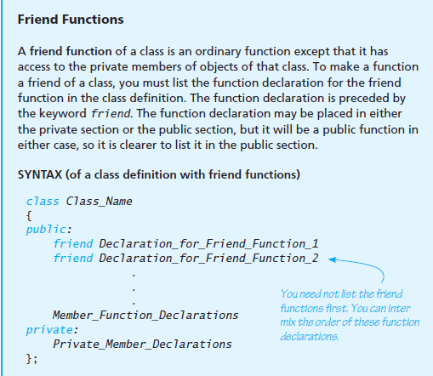
Friend Functions
Textbook Page 657

Slide 24
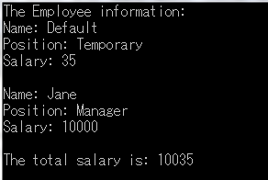

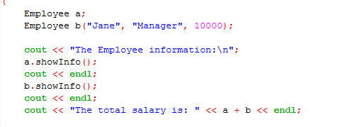
Operators
Example: +

Slide 25
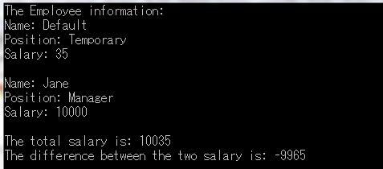
Exercise 3
Subtraction?
EmployeeA – EmployeeB = the basic salary of employee A – the basic salary of employee B

Slide 26
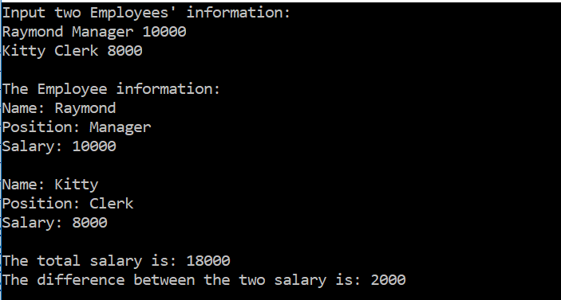
Exercise 3
Modify Exercise 2, and add the addition and subtraction operators. Ask the user to input two Employees’ information and then output their information. Besides, output the results of your + and – operators.

Slide 27
Thanks!

