Slide 1
WORKSHOP 6 ~ 2D Arrays & File I/O

Slide 2
Outline
2D Array
File I/O
Exercises

Slide 3
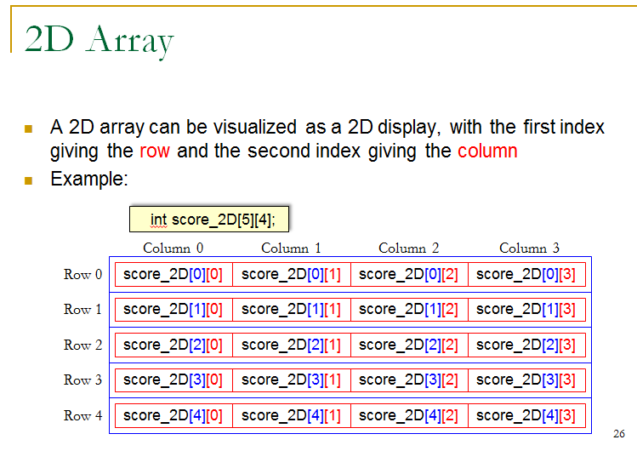
2D Array
Lecture Notes Chapter 5 Page 26

Slide 4

Exercise 1
A simple encryption method is by substitution
https://en.wikipedia.org/wiki/Substitution_cipher
Example:
Your message:
i_love_you
Encrypted message:
f_ilua_xlt

Slide 5
Exercise 1
Write a program called cipher.cpp and store the plaintext alphabet and ciphertext alphabet in a 2D array. Assume that the input message would be in small-letter.
The array:
char cipher[2][26] = {'a', 'b', 'c', 'd', 'e', 'f', 'g', 'h', 'i', 'j', 'k', 'l', 'm', 'n', 'o', 'p', 'q', 'r', 's', 't', 'u', 'v', 'w', 'x', 'y', 'z', 'z', 'e', 'b', 'r', 'a', 's', 'c', 'd', 'f', 'g', 'h', 'i', 'j', 'k', 'l', 'm', 'n', 'o', 'p', 'q', 't', 'u', 'v', 'w', 'x', 'y'};
Let the user to choose ‘0’ for decryption and ‘1’ for encryption.
Then ask the user to input the message until ‘!’and no“space” character in the message.

Slide 6
Exercise 1
Store the message into an array. Assume that the message would not exceeds 100 characters.
Depends on the user’s choice:
Encrypt the message and output the encrypted message on the screen if it is an encryption process.
Decrypt the message and output the original message on the screen if it is a decryption process.

Slide 7
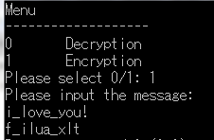
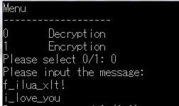
Sample run

Slide 8
Exercise 2
Let’s write a game – TicTacToe
Implement it by a 2D matrix
Two players – Player 1 and Player 2
Let them to specify their choice, e.g. 0 0 means he wants to choose m[0][0]
m[0][0] | m[0][1] | m[0][2]
m[1][0] | m[1][1] | m[1][2]
m[2][0] | m[2][1] | m[2][2]

Slide 9
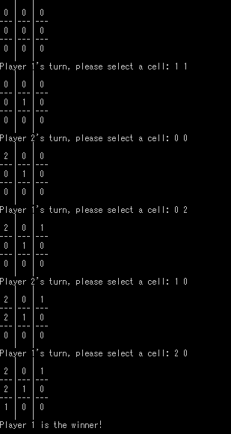
Exercise 2
Sample Run

Slide 10
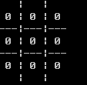
Exercise 2
Step 1 – Draw the board

Slide 11
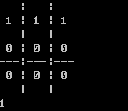
Exercise 2
Check winning condition
Report the winner number when he/she win the game

Slide 12
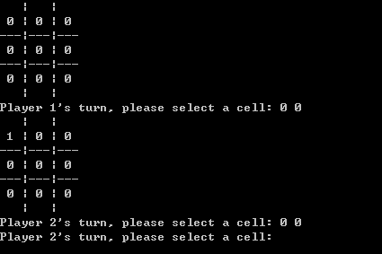
Exercise 2
Step 3: Let the users to choose an empty cell

Slide 13
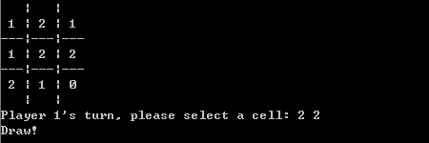
Exercise 2
Remember to check the draw case

Slide 14
File I/O
Standard input and output streams (cin, cout)
Read/Write data by using file input/output streams
E.g. Read data from a file, we need to create an input file stream

Slide 15
Create a file input stream
Remember to include the library
#include <fstream>
Declare a variable with the type ifstream
ifstream myvar;
Connect the variable to a file
myvar.open (“myfile.dat”);
Check the end of file
myvar.eof()
Close the file input stream
myvar.close();
Check if the opening is fail
myvar.fail()
Use it similar to cin
myvar >> myinput;

Slide 16

Example – Input from a file
// file i/o
#include <fstream>
using namespace std;
int main()
{
int a, b, c;
ifstream in_stream;
in_stream.open("infile.txt");
if (!in_stream.fail()) {
in_stream >> a >> b >> c;
in_stream.close();

Slide 17

Example – output to a file
ofstream out_stream;
out_stream.open("outfile.txt");
if (!out_stream.fail())
{
out_stream << "The sum of the three numbers:\n";
out_stream << a + b + c << endl;
out_stream.close();
}
}
return 0;
}

Slide 18
Directory
Where to put your files?
// file i/o
#include <fstream>
using namespace std;
int main()
{
ofstream out_stream;
out_stream.open("outfile.txt");
if (!out_stream.fail())
{
out_stream << "Testing\n";
out_stream.close();
}
return 0;
}

Slide 19
Exercise 3
Write a program (avg.cpp) to read a data file data.txt. The data file contains some numbers. The first number indicate the number of marks in the file. Read the marks one by one and calculate the average marks. Show the highest, lowest and average marks on the screen.
Remarks: all the marks are integers within 0 - 100.

Slide 20


Sample run
Input file:
Output:

Slide 21
Thanks!

