Slide 1
WORKSHOP 5 ~ Scope of variables, Functions & Arrays

Slide 2
Outline
Last Workshop Exercise
Scope of Variables
Call by value and Call by reference
Arrays
Exercises

Slide 3
Last Workshop Exercise
Randomly generate a number 1 -100
rand() % 100 + 1
From a student:
rand() / RAND_MAX * 100
Question from the student: Why always 0?
Good Try! But pay attention to the division.

Slide 4
Scope of variables - Sample Program
// Scope of variable
#include <iostream>
using namespace std;
int main ()
{
cout << "Enter 5 numbers" << endl;
int a, b, c, d, e;
int largest;
cin >> a >> b >> c >> d >> e;
{int largest=a;
if (b>a) largest = b;
if (c>a); largest = c;
if (d>a); largest = d;
if (e>a); largest = e;}
cout << "The average is " << endl;
cout << ((a + b + c + d + e) - largest)/4 << endl;
}
What is the result of this program?
Scope of largest?
Pay attention to the indentation!

Slide 5

Call by Value
int square_element(int x){
x = x * x;
return x;
}
int main(){
int num[3] = {1,2,3};
for(int i = 0; i < 3; ++i)
cout << num[i] << ' ';
cout << endl;
for(int j = 0; j < 3; ++j)
cout << square_element(num[j]) << ' ';
cout << endl;
for(int k = 0; k < 3; ++k)
cout << num[k] << ' ';
cout << endl;
return 0;
}

Slide 6

Call by Reference
int square_element(int &x){
x = x * x;
return x;
}
int main(){
int num[3] = {1,2,3};
for(int i = 0; i < 3; ++i)
cout << num[i] << ' ';
cout << endl;
for(int j = 0; j < 3; ++j)
cout << square_element(num[j]) << ' ';
cout << endl;
for(int k = 0; k < 3; ++k)
cout << num[k] << ' ';
cout << endl;
return 0;
}

Slide 7
Written Exercise
What is the output of the following code segment?
int func(int a, int &b)
{
a *= 10;
b *= 2;
return (a + b);
}
int main()
{
int a = 1;
int b = 2;
int c = func(b, a);
cout << a << " " << b << " " << c << endl;
}

Slide 8
Written Exercise
What is the output of the following code segment?
int func(int a, int &b)
{
a *= 10;
b *= 2;
return (a + b);
}
int main()
{
int a = 1;
int b = 2;
int c = func(b, a);
cout << a << " " << b << " " << c << endl;
}
a=2; b=1
a=20
b=2
return (22)
b=2; a=1
c=22; a=2
2 2 22

Slide 9
Define An Array
Syntax:
type_name array_name[size];
Example: bool bit[8];
int score[100];
double temp[20];
char grade[5];

Slide 10
Initialize An Array
There are two ways to initialize an array
Remember, the array index start at 0. And the maximum index is n-1 for a size n array.
Method 1
int num[3] = {1,2,3};
Method 2
int num[3];
num[0] = 1;
num[1] = 2;
num[2] = 3;

Slide 11

Pass an Array
void print(int x[], int size){
for(int i = 0; i < size; ++i)
cout << x[i] << ' ';
cout << endl;
}
void square_array(int x[], int size){
for(int i = 0; i < size; ++i)
x[i] = x[i] * x[i];
}
int main(){
int natural[3] = {1,2,3};
int even[4] = {2,4,6,8};
print(natural,3);
square_array(natural,3);
print(natural,3);
print(even,4);
square_array(even,4);
print(even,4);
}
x[ ] refer to natural[3] when execute the yellow block.
x[ ] refer to even[4] when execute the green block.

Slide 12
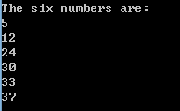
Exercise 1
Practice:
Pre-defined functions
Array
Loops
Write a program to generate 6 distinct numbers within 1-49.
Sample run:

Slide 13
Exercise 2
Let’s write a toy café program and fixed the product list with 10 items only
Step 1: Let the user to input the item and quantity they want to purchase and calculate the total amount until they input 0
Step 2: Use an array for storing product names and another array for storing the corresponding price:
#include <string>
string name[10];
double price[10];
string variables:
“Hello”, “Hello Kitty”, etc.

Slide 14
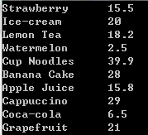
Exercise 2
Write a function for initialization
void initialize(string a[], double b[]);
Please input the items as follows:

Slide 15
Exercise 2
a[0] = "Strawberry";
a[1] = "Ice-cream";
a[2] = "Lemon Tea";
a[3] = "Watermelon";
a[4] = "Cup Noodles";
a[5] = "Banana Cake";
a[6] = "Apple Juice";
a[7] = "Cappuccino";
a[8] = "Coca-cola";
a[9] = "Grapefruit";
b[0] = 15.5;
b[1] = 20.0;
b[2] = 18.2;
b[3] = 2.5;
b[4] = 39.9;
b[5] = 28.0;
b[6] = 15.8;
b[7] = 29.0;
b[8] = 6.5;
b[9] = 21.0;

Slide 16
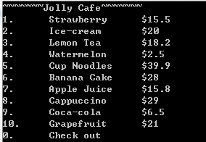
Exercise 2
Step 3: Write a menu() to print the new menu:

Slide 17
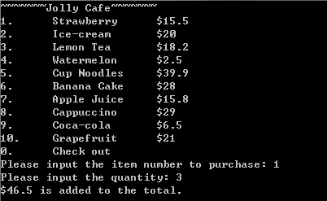
Exercise 2
Step 4: Write a sub() to calculate the sub-total

Slide 18
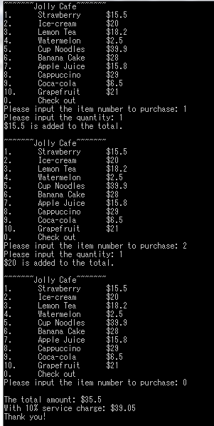
Exercise 2
Step 5: Print the total amount and the amount with 10% service charge when the user input 0
Sample Run:

Slide 19
Exercise 3
Practice:
Array
Loop
Self-defined function
Write a program to read at most 20 positive integers. The user could enter “-1” to indicate the end of the input if they want to enter fewer than 20. Store these numbers in the array. Write a rev function to reverse the order of the items in this array without creating a new array. Then print the result.
Example:
1 2 3 4 5 -1
5 4 3 2 1

Slide 20


Sample runs

Slide 21
Thanks!

