Slide 1
Cassandra – A NoSQL Database

Slide 2
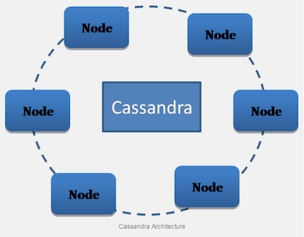
What is Cassandra ?
NoSQL Database
Totally decentralized
High scalability
Full redundancy

Slide 3
Vocabulary
The keywords you need to know about
Node : A physical or virtual machine where the data is stored/replicated
Cluster : A virtual combination of nodes
Replica : The name of a data
Replication Factor (RF) : Number of replica to be done for each data
Consistency level (CL) : determines the number of replicas on which the write must succeed before returning an acknowledgment to the client application
MemTable :
Commit Log :
SSTable :

Slide 4
How it works ?
Here are some of Cassandra’s main functionality that will be overviewed
Columnar data model
Consistent Hashing
Gossip Protocol
Hinted Handoff
Tuneable Consistancy

Slide 5
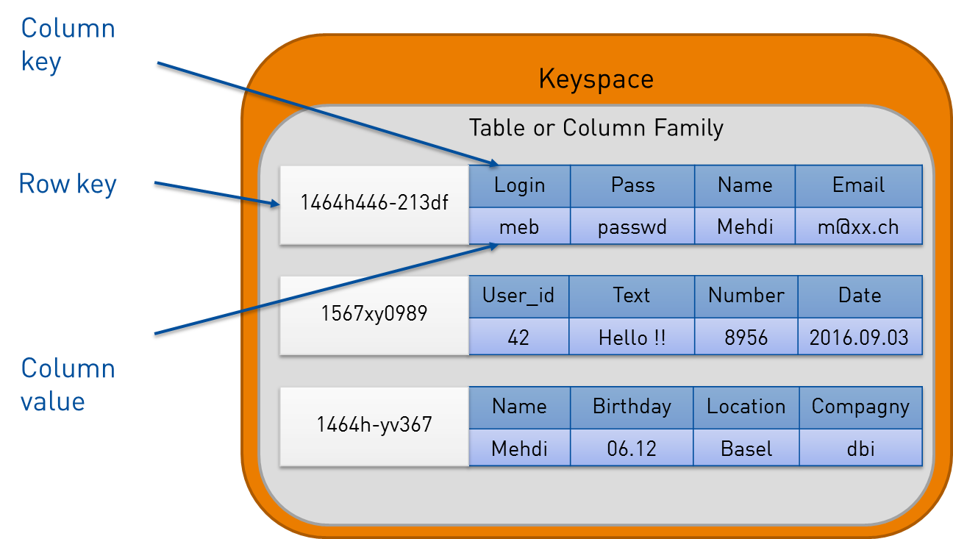
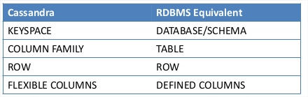
Columnar data model
Store highly compressed data in columns instead of rows to speed up query processing
Flexible data-model
Adapted to process large amount of data
Powerful no SPoF system
Efficient RAM stored data

Slide 6
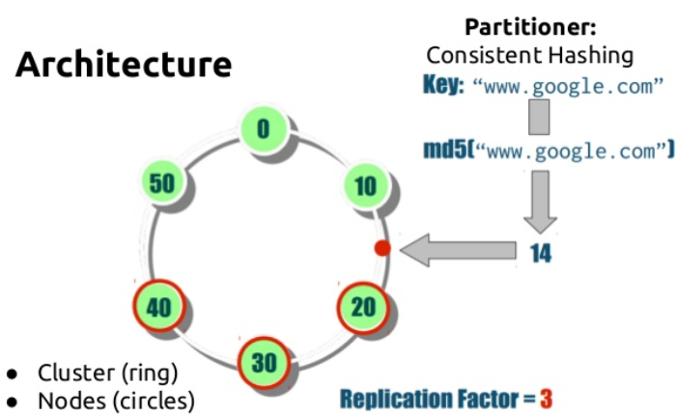
Consistent Hashing
Allow homogeneous distribution of data across a cluster
Hash the row key into a integer between 0 et 2^127
Place the data into the directly superior node

Slide 7
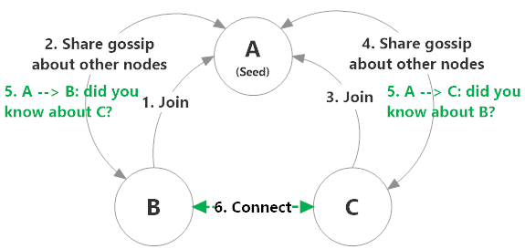
Gossip Protocol
Fault-tolerant, peer-peer commuincation protocol, allowing nodes to talk to each other
Every second, nodes communicates with each others
Allow to quickly know which node is down

Slide 8
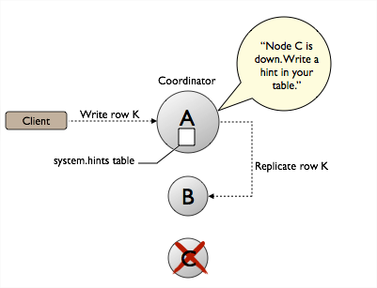
Hinted Handoff
If a node is down and is supposed to be written on, the coordinator keep a hint of the data with a TTL

Slide 9
1-Column (No Rule) Layout
Subtitle
Text Level 1
Text Level 2
Text Level 3
Text Level 4

Slide 10
2-Column Layout
Subtitle
Subtitle
Text Level 1
Text Level 2
Text Level 3
Text Level 4
Text Level 1
Text Level 2
Text Level 3
Text Level 4

Slide 12
3-Column Layout
Subtitle
Subtitle
Subtitle
Text Level 1
Text Level 2
Text Level 3
Text Level 4
Text Level 1
Text Level 2
Text Level 3
Text Level 4
Text Level 1
Text Level 2
Text Level 3
Text Level 4

Slide 13
4-Column Layout
Subtitle
Subtitle
Subtitle
Subtitle
Text Level 1
Text Level 2
Text Level 3
Text Level 4
Text Level 1
Text Level 2
Text Level 3
Text Level 4
Text Level 1
Text Level 2
Text Level 3
Text Level 4
Text Level 1
Text Level 2
Text Level 3
Text Level 4

Slide 14
Containers
Use these containers for short callouts or simple content, right click and choose “Edit Text”

Slide 15
2-Column Table
Subtitle
Subtitle
Category 1 | Text |  | Text
Category 2 | Text |  | Text
Category 3 | Text |  | Text

Slide 16
3-Column Table
Subtitle
Subtitle
Subtitle
Category 1 | Text |  | Text |  | Text
Category 2 | Text |  | Text |  | Text
Category 3 | Text |  | Text |  | Text

Slide 17
4-Column Table
Subtitle
Subtitle
Subtitle
Subtitle
Category 1 | Text |  | Text |  | Text |  | Text
Category 2 | Text |  | Text |  | Text |  | Text
Category 3 | Text |  | Text |  | Text |  | Text

Slide 18
Solid Table
Subtitle
Table Heading
Text

Slide 19

Section Title over dark image

Slide 20

Section Title over light image

Slide 21

Image

