Slide 1
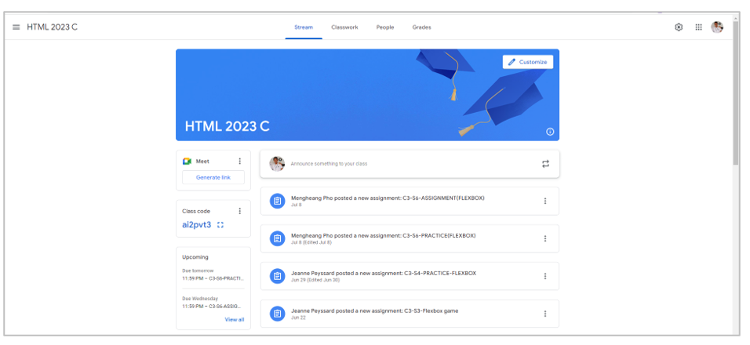
Exercise 1
Header
Main

Slide 2
Flex 1
Flex 2
Flex 1
Header left
Header center
Header right

Slide 3
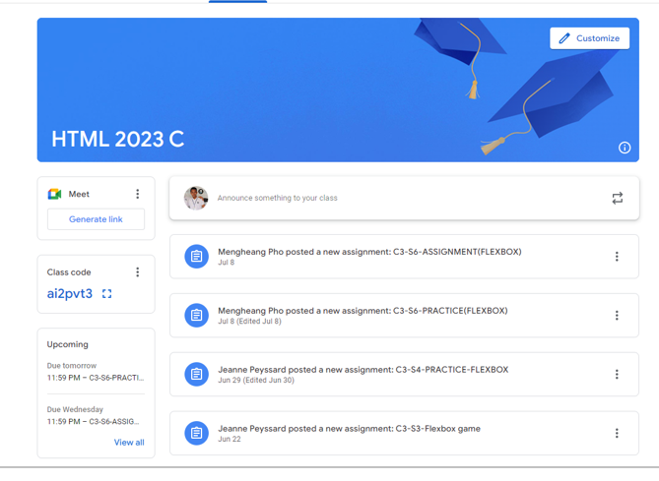
Main content
Sub Content
The yellow: flex 0
The green: flex 1

Slide 4
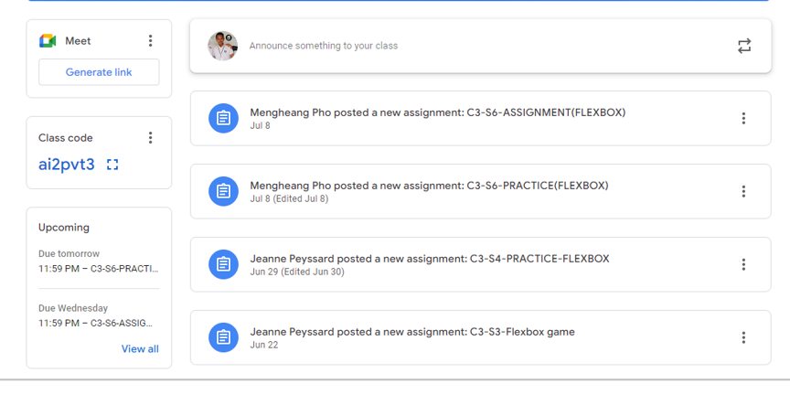
Sidebar
Message content
Flex 0
Flex 1

Slide 5

Flex 0
Flex 1
profile
Announce content

