Slide 1

Graphs to Interpret
FSEGT - 1MA

Slide 2
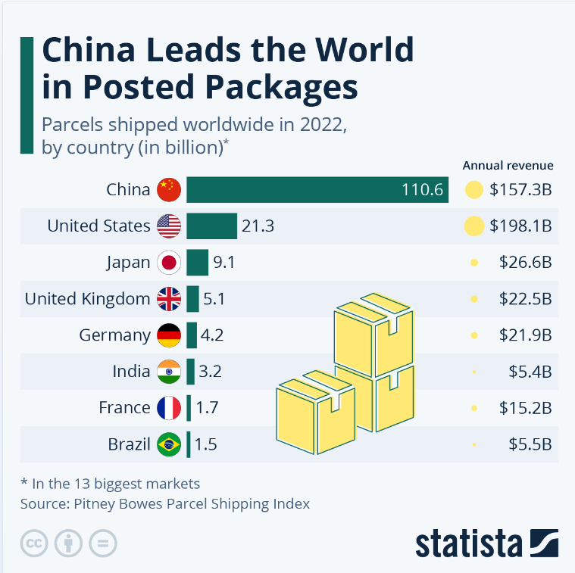
https://www.statista.com/chart/25936/number-of-parcels-shipped-worldwide/?fbclid=IwAR3UYDhhTJgtxeEeasVOyWX-3gt1U8PD4ulxQaauHM_gvNR2EayC1zQDpRs

Slide 3
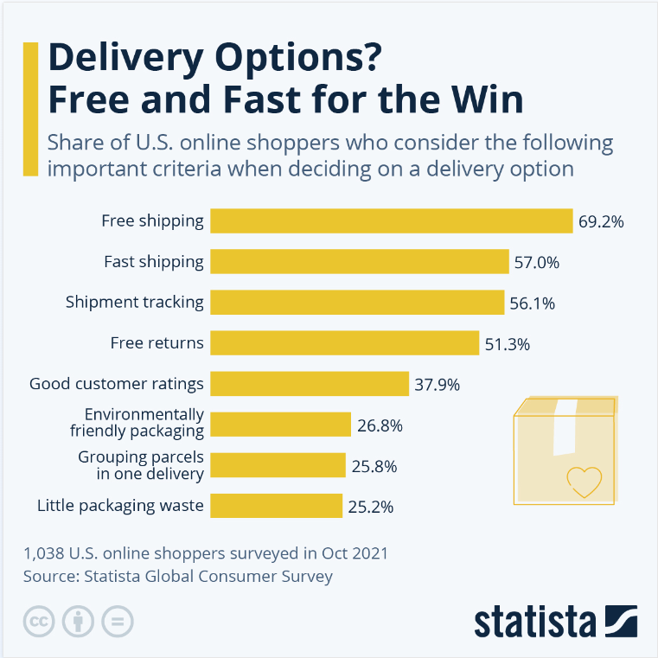
https://www.statista.com/chart/28414/important-shipping-criteria-to-us-online-shoppers/

Slide 4

https://www.statista.com/chart/29109/share-of-people-that-would-try-delivery-drones/

Slide 5
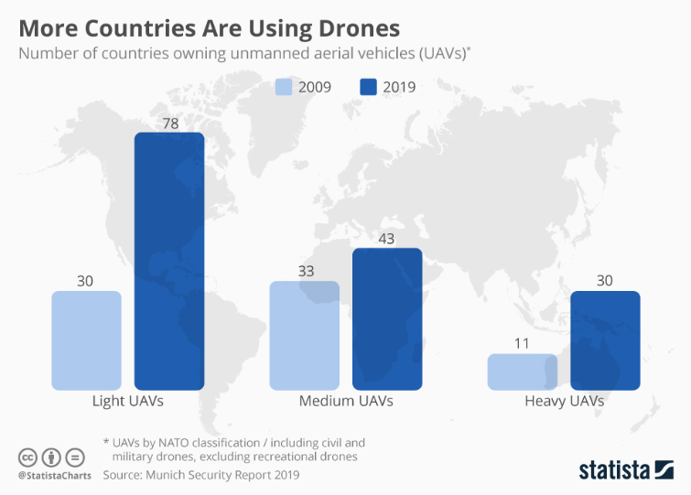
https://www.statista.com/chart/17021/number-of-countries-using-drones/

Slide 6

https://ecommercedb.com/insights/chart/11431

Slide 7

https://ecommercedb.com/insights/chart/11429

Slide 8
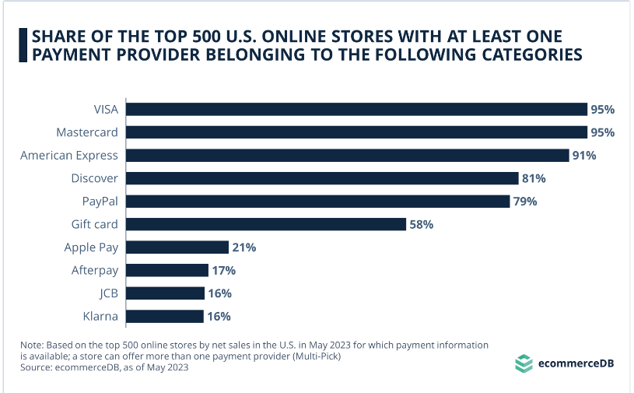
https://ecommercedb.com/insights/chart/11412

Slide 9
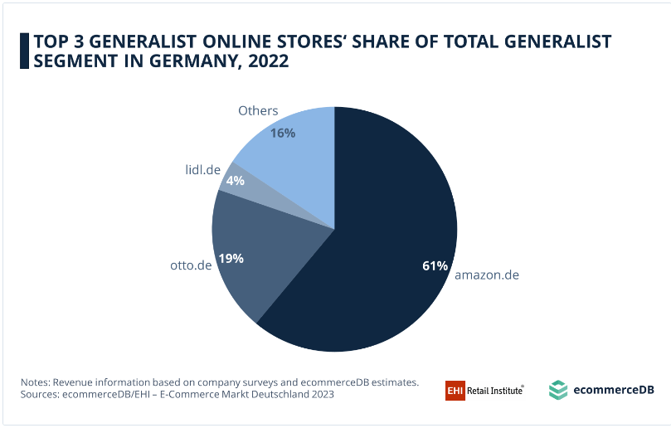
https://ecommercedb.com/insights/chart/11409

Slide 10
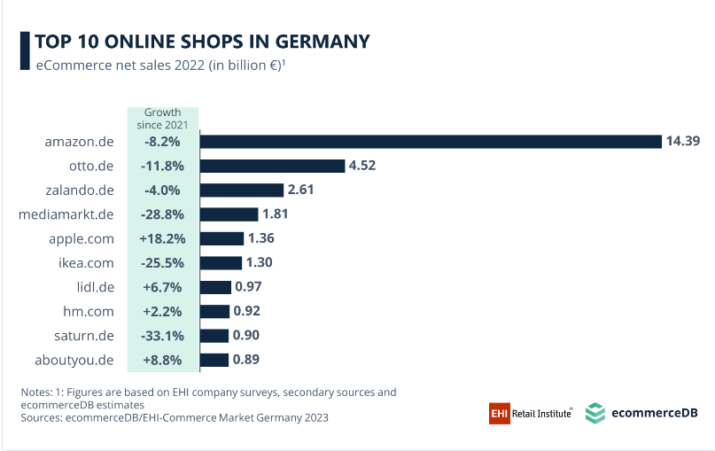
https://ecommercedb.com/insights/chart/11406

Slide 11
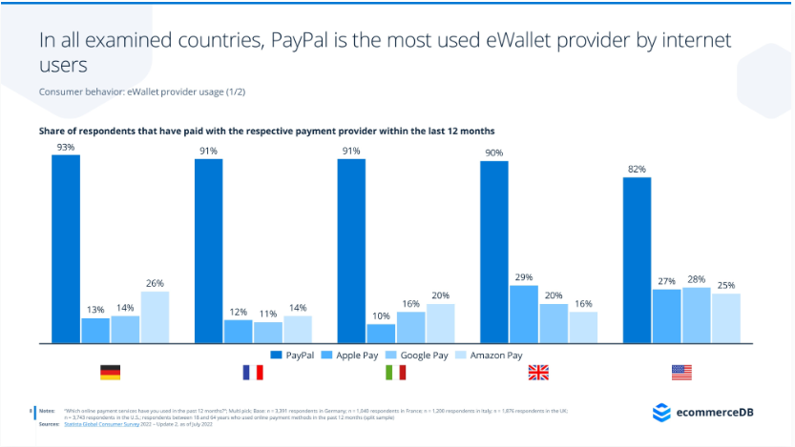
https://ecommercedb.com/reports/ecommerce-payment-provider-paypal/388

Slide 12
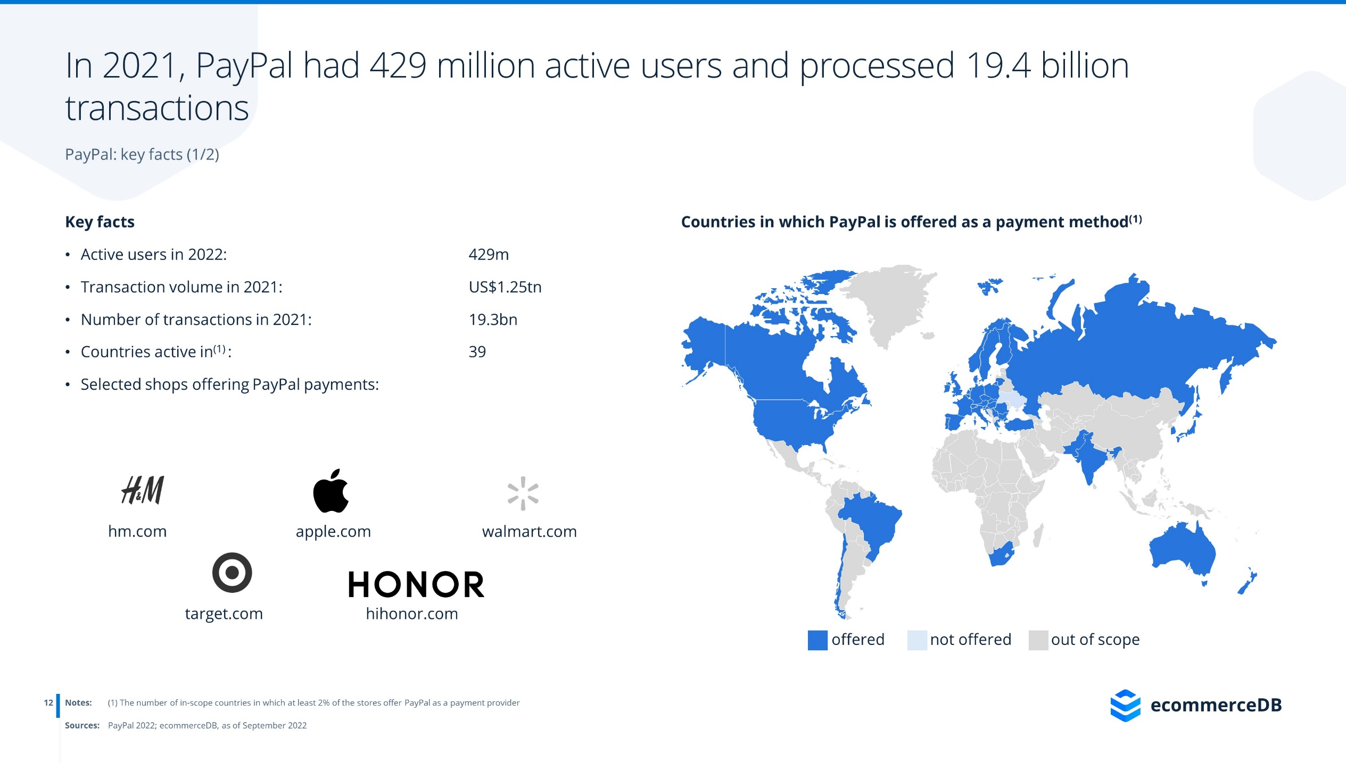
https://ecommercedb.com/reports/ecommerce-payment-provider-paypal/388

Slide 13
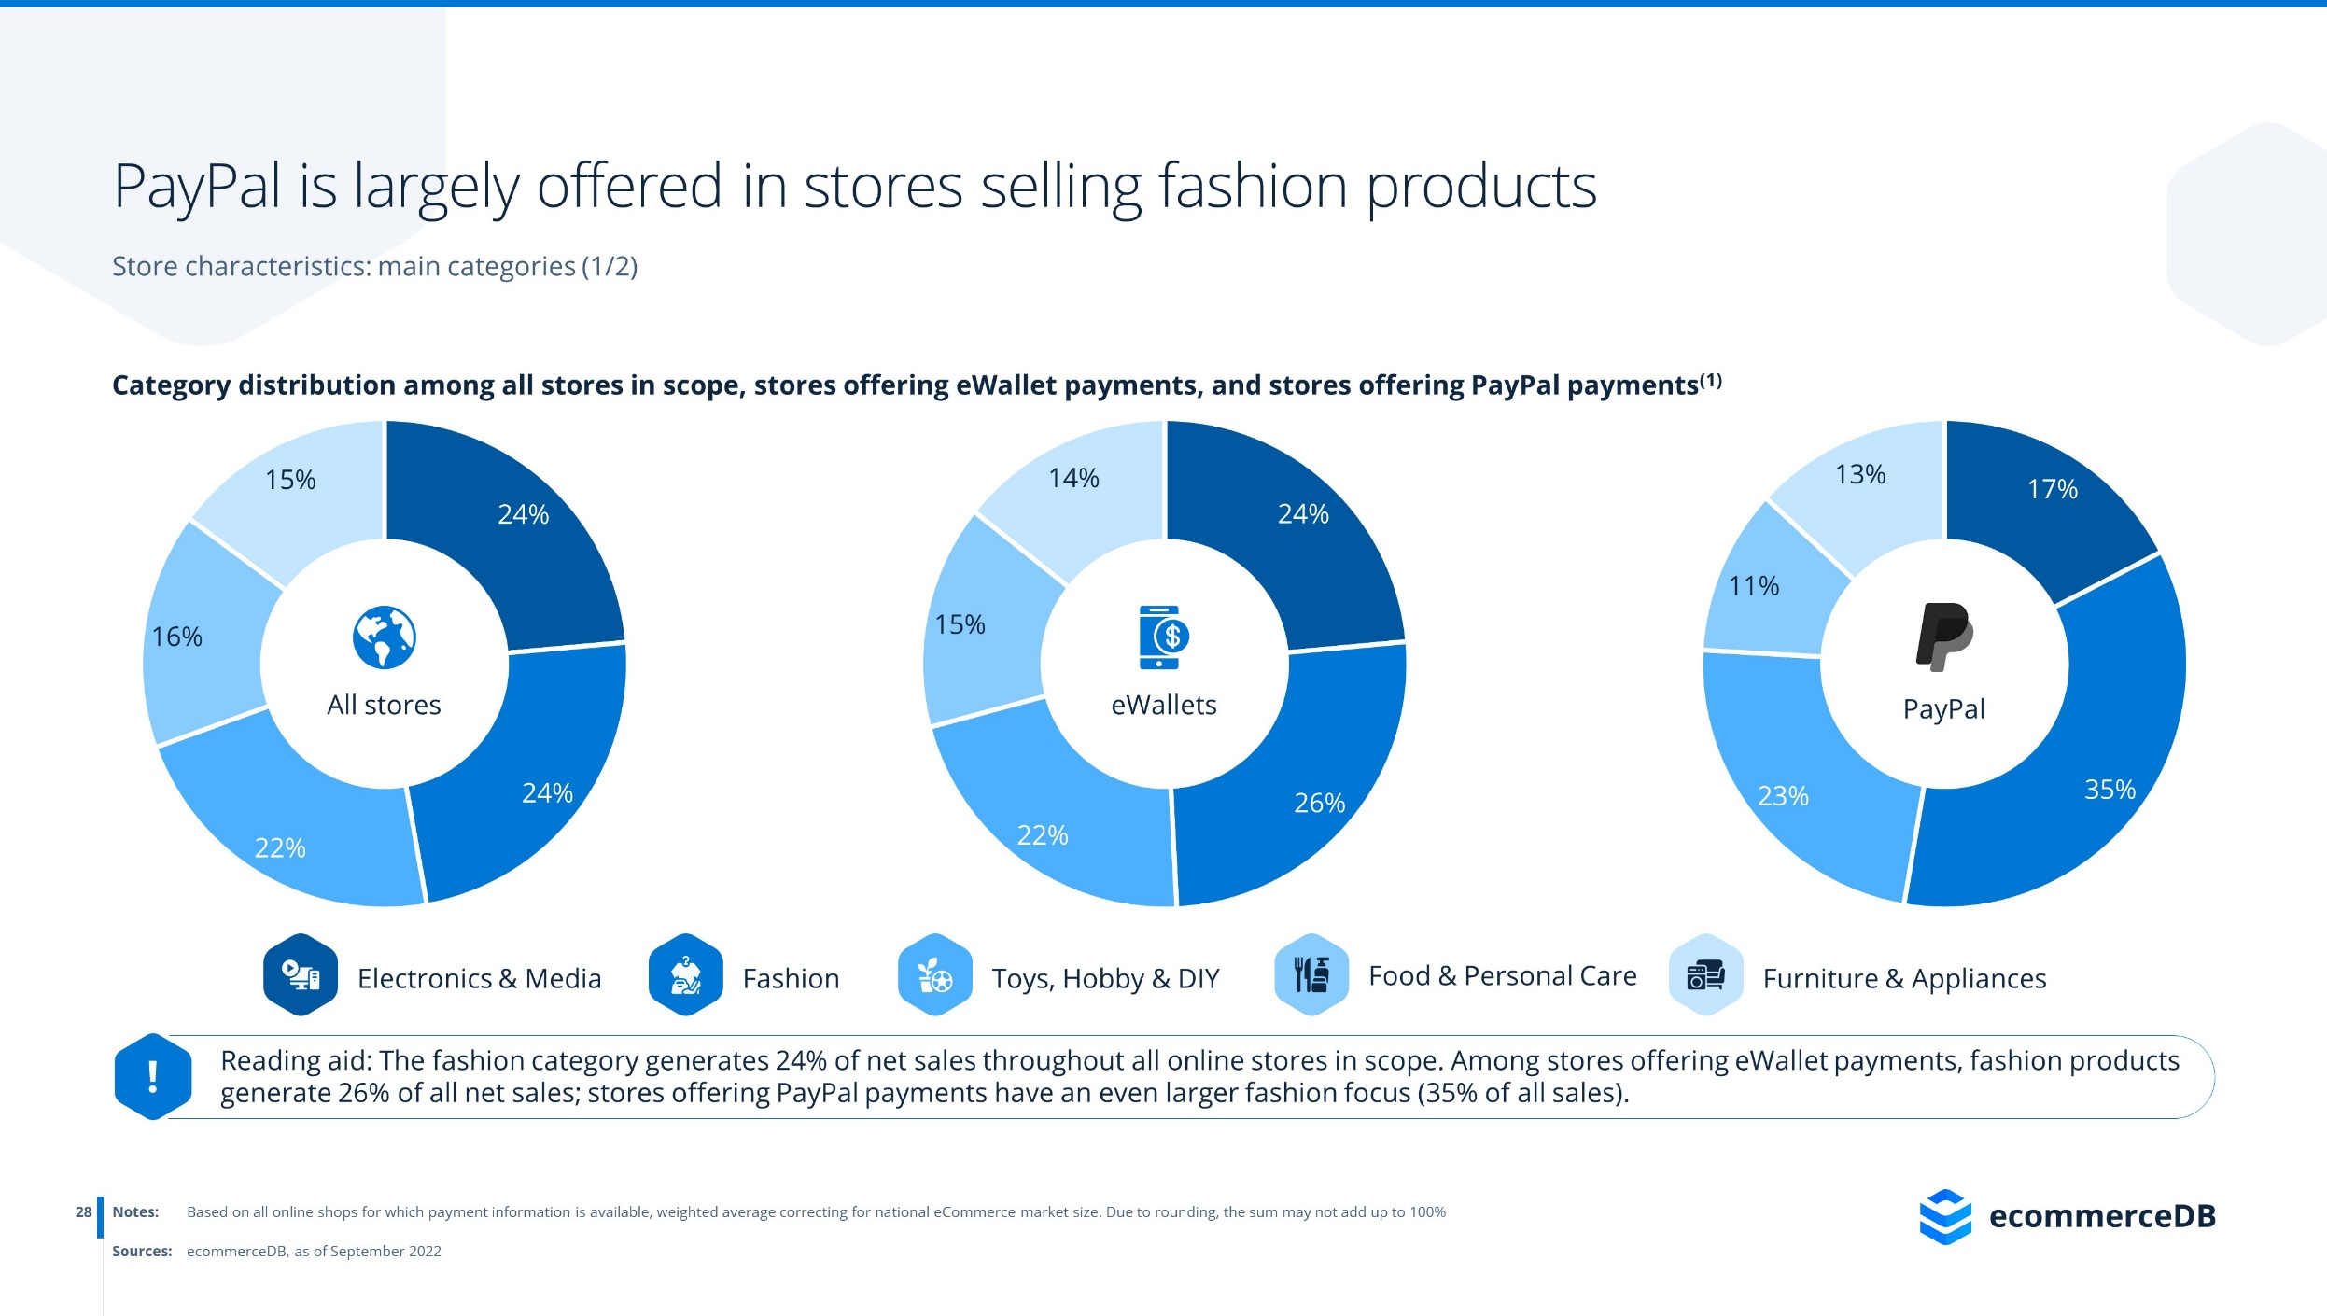
https://ecommercedb.com/reports/ecommerce-payment-provider-paypal/388

Slide 14
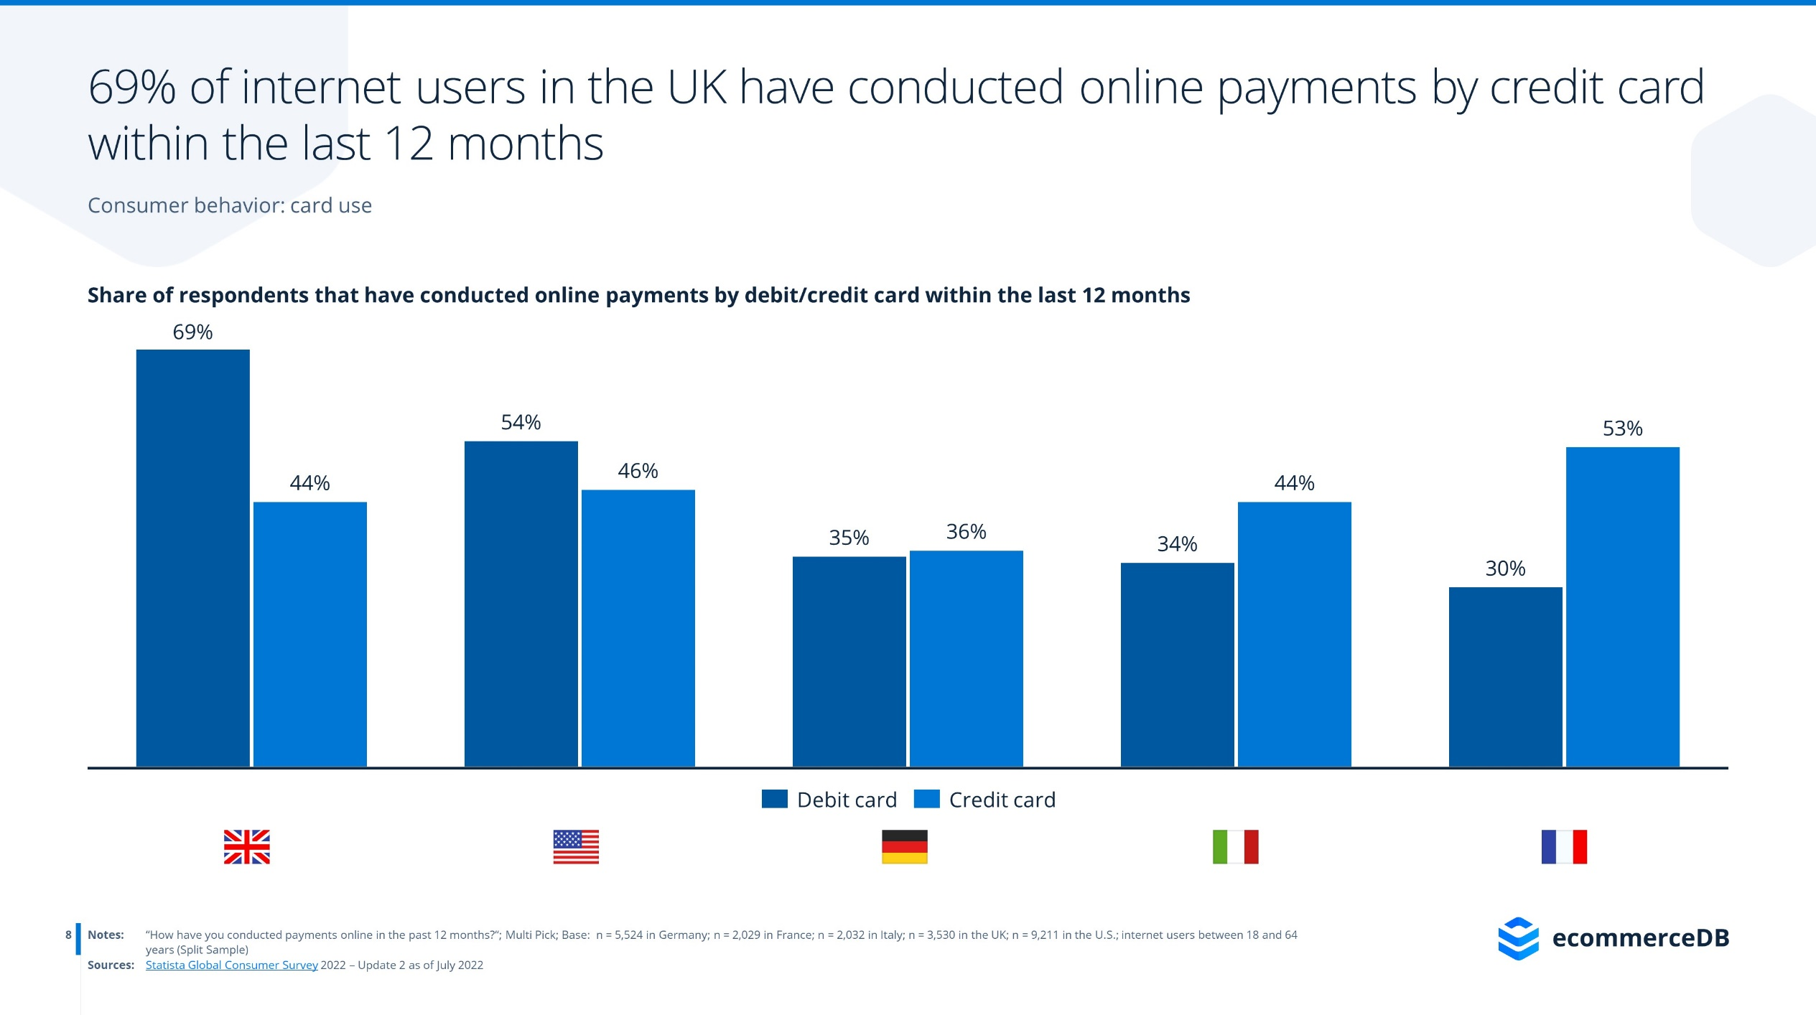
https://ecommercedb.com/reports/ecommerce-payment-provider-visa/389

Slide 15
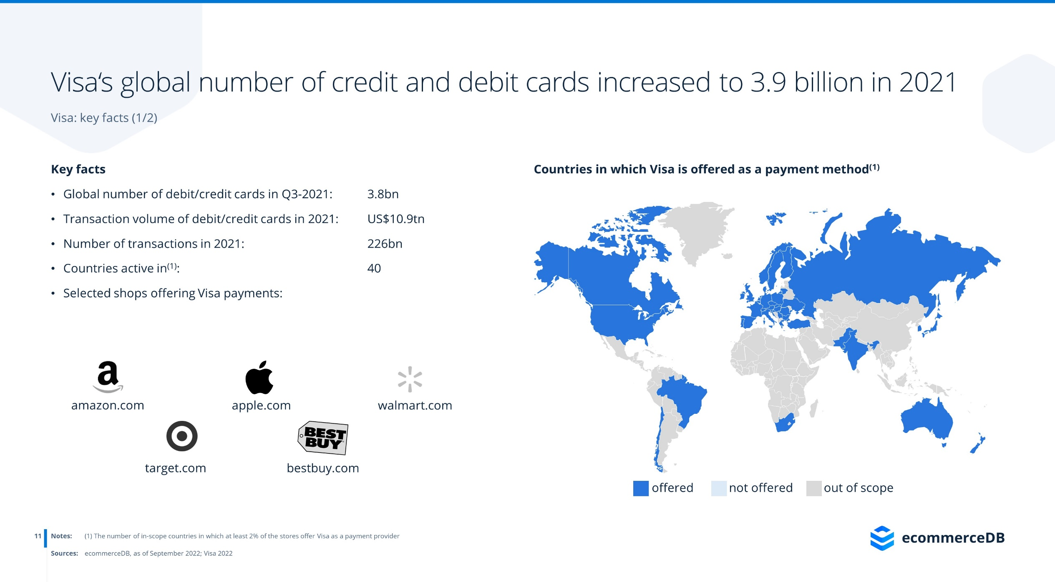
https://ecommercedb.com/reports/ecommerce-payment-provider-visa/389

Slide 16
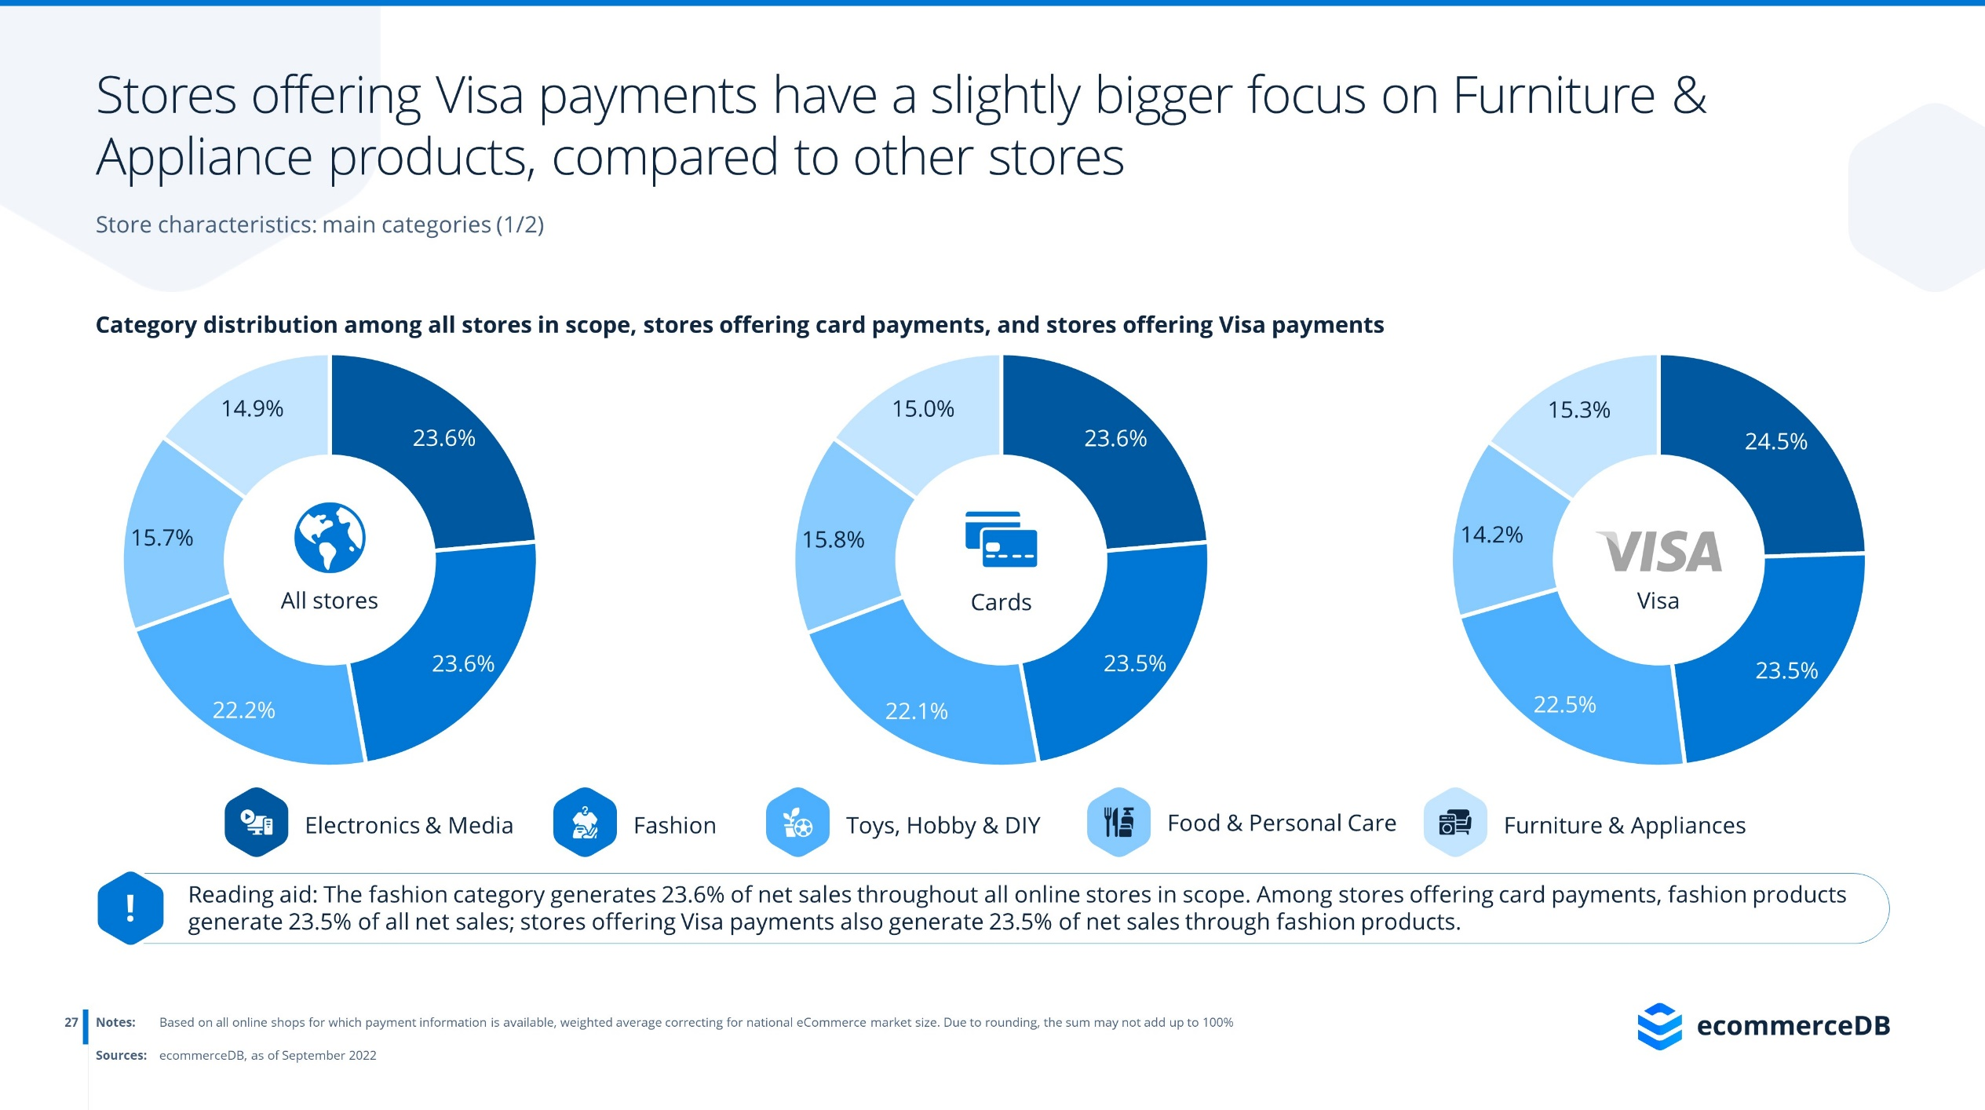
https://ecommercedb.com/reports/ecommerce-payment-provider-visa/389

Slide 17

https://ecommercedb.com/reports/ecommerce-payment-provider-visa/389

Slide 18
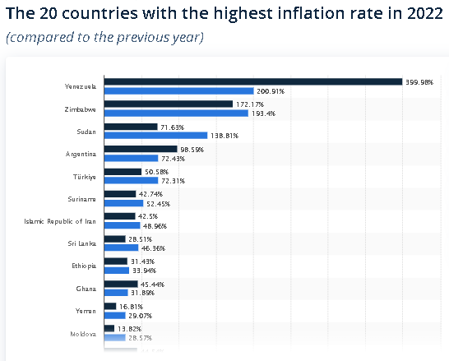
https://www.statista.com/statistics/268225/countries-with-the-highest-inflation-rate/

Slide 19
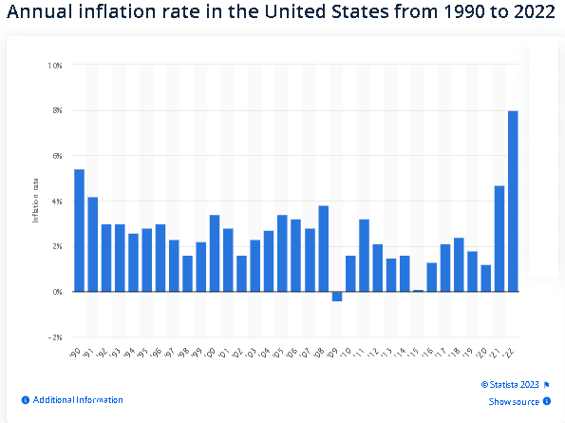
https://www.statista.com/statistics/191077/inflation-rate-in-the-usa-since-1990/

Slide 20
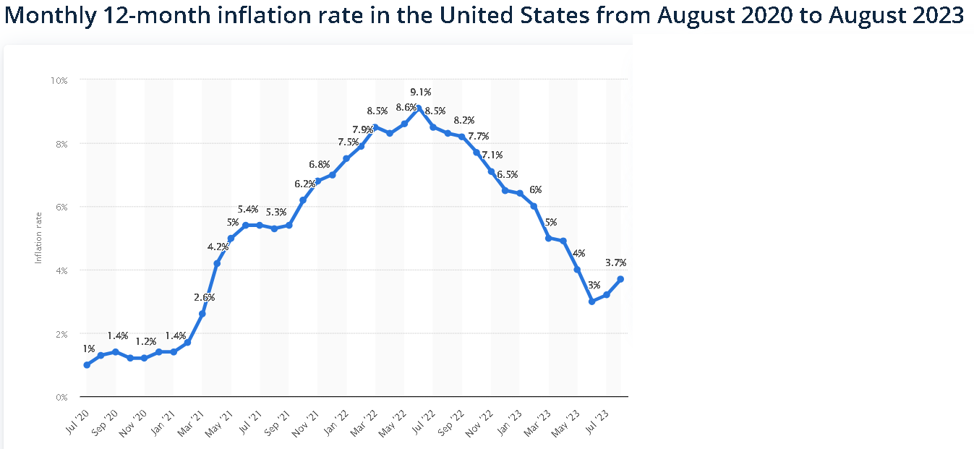
https://www.statista.com/statistics/273418/unadjusted-monthly-inflation-rate-in-the-us/

Slide 21
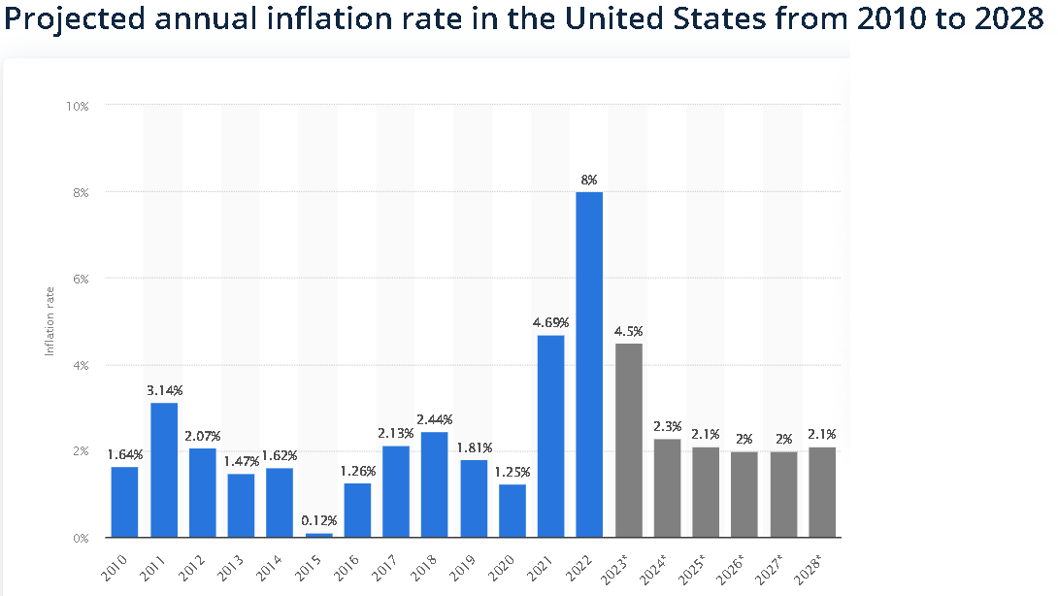
https://www.statista.com/statistics/244983/projected-inflation-rate-in-the-united-states/

Slide 22
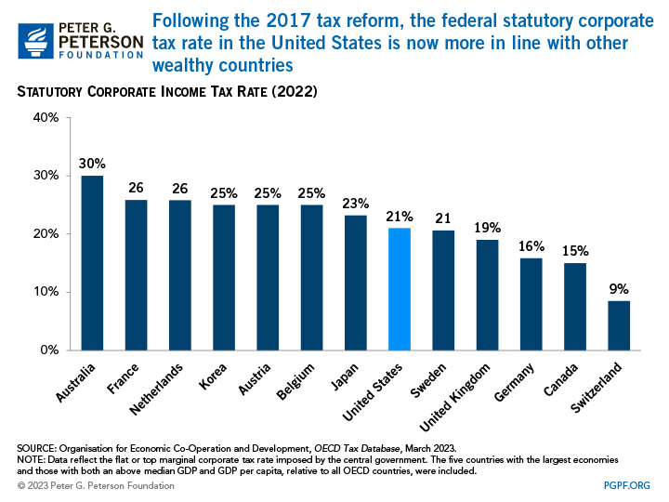
https://www.pgpf.org/blog/2023/04/six-charts-that-show-how-low-corporate-tax-revenues-are-in-the-united-states-right-now?fbclid=IwAR2qr-w1VUVGWE0S3Z_yf6L-Lf1jH0Nd75kiRGc2CF2PGLGxVPgEA1HiDFE
Notes:
Compared to historical trends and other advanced economies, corporate tax revenues in the United States are low. President Biden recently proposed substantial changes to the U.S. corporate income tax system, such as increasing the corporate tax rate, as potential ways to reduce the structural imbalance between spending and revenues. Below are charts that focus specifically the current state of our corporate income tax system, examining and illustrating reasons for the downward trend.
Since the Tax Cuts and Jobs Act (TCJA) was enacted in December 2017, the U.S. corporate tax rate is now more in line with the rates of other advanced economies. The current federal statutory tax rate on corporate income is 21 percent — this does not include the average of corporate taxes imposed at the state and local levels. However, the U.S. tax code has many preferences that affect the rate actually paid by corporations. The effective tax rate, which takes into account those tax provisions, often differs significantly from the statutory rate imposed by law. For example, profitable large corporations paid an average effective federal tax rate of 9 percent in 2018, a decrease from 16 percent in 2014.
Compared to historical trends and other advanced economies, corporate tax revenues in the United States are low. President Biden recently proposed substantial changes to the U.S. corporate income tax system, such as increasing the corporate tax rate, as potential ways to reduce the structural imbalance between spending and revenues. Below are charts that focus specifically the current state of our corporate income tax system, examining and illustrating reasons for the downward trend.
Since the Tax Cuts and Jobs Act (TCJA) was enacted in December 2017, the U.S. corporate tax rate is now more in line with the rates of other advanced economies. The current federal statutory tax rate on corporate income is 21 percent — this does not include the average of corporate taxes imposed at the state and local levels. However, the U.S. tax code has many preferences that affect the rate actually paid by corporations. The effective tax rate, which takes into account those tax provisions, often differs significantly from the statutory rate imposed by law. For example, profitable large corporations paid an average effective federal tax rate of 9 percent in 2018, a decrease from 16 percent in 2014.
Compared to historical trends and other advanced economies, corporate tax revenues in the United States are low. President Biden recently proposed substantial changes to the U.S. corporate income tax system, such as increasing the corporate tax rate, as potential ways to reduce the structural imbalance between spending and revenues. Below are charts that focus specifically the current state of our corporate income tax system, examining and illustrating reasons for the downward trend.
Since the Tax Cuts and Jobs Act (TCJA) was enacted in December 2017, the U.S. corporate tax rate is now more in line with the rates of other advanced economies. The current federal statutory tax rate on corporate income is 21 percent — this does not include the average of corporate taxes imposed at the state and local levels. However, the U.S. tax code has many preferences that affect the rate actually paid by corporations. The effective tax rate, which takes into account those tax provisions, often differs significantly from the statutory rate imposed by law. For example, profitable large corporations paid an average effective federal tax rate of 9 percent in 2018, a decrease from 16 percent in 2014.

Slide 23
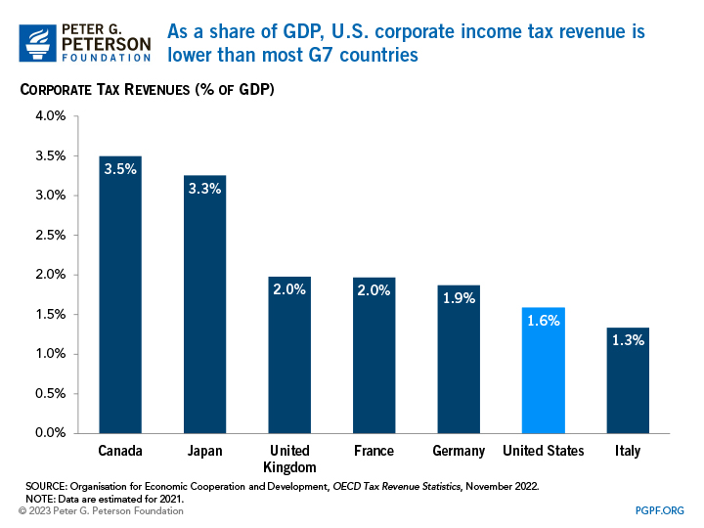
https://www.pgpf.org/blog/2023/04/six-charts-that-show-how-low-corporate-tax-revenues-are-in-the-united-states-right-now?fbclid=IwAR2qr-w1VUVGWE0S3Z_yf6L-Lf1jH0Nd75kiRGc2CF2PGLGxVPgEA1HiDFE
Notes:
Compared to historical trends and other advanced economies, corporate tax revenues in the United States are low. President Biden recently proposed substantial changes to the U.S. corporate income tax system, such as increasing the corporate tax rate, as potential ways to reduce the structural imbalance between spending and revenues. Below are charts that focus specifically the current state of our corporate income tax system, examining and illustrating reasons for the downward trend.
The United States collects fewer revenues from corporations, relative to the size of the economy, than most other advanced countries. In 2021, the latest year for which data is available for international comparison, U.S. corporate tax revenues accounted for just 1.6 percent of gross domestic product (GDP).

Slide 24
https://www.pgpf.org/blog/2023/04/six-charts-that-show-how-low-corporate-tax-revenues-are-in-the-united-states-right-now?fbclid=IwAR2qr-w1VUVGWE0S3Z_yf6L-Lf1jH0Nd75kiRGc2CF2PGLGxVPgEA1HiDFE
Notes:
Compared to historical trends and other advanced economies, corporate tax revenues in the United States are low. President Biden recently proposed substantial changes to the U.S. corporate income tax system, such as increasing the corporate tax rate, as potential ways to reduce the structural imbalance between spending and revenues. Below are charts that focus specifically the current state of our corporate income tax system, examining and illustrating reasons for the downward trend.
After reaching its peak in the late 1960s, the statutory rate of the U.S. federal corporate tax has been on a decline. The current tax rate for corporations is less than half the size it was in the 1950s and 60s.

Slide 25
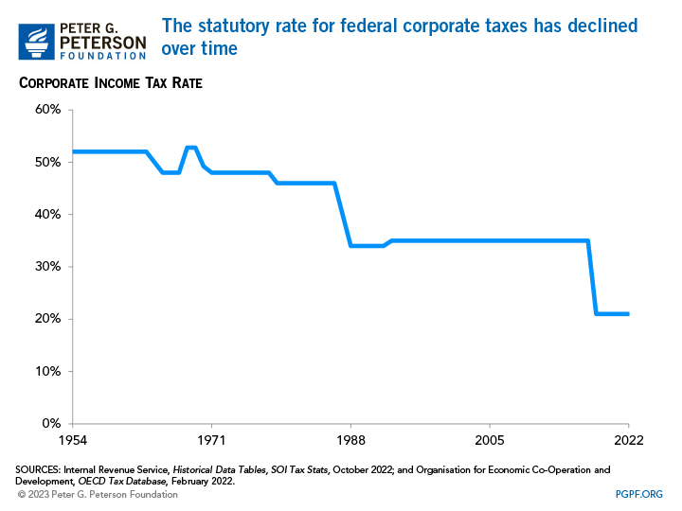
https://www.pgpf.org/blog/2023/04/six-charts-that-show-how-low-corporate-tax-revenues-are-in-the-united-states-right-now?fbclid=IwAR2qr-w1VUVGWE0S3Z_yf6L-Lf1jH0Nd75kiRGc2CF2PGLGxVPgEA1HiDFE
Notes:
Compared to historical trends and other advanced economies, corporate tax revenues in the United States are low. President Biden recently proposed substantial changes to the U.S. corporate income tax system, such as increasing the corporate tax rate, as potential ways to reduce the structural imbalance between spending and revenues. Below are charts that focus specifically the current state of our corporate income tax system, examining and illustrating reasons for the downward trend.
Not all businesses are taxed as corporations. Some businesses, known as pass-through entities, allocate profits to their owners who then pay taxes on those profits through the individual income tax code. In addition, since the enactment of the TCJA, eligible business owners qualify for a tax deduction of up to 20 percent of their qualified business income. Pass-through entities have accounted for an increasing share of net business income over the past few decades.

Slide 26
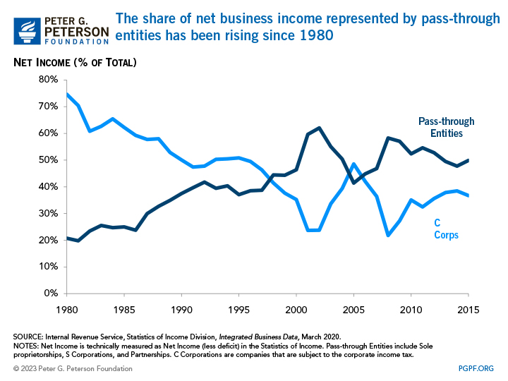
https://www.pgpf.org/blog/2023/04/six-charts-that-show-how-low-corporate-tax-revenues-are-in-the-united-states-right-now?fbclid=IwAR2qr-w1VUVGWE0S3Z_yf6L-Lf1jH0Nd75kiRGc2CF2PGLGxVPgEA1HiDFE
Notes:
Compared to historical trends and other advanced economies, corporate tax revenues in the United States are low. President Biden recently proposed substantial changes to the U.S. corporate income tax system, such as increasing the corporate tax rate, as potential ways to reduce the structural imbalance between spending and revenues. Below are charts that focus specifically the current state of our corporate income tax system, examining and illustrating reasons for the downward trend.
After reaching its peak in the late 1960s, the statutory rate of the U.S. federal corporate tax has been on a decline. The current tax rate for corporations is less than half the size it was in the 1950s and 60s.

Slide 27
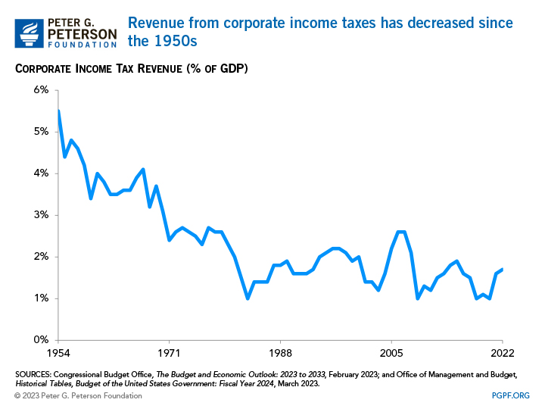
https://www.pgpf.org/blog/2023/04/six-charts-that-show-how-low-corporate-tax-revenues-are-in-the-united-states-right-now?fbclid=IwAR2qr-w1VUVGWE0S3Z_yf6L-Lf1jH0Nd75kiRGc2CF2PGLGxVPgEA1HiDFE
Notes:
Compared to historical trends and other advanced economies, corporate tax revenues in the United States are low. President Biden recently proposed substantial changes to the U.S. corporate income tax system, such as increasing the corporate tax rate, as potential ways to reduce the structural imbalance between spending and revenues. Below are charts that focus specifically the current state of our corporate income tax system, examining and illustrating reasons for the downward trend.
Revenues from corporate taxes have generally been declining as a share of GDP, in part as a result of lower tax rates and the increase in the prevalence of pass-through businesses.
entities mentioned above.

Slide 28
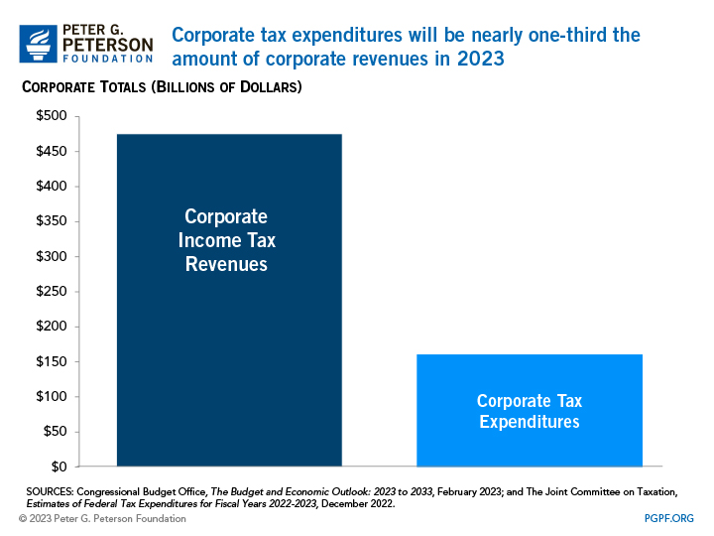
https://www.pgpf.org/blog/2023/04/six-charts-that-show-how-low-corporate-tax-revenues-are-in-the-united-states-right-now?fbclid=IwAR2qr-w1VUVGWE0S3Z_yf6L-Lf1jH0Nd75kiRGc2CF2PGLGxVPgEA1HiDFE
Notes:
Compared to historical trends and other advanced economies, corporate tax revenues in the United States are low. President Biden recently proposed substantial changes to the U.S. corporate income tax system, such as increasing the corporate tax rate, as potential ways to reduce the structural imbalance between spending and revenues. Below are charts that focus specifically the current state of our corporate income tax system, examining and illustrating reasons for the downward trend.
The United States will forgo $161 billion of revenues in 2023 as a result of tax expenditures, or special tax code provisions, for corporations. Those tax expenditures include reduced tax rates for income from a corporation’s foreign subsidiaries, as well as the tax deduction for pass-through entities mentioned above.

Slide 29
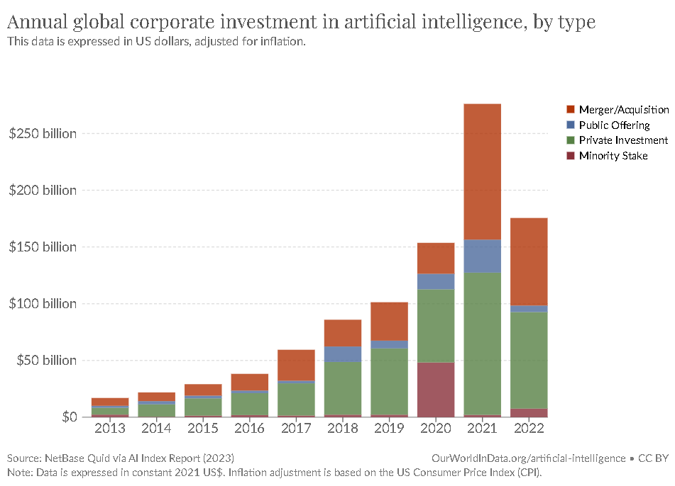
https://ourworldindata.org/artificial-intelligence?fbclid=IwAR09fwU6mI9MwxRXQKtVzA0X2SnfnHMyPqkcKGJeH-pqn23iuXxGovuhFGI

Slide 30
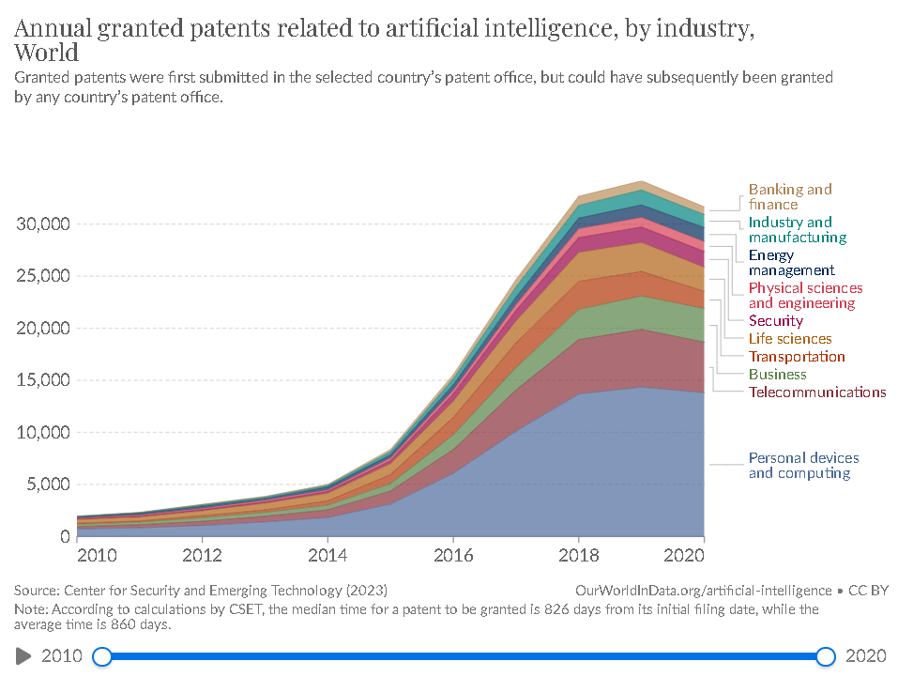
https://ourworldindata.org/artificial-intelligence?fbclid=IwAR09fwU6mI9MwxRXQKtVzA0X2SnfnHMyPqkcKGJeH-pqn23iuXxGovuhFGI

Slide 31
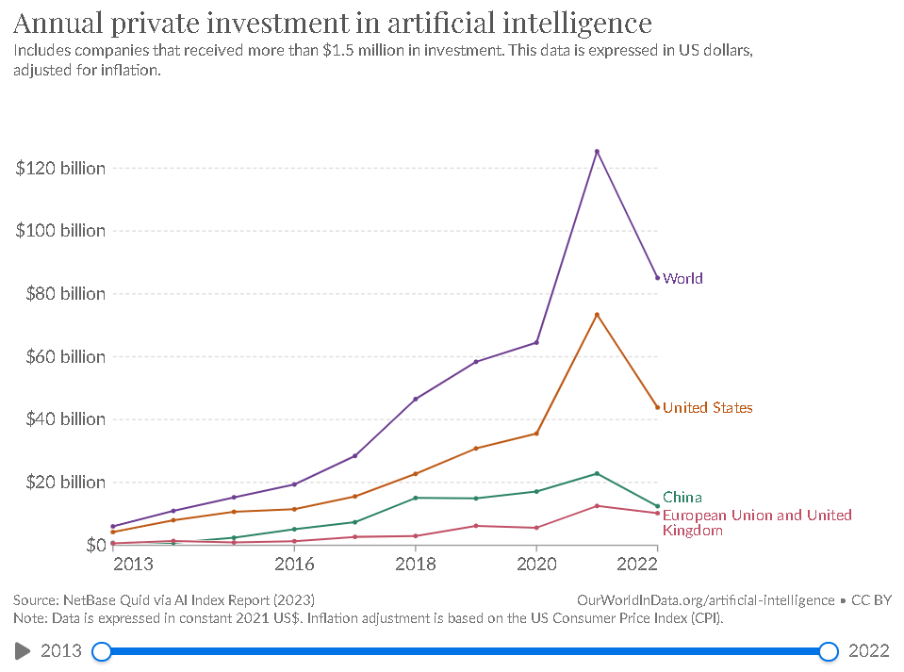
https://ourworldindata.org/artificial-intelligence?fbclid=IwAR09fwU6mI9MwxRXQKtVzA0X2SnfnHMyPqkcKGJeH-pqn23iuXxGovuhFGI

Slide 32
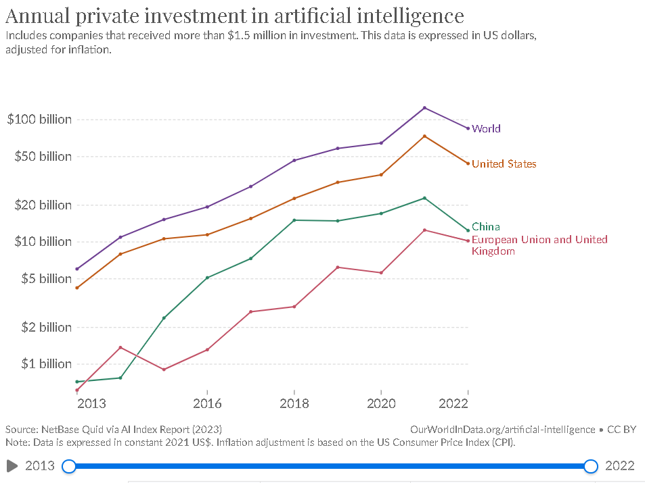
https://ourworldindata.org/artificial-intelligence?fbclid=IwAR09fwU6mI9MwxRXQKtVzA0X2SnfnHMyPqkcKGJeH-pqn23iuXxGovuhFGI

Slide 33
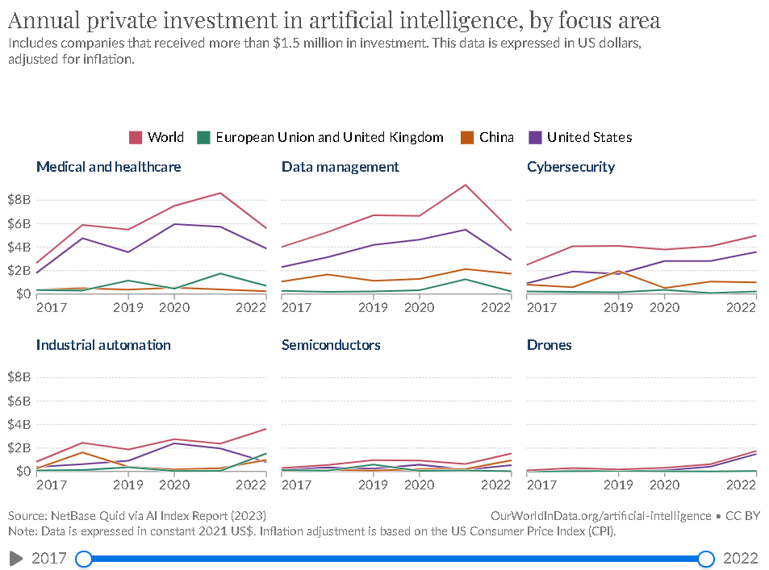
https://ourworldindata.org/artificial-intelligence?fbclid=IwAR09fwU6mI9MwxRXQKtVzA0X2SnfnHMyPqkcKGJeH-pqn23iuXxGovuhFGI

Slide 34
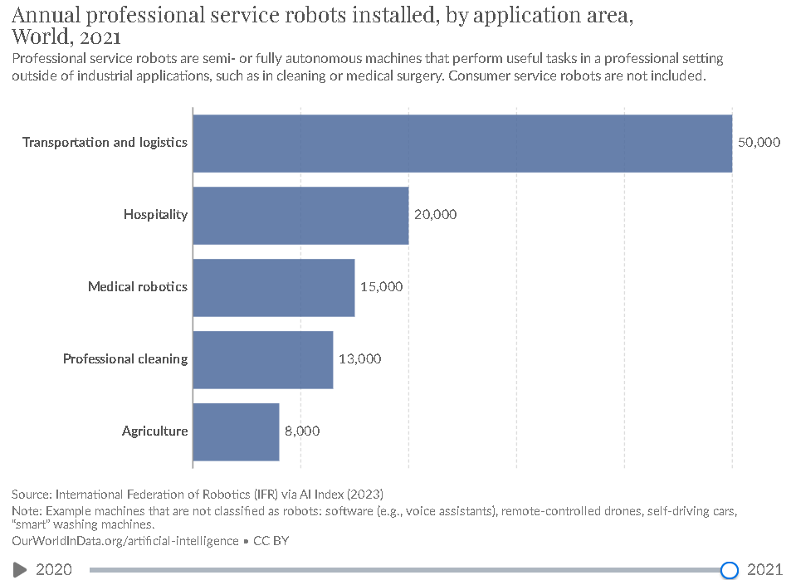
https://ourworldindata.org/artificial-intelligence?fbclid=IwAR09fwU6mI9MwxRXQKtVzA0X2SnfnHMyPqkcKGJeH-pqn23iuXxGovuhFGI

Slide 35
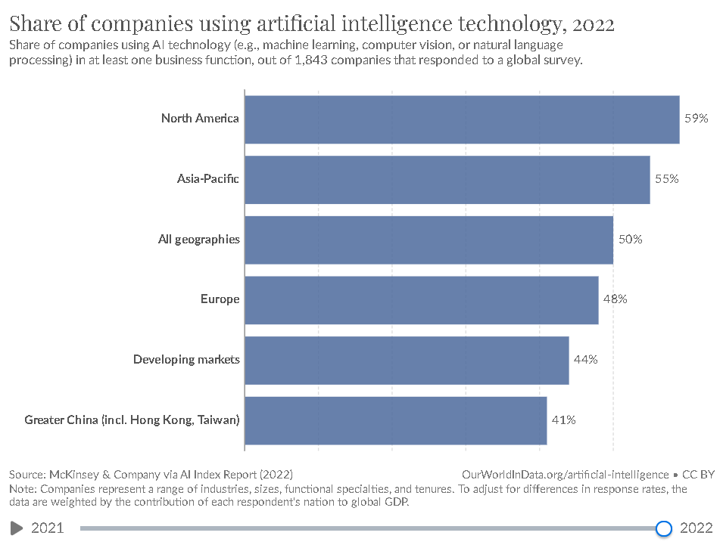
https://ourworldindata.org/artificial-intelligence?fbclid=IwAR09fwU6mI9MwxRXQKtVzA0X2SnfnHMyPqkcKGJeH-pqn23iuXxGovuhFGI

Slide 36
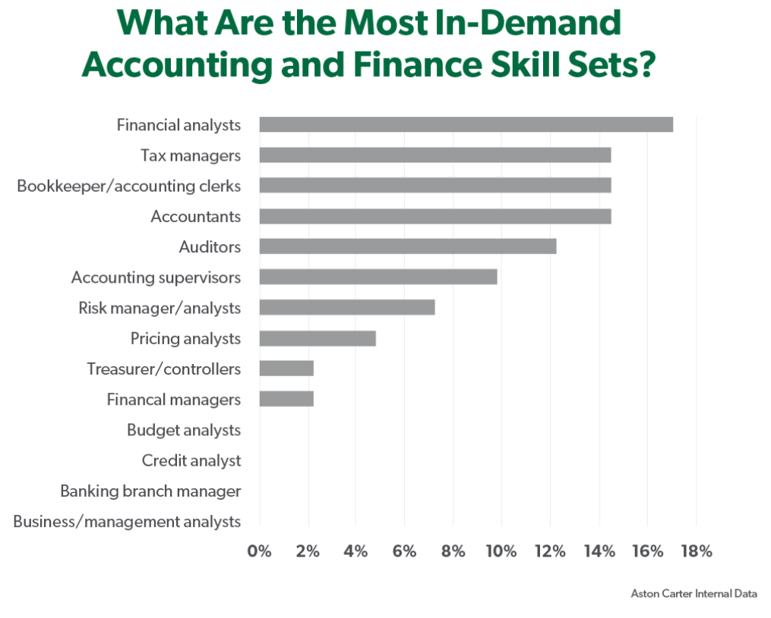
https://www.astoncarter.com/en/insights/articles/top-accounting-and-finance-hiring-trends-in-2023?fbclid=IwAR1okObjxtmHQCCz8pfhuR8cZKTbPLSzz0Lsg9jYYJhXeuF_lRCi6WbF8ug

Slide 37
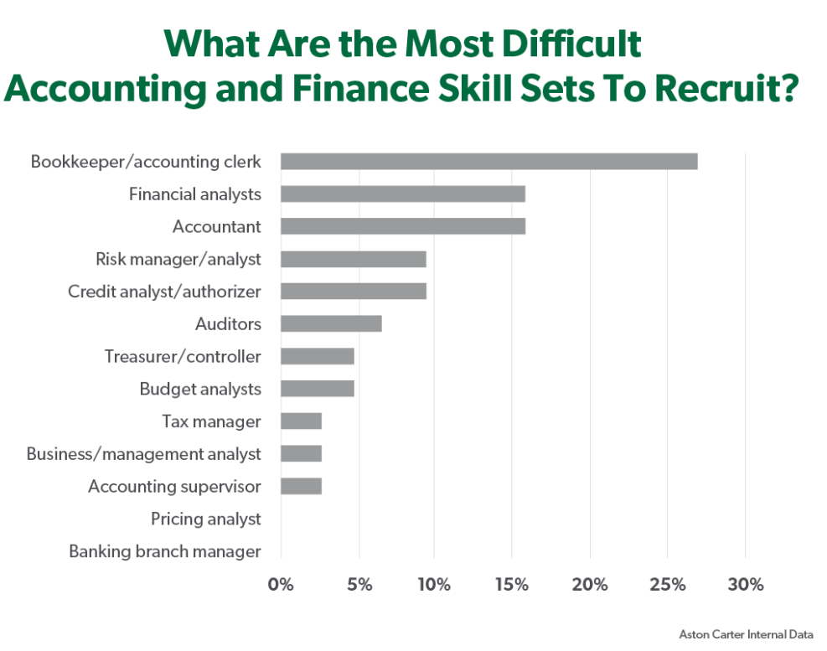
https://www.astoncarter.com/en/insights/articles/top-accounting-and-finance-hiring-trends-in-2023?fbclid=IwAR1okObjxtmHQCCz8pfhuR8cZKTbPLSzz0Lsg9jYYJhXeuF_lRCi6WbF8ug

