Slide 1
The Art of MarkPoint
Nejiwwkr

Slide 2
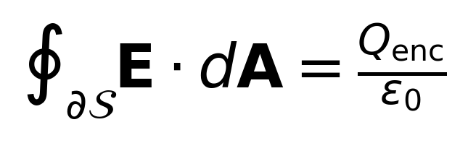
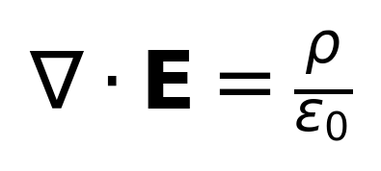
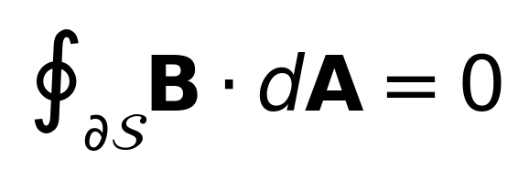
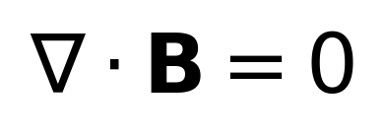
The Maxwell's Equations
Gauss's Law for Electric Fields
Integral Form:
Differential Form:
Gauss's Law for Magnetic Fields
Integral Form:
Differential Form:

Slide 3
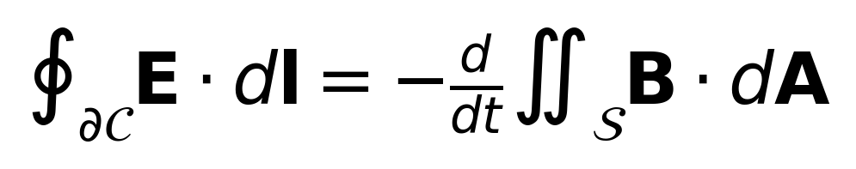
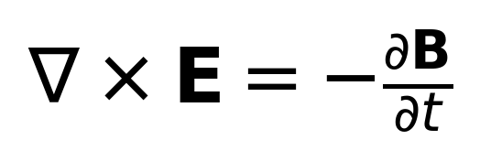
The Maxwell's Equations
Faraday's Law of Induction
Integral Form:
Differential Form:

Slide 4
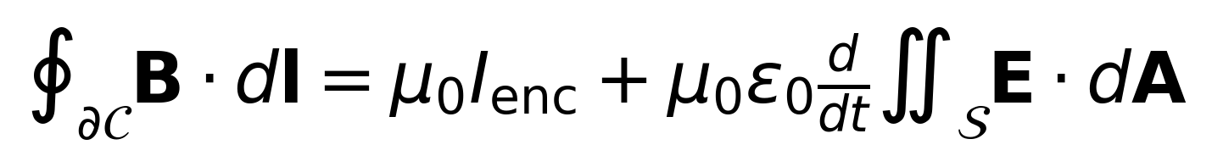
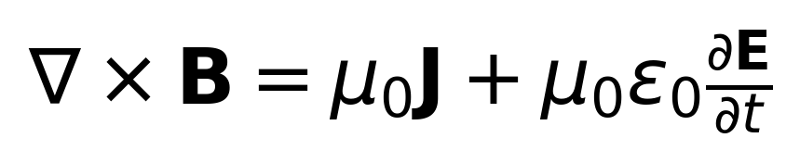
The Maxwell's Equations
Here's the start of the page, feel free to use !!! In the content.
Ampère's Law with Maxwell's Addition
Integral Form:
Differential Form:
These equations form the foundation of classical electromagnetism, unify the behavior of electric and magnetic fields, and predict the existence of electromagnetic waves.
line break here
Bold italic and bold is fine. And flat styles are fine

Slide 5
Empty page

Slide 6
Thanks for reading.
Rendered by MarkPoint.

