Slide 1
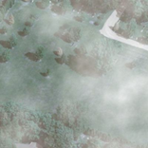
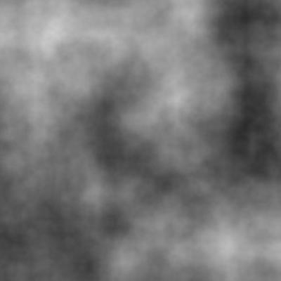
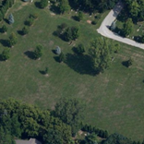




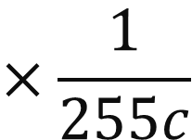
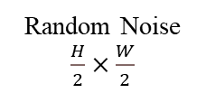










$$U_{p}^{2}∈ℝ^{H×W}$$
Resize
$$U_{p}^{1}∈ℝ^{H×W}$$
$$⊕$$
$$Q_{p}^{1}$$
Random Select Noise
Resize
$$Q_{p}^{2}$$
Random Noise $\frac{H}{2}×\frac{W}{2}$
$$U_{p}^{2}∈ℝ^{H×W}$$
$$U_{p}^{1}∈ℝ^{H×W}$$
$$⊕$$
$$Q_{p}^{s}$$
Resize
$$⊕$$
Final Image
$$I_{c}∈ℝ^{H×W}$$
$$U_{p}^{s}∈ℝ^{H×W}$$
$$U_{p}^{s}∈ℝ^{H×W}$$
(
)
$$×\frac{1}{255c}$$
⊙
White Image
$$W∈ℝ^{H×W}$$
Generated Cloud $T∈ℝ^{H×W}$
Original Image
$$I∈ℝ^{H×W}$$
Foreground Image
$$F∈ℝ^{H×W}$$

