Slide 1
CAPSTONE PROJECT
DATA SCIENCE PROJECT
Presented By:
1. Sri Nekha Velam V - AC Tech-Apparel technology

Slide 2
OUTLINE
Problem Statement
Proposed System/Solution
System Development Approach
Algorithm & Deployment
Result
Conclusion
Future Scope
References

Slide 3
PROBLEM STATEMENT
Python Program for Railway Reservation System

Slide 4
PROPOSED SOLUTION
To develop a Python program for railway ticket booking, you'll need to design and implement a system that handles various aspects such as train schedules, seat availability, user authentication, booking transactions, and more. Below are proposed solutions covering key functionalities and considerations for building a railway ticket booking program in Python:
1.⁠ ⁠Object-Oriented Design (OOD) Solution:
Use classes and objects to model entities like Train, Ticket, User, and Booking. This facilitates a structured approach to representing railway system components.
2.⁠ ⁠User Authentication and Management:
Solution: Implement user authentication functionalities to allow users to create accounts, log in, and manage their profiles.

Slide 5
3.⁠ ⁠Train and Seat Management Solution:
Manage train schedules, seat availability, and bookings within the booking system.
4.⁠ ⁠Booking Transactions:
Solution: Implement logic to handle booking transactions, including seat reservations and ticket issuance.
5.⁠ ⁠Data Persistence and Storage:
Solution: Implement data storage using file handling or databases (e.g., SQLite, PostgreSQL) to persist train schedules, user information, and booking records.

Slide 6
SYSTEM APPROACH
1. User Interface:
Frontend Interface: Users interact with the system through a graphical user interface (GUI) or command-line interface (CLI).
Input Validation: Validate user inputs to ensure correctness and prevent invalid data entry.
2. Data Management:
Trains Data:
Maintain a database or data structure to store information about trains, including train number, name, available seats, departure time, and possibly other attributes like class, fare, etc.
Store this data in a format that allows for efficient retrieval and modification.
Bookings Data:
Store information about bookings, including booking ID, train number, number of seats booked, and passenger details (name, age, contact).
Each booking should be linked to a specific train and have a unique identifier.

Slide 7
Functionalities:
Display Available Trains:
Retrieve information about available trains and display them to the user.
Include details like train number, name, available seats, departure time, etc.
Book Tickets:
Allow users to book tickets for a selected train.
Collect necessary details like train number, number of seats, passenger information.
Update the available seats for the selected train after booking.
Cancel Tickets:
Enable users to cancel their booked tickets by providing the booking ID.
Update the available seats for the respective train after cancellation.
View Booking Details:
Allow users to view details of their booked tickets by providing the booking ID.
Display booking details including train number, number of seats booked, passenger details, etc.

Slide 8
4. Business Logic:​
Validation:​
Validate user inputs to ensure they are within acceptable ranges and formats.​
Check for seat availability before booking.​
Handle edge cases and error conditions gracefully.​
Concurrency Control:​
Implement measures to handle concurrent access to the same data, preventing race conditions and ensuring data integrity.​
Use locks or other synchronization mechanisms if necessary.
5. Security:
User Authentication:
Implement user authentication to ensure only authorized users can access certain functionalities (e.g., booking, cancellation).
Protect sensitive data like user passwords using encryption.
Data Privacy:
Ensure that passenger details are stored securely and access is restricted to authorized personnel only.

Slide 9
6. Administration:​
Admin Interface:​
Provide an interface for administrators to manage trains, bookings, and user accounts.​
Allow admins to add/remove trains, modify seat availability, view booking history, etc.
7. Error Handling and Logging:
Error Handling:
Handle errors gracefully and provide informative error messages to users.
Log errors and exceptions for debugging and monitoring purposes.

Slide 10
ALGORITHM & DEPLOYMENT
Algorithm:
1. Initialization:
Initialize the RailwayReservationSystem class.
Initialize train data and booking data (either from a file/database or hardcoded).
2. Display Menu:
Display a menu with options: Display Trains, Book Ticket, Cancel Ticket, View Booking Details, and Exit.
3. Display Trains:
Iterate through the train data and display train details (train number, name, departure time, and available seats).

Slide 11
4. Book Ticket:​
Prompt the user to enter the train number, number of seats, and passenger details.​
Check if the train exists and if there are enough available seats.​
If valid, decrement the available seats, generate a booking ID, and store booking details.​
Display a success message with the booking ID.
5. Cancel Ticket:
Prompt the user to enter the booking ID to cancel.
Check if the booking ID exists.
If valid, increment the available seats, remove the booking from the booking data.
Display a success message.

Slide 12
6. View Booking Details:
Prompt the user to enter the booking ID.
Display the details of the booking if the ID exists.
7. Exit:
Exit the program.

Slide 13
Deployment:
1. Local Deployment:
Run Locally: Run the Python program on a local machine.
Installation: Ensure Python is installed. Execute the program in a Python IDE or command line.
Advantages: Simple setup, suitable for development and testing.
Disadvantages: Not accessible remotely, requires installation on each machine.
2. Web Application:
Web Framework: Use Python web frameworks like Flask or Django.
Deployment Platform: Deploy the web application on platforms like Heroku, AWS, or DigitalOcean.
Advantages: Accessible from any device with an internet connection, scalable, and easier maintenance.
Disadvantages: More complex setup, requires web development skills.

Slide 14
3. Cloud Deployment:
Serverless Computing: Utilize serverless platforms like AWS Lambda or Google Cloud Functions.
Containerization: Use Docker containers and deploy on container orchestration platforms like Kubernetes.
Advantages: Scalable, cost-effective, and managed infrastructure.
Disadvantages: Learning curve for setting up serverless or containerized environments.
4. Desktop Application:
GUI Framework: Use Python GUI frameworks like Tkinter, PyQt, or wxPython.
Deployment: Package the application using tools like PyInstaller or cx_Freeze.
Advantages: No need for internet connection, easy distribution.
Disadvantages: Platform-dependent, less accessible than web applications.

Slide 15
5. Mobile Application:
Cross-platform Frameworks: Use frameworks like Kivy or BeeWare to develop mobile applications using Python.
Deployment: Publish the application on app stores (e.g., Google Play Store, Apple App Store).
Advantages: Accessible on mobile devices, wider audience reach.
Disadvantages: Limited availability of cross-platform frameworks, performance considerations.

Slide 16
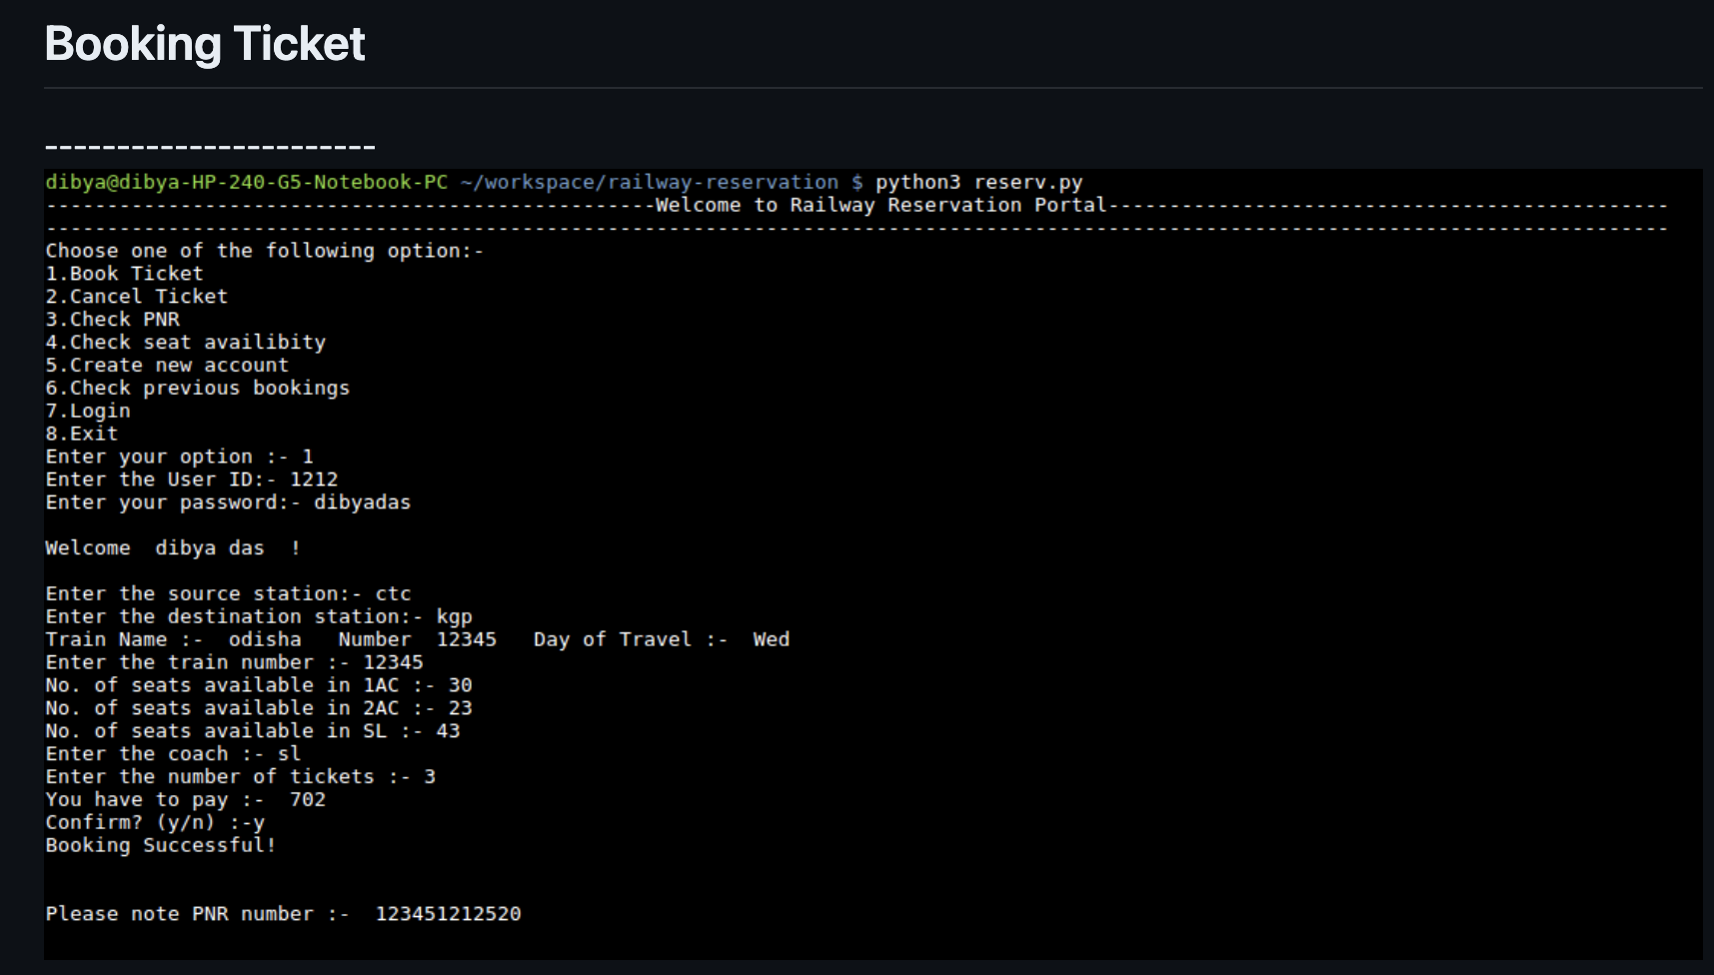
RESULT

Slide 17
CONCLUSION
The Railway Reservation System is a crucial system that facilitates the booking and management of train tickets. In this system, we have designed a Python program to handle basic functionalities like booking tickets, canceling tickets, and viewing train details.
Key Points:
Functionality:
Users can view available trains, book tickets for a specific train, cancel booked tickets, and view booking details.
Data Management:
Train data and booking data are stored using dictionaries and lists.
User Interface:
The system provides a simple menu-driven interface for users to interact with.

Slide 18
4. Error Handling:
Input validation and error messages are provided to ensure smooth user experience.
5. System Design:
The system is designed with clear components: user interface, data management, functionality, error handling, and control flow.
6. Optional Features:
The system can be extended with features like user authentication, admin interface, and data persistence.

Slide 19
FUTURE SCOPE
Mobile Ticketing and NFC Technology: Mobile ticketing will become even more prevalent, allowing passengers to book tickets, check schedules, and board trains using their smartphones. Near Field Communication (NFC) technology will enable passengers to simply tap their phones to access gates and board trains without physical tickets.
AI-Powered Customer Service: AI chatbots and virtual assistants will handle customer queries, assisting passengers with booking tickets, checking train statuses, and providing information about routes and schedules. These systems will become more sophisticated, providing personalized recommendations based on user preferences and historical data.
Dynamic Pricing and Revenue Management: Railway systems will implement dynamic pricing strategies similar to airlines, where ticket prices fluctuate based on demand, time of booking, and other factors. This will optimize revenue for railways and provide passengers with more options to choose from.

Slide 20
4. Predictive Maintenance: Railway companies will utilize IoT sensors and predictive analytics to monitor the condition of trains and tracks in real-time. This proactive approach to maintenance will reduce the chances of breakdowns and delays, ensuring smoother operations.
5. Biometric Identification and Security: Biometric identification methods such as facial recognition and fingerprint scanning will be integrated into reservation systems for ticketing and security purposes. This will enhance passenger convenience and improve security measures.
6. Integration with Public Transport: Railway reservation systems will be integrated with other modes of public transportation, such as buses and metros, to provide seamless multi-modal journeys. Passengers will be able to book a complete journey across different modes of transport through a single platform.
7. Augmented Reality (AR) for Navigation: AR technology will be used to provide passengers with real-time information and navigation assistance within railway stations. AR apps on smartphones or AR glasses can guide passengers to their platforms, exits, or amenities within the station.

Slide 21
8. Green Initiatives and Sustainability: Railway systems will focus on reducing their carbon footprint by adopting eco-friendly practices. This may include the introduction of electric trains, solar-powered stations, and waste management systems to make railways more sustainable.
9. Enhanced Accessibility: Railway reservation systems will prioritize accessibility for passengers with disabilities. This includes features such as wheelchair-accessible booking options, tactile navigation aids, and audio announcements for visually impaired passengers.
10. Blockchain for Ticketing and Security: Blockchain technology will be used to enhance the security and transparency of ticketing processes. Smart contracts can ensure secure transactions, prevent fraud, and streamline ticketing operations.

Slide 22
THANK YOU

