Slide 1
StudyPulse
Student Academic Risk Early-Warning System
IBM SkillsBuild Applied AI/ML Virtual Internship | SDG 4: Quality Education
Neknarayan | UIT-RGPV

Slide 2
Problem Statement
• Struggling students are usually noticed only after exam results - too late to help.
• Teachers cannot manually track attendance, assignments and study habits for every student.
• Result: preventable failures and dropouts, working against SDG 4.

Slide 3
Proposed Solution
• Estimate each student's probability of failing from routine academic indicators.
• Group students into High / Medium / Low risk and rank them for teachers.
• Explain WHY each student is flagged and suggest a support action.
• What-if predictor to test the effect of better attendance or study time.

Slide 4
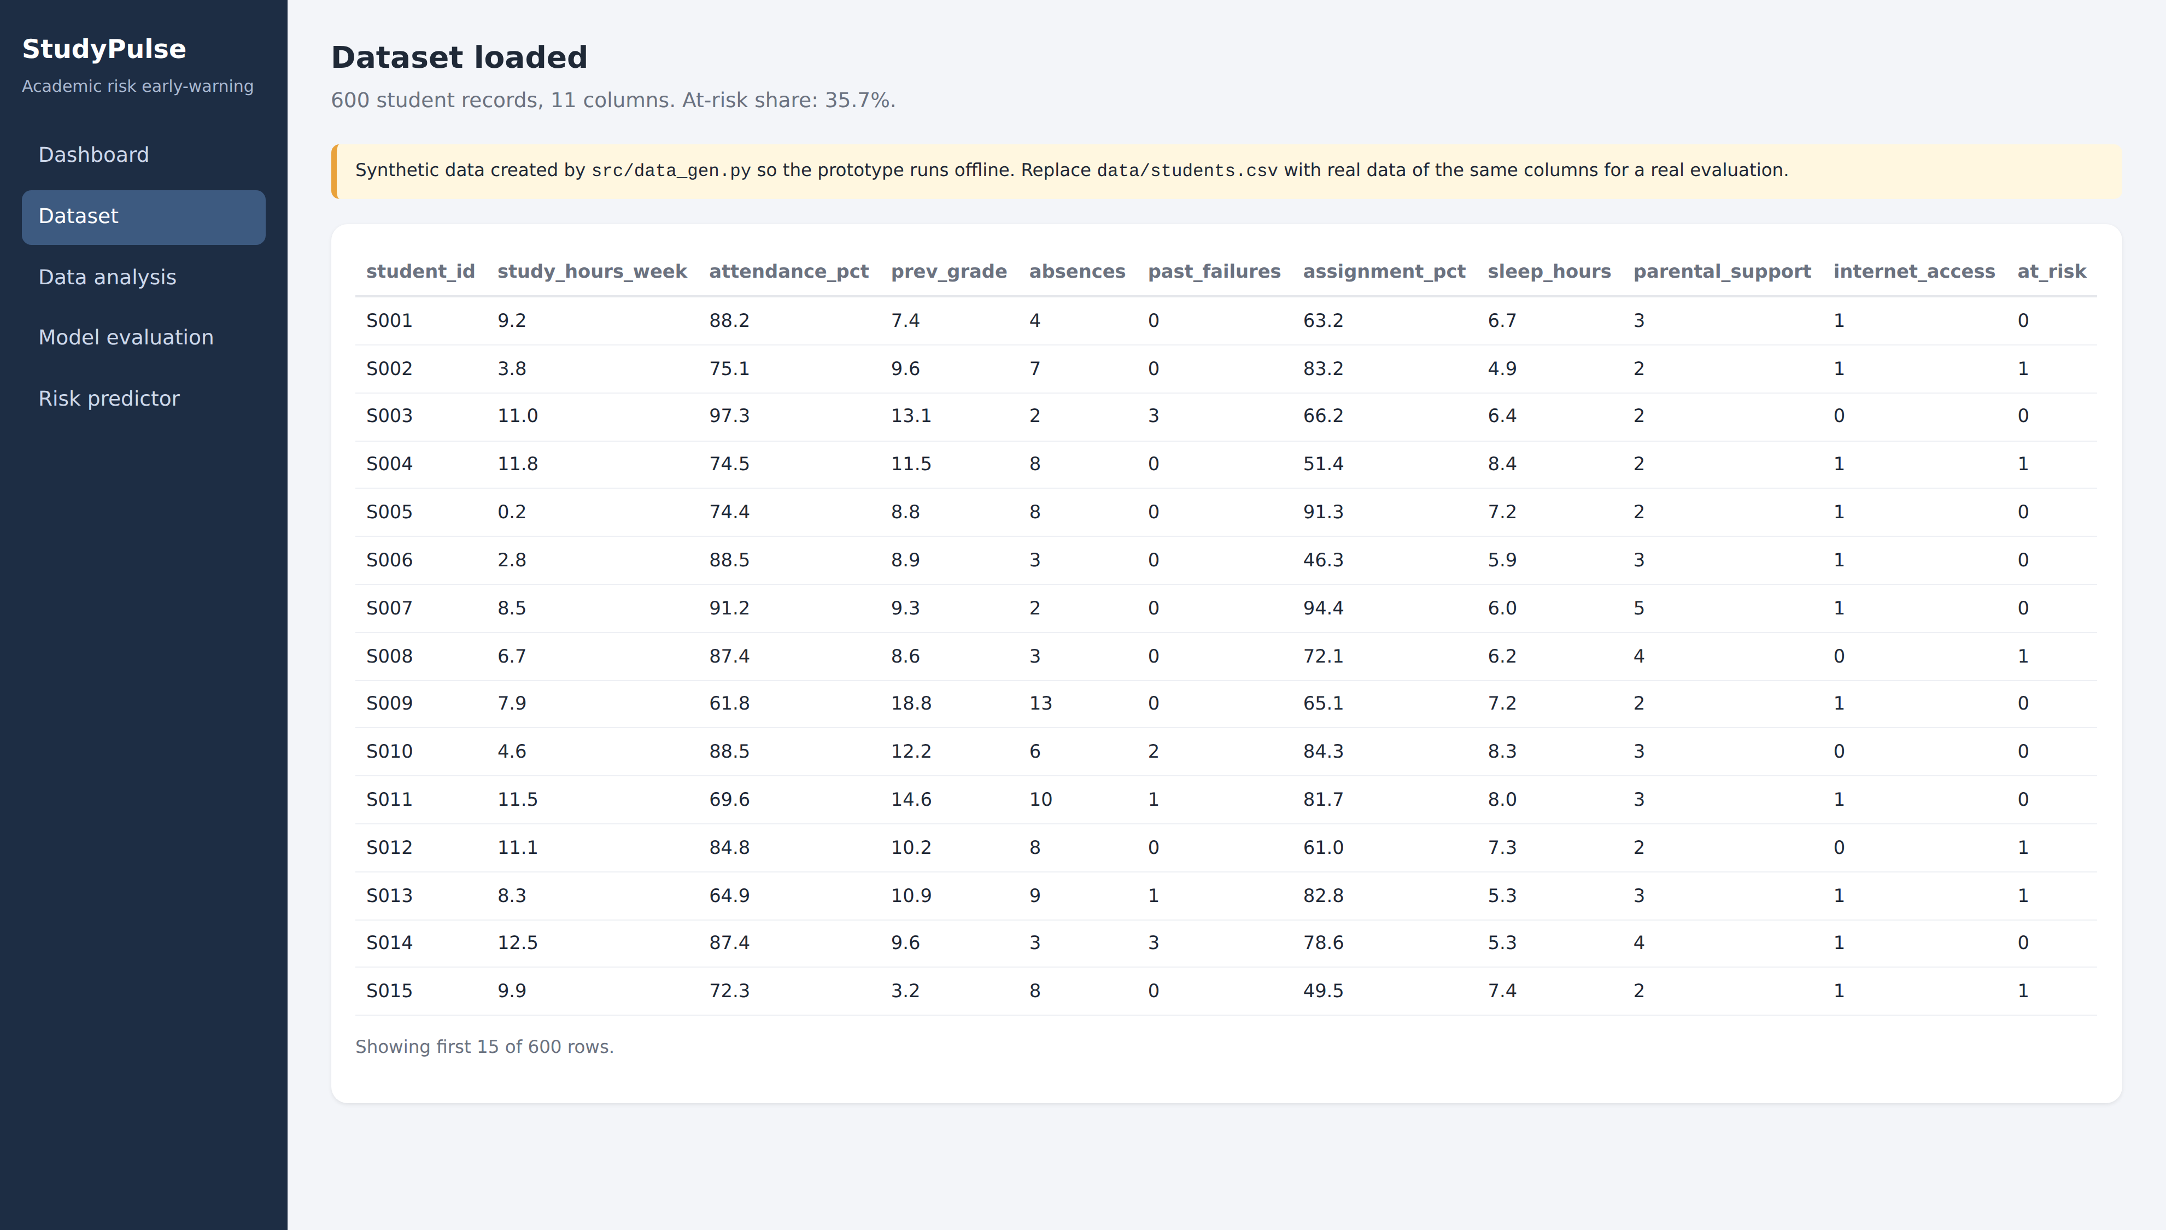
Data
• 9 features: study hours, attendance, previous grade, absences, past failures, assignments, sleep, parental support, internet access.
• Target: at-risk (will fail) yes / no.
• Prototype uses a synthetic dataset of 600 students - no real student data.
• Pipeline accepts any real dataset with the same columns.

Slide 5
Technology Stack
• Python, Pandas, NumPy
• scikit-learn: Logistic Regression, Random Forest
• Matplotlib for charts
• Flask + HTML/CSS for the web app
• GitHub for version control

Slide 6
Methodology
• Stratified 80/20 split: 480 train / 120 test.
• Standardise features; train Logistic Regression and Random Forest.
• Evaluate: accuracy, precision, recall, F1, ROC-AUC, 5-fold CV.
• Deploy Logistic Regression - explainable and higher recall.
• Explain: coefficient x standardised value per student.

Slide 7
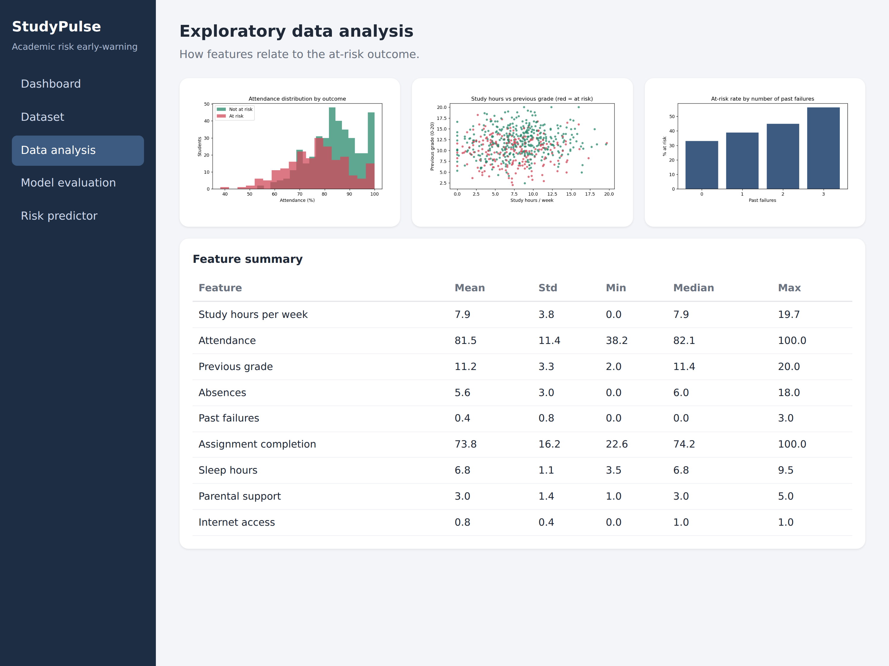
Exploratory Analysis

Slide 8
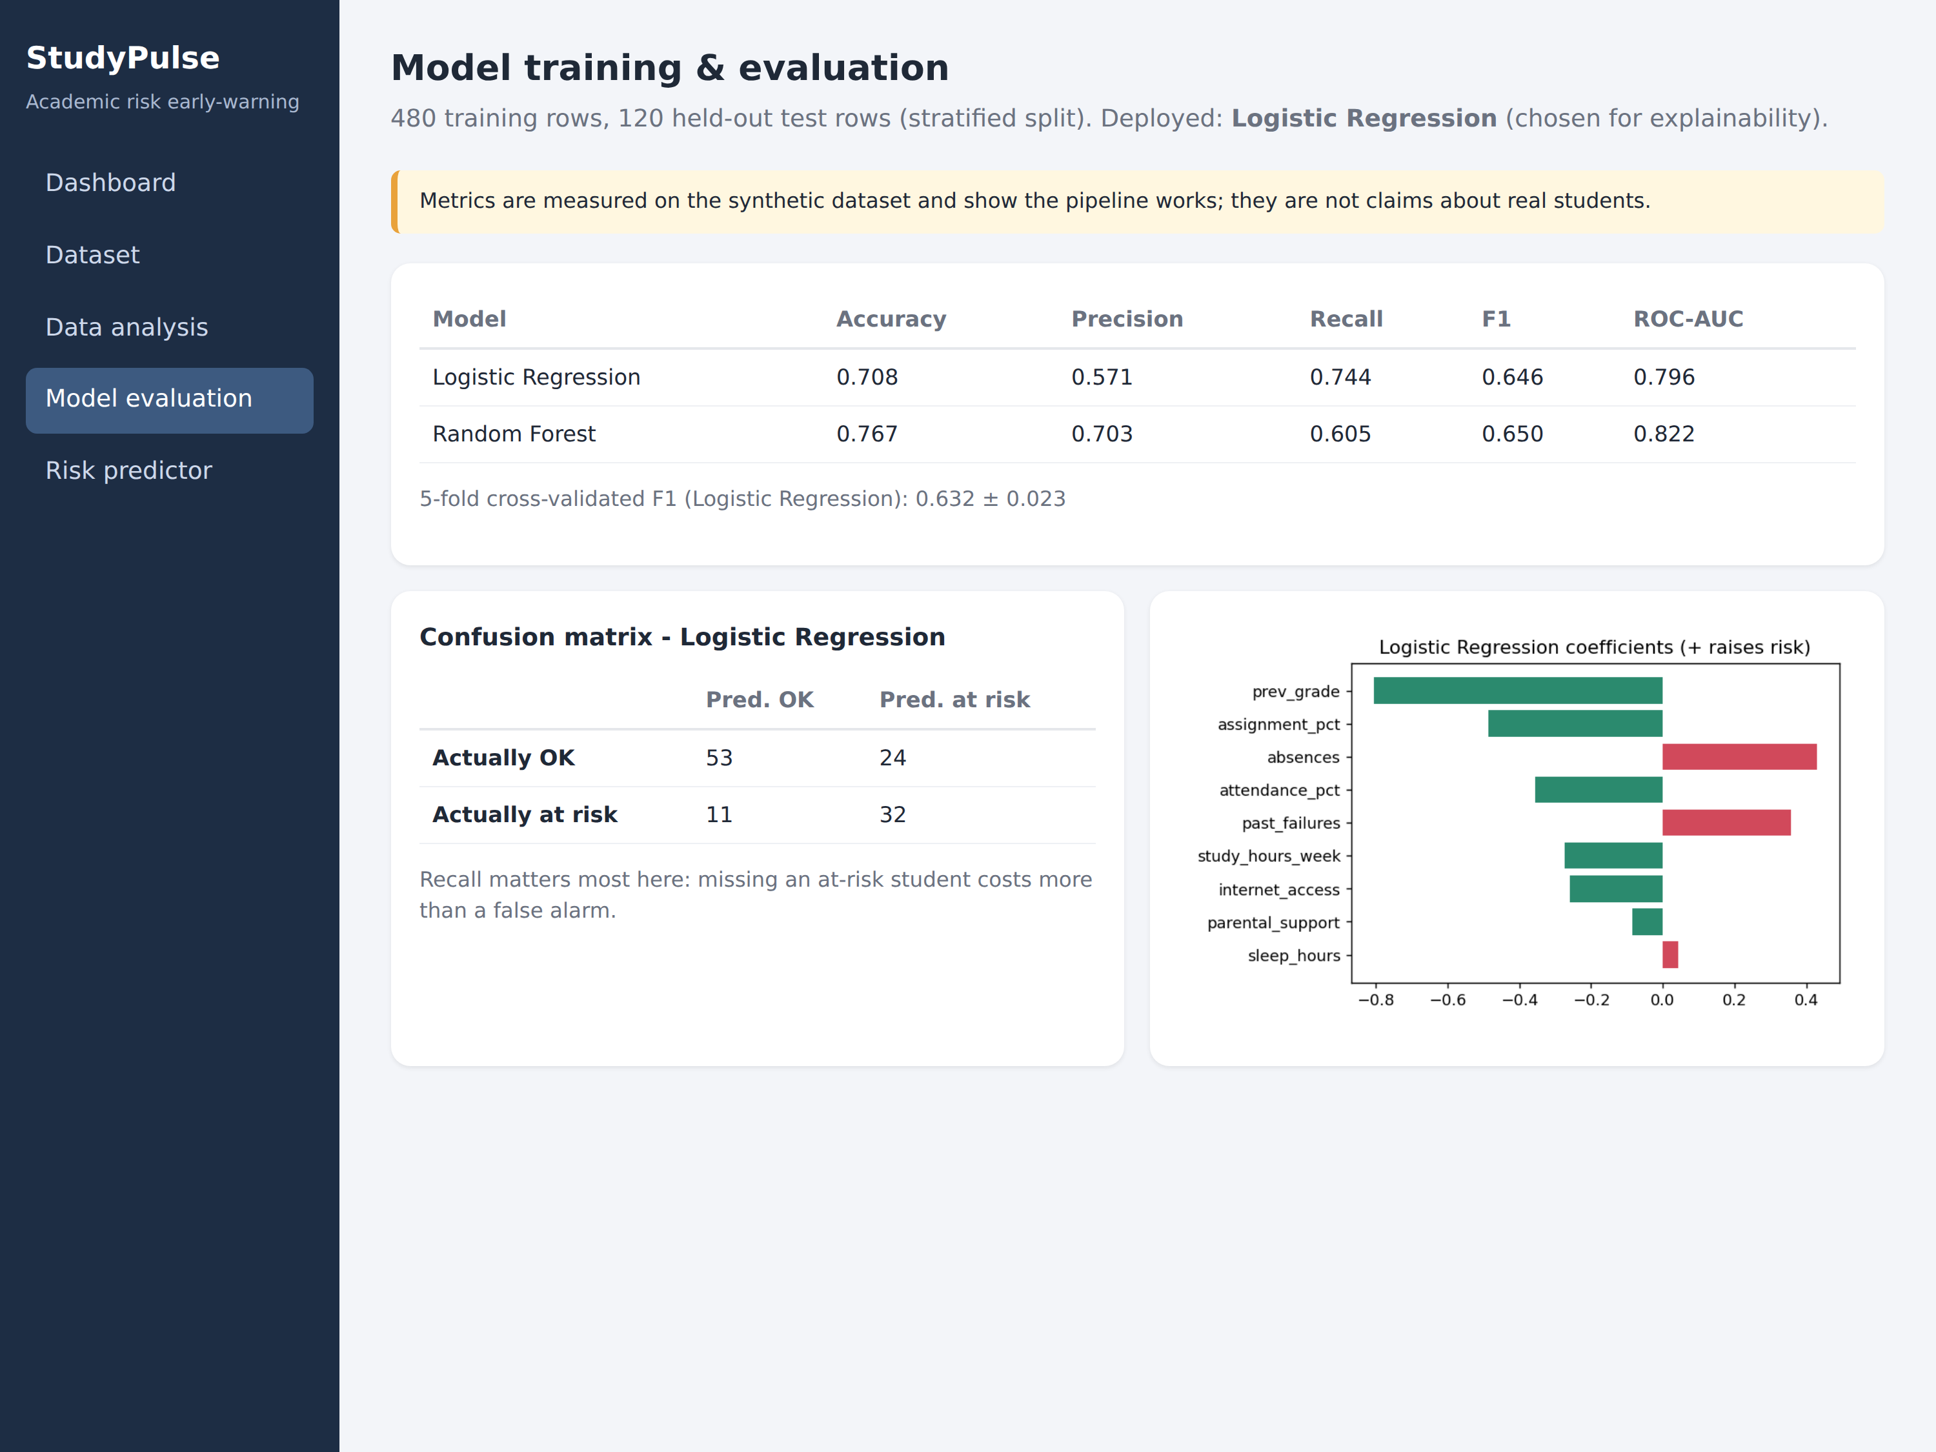
Model Evaluation (synthetic data)
• Logistic Regression: F1 0.65, recall 0.74, AUC 0.80
• Random Forest: F1 0.65, recall 0.60, AUC 0.82
• 5-fold CV F1 (LR): 0.63 +/- 0.02
• Demonstrates the pipeline; not real-student results.

Slide 9
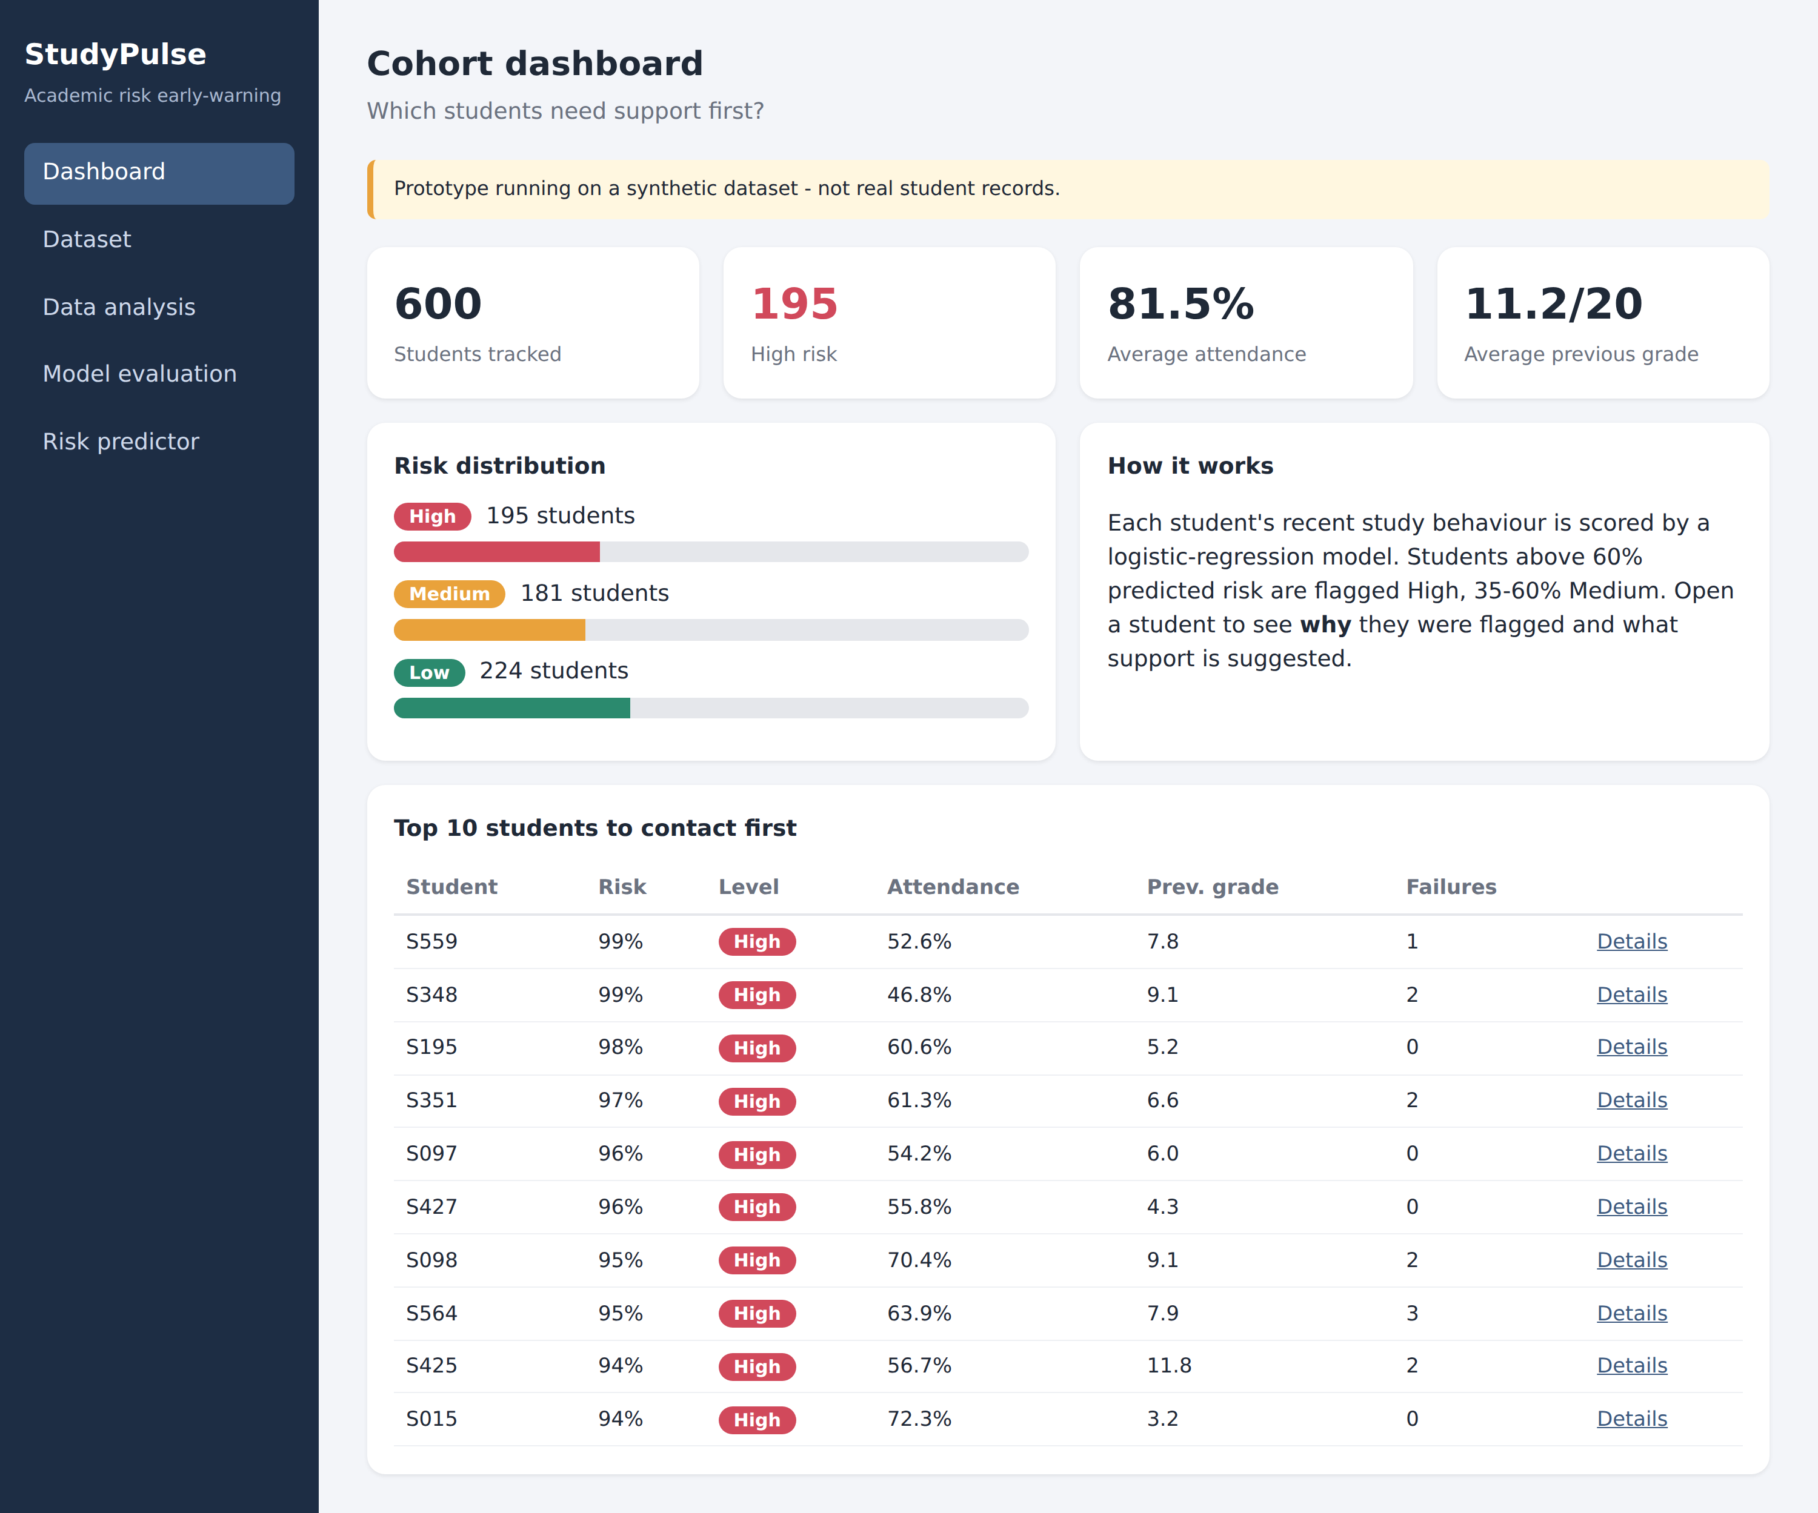
Dashboard

Slide 10
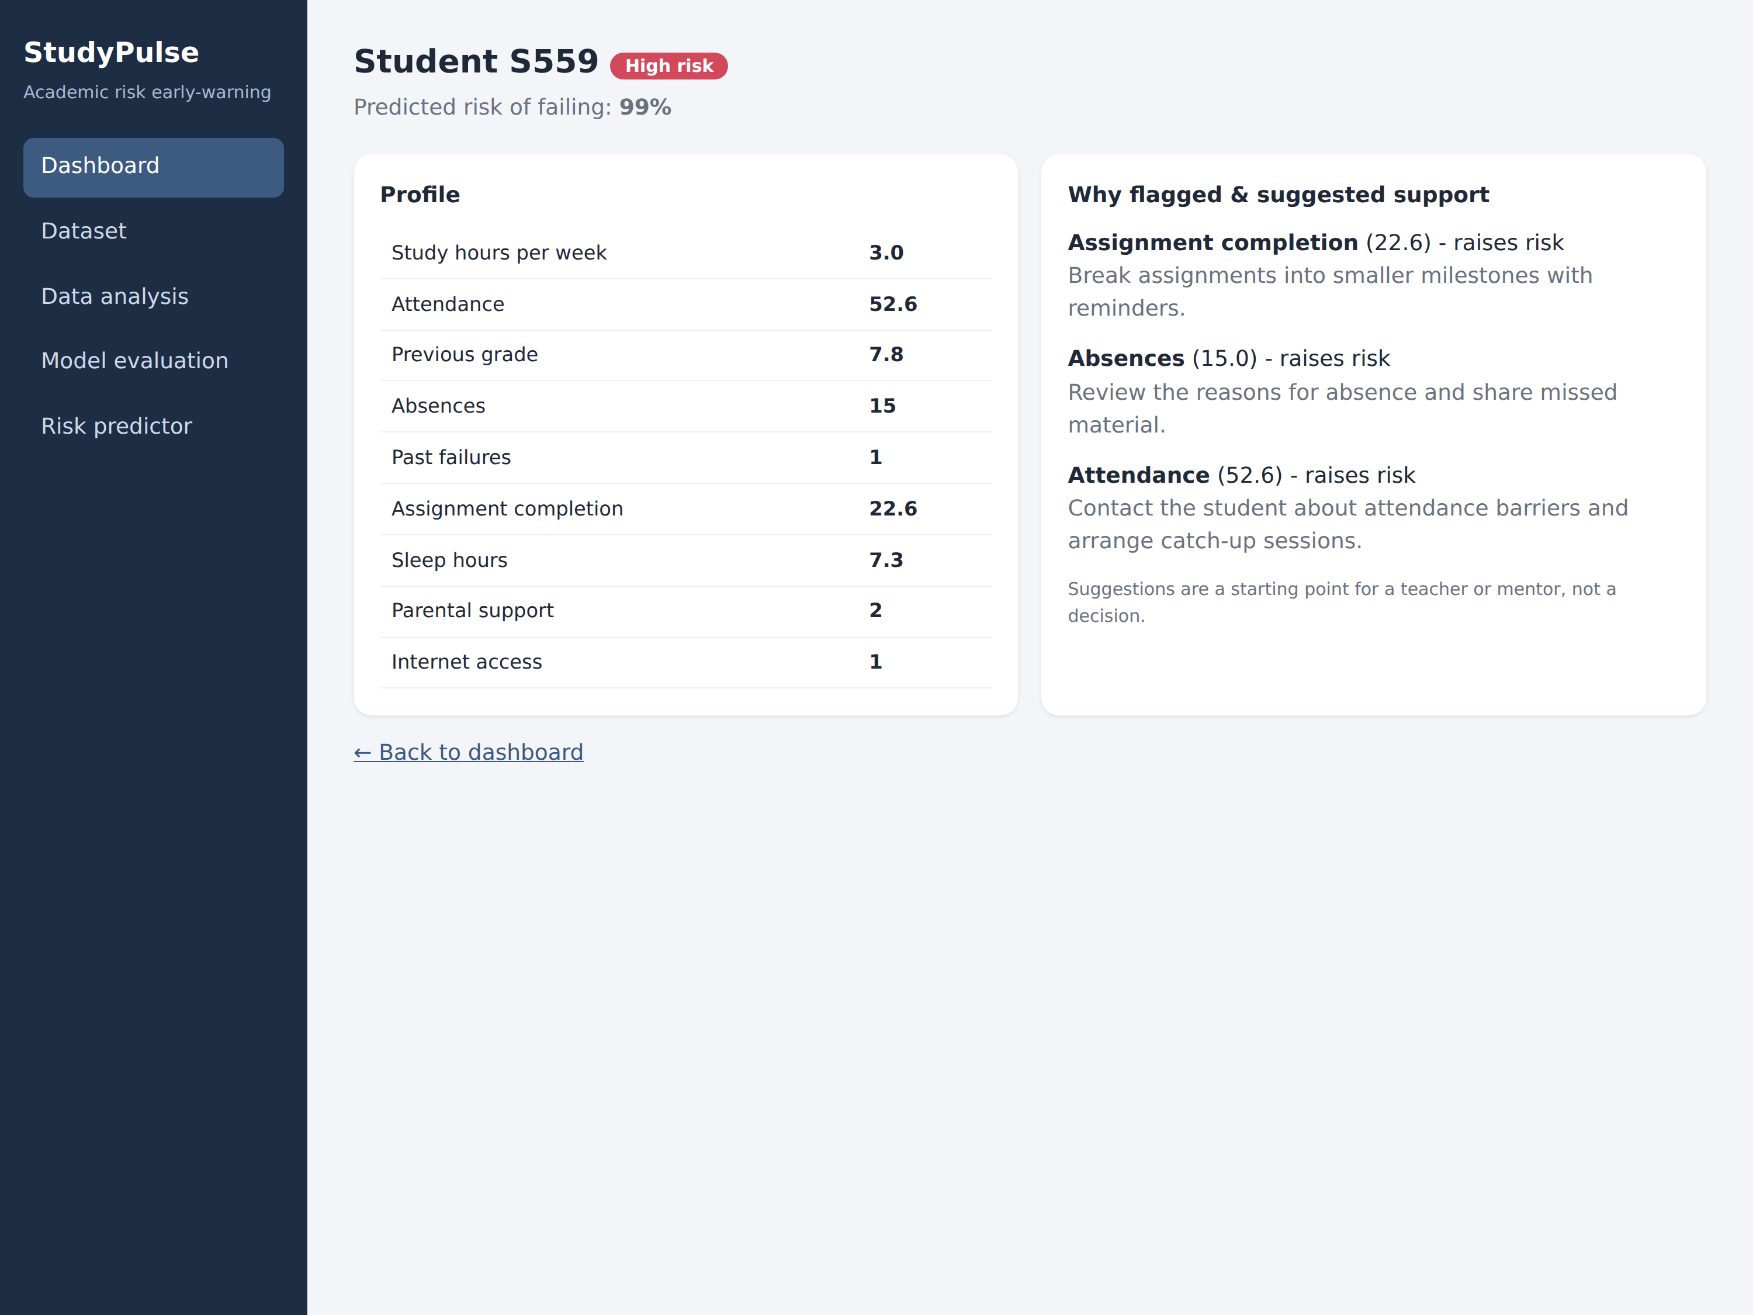
Explainable Output
• Each student page shows the top factors raising their risk.
• Each factor maps to a suggested support action.
• Teachers review - the system never decides alone.

Slide 11
Expected Impact
• Earlier identification of students who need help.
• Teacher time focused where it matters most.
• Transparent reasons build trust in the tool.
• Supports SDG 4 by aiming to reduce preventable failures.

Slide 12
Ethics, Limitations & Future Scope
• Ethics: decision support only; anonymised data; check fairness across groups.
• Limitation: synthetic data - real accuracy unknown until validated.
• Next: real anonymised data, weekly trends, bias audit, alerts, cloud deployment.

Slide 13
Conclusion
• StudyPulse turns routine academic data into an early, explainable warning.
• Built end to end: data, model, explanation and web app.
• Ready for validation on real data.

Slide 14
Thank you - Questions?

