Slide 1

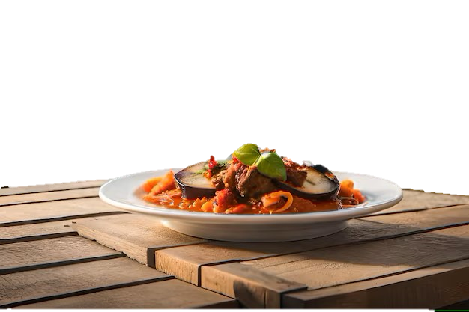


Surban Outfitter
Shopping Urban

Slide 2
Surban Outfitter

Slide 3
Surban Outfitter

Slide 4


OBJECTIVE
• Create an intuitive and user-friendly online shopping platform to cater to the needs of diverse users.
• Implement an e-commerce system that includes product management, order management, and
user management functionalities.
Breaking Down
Goal & Methology
Visualization
Retrospective
MEDTHOLOGY
Data Sources: Create our own user data.
Manipulation Tools: SQL, PHP, SQLi, JAVASCRIPT, HTML, CSS

Slide 5
Use Cases
Add a new Customer
Update info
Add Product
Delete Product
Add Product to Cart
Site Visitor
Place Order
Breaking Down
Goal & Methology
Visualization
Retrospective

Slide 6
we have 2 interactive use cases for user and admin.
The Admin interface will be able to do as user do plus extra function to update product
The User interface has the ability to update account, checkout, order history, and see their cart items.
Goal & Methology
Breaking Down
Visualization
Retrospective

Slide 7
Highlights
Have unique script to prevent direct object reference without the user credential identification
Interactive use cases
The teamwork and iterative testing approach
Refinements
Better initial documentation of the use cases responses and wireframe would have reduced the time spent handling unexpected formatting issues.
More robust error handling in our code execution could have minimized the number of retries required when fetching data.
Goal & Methology
Breaking Down
Retrospective
Visualization
Future
Enhance the ability to make website more interactable

