Slide 1
My Website
By Me

Slide 2
Aim
Online CV
Symplistic style = fast loading times
Accessibility is key
Notes:
- The aim of this website is to demonstrate my skills in web design and act as an online CV
The simplistic style will be reminiscent of the fast loading times of google.com
Accessibility is key to gaining a wider base. Blind, Deaf, Colour Blind and Dyslexic users do not need to shy away from the internet if the way is paved for them.

Slide 3
My SiteMap
Home Page
About Me
My Blog
Contact me
Notes:
The site will have four webpages linked via the navbar
The active website will have the link enlarged

Slide 4
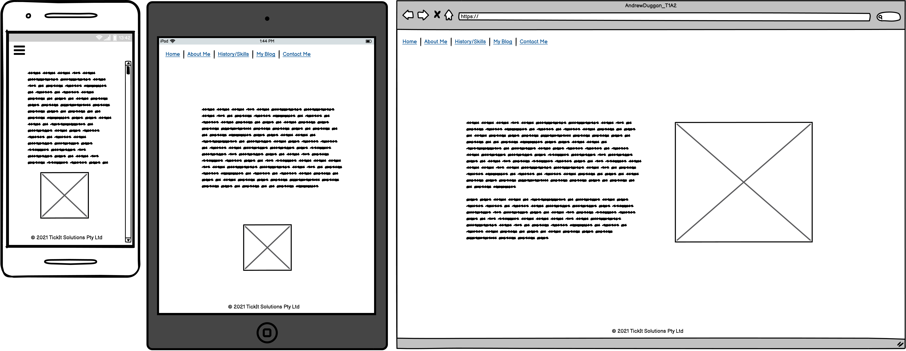
Homepage

Slide 5
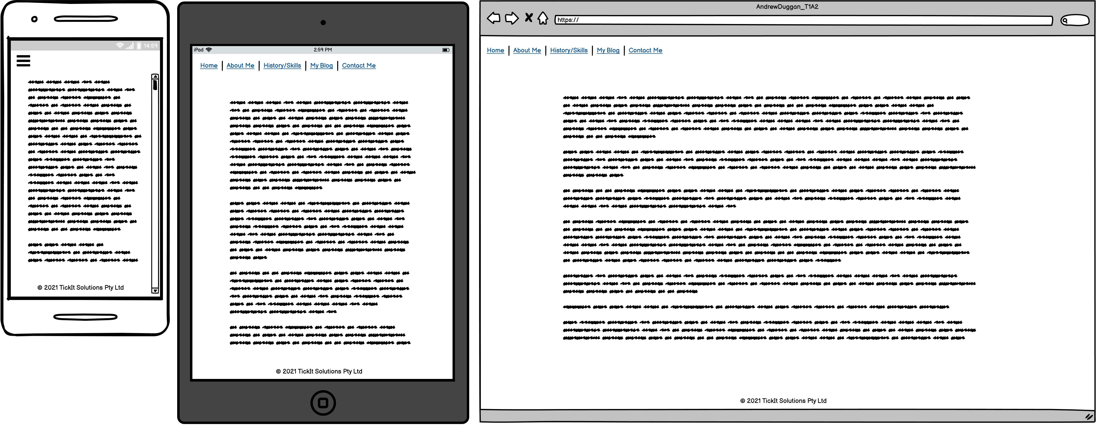
About Me

Slide 6
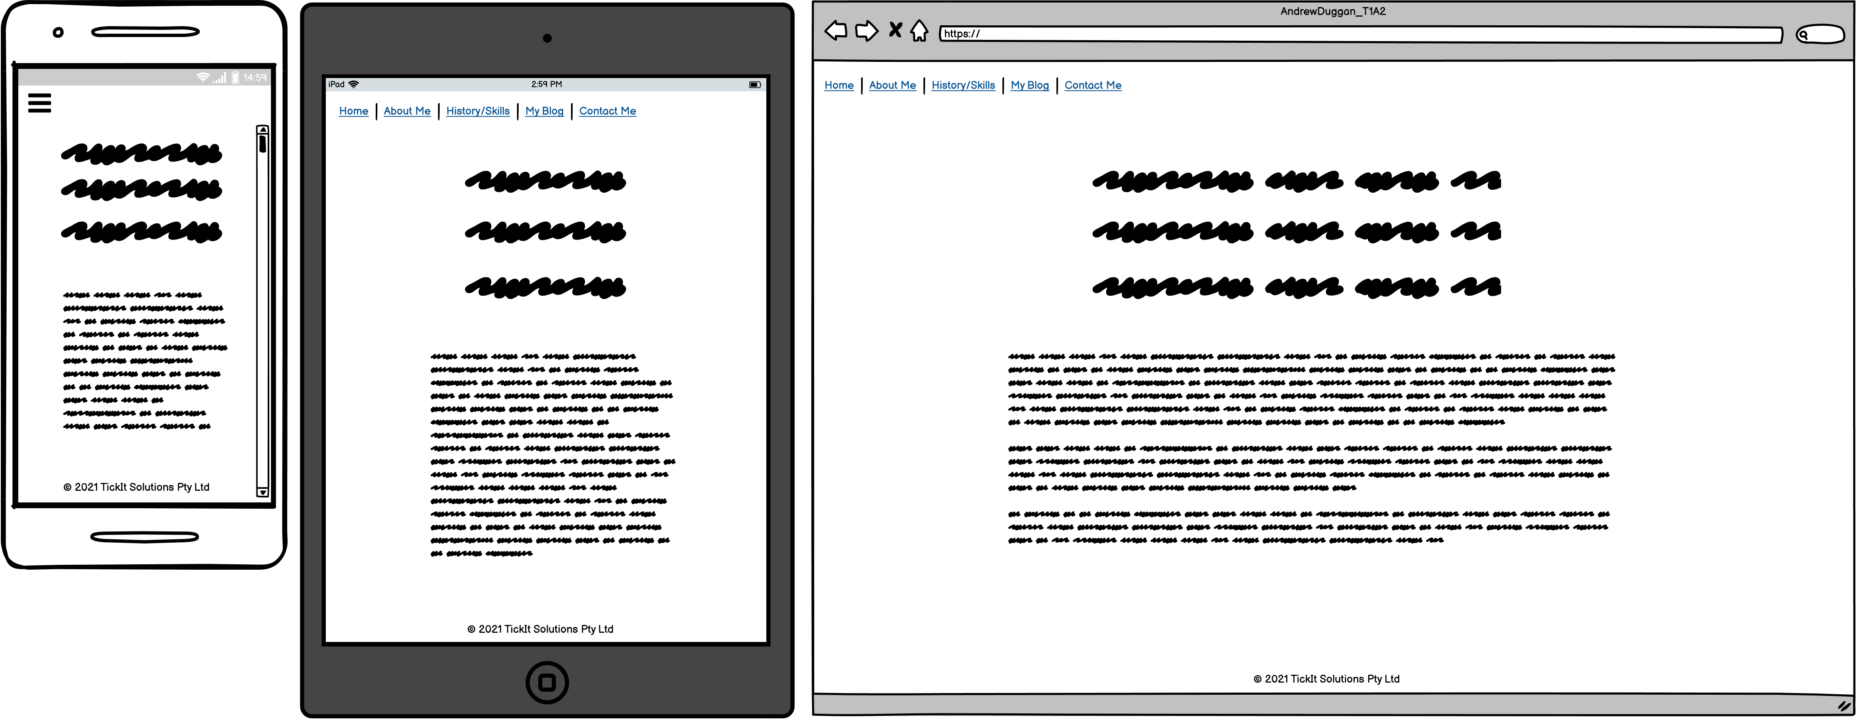
My Blog

Slide 7
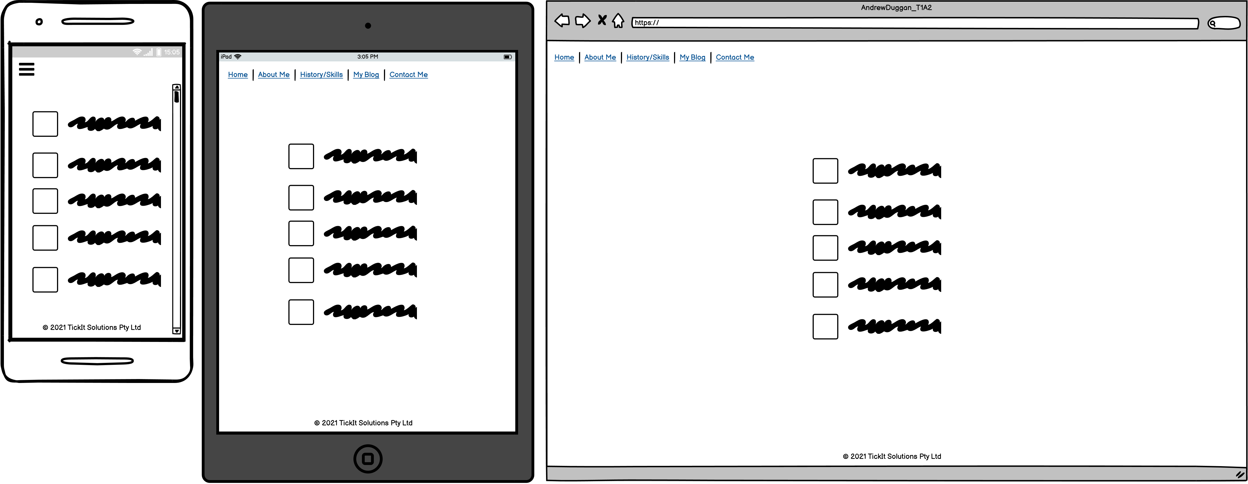
Contact Me

Slide 8
Components
Homepage
Nav Bar
Photo ID
Adapting Behaviour and TickIt Solutions logo’s for the companies that I work for
Main box containing the various data for the pages
Notes:
Nav Bar – expanding on the mobile, LHS for tablet and PC
Photo ID – Photo of Andrew Duggan
Adapting Behaviour and TickIt Solutions logo’s for the companies that I work for

