Slide 1
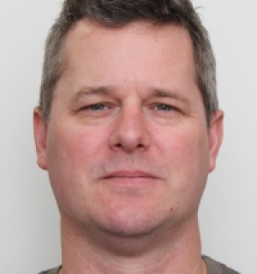

My Profile
By Andrew Duggan

Slide 2
Aim
Online CV
Simplistic style = fast loading times
Accessibility is key
©2021 Tick It Business Solutions Pty Ltd
Notes:
Decision making process is COMPREHENSIVELY explained with regards to the overall aesthetic of the website
- The aim of this website is to demonstrate my skills in web design and act as an online CV
The simplistic style will be reminiscent of the fast loading times of google.com
Accessibility is key to gaining a wider base. Blind, Deaf, Colour Blind and Dyslexic users do not need to shy away from the internet if the way is paved for them.
With this in mind, I will ensure that the website is accessible via a screen reader using ARIA commands and will use a colour-blind friendly scheme.

Slide 3
Site Map
Home Page
About Me
My Blog
Contact me
©2021 Tick It Business Solutions Pty Ltd
Notes:
Slides include wireframes/mockups of ALL planned pages of the website. Decision making process is COMPREHENSIVELY explained with regards to the overall aesthetic of the website:
Slides include a VERY DETAILED list of components that will be used. A COMPREHENSIVE explanation is given as to how components and styling will engage the audience.

Slide 4
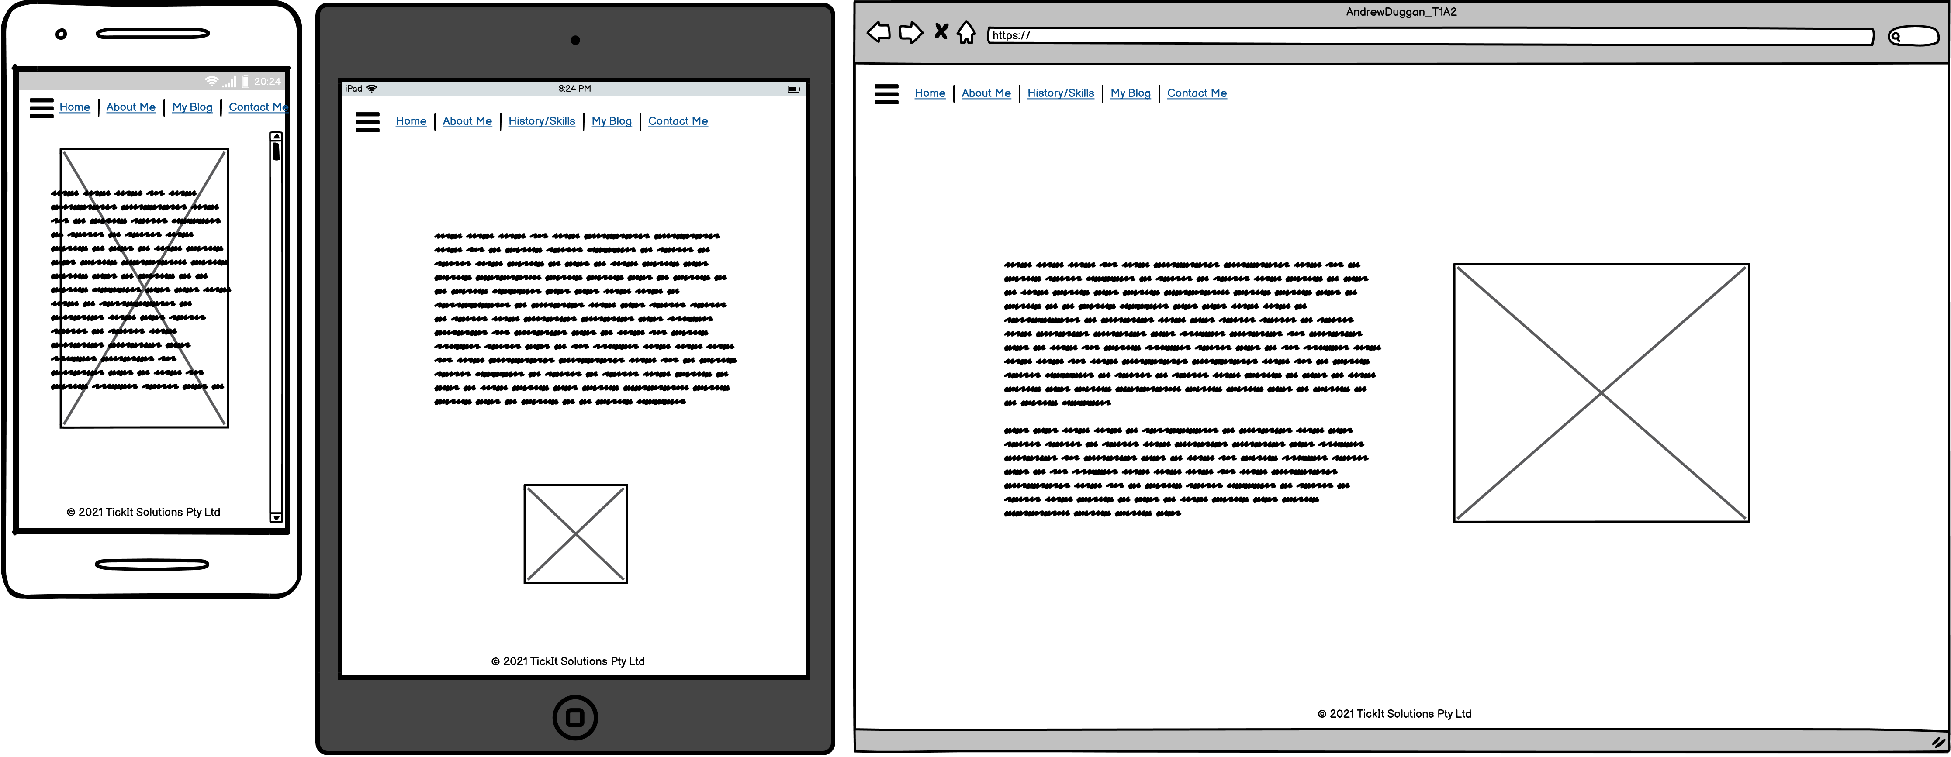
Homepage
©2021 Tick It Business Solutions Pty Ltd
Notes:
Slides include wireframes/mockups of ALL planned pages of the website. Decision making process is COMPREHENSIVELY explained with regards to the overall aesthetic of the website:
Slides include a VERY DETAILED list of components that will be used. A COMPREHENSIVE explanation is given as to how components and styling will engage the audience.
Main Page:
Nav Bar – expanding on the mobile, LHS for tablet and PC
Photo ID – Photo of Andrew Duggan
Text box with a small introduction
Footer – Copyright statement

Slide 5
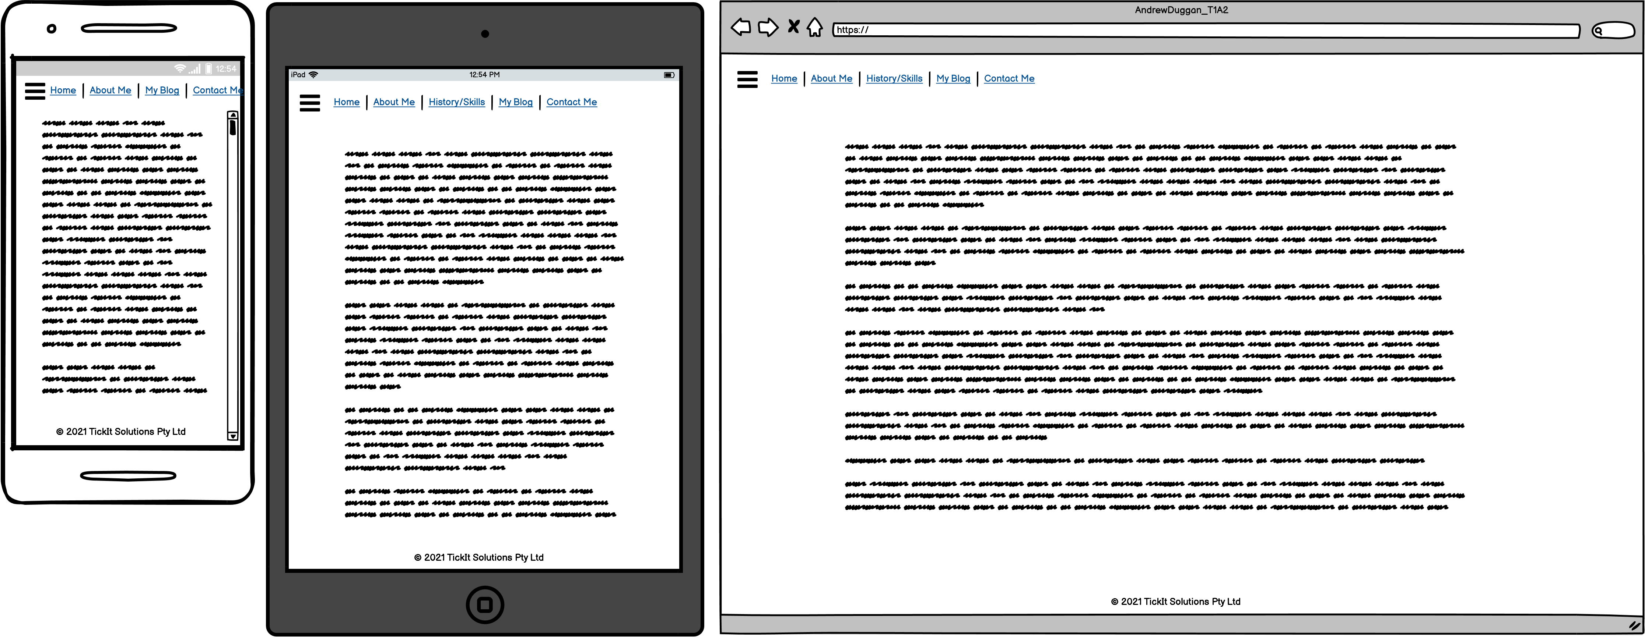
About Me
©2021 Tick It Business Solutions Pty Ltd
Notes:
Slides include wireframes/mockups of ALL planned pages of the website. Decision making process is COMPREHENSIVELY explained with regards to the overall aesthetic of the website:
Slides include a VERY DETAILED list of components that will be used. A COMPREHENSIVE explanation is given as to how components and styling will engage the audience.
Text Box’s separating Skills, Projects and Qualifications, in order to pass in the information without distracting the potential client/employer

Slide 6
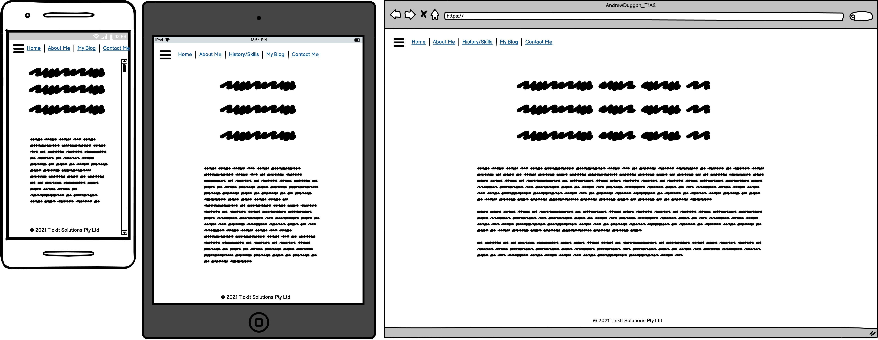
My Blog
©2021 Tick It Business Solutions Pty Ltd
Notes:
Slides include wireframes/mockups of ALL planned pages of the website. Decision making process is COMPREHENSIVELY explained with regards to the overall aesthetic of the website:
Slides include a VERY DETAILED list of components that will be used. A COMPREHENSIVE explanation is given as to how components and styling will engage the audience.
Links to my external blogs and papers
I will have my blog underneath

Slide 7
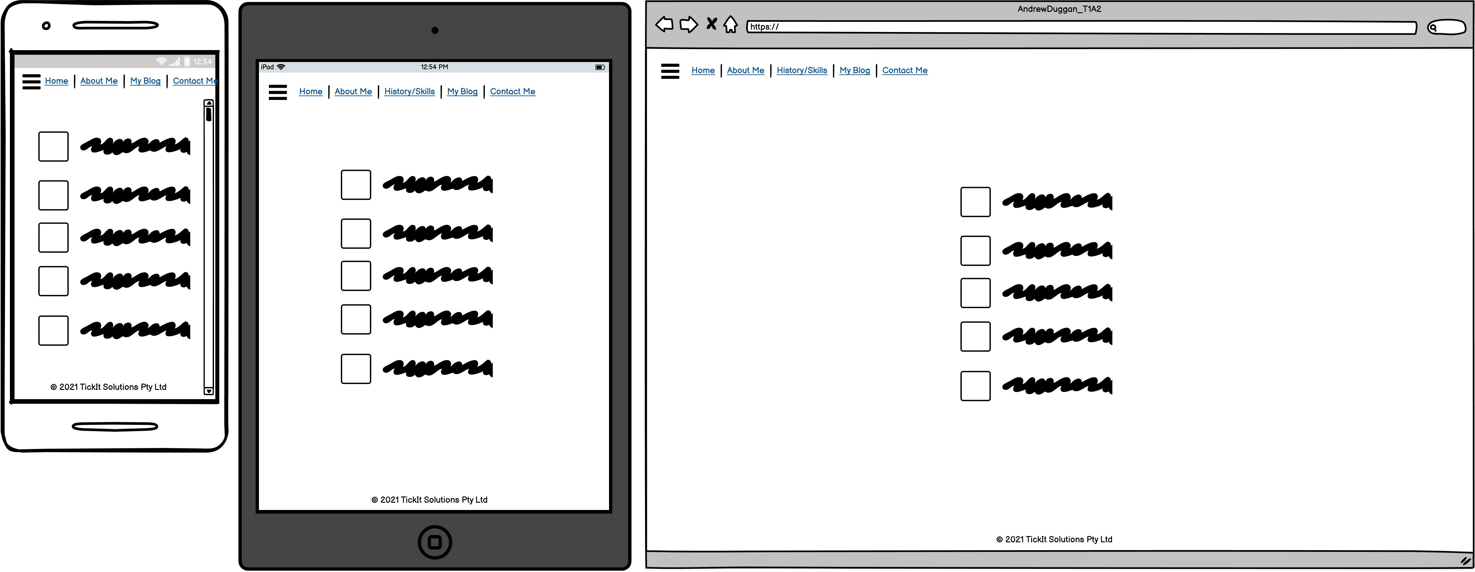
Contact Me
©2021 Tick It Business Solutions Pty Ltd
Notes:
Slides include wireframes/mockups of ALL planned pages of the website. Decision making process is COMPREHENSIVELY explained with regards to the overall aesthetic of the website:
Slides include a VERY DETAILED list of components that will be used. A COMPREHENSIVE explanation is given as to how components and styling will engage the audience.
Contact me:
LinkedIn logo with link
Twitter logo with link
GitHub logo with link
The links

Slide 8
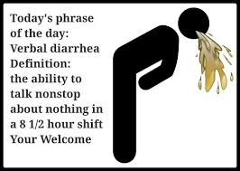
Final Thoughts
©2021 Tick It Business Solutions Pty Ltd
Notes:
Slides include wireframes/mockups of ALL planned pages of the website. Decision making process is COMPREHENSIVELY explained with regards to the overall aesthetic of the website:
Slides include a VERY DETAILED list of components that will be used. A COMPREHENSIVE explanation is given as to how components and styling will engage the audience.
Contact me:
LinkedIn logo with link
Twitter logo with link
GitHub logo with link
The links

Slide 9

Questions
©2021 Tick It Business Solutions Pty Ltd
Notes:
Slides include wireframes/mockups of ALL planned pages of the website. Decision making process is COMPREHENSIVELY explained with regards to the overall aesthetic of the website:
Slides include a VERY DETAILED list of components that will be used. A COMPREHENSIVE explanation is given as to how components and styling will engage the audience.
Contact me:
LinkedIn logo with link
Twitter logo with link
GitHub logo with link
The links

