Slide 1
My Website
By Me

Slide 2
Aim
Online CV
Symplistic style = fast loading times
Accessibility is key
Notes:
Decision making process is COMPREHENSIVELY explained with regards to the overall aesthetic of the website
- The aim of this website is to demonstrate my skills in web design and act as an online CV
The simplistic style will be reminiscent of the fast loading times of google.com
Accessibility is key to gaining a wider base. Blind, Deaf, Colour Blind and Dyslexic users do not need to shy away from the internet if the way is paved for them.
With this in mind, I will ensure that the website is accessible via a screen reader using ARIA commands and will use a colour-blind friendly scheme.

Slide 3
My SiteMap
Home Page
About Me
My Blog
Contact me
Notes:
Slides include an overview or sitemap of ALL pages on the website. COMPREHENSIVELY explains the overall structure of the website and how different pages will be navigated.:
The site will have four webpages linked via the navbar
The active website will have the link enlarged

Slide 4
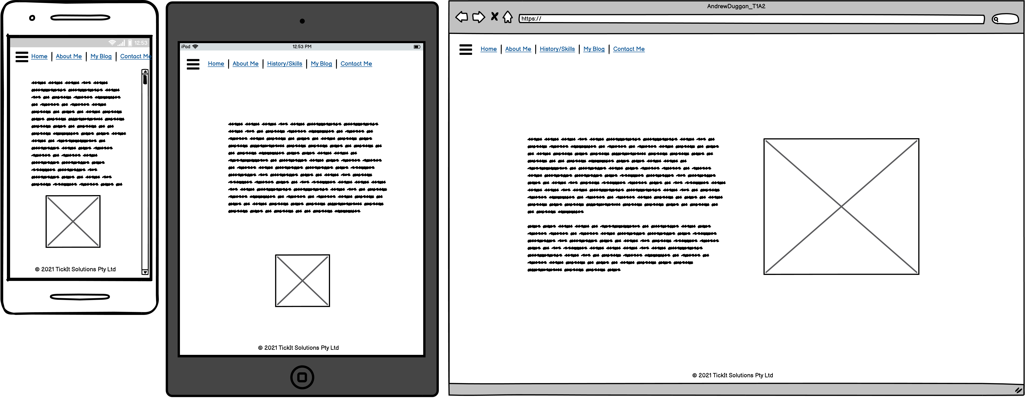
Homepage
Notes:
Slides include wireframes/mockups of ALL planned pages of the website. Decision making process is COMPREHENSIVELY explained with regards to the overall aesthetic of the website:

Slide 5
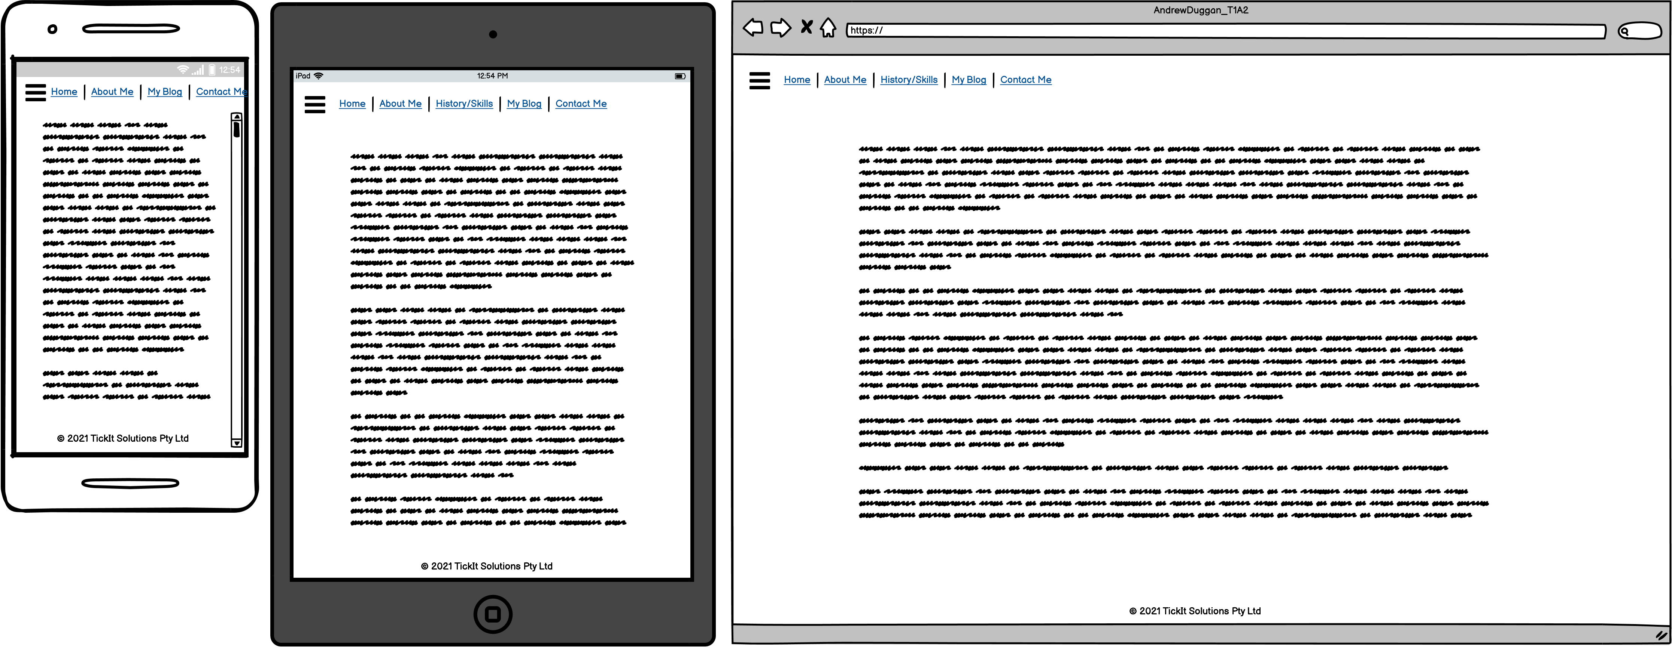
About Me

Slide 6
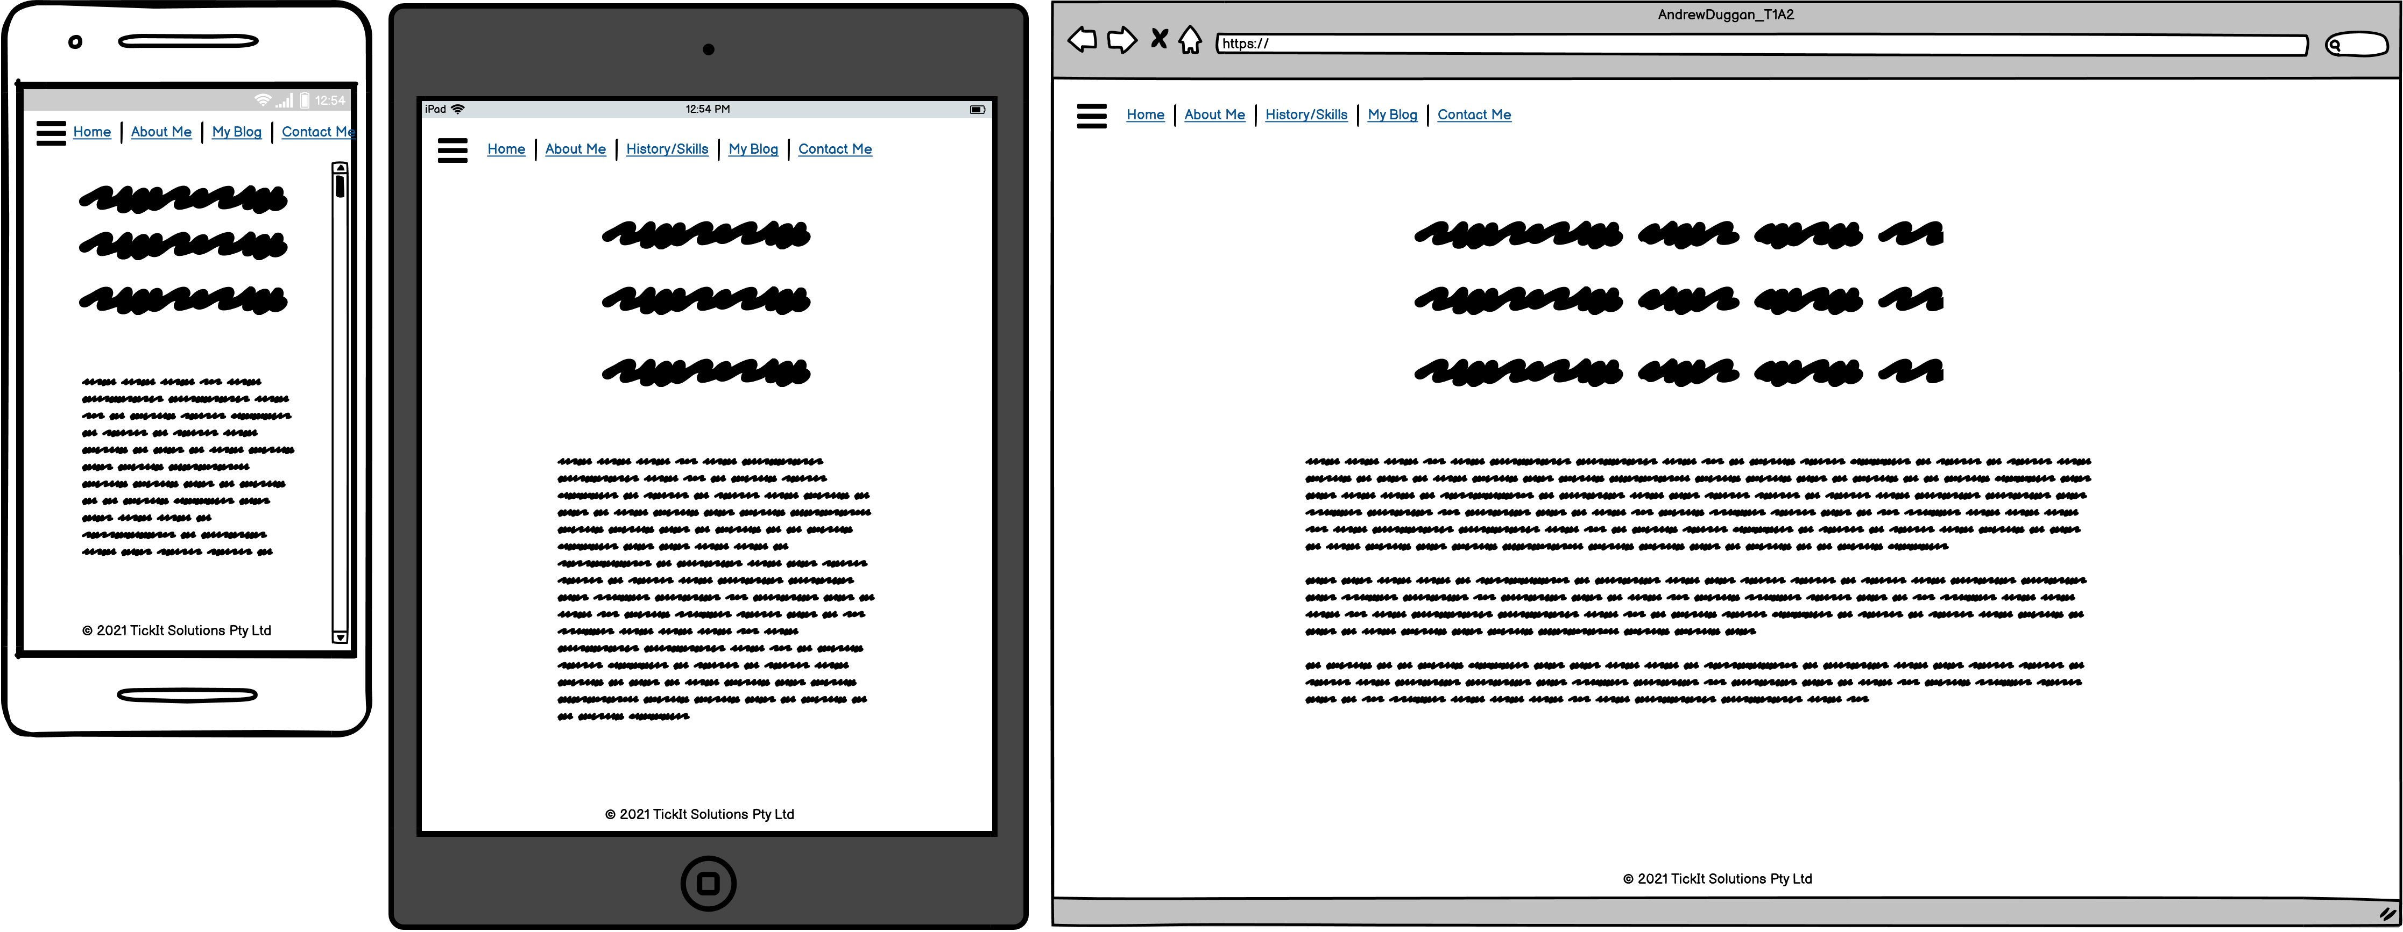
My Blog

Slide 7
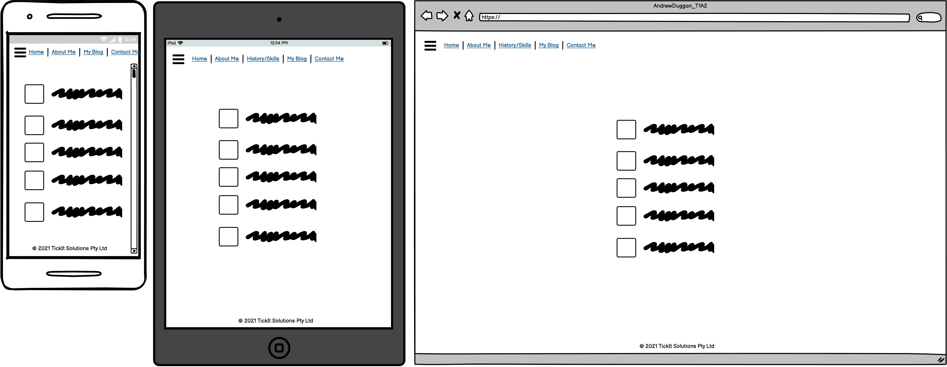
Contact Me

Slide 8
Components
Homepage
Nav Bar
Photo ID
Adapting Behaviour and TickIt Solutions logo’s for the companies that I work for
Main box containing the various data for the pages
LinkedIn logo
Twitter Logo
Notes:
Slides include a VERY DETAILED list of components that will be used. A COMPREHENSIVE explanation is given as to how components and styling will engage the audience:
Main Page
Nav Bar – expanding on the mobile, LHS for tablet and PC
Photo ID – Photo of Andrew Duggan
Adapting Behaviour and TickIt Solutions logo’s for the companies that I work for
Contact me
LinkedIn logo with

