Slide 1

T3A2 Full-stack Application Presentation
Timothy Moss + Andrew Duggan

Slide 2

Purpose
Creates a checklist for parents to make sure their children are taking their medication
Designed to apply positive reinforcement so the children build good habits through a rewards system

Slide 3

Target Audience
Primary Audience focuses on Parents with children who are required to take medication.
Specifically, Parents who are often busy with their careers or with errands around the house and do not have the time to be constantly remembering the times when medication must be taken.

Slide 4





Tech Stack
Backend Tech Stack :
Ruby on Rails (API Edition)
Hosted on Heroku
Source Control: GitHub
Frontend Functionality:
ReactJS
Hosted on Netlify
Source Control: GitHub

Slide 5
Primary Features
User Authentication features, such as login and signup capabilities
Parents can Add and View medications in a list format
Parents can create checklists for their children, and Update or Remove the lists as needed.
Parents can utilize a rewards system within the application when a child completes the check-list
Parents also can receive reminders on the web page when a checklist is not being completed.
Parents add multiple children on one user

Slide 6
Secondary Features
It has also been proposed to add these secondary features should there be time in the projects timeline to work on them:
Allowing for an image upload system, so Users can upload images to match the medication
Parental Controls, that ensure that their children cannot log in and modify any settings
Parents can view the completion history of the checklists for each of their children

Slide 7
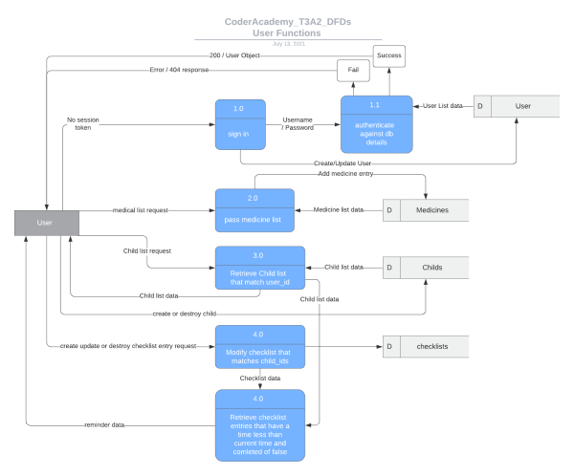
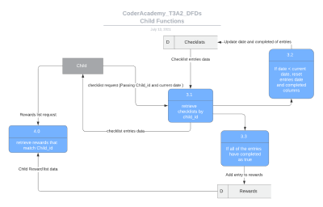
Data Flow

Slide 8
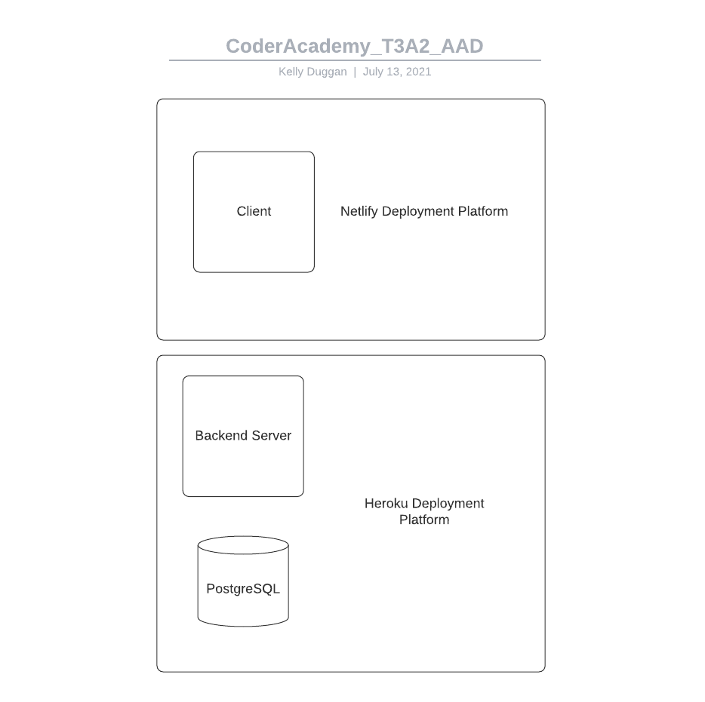
Architecture Diagram

Slide 9
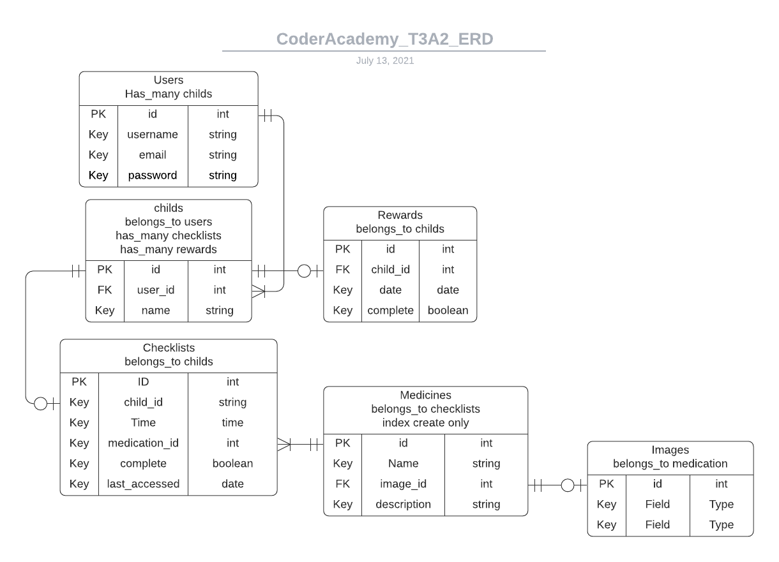
ERD

