Slide 1

ZZ-HVS: Zig-Zag Horizontal and Vertical Sleep Transistor Sharing to Reduce Leakage Power in
On-Chip SRAM Peripheral Circuits
Houman Homayoun Avesta Makhzan and Alex Veidenbaum
Dept. of Computer Science, UC Irvine
hhomayou@ics.uci.edu

Slide 2
Outline
Cache Power Dissipation
Why Cache Peripheral ?
Proposed Circuit Technique to Reduce Leakage in Cache Peripheral
Circuit Evaluation
Proposed Architecture to Control the Circuit
Results
Conclusion

Slide 3
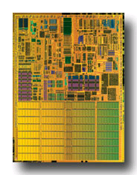
On-chip Caches and Power
On-chip caches in high-performance processors are large
  more than 60% of chip budget
Dissipate significant portion of power via leakage
  Much of it was in the SRAM cells
    Many architectural techniques proposed to remedy this
Today, there is also significant leakage in the peripheral circuits of an SRAM (cache)
  In part because cell design has been optimized
Pentium M processor die photo
Courtesy of intel.com

Slide 4
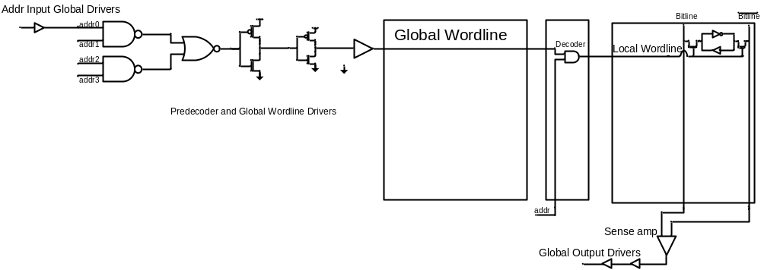
Peripherals ?
Data Input/Output Driver
Address Input/Output Driver
Row Pre-decoder
Wordline Driver
Row Decoder
Others : sense-amp, bitline pre-charger, memory cells, decoder logic

Slide 5
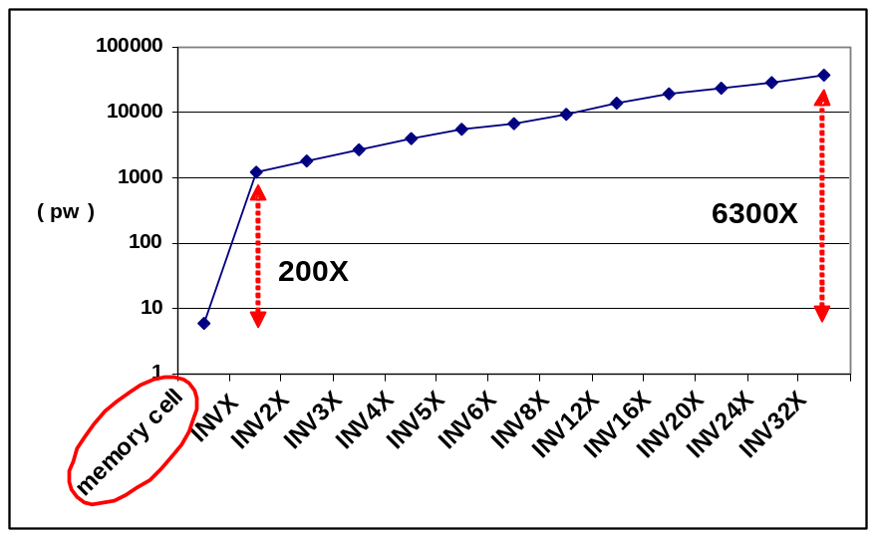
Why Peripherals ?
  Using minimal sized transistor for area considerations in cells and larger, faster and accordingly more leaky transistors to satisfy timing requirements in peripherals.
  Using high vt transistors in cells compared with typical threshold voltage transistors in peripherals

Slide 6
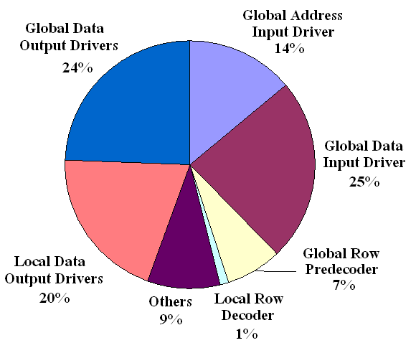
Leakage Power Components of L2 Lache
  SRAM peripheral circuits dissipate more than 90% of the total leakage power

Slide 7
Circuit Techniques Address Leakage in SRAM Cell
Gated-Vdd, Gated-Vss
Voltage Scaling (DVFS)
ABB-MTCMOS
Forward Body Biasing (FBB), RBB
Sleepy Stack
Sleepy Keeper
Target SRAM memory cell

Slide 8
Architectural Techniques
Way Prediction, Way Caching, Phased Access
  Predict or cache recently access ways, read tag first
Drowsy Cache
  Keeps cache lines in low-power state, w/ data retention
Cache Decay
  Evict lines not used for a while, then power them down
Applying DVS, Gated Vdd, Gated Vss to memory cell
  Many architectural support to do that.
All target cache SRAM memory cell

Slide 9
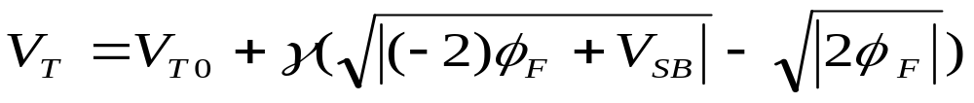
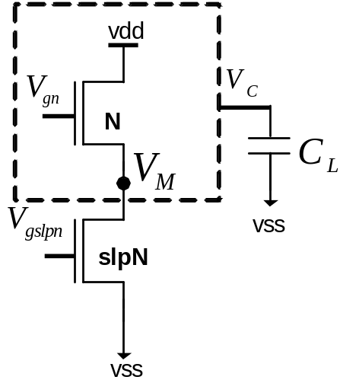
Sleep Transistor Stacking Effect
Subthreshold current: inverse exponential function of threshold voltage
Stacking transistor N with slpN:
  The source to body voltage (VM ) of
  transistor N increases, reduces its
  subthreshold leakage current, when
  both transistors are off
Drawback : rise time, fall time, wakeup delay, area, dynamic power, instability

Slide 10
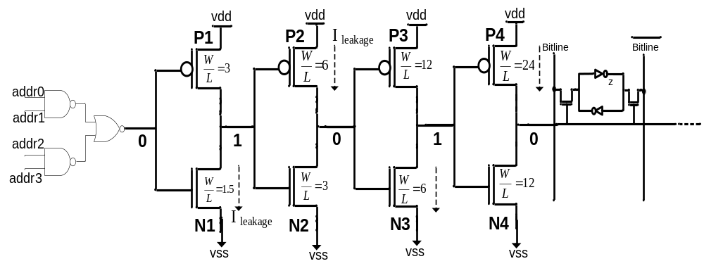
Source of Subthreshold Leakage in the Peripheral Circuitry
The inverter chain has to drive a logic value 0 to the pass transistors when a memory row is not selected
  N1,N3 and P2,P4 are in the off state and are leaking

Slide 11
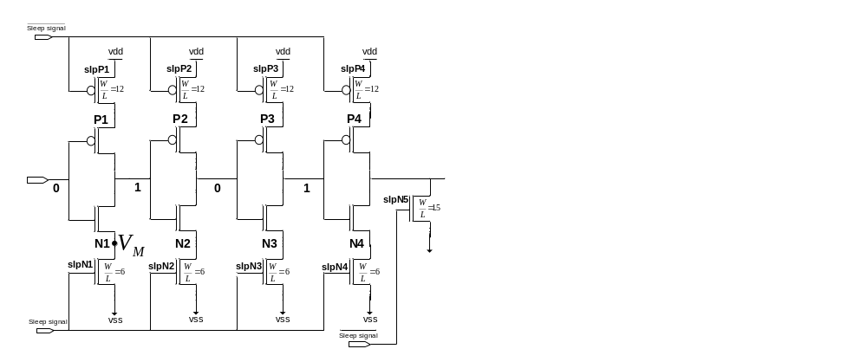
A Redundant Circuit Approach
Drawback impact on wordline driver output
rise time, fall time and propagation delay

Slide 12
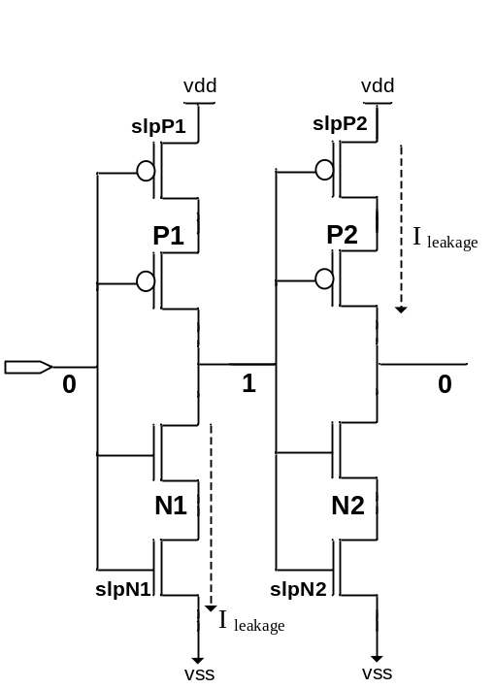
Impact on Rise Time and Fall Time
The rise time and fall time of the output of an inverter is proportional to the
R_{peq} * C_{L} and R_{neq} * C_{L}
Inserting the sleep transistors increases both R_{neq} and R_{peq}
Increasing in rise time
Impact on performance
Increasing in fall time
Impact on memory functionality

Slide 13
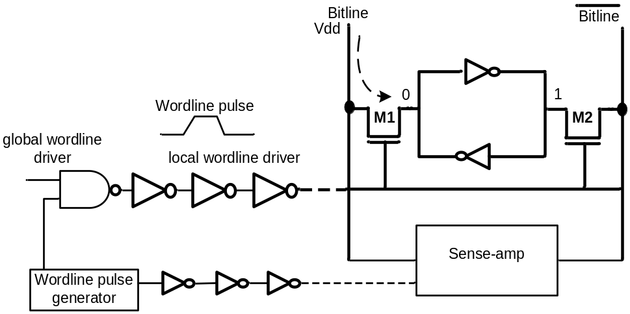
Fall Time Increase Impact
Fall time increase ➔ pass transistor active period increase (read operation)
  The bitline over-discharge, the memory content over-charge during the read operation.
  Such over-discharge
    increases the dynamic power dissipation of bitlines
    can cause cell content flip if the over-discharge period is large
The sense amplifier timing circuit and the wordline pulse generator circuit need to be redesigned!

Slide 14
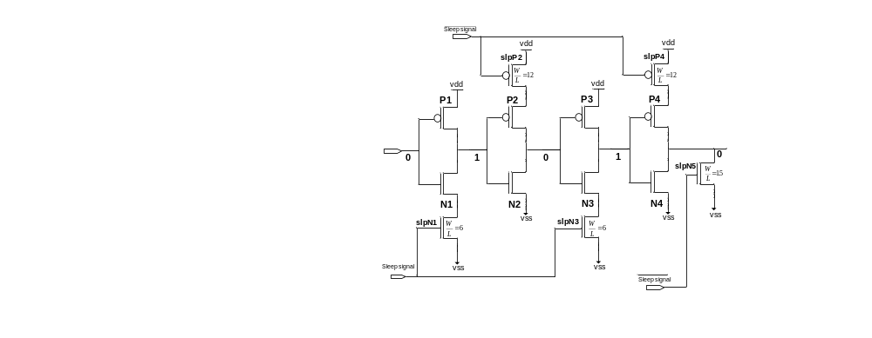
A Zig-Zag Circuit
R_{peq} for the first and third inverters and R_{neq} for the second and fourth inverters doesn’t change.
  Fall time of the circuit does not change

Slide 15
A Zig-Zag Share Circuit
To improve leakage reduction and area-efficiency of the zig-zag scheme, using one set of sleep transistors shared between multiple stages of inverters
  Zig-Zag Horizontal Sharing
  Zig-Zag Horizontal and Vertical Sharing

Slide 16
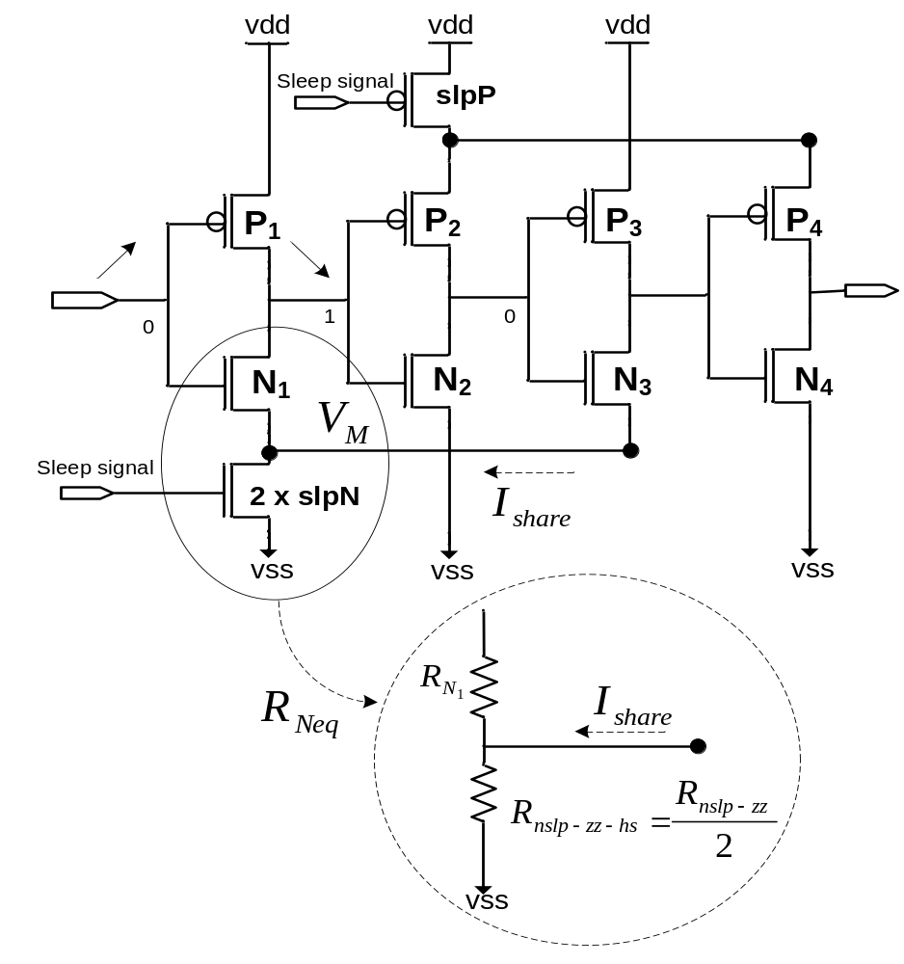
Zig-Zag Horizontal Sharing
Comparing zz-hs with zigzag scheme, with the same area overhead
  Zz-hs less impact on rise time
  Both reduce leakage almost the same

Slide 17

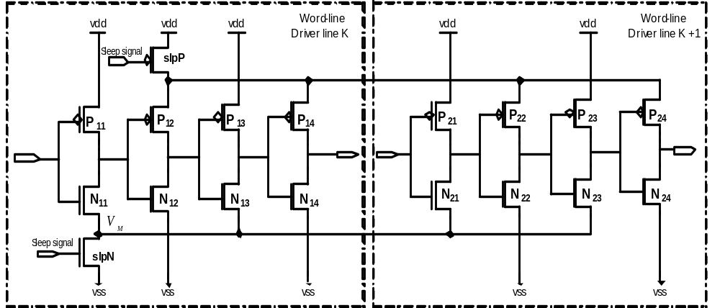
Zig-Zag Horizontal and Vertical Sharing

Slide 18
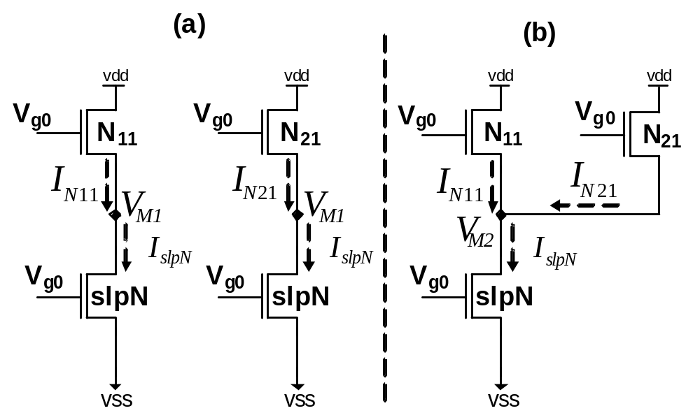

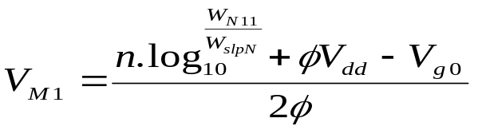
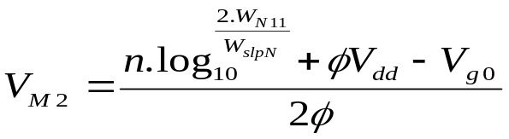
Leakage Reduction of Zig-Zag Horizontal and Vertical Sharing
Increase in virtual ground voltage increase leakage reduction

Slide 19
Circuit Evaluation
Test Experiment
  Wordline inverter chain drives 256 one-bit memory cells.
  Using Mentor Graphic IC-Station in TSMC 65nm technology
  Use Synopsis Hspice and the supply voltage of 1.08V at typical corner (25⁰ C)
  The empirical results presented are for the
    leakage current
    rise time and fall time
    propagation delay
    dynamic power
    area

Slide 20
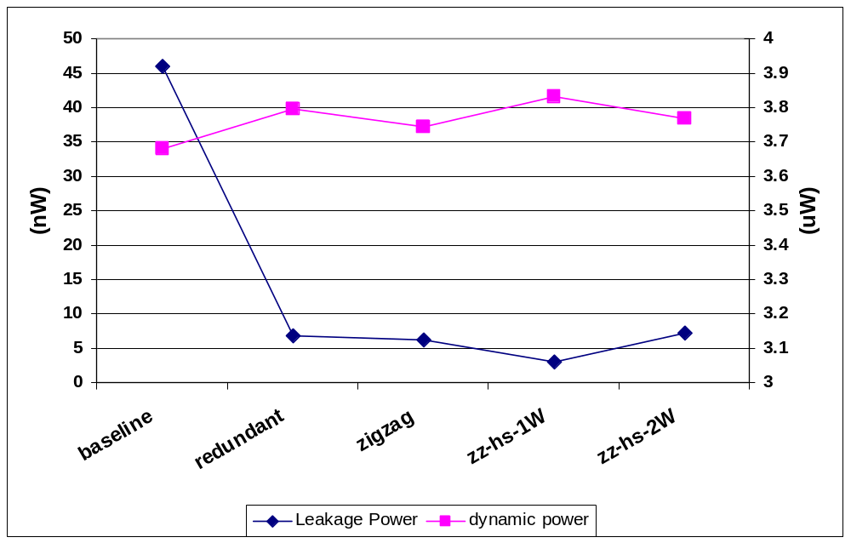
Zig-zag Horizontal Sharing: Power Results
Dynamic power increase of 1.5% to 3.5%
Max leakage reduction of 94%

Slide 21
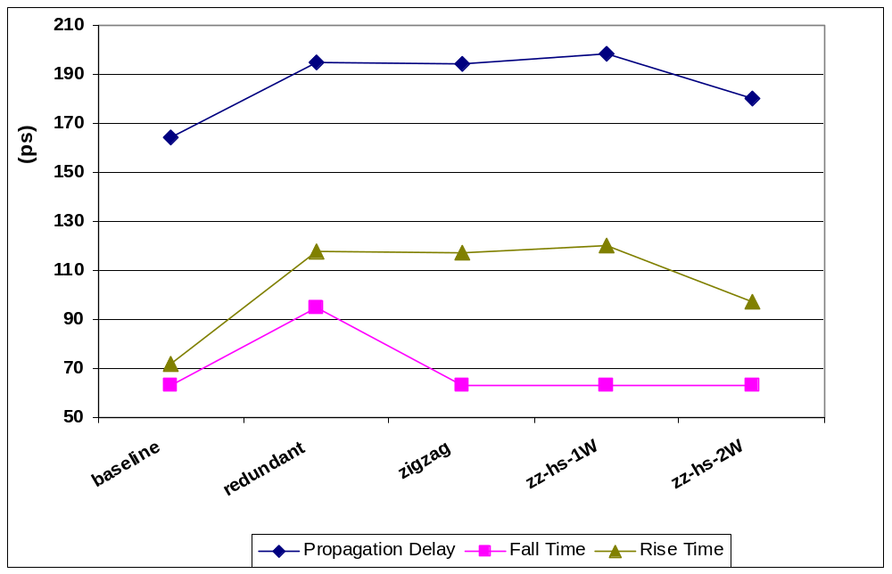
Zig-zag Horizontal Sharing: Latency Results
Both zig-zag and zig-zag share wordline driver fall time is not affected
zz-hs-2W has the least impact on rise time and propagation delay

Slide 22
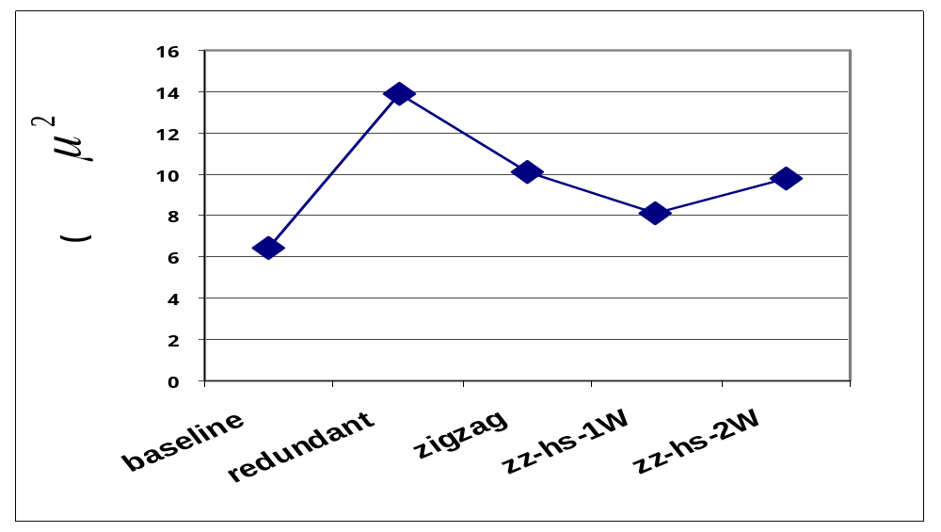
Zig-zag Horizontal Sharing: Area Results
Area increase varies significantly from 25% for zz-hs-1W circuit to 115% for the redundant scheme

Slide 23
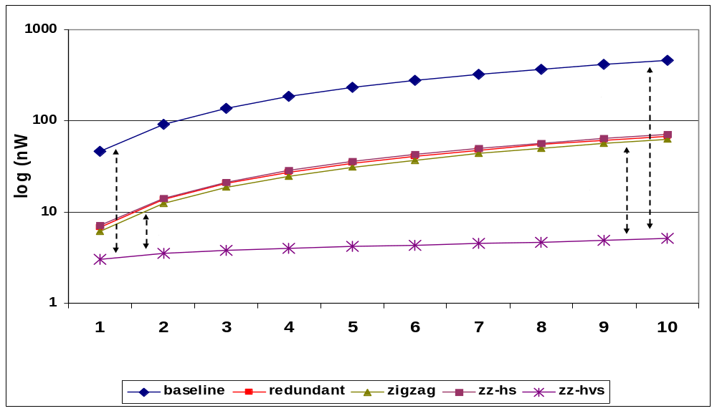
ZZ-HVS Evaluation : Power Result
Increasing the number of wordline rows share sleep transistors increases the leakage reduction and reduces the area overhead
Leakage power reduction varies form a 10X to a 100X when 1 to 10 wordline shares the same sleep transistors
  2~10X more leakage reduction, compare to the zig-zag scheme

Slide 24
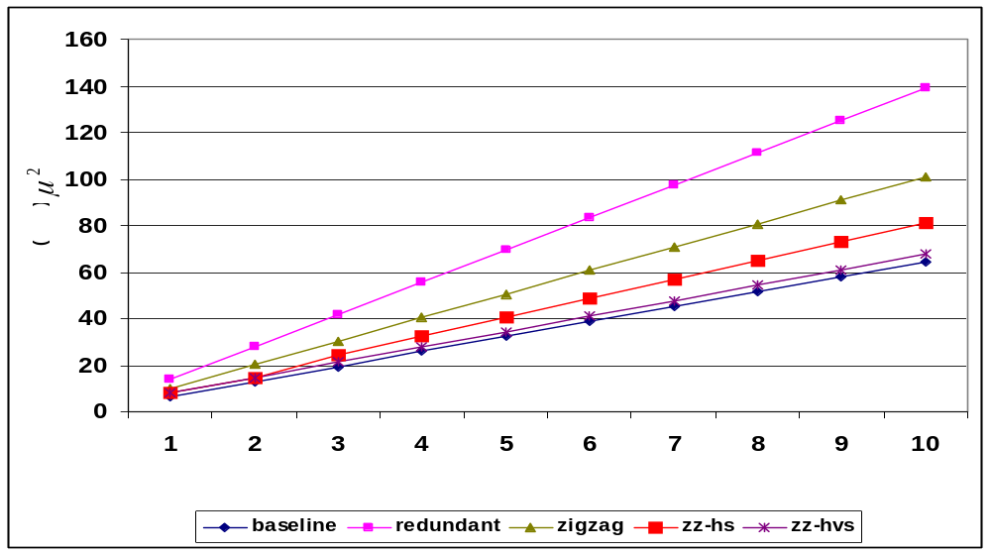
ZZ-HVS Evaluation : Area Result
zz-hvs has the least impact on area, 4~25%
depends on the number of wordline rows shared

Slide 25
ZZ-HVS Circuit Evaluation: Sleep Transistor Sizing
Trade-off between the leakage savings and impact on the wordline driver propagation delay
zz-hvs-3W (3X) show an optimal trade-off
40X reduction in leakage at 5% increase in propagation delay

Slide 26
Wakeup Latency
To benefit the most from the leakage savings of stacking sleep transistors
  keep the bias voltage of NMOS sleep transistor as low as possible (and for PMOS as high as possible)
Drawback: impact on the wakeup latency of wordline drivers
Wakeup latency associated with the zz-hvs-3W circuit is 1.3ns
  4 processor cycles (3.3 GHz)
  For large memory, such as 2MB L2 cache the overall wake up latency can be as high 6 to 10 cycles

Slide 27
Impact on Propagation Delay
The zz-hvs increases the propagation delay of the peripheral circuit by 5%, when applied to wordline drivers, input/output drivers, etc
  Translate to 5% reduction in maximum operating clock frequency of the memory in a single pipeline memory
  Deep pipelined memories such as L1 and L2 cache hide negligible increase in peripheral circuit latency

Slide 28
Sleep-Share: ZZ-HVS + Architectural Control
When an L2 cache miss occurs the processor executes a number of miss-independent instructions and then ends up stalling
  The processor stays idle until the L2 cache miss is serviced. This may take hundreds of cycle (300 cycles for our processor architecture)
  During such a stall period there is no access to L1 and L2 caches and they can be put into low-power mode

Slide 29
Detecting Processor Idle Period
The instruction queue and functional units of the processor monitored after an L2 miss
  Instruction queue has not issued any instructions
  Functional units have not executed any instructions for K consecutive cycles (K=10)
    The sleep signal is asserted
    The sleep signal is de-asserted 10 cycles before the miss service is completed
Assumption: memory access latency is deterministic.
  No performance loss

Slide 30
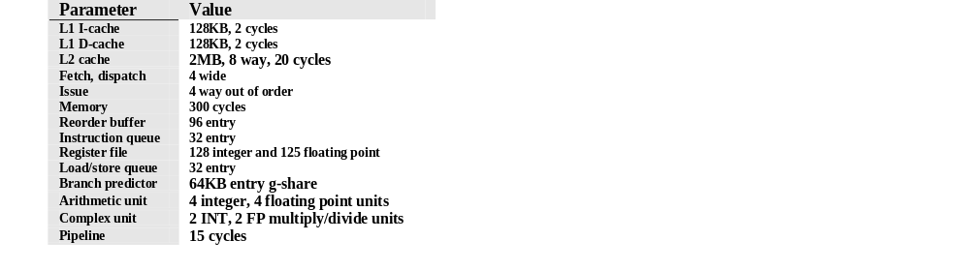
Simulated Processor Architecture
SimpleScalar 4.0
SPEC2K benchmarks
  Compiled with the -O4 flag using the Compaq compiler targeting the Alpha 21264 processor
  fast–forwarded for 3 billion instructions, then fully simulated for 4 billion instructions
    using the reference data sets.

Slide 31
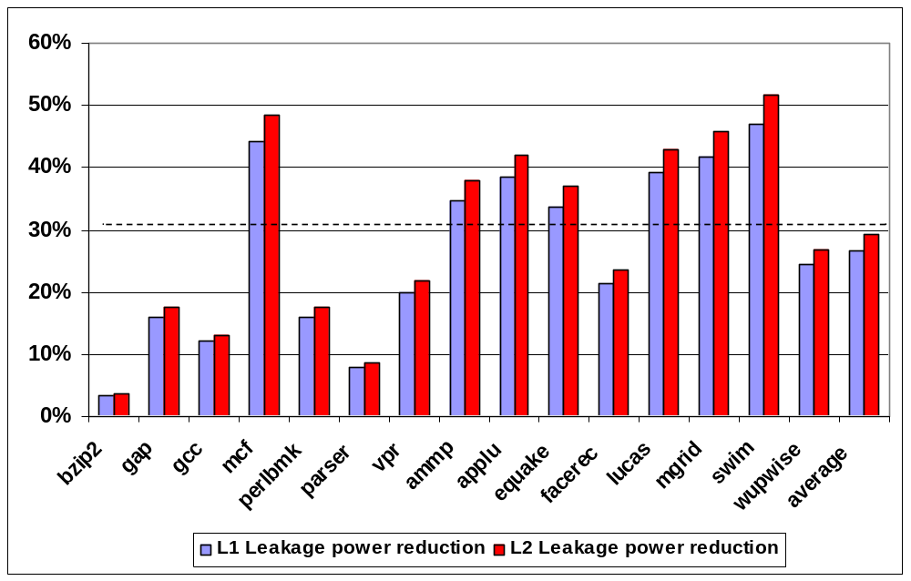
L1 and L2 Leakage Power Reduction
Leakage reduction of 30% for the L2 cache and 28% for the L1 cache

Slide 32
Conclusion
Study break down of leakage in L2 cache components, show peripheral circuit leaking considerably
proposed zig-zag share to reduce leakage in SRAM memory peripheral circuits
zig-zag share reduces peripheral leakage by up to 40X with only a small increase in memory area and delay
Propose Sleep-Share to control zig-zag share circuits in L1 and L2 cache peripherals
Leakage reduction of 30% for the L2 cache and 28% for the L1 cache

