Slide 1


Multiple Sleep Mode Leakage Control for Cache Peripheral Circuits in Embedded Processors
Houman Homayoun, Avesta Makhzan, Alex Veidenbaum
Dept. of Computer Science, UC Irvine
hhomayou@ics.uci.edu

Slide 2
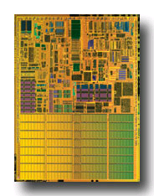
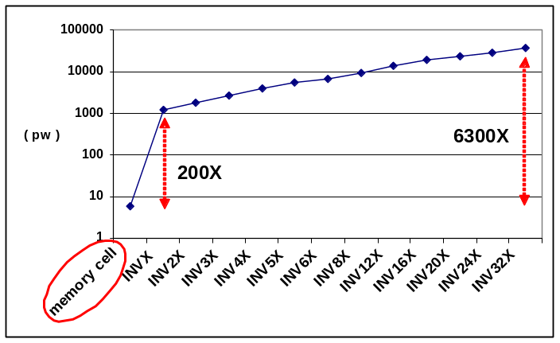
On-chip Caches and Power
On-chip caches in high-performance processors are large
  more than 60% of chip budget
Dissipate significant portion of power via leakage
  Much of it was in the SRAM cells
    Many architectural techniques proposed to remedy this
Today, there is also significant leakage in the peripheral circuits of an SRAM (cache)
  In part because cell design has been optimized
Pentium M processor die photo
Courtesy of intel.com
  Using minimal sized transistor for area considerations in cells and larger, faster and accordingly more leaky transistors to satisfy timing requirements in peripherals.
  Using high vt transistors in cells compared with typical threshold voltage transistors in peripherals

Slide 3
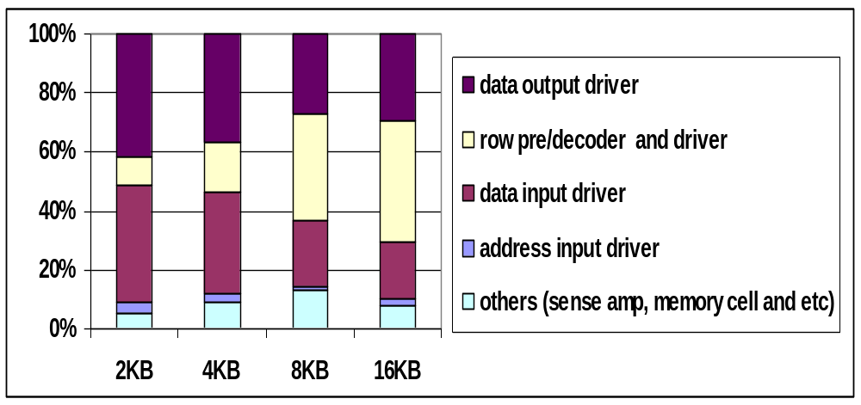
Leakage Power Component of Different Cache Size
  SRAM peripheral circuits dissipate more than 80% of the total leakage power

Slide 4
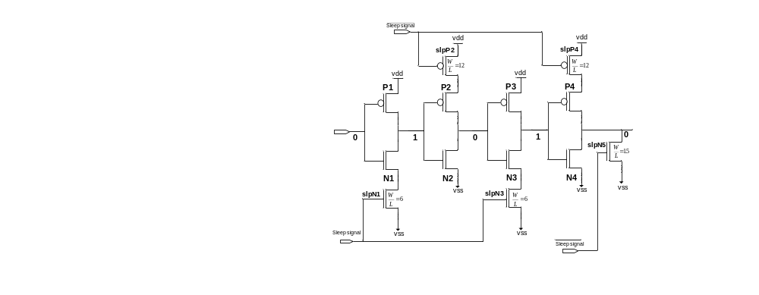
A Zig-Zag Circuit
R_{peq} for the first and third inverters and R_{neq} for the second and fourth inverters doesn’t change.
  Fall time of the circuit does not change

Slide 5
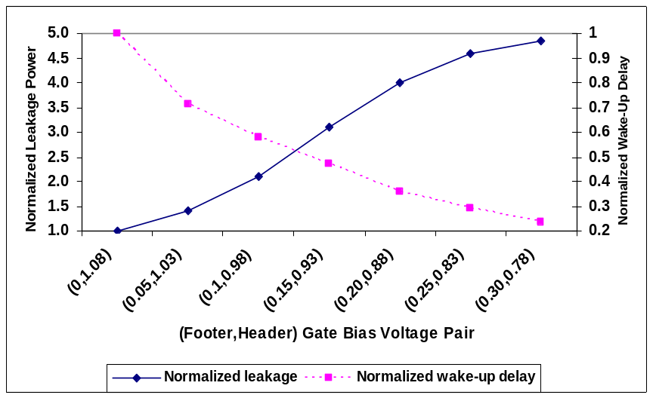
A Zig-Zag Share Circuit
To improve leakage reduction and area-efficiency of the zig-zag scheme, using one set of sleep transistors shared between multiple stages of inverters (ICCD’08)
Zig-Zag Horizontal Sharing
  Minimize impact on rise time
  Minimize area overhead
Zig-Zag Horizontal and Vertical
Sharing
  Maximize leakage power saving
  Minimize the area overhead
Increasing the bias voltage increases the leakage power
while decreases the wakeup delay overhead

Slide 6
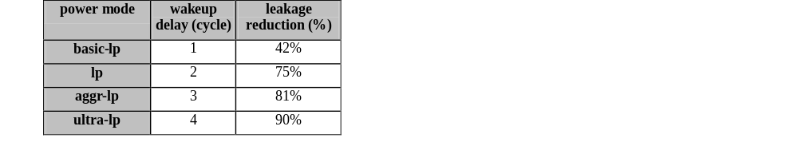
Multiple Sleep Modes
Power overhead of waking up peripheral circuits
  Almost equivalent to the switching power of sleep transistors
  Sharing a set of sleep transistors horizontally and vertically for multiple stages of a (wordline) driver makes the power overhead even smaller

Slide 7
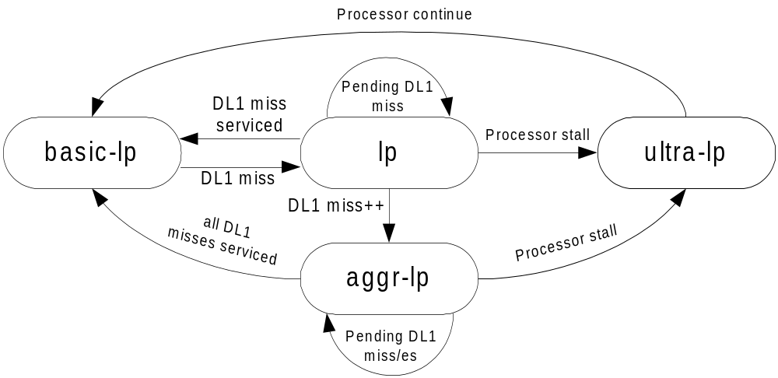
Low-end Architecture
Given the miss service time of 30 cycles
  likely that processor stalls during the miss service period
  Occurrence of additional cache misses while one DL1 cache miss is already pending further increases the chance of pipeline stall

Slide 8
Low Power Modes in a 2KB DL1 Cache
100%
90%
80%
70%
60%
50%
40%
30%
20%
10%
0%
bc
crc
dijkstra
djpeg
fft
gs
gsm
lame
mad
patricia
pgp
qsort
rijndael
search
sha
tiff2bw
average
basicmath
susan_edges
susan_corners
hp
trivial-lp
lp
aggr-lp
ultra-lp
Fraction of total execution time DL1 cache spends in each of the power mode
85% of the time DL1 peripherals put into low power modes
  Most of the time spent in the basic-lp mode (58% of total execution time)

