Slide 1


Architectural and Circuit-Levels Design Techniques for Power and Temperature Optimizations in On-Chip SRAM Memories
Houman Homayoun
PhD Candidate
Dept. of Computer Science, UC Irvine

Slide 2

Outline
Past Research
  Low Power Design
    Power Management in Cache Peripheral Circuits (CASES-2008, ICCD-2008,ICCD-2007, TVLSI, CF-2010)
    Clock Tree Leakage Power Management (ISQED-2010)
  Thermal-Aware Design
    Thermal Management in Register File (HiPEAC-2010)
  Reliability-Aware Design
    Process Variation Aware Cache Architecture for Aggressive Voltage-Frequency Scaling (DATE-2009, CASES-2009)
  Performance Evaluation and Improvement
    Adaptive Resource Resizing for Improving Performance in Embedded Processor (DAC-2008, LCTES-2008)

Slide 3
RELOCATE
Register File Local Access Pattern Redistribution Mechanism for Power and Thermal Management in Out-of-Order Embedded Processor
Houman Homayoun, Aseem Gupta, Alexander V. Veidenbaum
Avesta Sasan, Fadi J. Kurdahi, Nikil Dutt

Slide 4
Outline
Motivation
Background study
Study of Register file Underutilization
Study of Register file default access patterns
Access concentration and activity redistribution to relocate register file access patterns
Results

Slide 5
Why Temperature?
Higher power densities (Watt per mm2) lead to higher operating temperatures, which
  (i) Increase the probability of timing violations
  (ii) Reduce IC lifetime
  (iii) Lower operating frequency
  (iv) Increase leakage power
  (v) Require expensive cooling mechanisms
  (vi) Overall increase in design effort and cost

Slide 6
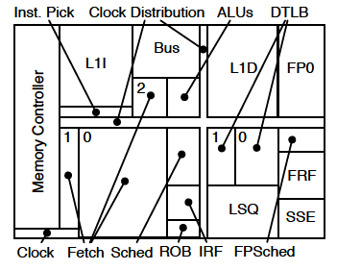
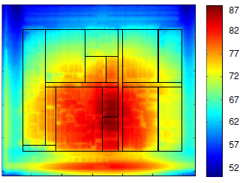
Why Register File?
RF is one of the hottest units in a processor
  A small, heavily multi-ported SRAM
  Accessed very frequently
Example: IBM PowerPC 750FX, AMD Athlon 64
Thermal Image of AMD Athlon 64 core floorplan blocks using infrared cameras, Courtesy of Renau et al. ISCA 2007
AMD Athlon 64 core floorplan blocks

Slide 7
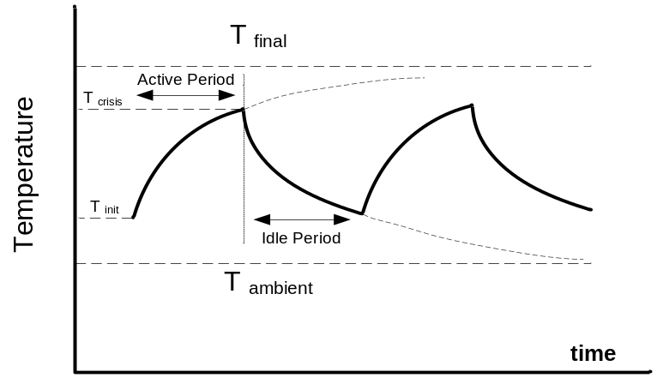
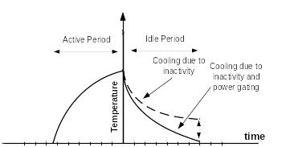
Prior Work: Activity Migration
Reduces temperature by migrating the activity to a replicated unit.
  requires a replicated unit
    large area overhead
  leads to a large performance degradation
AM
AM+PG
Notes:
Figures for illustration only, show trends. AM - activity migration. PG - Power Gating

Slide 8
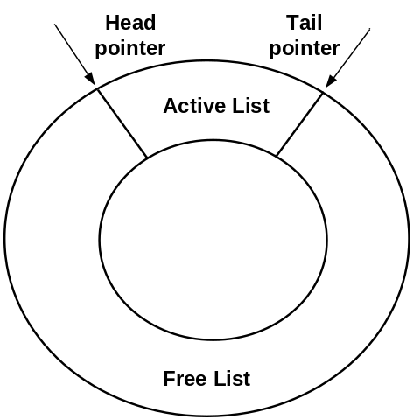

Conventional Register Renaming
Register Renamer
Register allocation-release
Physical registers are allocated/released in a somewhat random order
Notes:
Renamer with lists of free and used regs. Registers are not in any order
Example assumes branch taken.

Slide 9
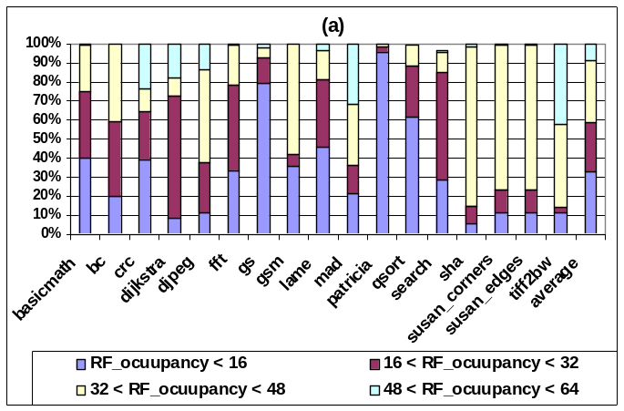
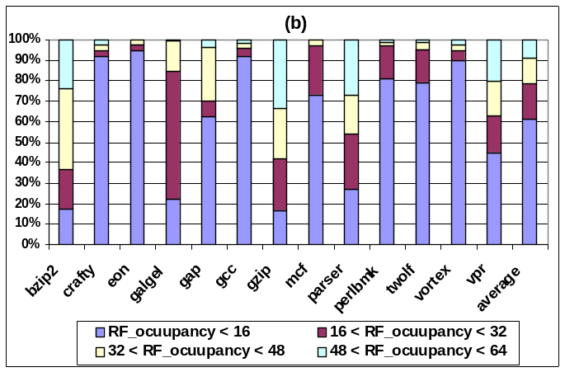
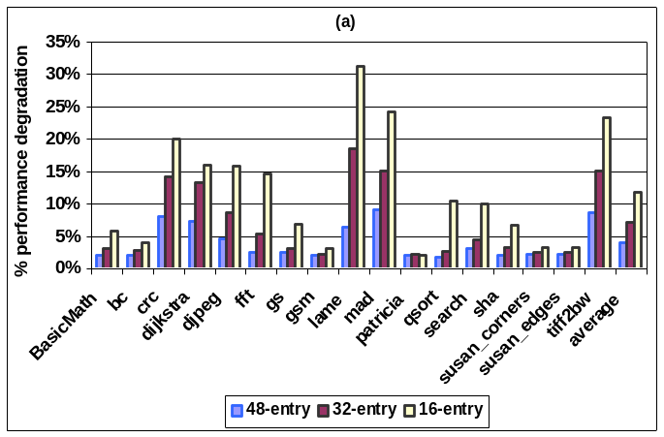
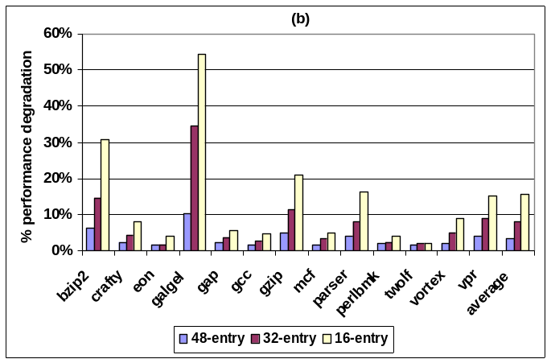
Analysis of Register File Operation: Register File Occupancy
MiBench
SPECint2K
Performance Degradation with a Smaller Register File
Notes:
Many unused registers

Slide 10
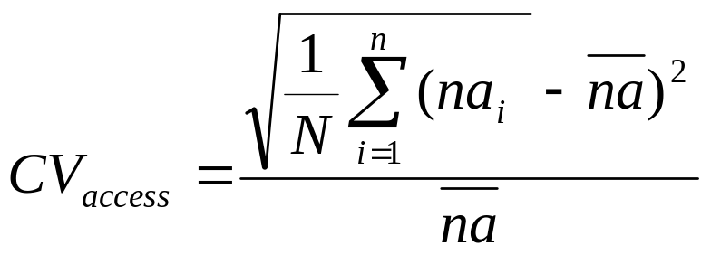
Analysis of Register File Operation
Register File Access Distribution
  Coefficient of variation (CV) shows a “deviation” from average # of accesses for individual physical registers.
    na_{i} is the number of accesses to a physical register i during a specific period (10K cycles). na is the average
    N, the total number of physical registers

Slide 11
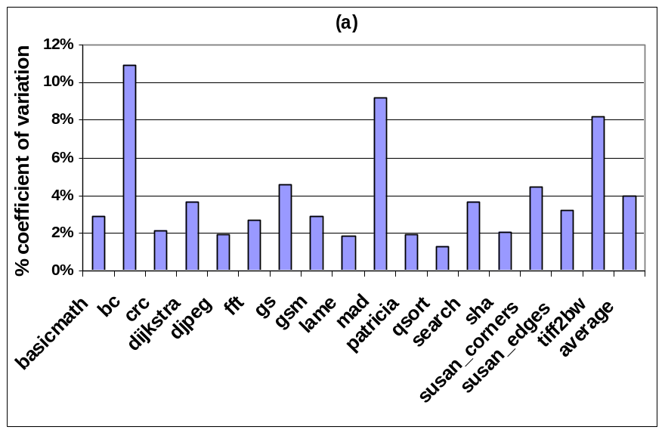
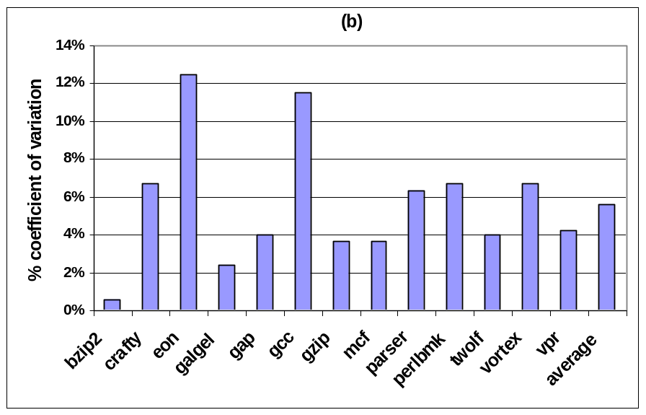
Coefficient of Variation
MiBench
SPEC2K
Notes:
Shows non-uniformity, ie some regs accessed more frequently than others

Slide 12
Register File Operation
Underutilization which is distributed uniformly
while only a small number of registers are occupied at any given time, the total accesses are uniformly distributed over the entire physical register file during the course of execution

Slide 13
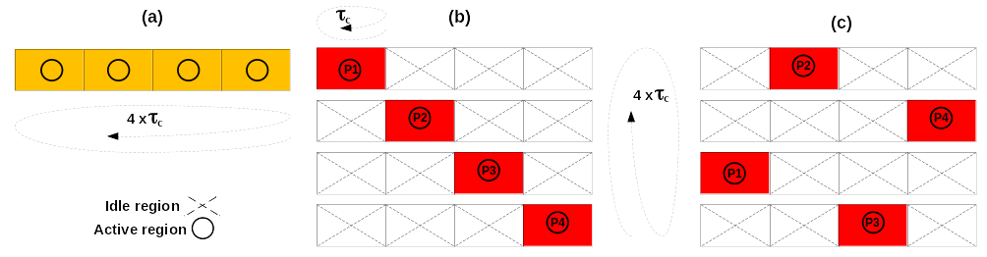
RELOCATE: Access Redistribution within a Register File
The goal is to “concentrate” accesses within a partition
of a RF (region)
  Some regions will be idle (for 10K cycles)
    Can power-gate them and allow to cool down
register activity (a) baseline, (b) in-order (c) distant patterns
Notes:
10K cycles is a time scale for temperature change.
Baseline has random access patern, so all regions are active. b) vs c) - adjacent regions heat each other up, so c) is better

Slide 14
An Architectural Mechanism to Support Access Redistribution
Active partition:
  a register renamer partition currently used in register renaming
Idle partition:
  a register renamer partition which does not participate in renaming
Active region:
  a region of the register file corresponding to a register renamer partition (whether active or idle) which has live registers
Idle region:
  a region of the register file corresponding to a register renamer partition (whether active or idle) which has no live registers

Slide 15
Activity Migration without Replication
An access concentration mechanism allocates registers from only one partition
This default active partition (DAP) may run out of free registers before the 10K cycle “convergence period” is over
  another partition (according to some algorithm) is then activated (referred to as additional active partitions or AAP )
  To facilitate physical register concentration in DAP, if two or more partitions are active and have free registers, allocation is performed in the same order in which partitions were activated.

Slide 16
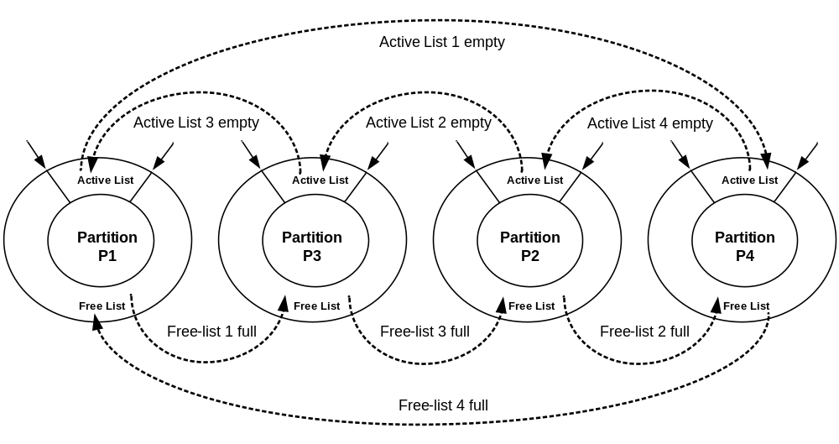
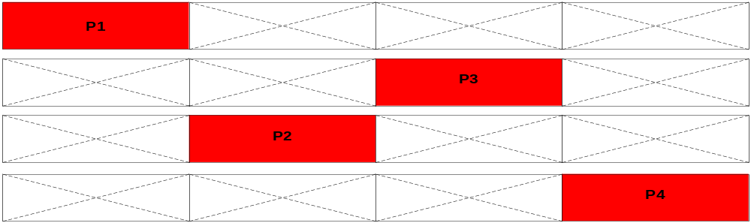
The Access Concentration Mechanism
Partition activation order is 1-3-2-4

Slide 17
The Redistribution Mechanism
The default active partition is changed once every N cycles to redistribute the activity within the register file (according to some algorithm)
  Once a new default partition (NDP) is selected, all active partitions (DAP+AAP) become idle.
The idle partitions do not participate in register renaming, but their corresponding RF regions may have to be kept active (powered up)
  A physical register in an idle partition may be live
An idle RF region is power gated when its active list becomes empty.

Slide 18
Performance Impact?
There is a two-cycle delay to wakeup a power gated physical register region
The register renaming occurs in the front end of the microprocessor pipeline whereas the register access occurs in the back end.
  There is a delay of at least two pipeline stages between renaming and accessing a physical register file
  Can wake up the requested region in time
Can wake up a required register file region
without incurring a performance penalty
at the time of access

Slide 19
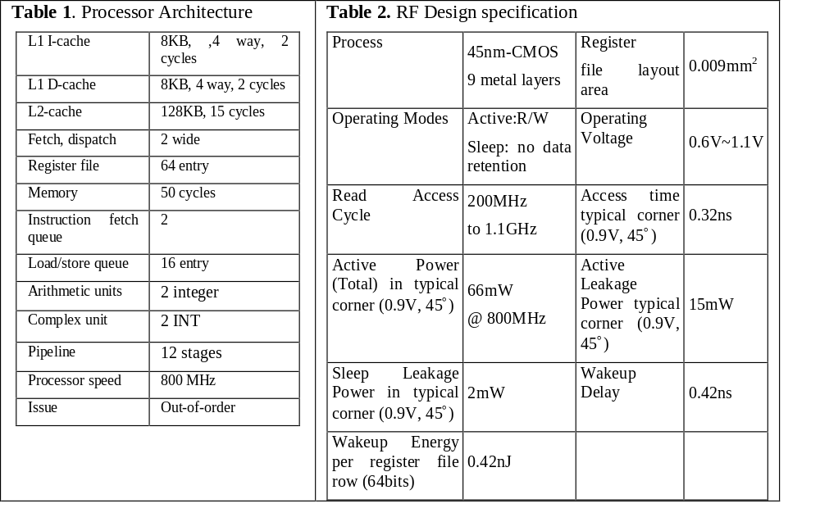
Experimental setup
MASE (SimpleScalar 4.0)
  Model MIPS-74K processor, 800 MHz
MiBench and SPECint2K benchmarks compiled with Compaq compiler, -O4 flag
Industrial memory compiler used
  64-entry, 64bit single-ended SRAM memory in TSMC 45nm technology
HotSpot to estimate thermal profiles

Slide 20
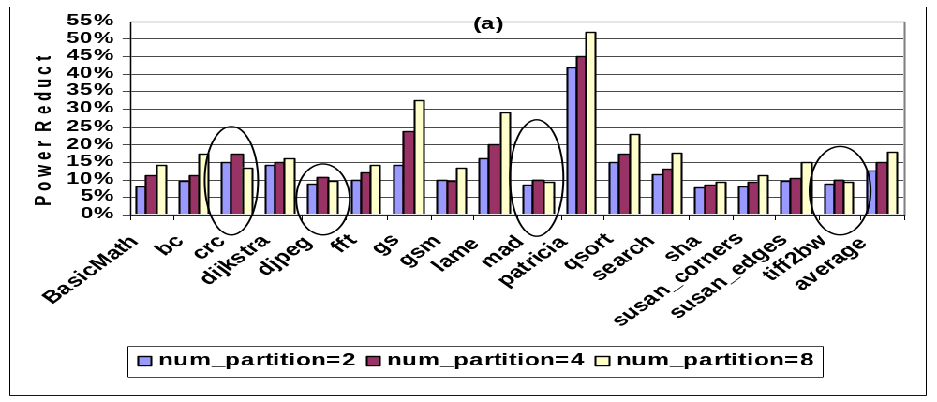
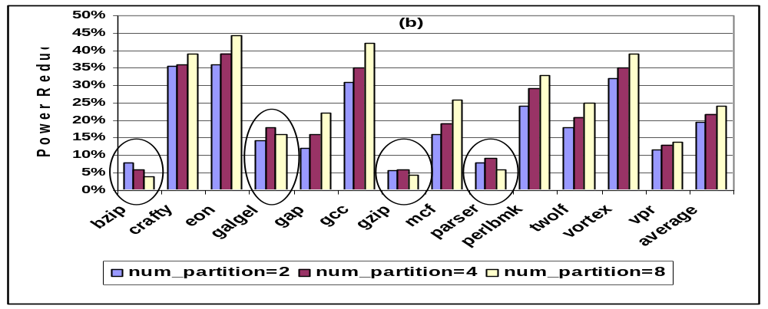
Results-Power Reduction
Mibench RF power reduction
SPEC2K RF power reduction
Notes:
From power gating idle regions

Slide 21
Analysis of Power Reduction
Increasing the number of RF partitions provides more opportunity to capture and cluster unmapped registers to a partition
  Indicates that wakeup overhead is amortized for a larger number of partitions.
Some exceptions
  the overall power overhead associated with waking up an idle region becomes larger as the number of partition increases.
  frequent but ineffective power gating and its overhead as the number of partition increases

Slide 22
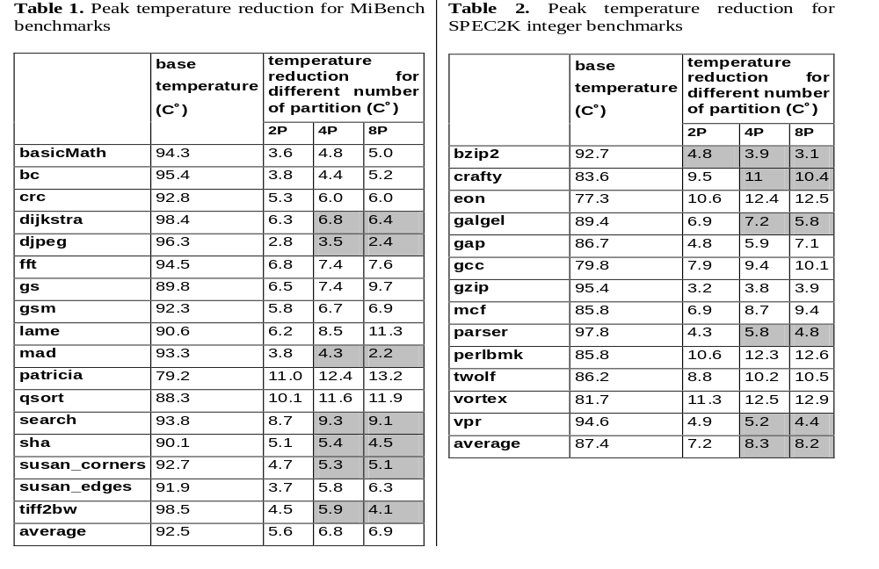
Peak Temperature Reduction
Notes:
4 partitions is best

Slide 23
Analysis of Temperature Reduction
Increasing the number of partitions results in larger power density in each partition because RF access activity is concentrated in a smaller partition
  While capturing more idle partitions and power gating them may potentially result in higher power reduction, larger power density due to smaller partition size results in overall higher temperature

Slide 24
Conclusions
Showed Register File Underutilization
Studied Register file default access patterns
Propose access concentration and activity redistribution to relocate register file accesses
Results show a noticeable power and temperature reduction in the RF
RELOCATE technique can be applied when units are underutilized
  as opposed to activity migration, which requires replication

Slide 25
Current and Future Work Extension
Formulate the Best partition selection out of available partitions for activity redistribution.
Apply activity concentration and redistribution mechanism to other hot units; example: L1 cache.
Apply Proactive NBTI Recovery to the idle partitions to improve lifetime reliability.
Trade-off NBTI recovery and power gating to simultaneously reduce power and improve lifetime reliability.
Tackle the temperature barrier in 3D stack processor design using similar activity concentration and redistribution.

Slide 26
Multiple Sleep Modes Leakage Control for Cache Peripherals
Houman Homayoun, Avesta Sasan, Alexander V. Veidenbaum

Slide 27
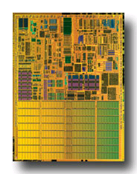
On-chip Caches and Power
On-chip caches in high-performance processors are large
  more than 60% of chip budget
Dissipate significant portion of power via leakage
  Much of it was in the SRAM cells
    Many architectural techniques proposed to remedy this
Today, there is also significant leakage in the peripheral circuits of an SRAM (cache)
  In part because cell design has been optimized
Pentium M processor die photo
Courtesy of intel.com

Slide 28
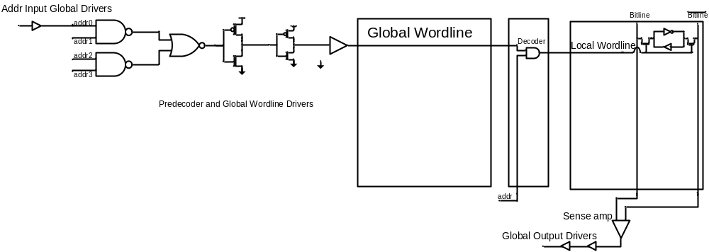
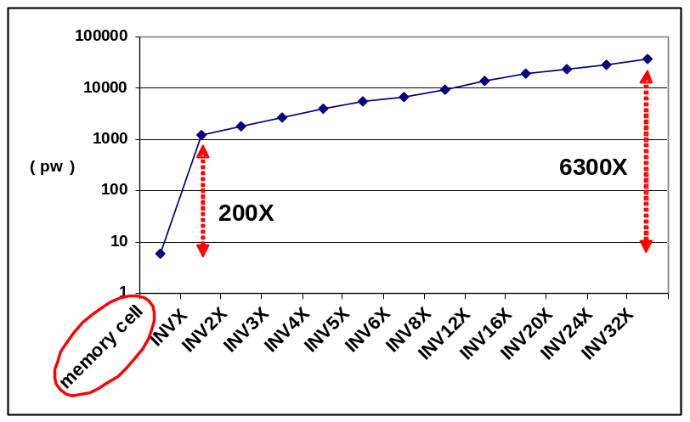
Peripherals ?
Data Input/Output Driver
Address Input/Output Driver
Row Pre-decoder
Wordline Driver
Row Decoder
  Using minimal sized transistor for area considerations in cells and larger, faster and accordingly more leaky transistors to satisfy timing requirements in peripherals.
  Using high vt transistors in cells compared with typical threshold voltage transistors in peripherals

Slide 29
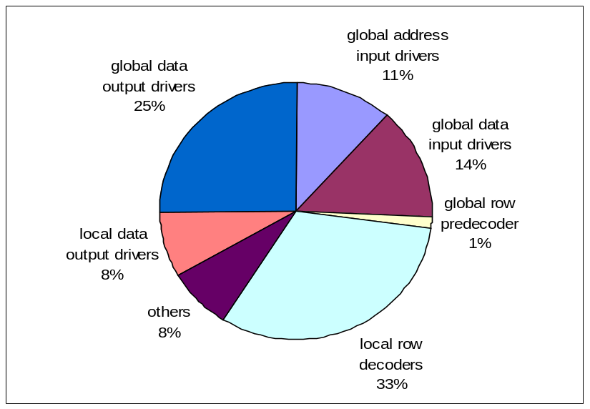
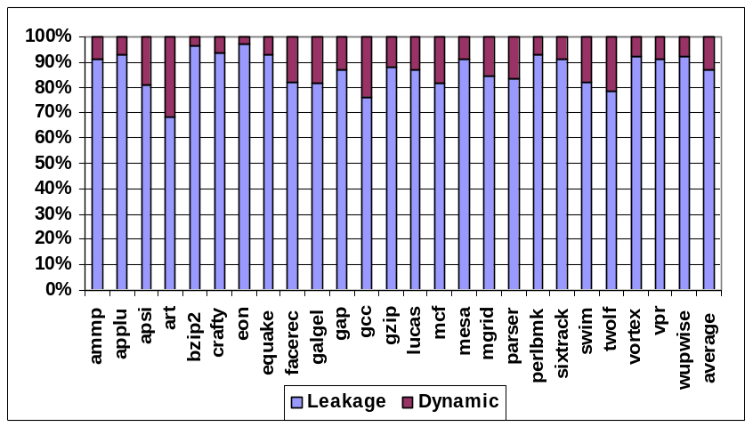
Power Components of L2 Cache
  SRAM peripheral circuits dissipate more than 90% of the total leakage power
L2 cache leakage power dominates its dynamic power above 87% of the total

Slide 30
Techniques Address Leakage in SRAM Cell
Gated-Vdd, Gated-Vss
Voltage Scaling (DVFS)
ABB-MTCMOS
Forward Body Biasing (FBB), RBB
Sleepy Stack
Sleepy Keeper
Circuit
Way Prediction, Way Caching, Phased Access
  Predict or cache recently access ways, read tag first
Drowsy Cache
  Keeps cache lines in low-power state, w/ data retention
Cache Decay
  Evict lines not used for a while, then power them down
Applying DVS, Gated Vdd, Gated Vss to memory cell
  Many architectural support to do that.
Architecture
Target SRAM memory cell

Slide 31
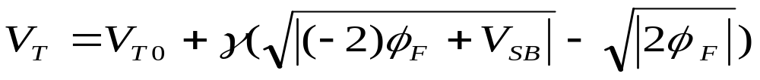
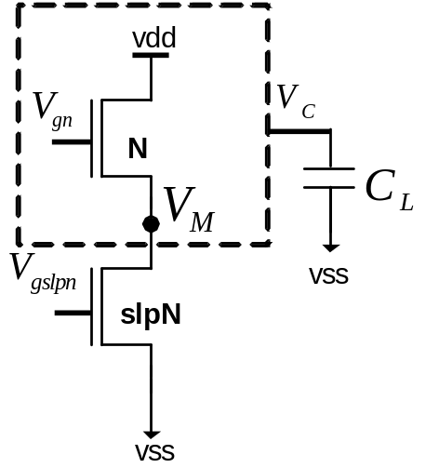
Sleep Transistor Stacking Effect
Subthreshold current: inverse exponential function of threshold voltage
Stacking transistor N with slpN:
  The source to body voltage (VM ) of
  transistor N increases, reduces its
  subthreshold leakage current, when
  both transistors are off
Drawback : rise time, fall time, wakeup delay, area, dynamic power, instability

Slide 32
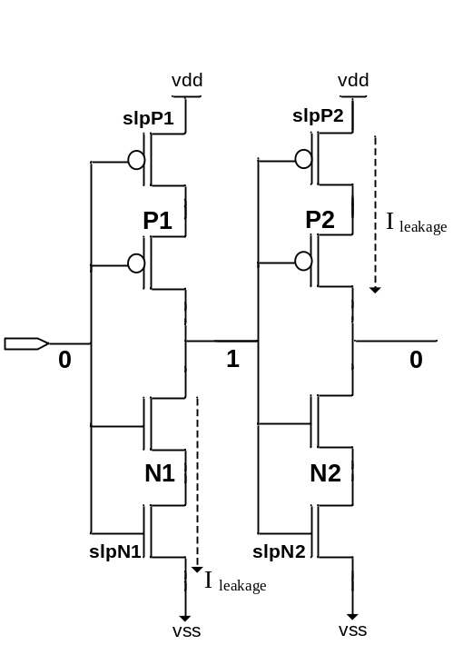
Impact on Rise Time and Fall Time
The rise time and fall time of the output of an inverter is proportional to the
R_{peq} * C_{L} and R_{neq} * C_{L}
Inserting the sleep transistors increases both R_{neq} and R_{peq}
Increasing in rise time
Impact on performance
Increasing in fall time
Impact on memory functionality

Slide 33
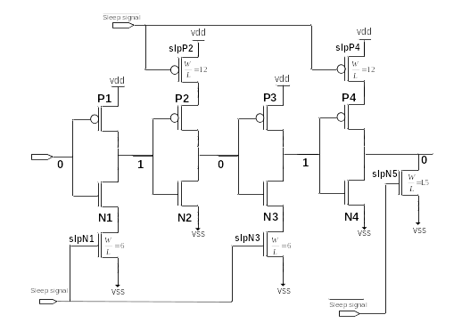
A Zig-Zag Circuit
R_{peq} for the first and third inverters and R_{neq} for the second and fourth inverters doesn’t change.
  Fall time of the circuit does not change
To improve leakage reduction and area-efficiency of the zig-zag scheme, using one set of sleep transistors shared between multiple stages of inverters
    Zig-Zag Horizontal Sharing
    Zig-Zag Horizontal and Vertical Sharing

Slide 34
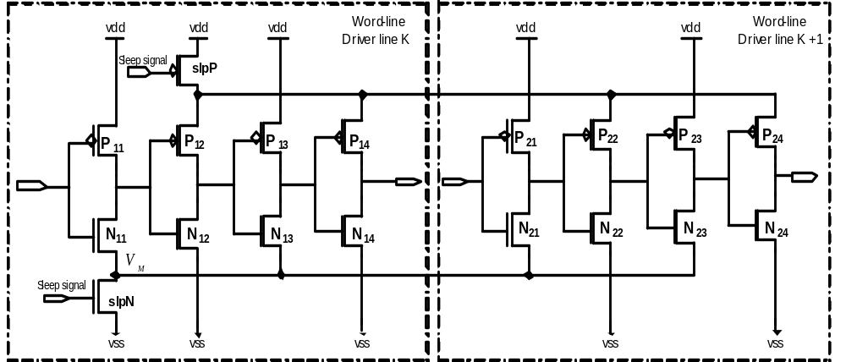

Zig-Zag Horizontal and Vertical Sharing
To improve leakage reduction and area-efficiency of the zig-zag scheme, using one set of sleep transistors shared between multiple stages of inverters
  Zig-Zag Horizontal Sharing
    Minimize impact on rise time
    Minimize area overhead
  Zig-Zag Horizontal and Vertical Sharing
    Maximize leakage power saving
    Minimize the area overhead

Slide 35
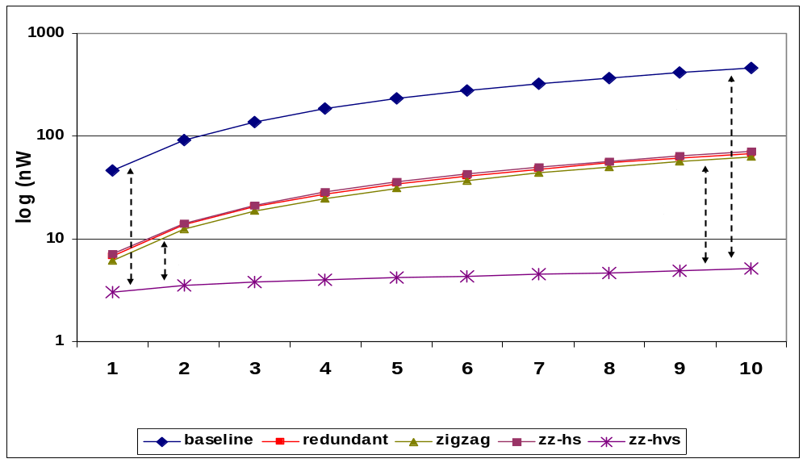
ZZ-HVS Evaluation : Power Result
Increasing the number of wordline rows share sleep transistors increases the leakage reduction and reduces the area overhead
Leakage power reduction varies form a 10X to a 100X when 1 to 10 wordline shares the same sleep transistors
  2~10X more leakage reduction, compare to the zig-zag scheme

Slide 36
Wakeup Latency
To benefit the most from the leakage savings of stacking sleep transistors
  keep the bias voltage of NMOS sleep transistor as low as possible (and for PMOS as high as possible)
Drawback: impact on the wakeup latency of wordline drivers
Control the gate voltage of the sleep transistors
  Increasing the gate voltage of footer sleep transistor reduces the virtual ground voltage (VM)
reduction in leakage power savings
reduction in the circuit wakeup delay overhead

Slide 37
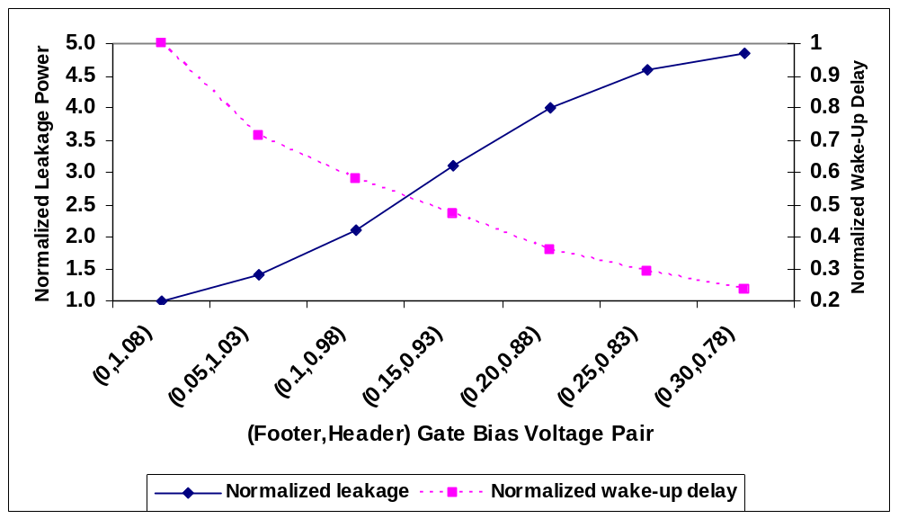
Wakeup Delay vs. Leakage Power Reduction
trade-off between the
wakeup overhead
and leakage power saving
Increasing the bias voltage increases the leakage power while decreases the wakeup delay overhead

Slide 38
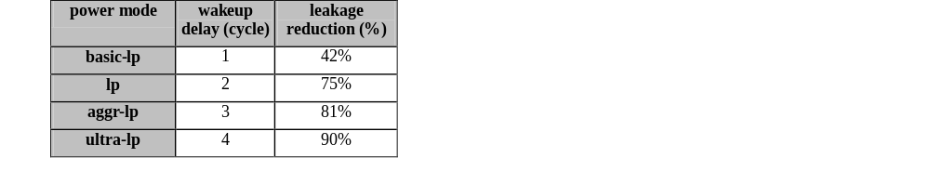
Multiple Sleep Modes
Power overhead of waking up peripheral circuits
  Almost equivalent to the switching power of sleep transistors
  Sharing a set of sleep transistors horizontally and vertically for multiple stages of a (wordline) driver makes the power overhead even smaller

Slide 39
Reducing Leakage in L1 Data Cache
Maximize the leakage reduction in DL1 cache
  put DL1 peripheral into ultra low power mode
  adds 4 cycles to the DL1 latency
    significantly reduces performance
Minimize Performance Degradation
  put DL1 peripherals into the basic low power mode
  requires only one cycle to wakeup and
  hide this latency during address computation stage thus not degrading performance
    Not noticeable leakage power reduction

Slide 40
Motivation for Dynamically Controlling Sleep Mode
dynamically adjust
peripheral circuit
sleep power mode
large leakage reduction benefit
  Ultra and aggressive low power modes
low performance impact benefit
  Basic-lp mode
Periods of frequent access
  Basic-lp mode
Periods of infrequent access
  Ultra and aggressive low power modes

Slide 41
Reducing DL1 Wakeup Delay
Can determine whether an instruction is load or a store at least one cycle prior cache access
  Accessing DL1 while its peripherals are in basic-lp mode doesn’t require an extra cycle
  wake up DL1 peripherals one cycle prior to access
One cycle of wakeup delay can be hidden for all other low-power modes
  Reducing the wakeup delay by one cycle
Put DL1 in basic-lp mode by default

Slide 42
Architectural Motivations
Architectural Motivation
  A load miss in L1/L2 caches takes a long time to service
    prevents dependent instructions from being issued
When dependent instructions cannot issue
  performance is lost
At the same time, energy is lost as well!
  This is an opportunity to save energy

Slide 43
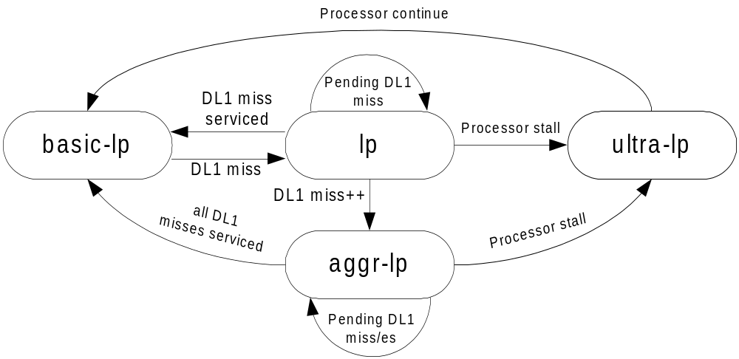
Low-end Architecture
Given the miss service time of 30 cycles
  likely that processor stalls during the miss service period
  Occurrence of additional cache misses while one DL1 cache miss is already pending further increases the chance of pipeline stall

Slide 44
Low Power Modes in a 2KB DL1 Cache
100%
90%
80%
70%
60%
50%
40%
30%
20%
10%
0%
bc
crc
dijkstra
djpeg
fft
gs
gsm
lame
mad
patricia
pgp
qsort
rijndael
search
sha
tiff2bw
average
basicmath
susan_edges
susan_corners
hp
trivial-lp
lp
aggr-lp
ultra-lp
Fraction of total execution time DL1 cache spends in each of the power mode
85% of the time DL1 peripherals put into low power modes
  Most of the time spent in the basic-lp mode (58% of total execution time)

Slide 45
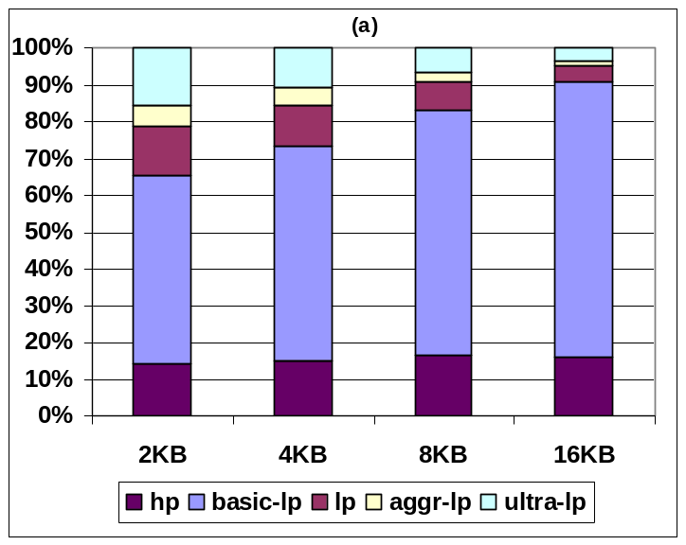
Low Power Modes in Low-End Architecture
10%
9%
8%
7%
6%
5%
4%
3%
2%
1%
0%
bc
crc
djpeg
fft
gs
gsm
lame
mad
pgp
qsort
search
sha
tiff2bw
basicmath
dijkstra
patricia
rijndael
average
susan_edges
susan_corners
2KB
4KB
8KB
16KB
Performance degradation
Frequency of different low power mode
Increasing the cache size reduces DL1 cache miss rate
  Reduces opportunities to put the cache into more aggressive low power modes
  Reduces performance degradation for larger DL1 cache

Slide 46
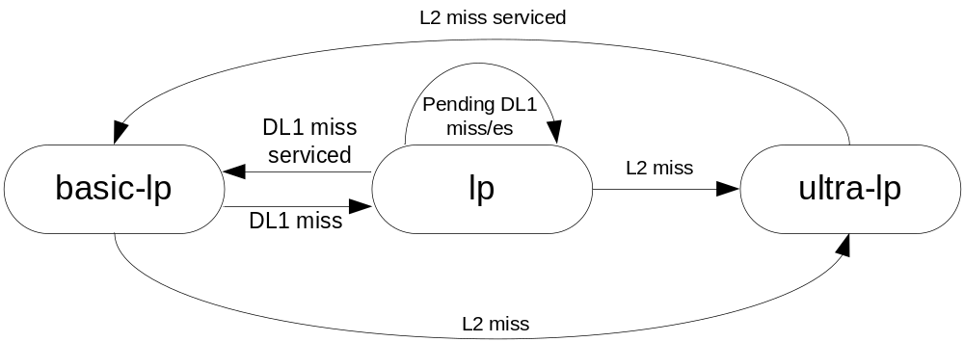
High-end Architecture
DL1 transitions to ultra-lp mode right after an L2 miss occurs
  Given a long L2 cache miss service time (80 cycles) the processor will stall waiting for memory
DL1 returns to the basic-lp mode once the L2 miss is serviced

Slide 47
Leakage Power Reduction
80%
70%
60%
50%
40%
30%
20%
10%
0%
bc
crc
fft
gs
gsm
mad
pgp
sha
dijkstra
djpeg
lame
patricia
qsort
search
tiff2bw
basicmath
rijndael
susan_edges
average
susan_corners
trivial-lp
lp
aggr-lp
ultra-lp
DL1 leakage is reduced by 50%
While ultra-lp mode occurs much less frequently compared to basic-lp mode, its leakage reduction is comparable to the basic-lp mode.
  in ultra-lp mode the peripheral leakage is reduced by 90%, almost twice that of basic-lp mode.
90%
80%
70%
60%
50%
40%
30%
20%
10%
0%
apsi
art
eon
gap
gcc
gzip
mcf
swim
twolf
vpr
ammp
applu
bzip2
crafty
facerec
galgel
lucas
mesa
mgrid
parser
vortex
equake
perlbmk
average
wupwise
trivial-lp
lp
ultra-lp
The average leakage reduction is almost 50%

Slide 48
Conclusion
Highlighted the large leakage power dissipation in SRAM peripheral circuits.
Proposed zig-zag share to reduce leakage in SRAM peripheral circuits.
Extended zig-zag share with multiple sleep modes which trade-off the leakage power reduction vs wakeup delay overhead.
Applied multiple sleep modes technique in L1 cache of an embedded processor.
Presented Leakage power reduction.

Slide 49
T H A N K S

