Slide 1


Temperature-Aware SoC
Optimization Framework
SRC Task # 1617.001
PIs: Fadi J. Kurdahi and Nikil D. Dutt
Center for Embedded Computer Systems (CECS)
University of California, Irvine
{kurdahi, dutt}@uci.edu

Slide 2
Outline
Background and Motivation
Task Details, Accomplishments
Technical Overview
Annual Review: March 2009 #<number>

Slide 3
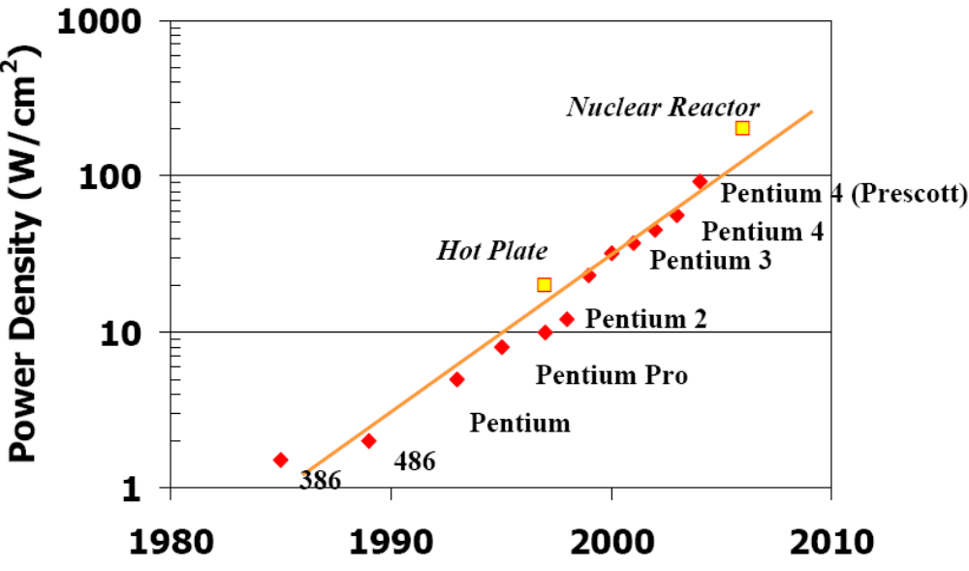
Background and Motivation
SOC Design Methodologies
  Traditionally focused on performance, cost, and switching power
    Temperature and its effects were second tier metrics
  Temperature is increasingly becoming a primary design constraint
    Particularly for sub-100 nm process technologies
Annual Review: March 2009 #<number>

Slide 4
Temperature & SRAM
Effects of high temperature:
  Increased leakage power
  Reduced lifetime (e.g. electromigration, stress)
  Increased interconnect signal propagation delay
  Increased switching delay of transistors
Increased cell delay due to temperature
  SRAM’s access time (read/write) will increase
  A failure occurs when access time > rated time period
Thus, an increase in temperature can cause an SRAM cell to fail.

Slide 5
Process Variation & SRAM
Random Dopant Fluctuation (RDF):
  Dominant impact on a transistor’s strength mismatch
  Intra-Die Variation (different characteristics of cells within an SRAM block)
  RDF typically modeled as a Gaussian distribution of threshold voltage
Because of process variation, not all the cells in an SRAM block will fail at the same temperature
  Different cells will fail at different temperature
  Read failure, Write failure
Because of variation in threshold voltage, value stored in the cell may flip (Destructive read failure)

Slide 6
Outline
Background and Motivation
Task Details, Accomplishments
Technical Overview
Annual Review: March 2009 #<number>

Slide 7


RELOCATE
Register File Local Access Pattern Redistribution Mechanism for Power and Thermal Management in Out-of-Order Embedded Processor
Houman Homayoun, Aseem Gupta, Avesta Sasan, Alex Veidenbaum,
Fadi Kurdahi, Nikil Dutt
University of California Irvine

Slide 8
Outline
Motivation
Background study
Study of Register file Underutilization
Study of Register file default access patterns
Access concentration and activity redistribution to relocate register file access patterns
Results

Slide 9
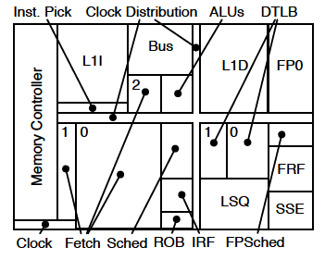
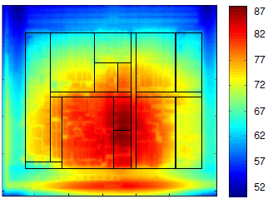
Why Register File?
RF is one of the hottest units in a processor
  A small, heavily multi-ported SRAM
  Accessed very frequently
Example: IBM PowerPC 750FX, AMD Athlon 64
Thermal Image of AMD Athlon 64 core floorplan blocks using infrared cameras, Courtesy of Renau et al. ISCA 2007
AMD Athlon 64 core floorplan blocks

Slide 10
Why Temperature?
Higher power densities (Watt per mm2) lead to higher operating temperatures, which
  (i) Increase the probability of timing violations
  (ii) Reduce IC lifetime
  (iii) Lower operating frequency
  (iv) Increase leakage power
  (v) Require expensive cooling mechanisms
  (vi) Overall increase in design effort and cost

Slide 11
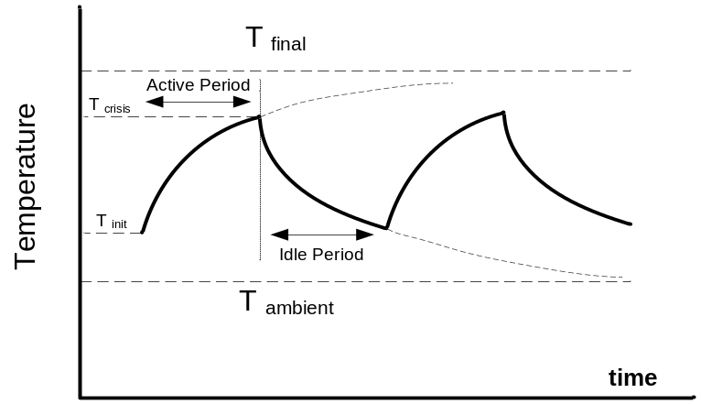
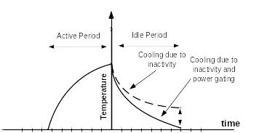
Prior Work: Activity Migration
Reduces temperature by migrating the activity to a replicated unit.
  requires a replicated unit
    large area overhead
  leads to a large performance degradation
AM
AM+PG
Notes:
Figures for illustration only, show trends. AM - activity migration. PG - Power Gating

Slide 12
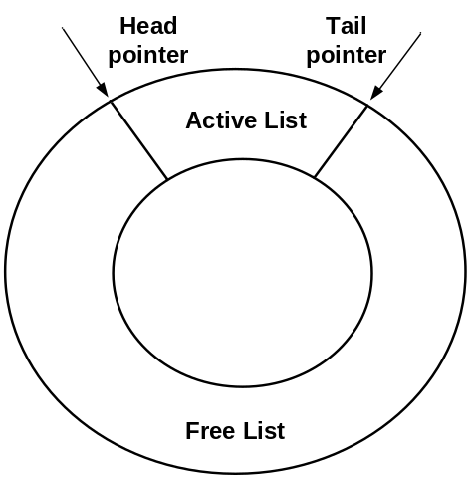

Conventional Register Renaming
Register Renamer
Register allocation-release
Physical registers are allocated/released in a somewhat random order
Notes:
Renamer with lists of free and used regs. Registers are not in any order
Example assumes branch taken.

Slide 13
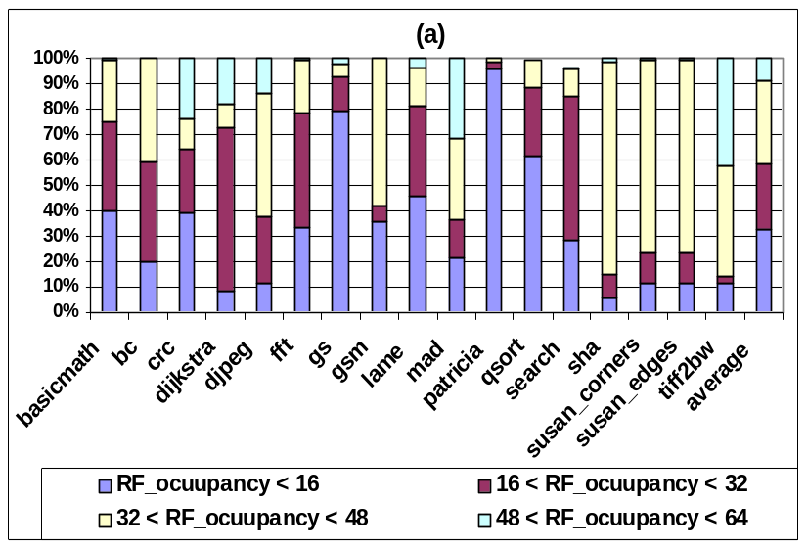
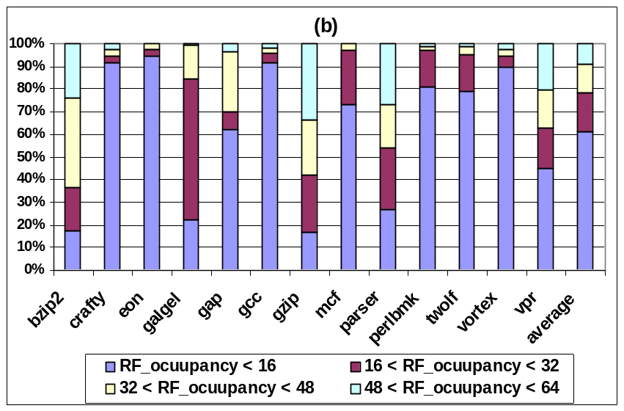
Analysis of Register File Operation
  Register File Occupancy
MiBench
SPECint2K
Notes:
Many unused registers

Slide 14
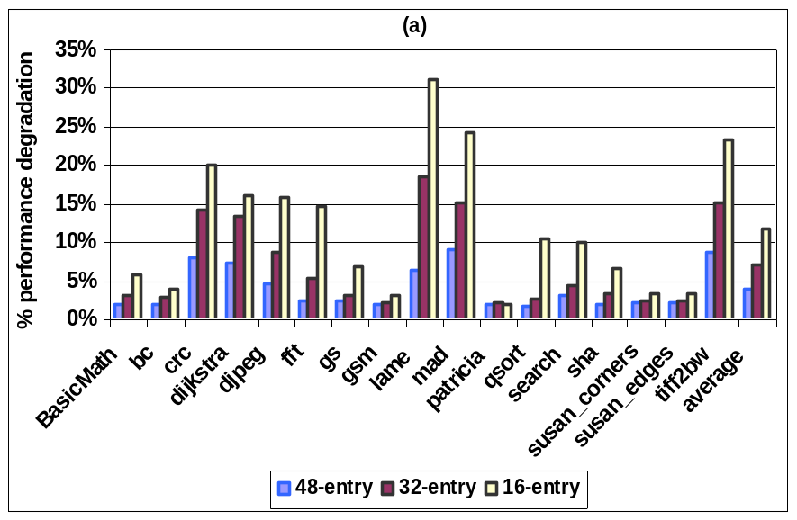
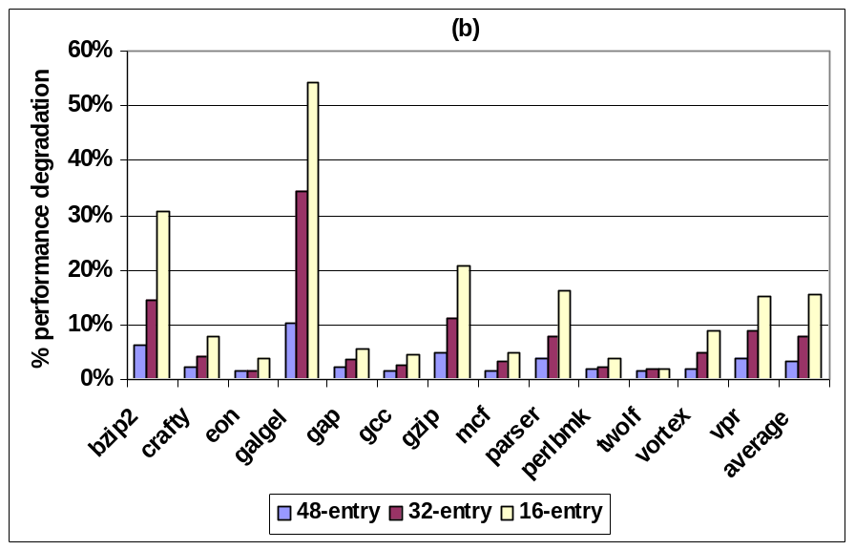
Performance Degradation with a Smaller Register File
MiBench
SPECint2K
Notes:
Many unused registers, but cannot reduce RF size to reduce leakage/temp because performance will degrade

Slide 15
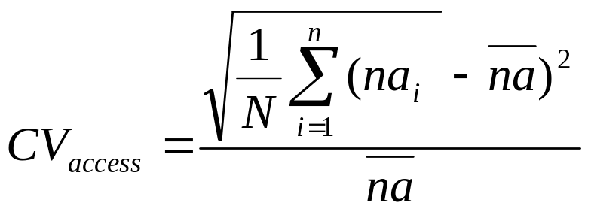
Analysis of Register File Operation
2. Register File Access Distribution
  Coefficient of variation (CV) shows a “deviation” from average # of accesses for individual physical registers.
    na_{i} is the number of accesses to a physical register i during a specific period (10K cycles). na is the average
    N, the total number of physical registers

Slide 16
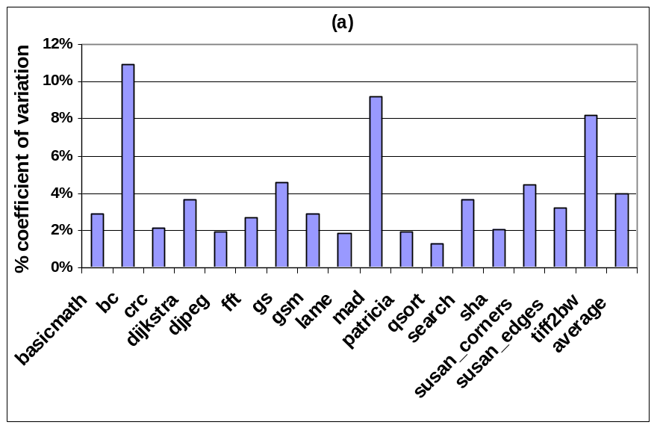
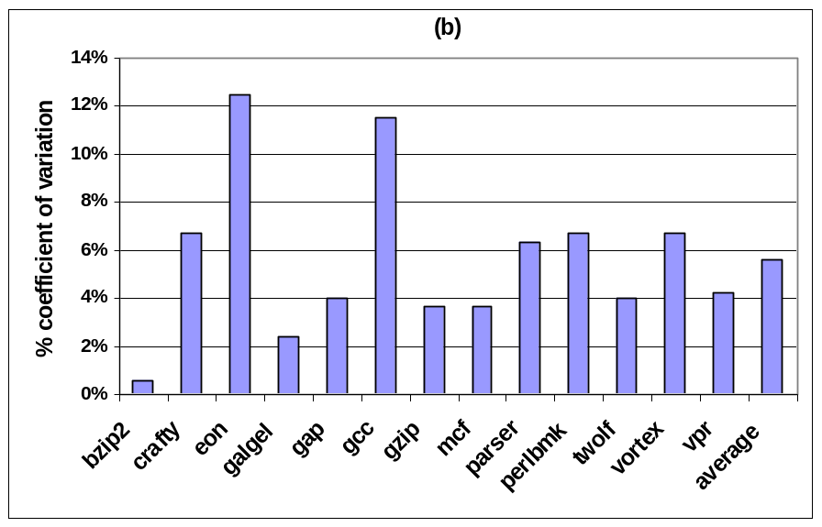
Coefficient of Variation
MiBench
SPEC2K
Notes:
Shows non-uniformity, ie some regs accessed more frequently than others

Slide 17
Register File Operation
Underutilization which is distributed uniformly
while only a small number of registers are occupied at any given time, the total accesses are uniformly distributed over the entire physical register file during the course of execution

Slide 18
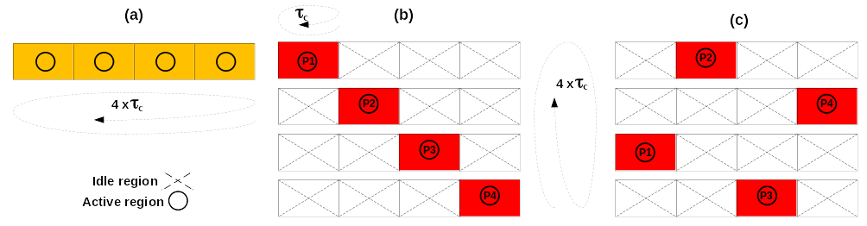
RELOCATE: Access Redistribution within a Register File
The goal is to “concentrate” accesses within a partition of a RF (region)
  Some regions will be idle (for 10K cycles)
    Can power-gate them and allow to cool down
register activity (a) baseline, (b) in-order (c) distant patterns
Notes:
10K cycles is a time scale for temperature change.
Baseline has random access patern, so all regions are active. b) vs c) - adjacent regions heat each other up, so c) is better

Slide 19
An Architectural Mechanism to Support Access Redistribution
Active partition:
  a register renamer partition currently used in register renaming
Idle partition:
  a register renamer partition which does not participate in renaming
Active region:
  a region of the register file corresponding to a register renamer partition (whether active or idle) which has live registers
Idle region:
  a region of the register file corresponding to a register renamer partition (whether active or idle) which has no live registers

Slide 20
Activity Migration without Replication
An access concentration mechanism allocates registers from only one partition
This default active partition (DAP) may run out of free registers before the 10K cycle “convergence period” is over
  another partition (according to some algorithm) is then activated (referred to as additional active partitions or AAP )
  To facilitate physical register concentration in DAP, if two or more partitions are active and have free registers, allocation is performed in the same order in which partitions were activated.

Slide 21
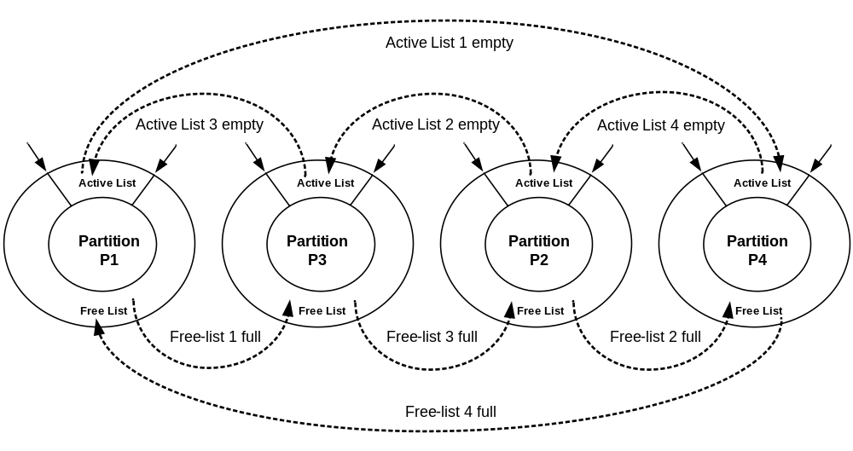
The Access Concentration Mechanism
Partition activation order is 1-3-2-4

Slide 22
The Redistribution Mechanism
The default active partition is changed once every N cycles to redistribute the activity within the register file (according to some algorithm)
  Once a new default partition (NDP) is selected, all active partitions (DAP+AAP) become idle.
The idle partitions do not participate in register renaming, but their corresponding RF regions may have to be kept active (powered up)
  A physical register in an idle partition may be live
An idle RF region is power gated when its active list becomes empty.

Slide 23
The Redistribution Mechanism

Slide 24
Performance Impact?
There is a two-cycle delay to wakeup a power gated physical register region
The register renaming occurs in the front end of the microprocessor pipeline whereas the register access occurs in the back end.
  There is a delay of at least two pipeline stages between renaming and accessing a physical register file
  Can wake up the requested region in time
Can wake up a required register file region
without incurring a performance penalty
at the time of access

Slide 25
Experimental setup
MASE (SimpleScalar 4.0)
  Model MIPS-74K processor, 800 MHz
MiBench and SPECint2K benchmarks compiled with Compaq compiler, -O4 flag
Industrial memory compiler used
  64-entry, 64bit single-ended SRAM memory in TSMC 45nm technology
HotSpot to estimate thermal profiles

Slide 26
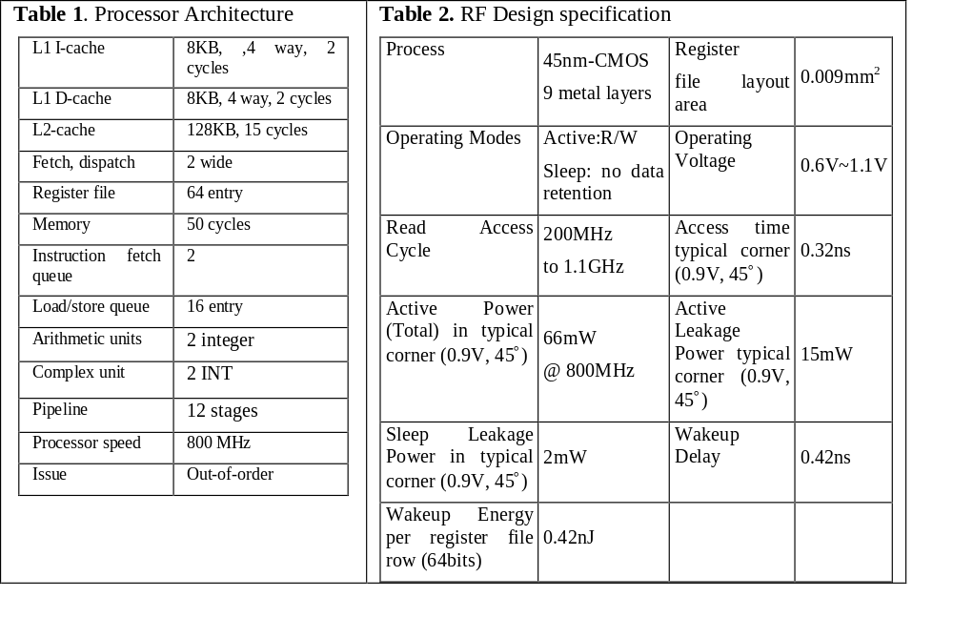
Experimental setup

Slide 27
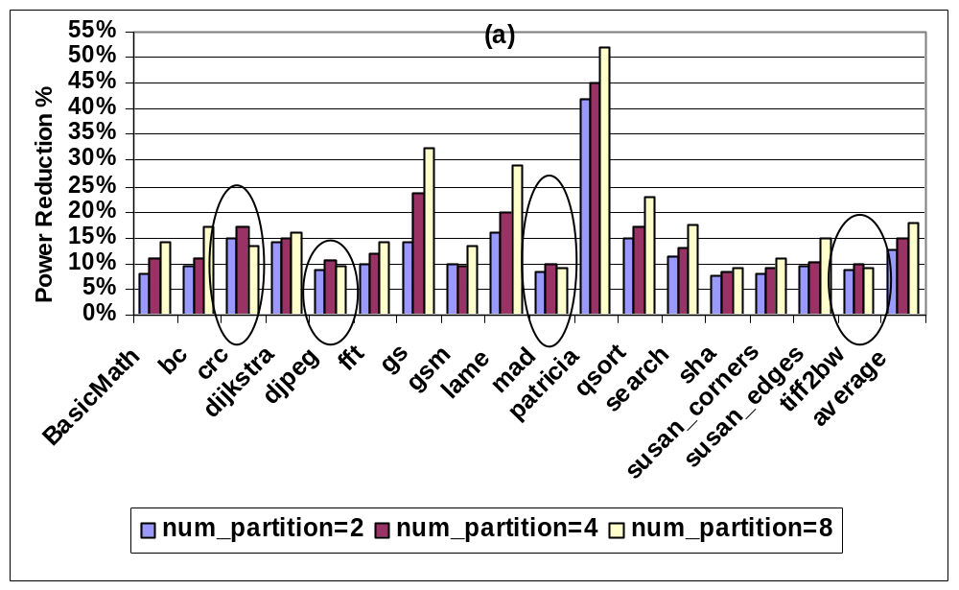
Results
Mibench RF power reduction
Notes:
From power gating idle regions

Slide 28
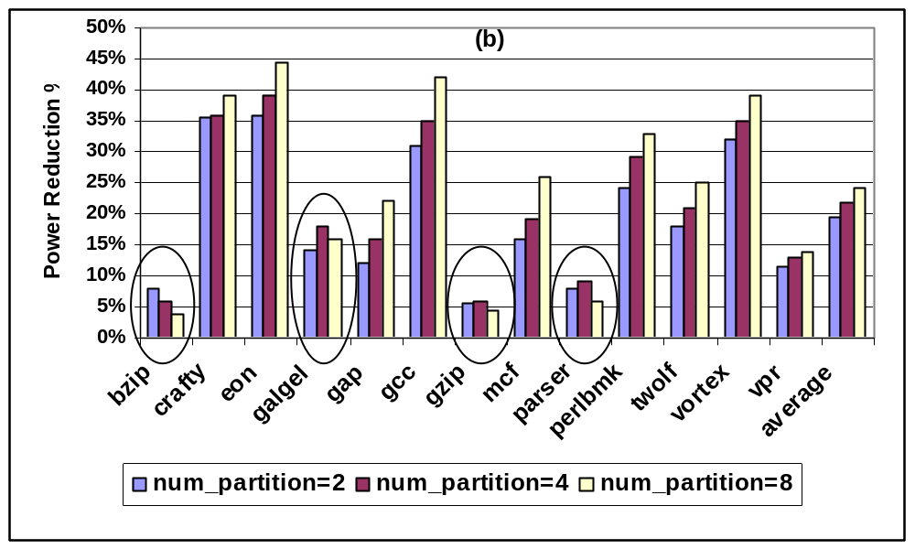
Results
SPEC2K RF power reduction

Slide 29
Analysis of Power Reduction
Increasing the number of RF partitions provides more opportunity to capture and cluster unmapped registers to a partition
  Indicates that wakeup overhead is amortized for a larger number of partitions.
Some exceptions
  the overall power overhead associated with waking up an idle region becomes larger as the number of partition increases.
  frequent but ineffective power gating and its overhead as the number of partition increases

Slide 30
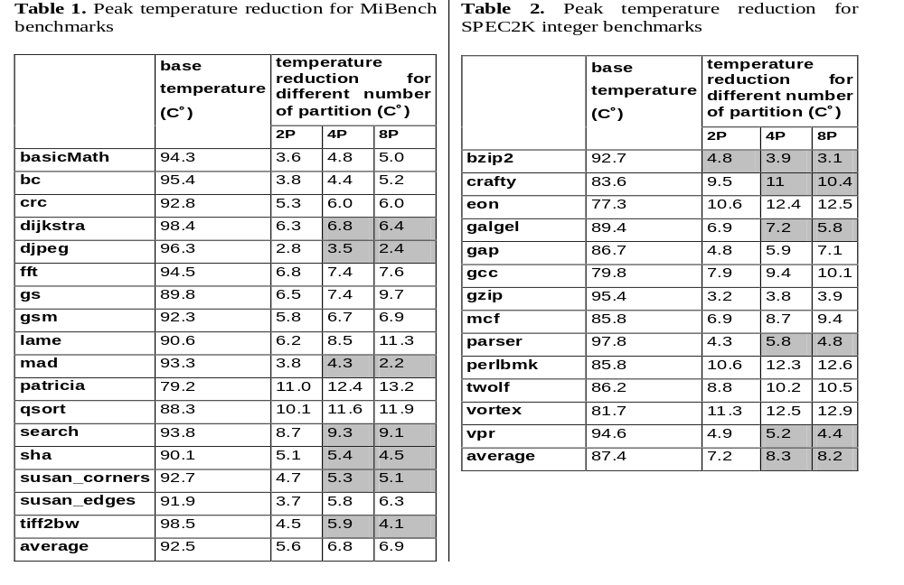
Peak Temperature Reduction
Notes:
4 partitions is best

Slide 31
Analysis of Temperature Reduction
Increasing the number of partitions results in larger power density in each partition because RF access activity is concentrated in a smaller partition
  While capturing more idle partitions and power gating them may potentially result in higher power reduction, larger power density due to smaller partition size results in overall higher temperature

Slide 32
Conclusions
Showed Register File Underutilization
Studied Register file default access patterns
Propose access concentration and activity redistribution to relocate register file accesses
Results show a noticeable power and temperature reduction in the RF
RELOCATE technique can be applied when units are underutilized
  as opposed to activity migration, which requires replication

Slide 33
Current and Future Work Extension
Formulate the Best partition selection out of available partitions for activity redistribution.
Apply activity concentration and redistribution mechanism to other hot units; example: L1 cache.
Apply Proactive NBTI Recovery to the idle partitions to improve lifetime reliability.
Trade-off NBTI recovery and power gating to simultaneously reduce power and improve lifetime reliability.
Tackle the temperature barrier in 3D stack processor design using similar activity concentration and redistribution.

