Slide 1
Beyond Memory Cells for
Leakage and Temperature
Control in SRAM-based Units, the Peripheral Circuits Story
Houman Homayoun
National Science Foundation CI Fellow
Department of Computer Science
University of California San Diego
Notes:
Houman Homayoun

Slide 2
Outline
Why SRAMs? Why Peripherals?
Circuit solution to reduce leakage in peripheral
Architectural control of the proposed circuit
Conclusion and future work

Slide 3
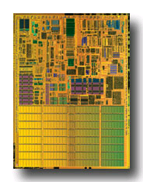
On-chip SRAMs and Power
On-chip SRAMs in high-performance processors are large
  more than 60% of chip budget
Dissipate significant portion of power via leakage
  Much of it was in the SRAM cells
    Many architectural techniques proposed to remedy this
Today, there is also significant leakage in the peripheral circuits of an SRAM (cache)
  In part because cell design has been optimized
Pentium M processor die photo
Courtesy of intel.com
Notes:
Houman Homayoun

Slide 4
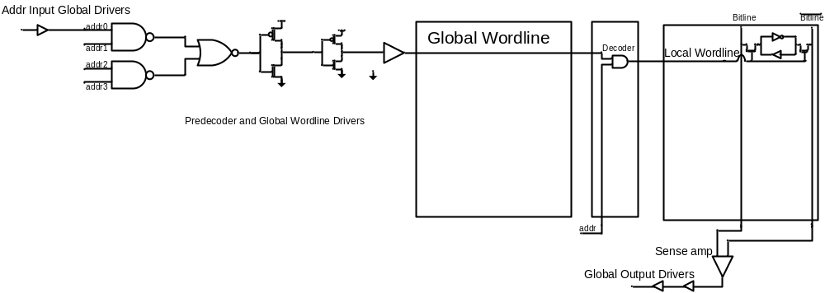
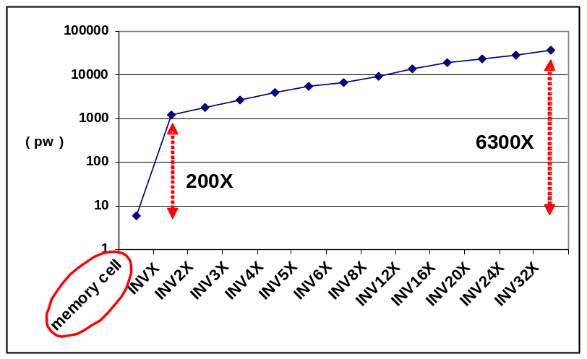
Peripherals ?
Data Input/Output Driver
Address Input/Output Driver
Row Pre-decoder
Wordline Driver
Row Decoder
  Using minimal sized transistor for area considerations in cells and larger, faster and accordingly more leaky transistors to satisfy timing requirements in peripherals.
  Using high vt transistors in cells compared with typical threshold voltage transistors in peripherals
Notes:
Houman Homayoun

Slide 5
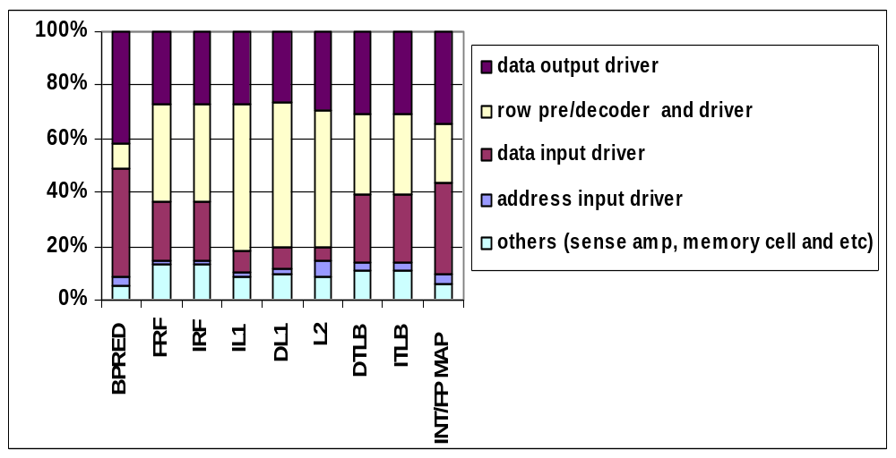
Leakage Power Components of On-Chip SRAMS
The peripheral circuits – data drivers, address
driver, decoder, and wordline drivers account for
over 80% of the overall SRAM leakage
Notes:
Houman Homayoun

Slide 6
Prior Work to Reduce Leakage in SRAM Cell
Gated-Vdd, Gated-Vss
Voltage Scaling (DVFS)
ABB-MTCMOS
Forward Body Biasing (FBB), RBB
Sleepy Stack
Sleepy Keeper
Circuit
Way Prediction, Way Caching, Phased Access
  Predict or cache recently access ways, read tag first
Drowsy Cache
  Keeps cache lines in low-power state, w/ data retention
Cache Decay
  Evict lines not used for a while, then power them down
Applying DVS, Gated Vdd, Gated Vss to memory cell
  Many architectural support to do that.
Architecture
Target SRAM memory cell
PhD Final Defense 2010 – Houman Homayoun
University of California Irvine
Notes:
Houman Homayoun

Slide 7
The goals of this work are:
Reduce leakage power and accordingly temperature in on chip SRAMs peripheral circuits.
  Minimal area cost, timing impact
  Minimal design modification, complexity overhead
  Minimal/NO performance impact
Propose circuit technique to reduce leakage
Control the circuit when application are running to maximize the leakage reduction benefit while minimal/NO impact on application perfomance.
Notes:
Houman Homayoun

Slide 8
Multiple Sleep Mode Zig-Zag Horizontal and Vertical Sleep Transistor Sharing
Notes:
Houman Homayoun

Slide 9
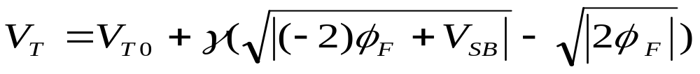
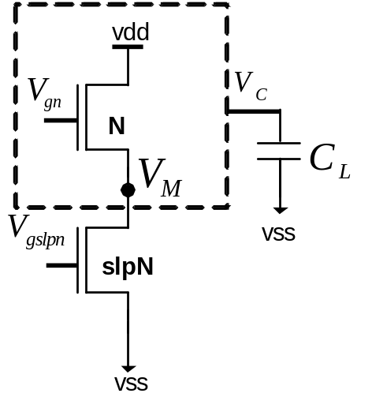
Sleep Transistor Stacking Effect
Subthreshold current: inverse exponential function of threshold voltage
Stacking transistor N with slpN:
  The source to body voltage (VM ) of
  transistor N increases, reduces its
  subthreshold leakage current, when
  both transistors are off
Drawback : rise time, fall time, wakeup delay, area, dynamic power, instability
Notes:
Houman Homayoun

Slide 10
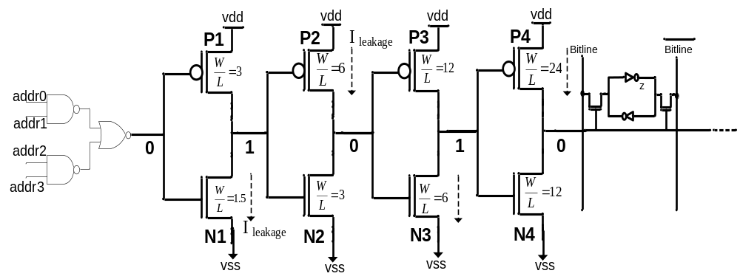
Source of Subthreshold Leakage in the Peripheral Circuitry
The inverter chain has to drive a logic value 0 to the pass transistors when a memory row is not selected
  N1,N3 and P2,P4 are in the off state and are leaking
Notes:
Houman Homayoun

Slide 11
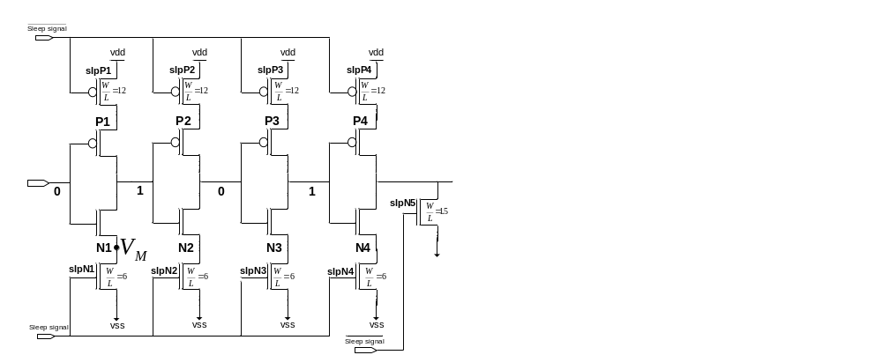
A Redundant Circuit Approach
Drawback impact on wordline driver output
rise time, fall time and propagation delay
Notes:
Houman Homayoun

Slide 12
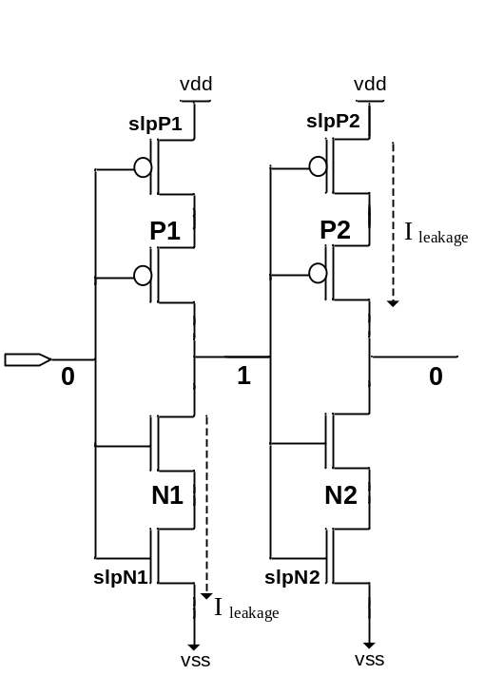
Impact on Rise Time and Fall Time
The rise time and fall time of the output of an inverter is proportional to the
R_{peq} * C_{L} and R_{neq} * C_{L}
Inserting the sleep transistors increases both R_{neq} and R_{peq}
Increasing in rise time
Impact on performance
Increasing in fall time
Impact on memory functionality
Notes:
Houman Homayoun

Slide 13
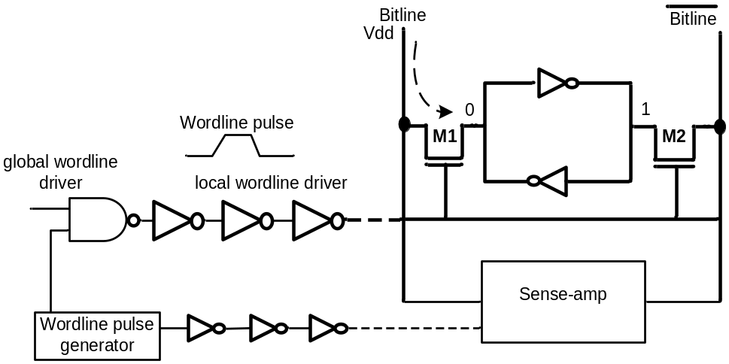
Fall Time Increase Impact
Fall time increase ➔ pass transistor active period increase (read operation)
  The bitline over-discharge, the memory content over-charge during the read operation.
  Such over-discharge
    increases the dynamic power dissipation of bitlines
    can cause cell content flip if the over-discharge period is large
The sense amplifier timing circuit and the wordline pulse generator circuit need to be redesigned!
Notes:
Houman Homayoun

Slide 14
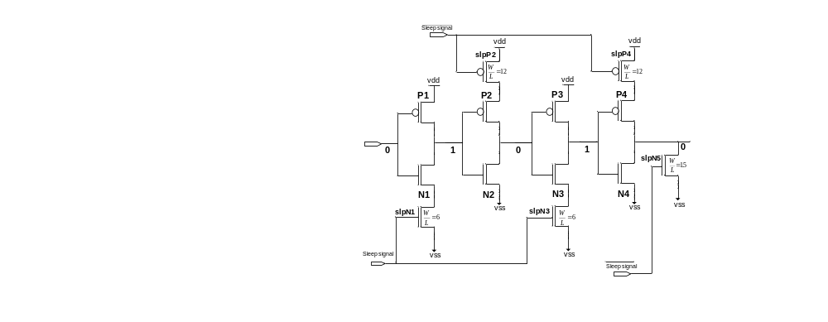
A Zig-Zag Circuit
R_{peq} for the first and third inverters and R_{neq} for the second and fourth inverters doesn’t change.
  Fall time of the circuit does not change
Notes:
Houman Homayoun

Slide 15
A Zig-Zag Share Circuit
To improve leakage reduction and area-efficiency of the zig-zag scheme, using one set of sleep transistors shared between multiple stages of inverters
  Zig-Zag Horizontal Sharing
  Zig-Zag Horizontal and Vertical Sharing
Notes:
Houman Homayoun

Slide 16
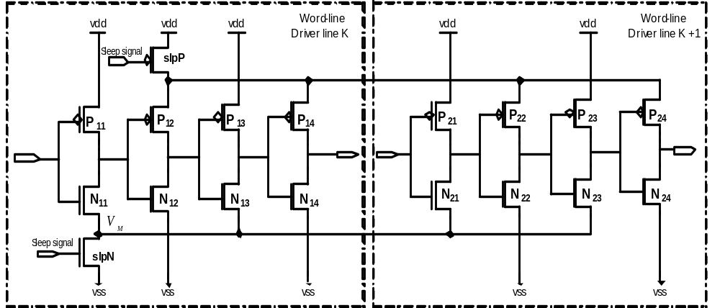

Zig-Zag Horizontal and Vertical Sharing
Zig-Zag Horizontal and Vertical Sharing
  To improve leakage reduction and area-efficiency of the zig-zag scheme, using one set of sleep transistors shared between multiple stages of inverters
    Zig-Zag Horizontal Sharing
      Minimize impact on rise time
      Minimize area overhead
    Zig-Zag Horizontal and Vertical Sharing
      Maximize leakage power saving
      Minimize the area overhead
Notes:
Houman Homayoun

Slide 17
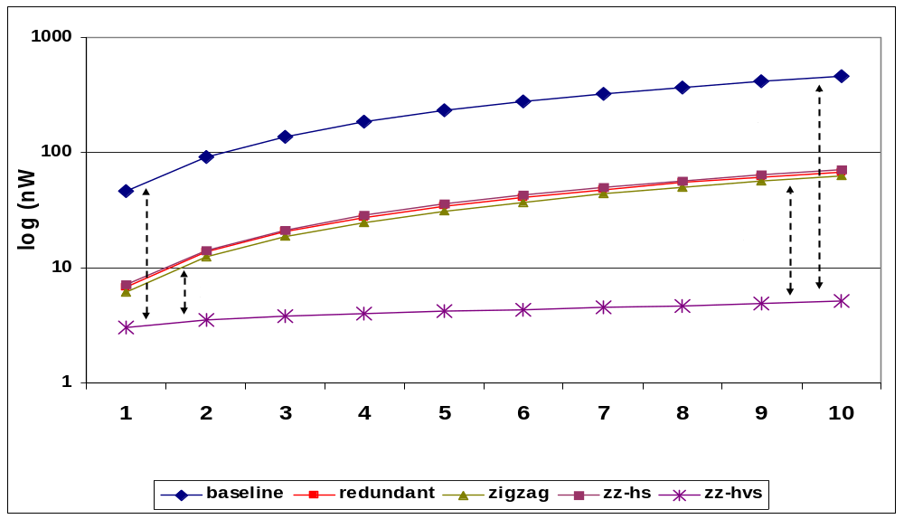
ZZ-HVS Evaluation (Cont.)
Increasing the number of wordline rows share sleep transistors increases the leakage reduction and reduces the area overhead
Leakage power reduction varies form a 10X to a 100X when 1 to 10 wordline shares the same sleep transistors
  2~10X more leakage reduction, compare to the zig-zag scheme
Notes:
Houman Homayoun

Slide 18
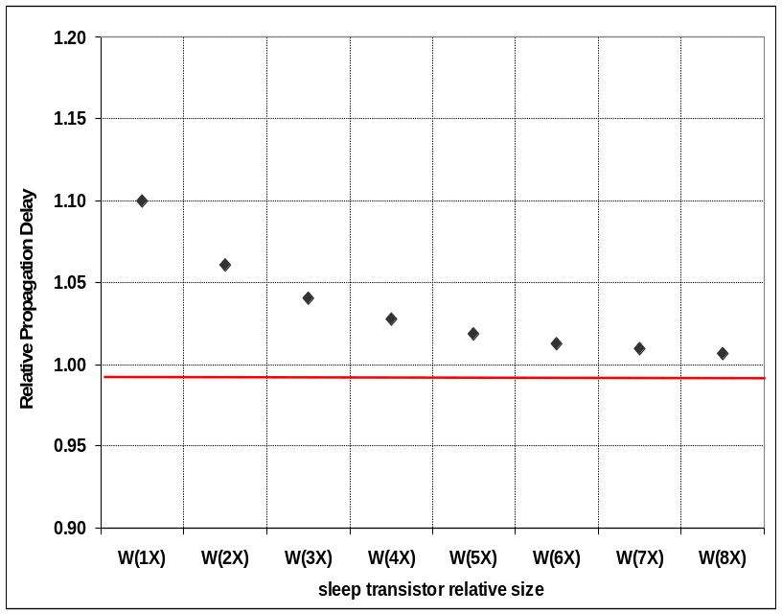
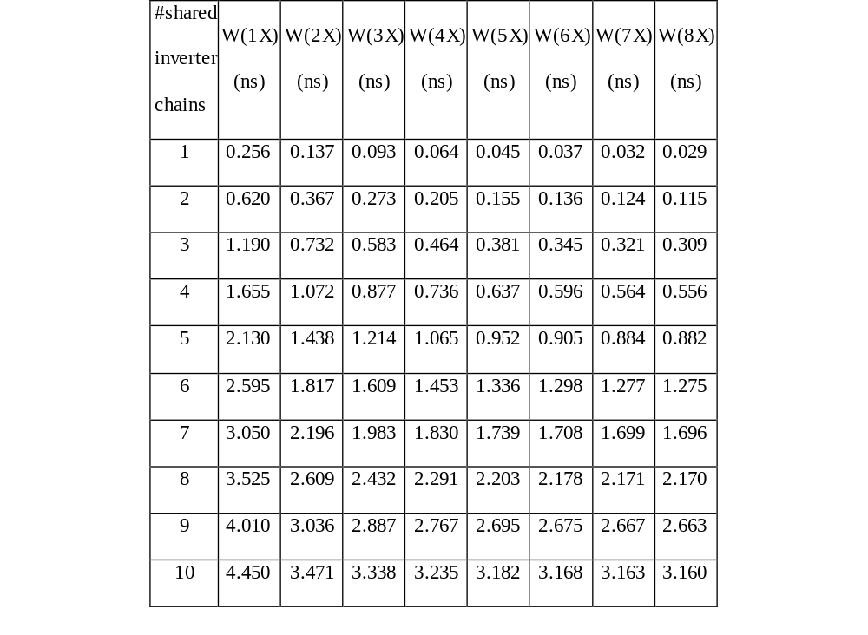
Impact on Wakeup and Propagation Delay
Impact of sleep transistor sharing and
sizing on the wakeup delay
Impact of sleep transistor sizing
on propagation delay
Notes:
Houman Homayoun

Slide 19
Wakeup Latency
To benefit the most from the leakage savings of stacking sleep transistors
  keep the bias voltage of NMOS sleep transistor as low as possible (and for PMOS as high as possible)
Drawback: impact on the wakeup latency of wordline drivers
Control the gate voltage of the sleep transistors
  Increasing the gate voltage of footer sleep transistor reduces the virtual ground voltage (VM)
reduction in leakage power savings
reduction in the circuit wakeup delay overhead
Notes:
Houman Homayoun

Slide 20
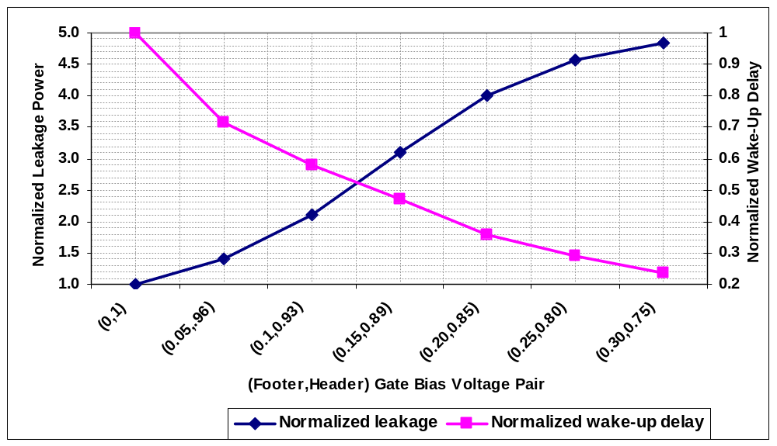
Wakeup Delay vs. Leakage Power Reduction
trade-off between the
wakeup overhead
and leakage power saving
Increasing the bias voltage increases the leakage power while decreases the wakeup delay overhead
Notes:
Houman Homayoun

Slide 21
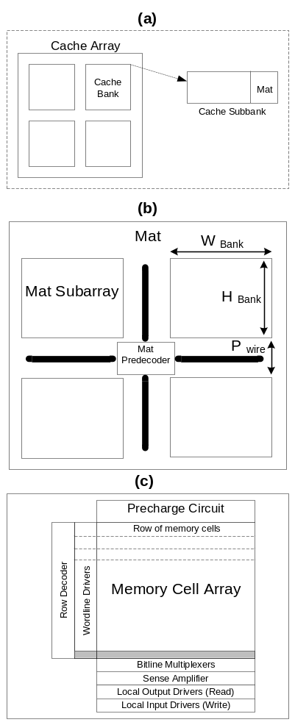
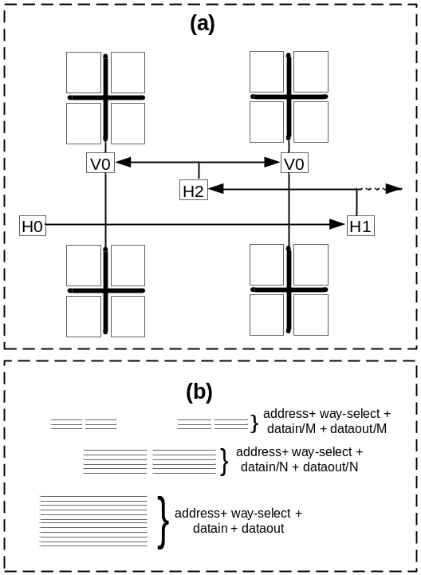
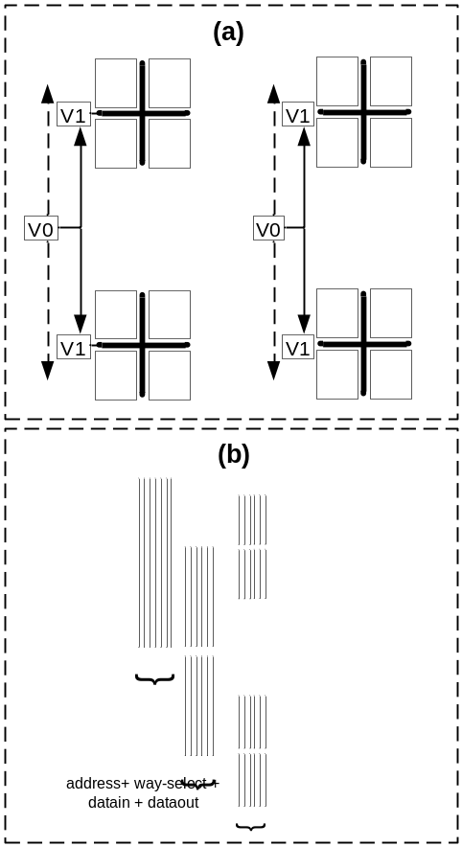
Impact on Layout and on Power Grid Network
Layout of vertical/Horizontal H-tree
address and data (b) Layout of wires for vertical/Horizontal H-tree
High Level Composition
of a cache memory
Notes:
Houman Homayoun

Slide 22
Multiple Sleep Modes Leakage Control in Peripheral Circuits of All Major SRAM-Based Units in a High Performance Processor
Notes:
Houman Homayoun

Slide 23
Why all SRAMs?
Some of the on-chip SRAMs are small, such as register files, while others are very large, such as the L2 cache.
Reducing leakage in small SRAMs has a minor impact on overall chip leakage compared to large SRAMs, but our leakage reduction approach leads to significant temperature reduction in these small SRAMs.
For large SRAMs, it provides both leakage and temperature reduction.
Notes:
Houman Homayoun

Slide 24

Multiple Sleep Modes Specifications
On-chip SRAM peripherals multiple sleep mode normalized leakage power savings
Basic-lp mode, requires a near-zero wakeup overhead.
In low power (lp), aggressive low power (aggr-lp) and ultra low power (ultra-lp) peripheral wakeup delays are 1, 2 and above 3 cycles, respectively.
For IL1, DL1 and L2, due to large size, the overall wakeup delay is more than 1 cycle for any bias voltage.
  can not be put into basic-lp mode.
The rest of the SRAMs can be put into basic-lp mode and their access can still be completed in one processor cycle.
Notes:
Houman Homayoun

Slide 25
Reducing Leakage in SRAM Peripherals
Maximize the leakage reduction
  put peripheral into ultra low power mode
  adds few cycles to the SRAM access latency
    significantly reduces performance
Minimize Performance Degradation
  put peripherals into the basic low power mode
  requires near zero wakeup overhead
    Not noticeable leakage power reduction
Notes:
Houman Homayoun

Slide 26
Motivation for Dynamically Controlling Sleep Mode
dynamically adjust
peripheral circuit
sleep power mode
large leakage reduction benefit
  Ultra and aggressive low power modes
low performance impact benefit
  Basic-lp mode
Periods of frequent access
  Basic-lp mode
Periods of infrequent access
  Ultra and aggressive low power modes
Notes:
Houman Homayoun

Slide 27
Architectural Motivations
Architectural Motivation
  A load miss in L1/L2 caches takes a long time to service
    prevents dependent instructions from being issued
When dependent instructions cannot issue
  performance is lost
At the same time, energy is lost as well!
  This is an opportunity to save energy
Notes:
Houman Homayoun

Slide 28
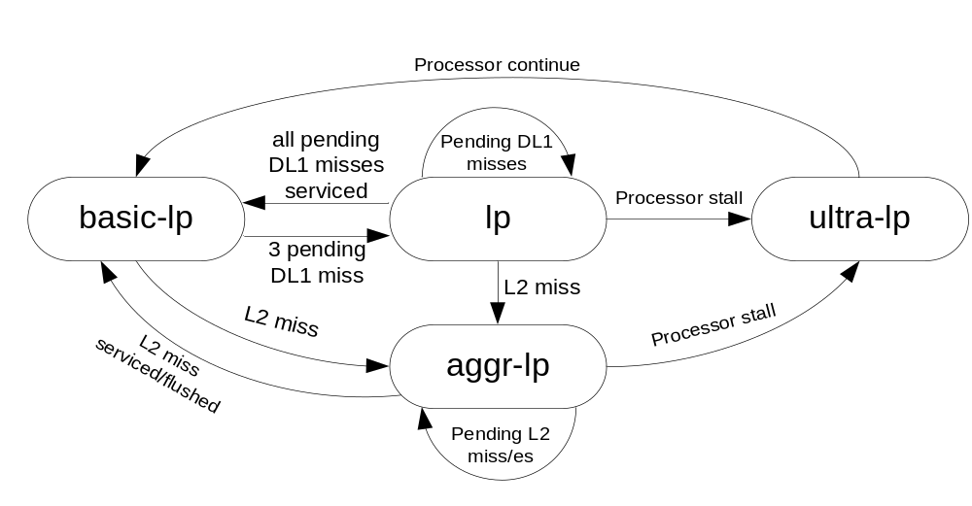
Multiple Sleep Mode Control Mechanism
General state machine to control power mode transitions
L2 cache miss or multiple DL1 misses triggers power mode transitioning.
The general algorithm may not deliver optimal results for all units.
  modified the algorithm for individual on-chip SRAM-based units to maximize the leakage reduction at NO performance cost.
Notes:
Houman Homayoun

Slide 29

Branch Predictor
1 out of every 9 fetched instructions in integer benchmarks and out of 63 fetched instructions in floating point benchmarks accesses the branch predictor
  always put branch predictor in deep low power modes (lp, ultra-lp or aggr-lp) and waking up on access.
    noticeable performance degradation for some benchmarks.
Notes:
Houman Homayoun

Slide 30
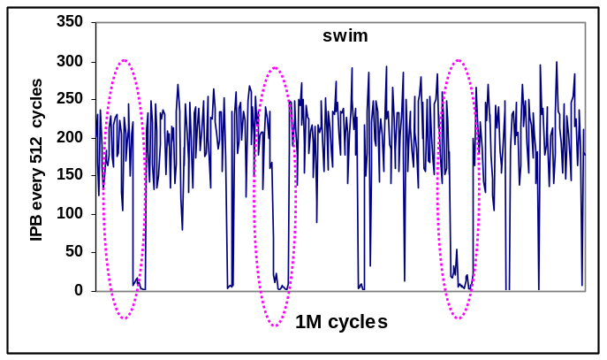
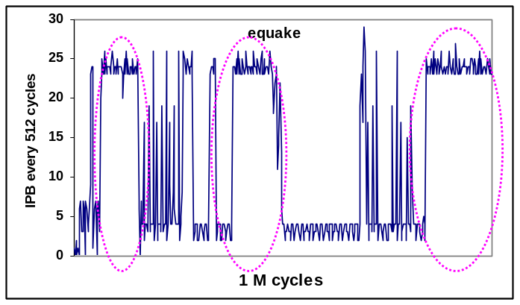
Observation: Branch Predictor Access Pattern
Distribution of the number of branches per 512-instruction interval (over 1M cycles)
Within a benchmark there is significant variation in Instructions Per Branch (IPB).
  The highlighted circles for swim identify regions in which the number of branch in a 512-instruction interval is significantly lower than its average IPB of 77. A similar situation for equake
  The duration of a period where the IPB stays low (or high):
    once the IPB drops (increases) significantly it may remain low (high) for a long period of time.
Notes:
Houman Homayoun

Slide 31
Branch Predictor Peripherals Leakage Control
Can identify the high IPB period, once the first low IPB period is detected.
  The number of fetched branches is counted every 512 cycles, once the number of branches is found to be less than a certain threshold (24 in this work) a high IPB period identified. The IPB is then predicted to remain high for the next twenty 512 cycles intervals (10K cycles).
Branch predictor peripherals transition from basic-lp mode to lp mode when a high IPB period is identified.
During pre-stall and stall periods the branch predictor peripherals transition to aggr-lp and ultra-lp mode, respectively.
Notes:
Houman Homayoun

Slide 32
L1 Data Cache
Read ports are accessed more frequently than write ports.
  making a write port one cycle slower has almost no impact on performance.
  one extra cycle of delay on every DL1 read (port) leads to noticeable performance degradation in some of the benchmarks (e.g. gzip, twolf and vpr).
DL1 write port is always kept in lp mode and is awaken only when it is accessed.
The read port is put into lp mode only during cache miss period.
  processor performance drops noticeably, slowing load instructions execution by one cycle does not appreciably degrade performance.
During pre-stall period DL1 peripherals are put into aggr-lp mode.
Both read and write ports are put into ultra-lp mode once processor is stalled.
Notes:
Houman Homayoun

Slide 33
L1 Instruction Cache
IL1 is accessed very frequently.
Due to large size, the overall wakeup delay of its peripherals from basic-lp mode takes more than 1 cycle for any bias voltage.
  Putting into basic-lp mode would result in significant performance degradation.
IL1 cache peripherals transition to the ultra-lp mode only when an L2 cache miss is detected.
  every access to it will take 5 cycles (2 cycles access time + 3 cycles wakeup time).
  No performance degradation.
During L2 miss period processor execute few independent instructions ends up being stalled
  slowing down the execution of independent instructions by slowing down the IL1 cache access, does not degrade the performance as long as independent instructions execution can be completed before the L2 cache miss is serviced.
Notes:
Houman Homayoun

Slide 34
L2 Cache
L2 cache is accessed infrequently (on average 1 out of 500 instruction access L2).
  Always keep it in deep low power mode (aggr-lp) and only wake it up before accessing it.
  The wakeup delay of aggr-lp mode is 2 cycles much less than the L2 cache latency (20 cycles).
    Very small performance impact.
Once an L2 miss occurs, we put L2 into ultra-lp mode.
Notes:
Houman Homayoun

Slide 35
Register File
On average, in more than 50% of all cycles there are no read and write port accesses to integer register file.
The fraction is even higher for FRF: more than 80%. Given such low port utilizations, all register files read and write ports are kept in basic-lp mode.
  Register files can still be accessed in one cycle while waking up its peripherals from basic-lp mode.
Register file peripherals transition to the ultra-lp mode once the processor stalls completely.
Notes:
Houman Homayoun

Slide 36
DTLB/ITLB and Rename Unit
ITLB, DTLB and register rename unit are accessed very frequently
  These units are always kept in basic-lp mode and only woken up when accessed.
  They transition to the ultra-lp mode once the processor stalls.
Notes:
Houman Homayoun

Slide 37
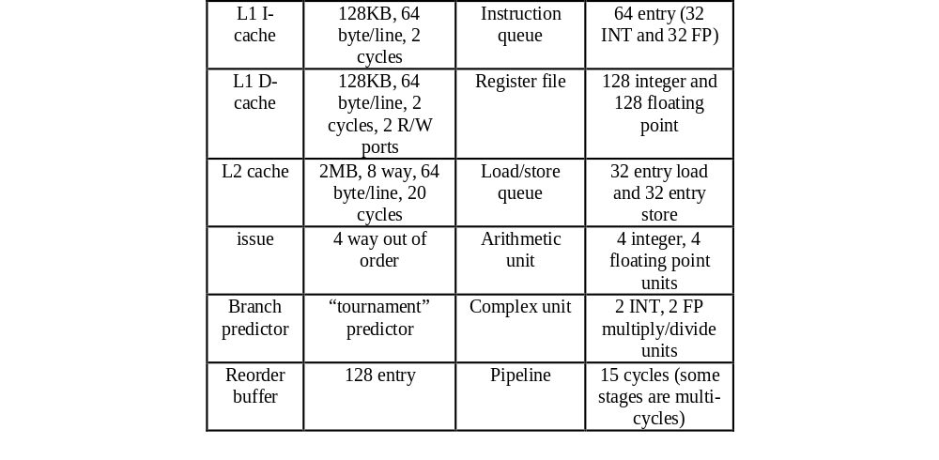
EXPERIMENTAL EVALUATION
Modeled 64-bit processor similar to Alpha 21264 operating at 2.2 GHz.
Used an extensively modified version of SimpleScalar4
Used SPEC2K benchmarks with reference data sets.
Compiled using the Compaq compiler with the -O4 flag targeted for the Alpha 21264 processor.
Fast–forwarded for 2 billion instructions, fully simulated for 2 billion instructions.
Notes:
Houman Homayoun

Slide 38
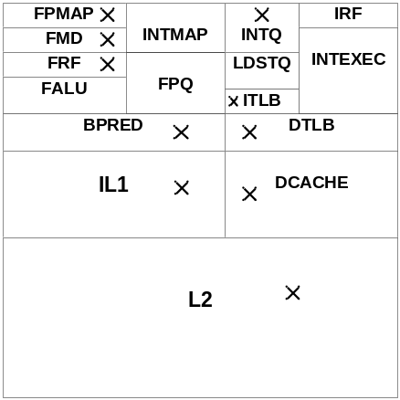
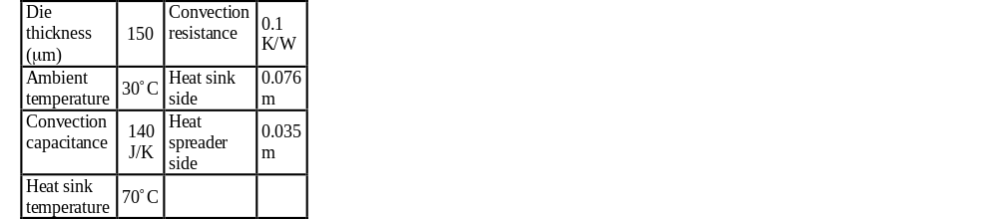
Power, Timing and Temperature Model
Thermal Model
Processor floorplan
Used Hspice with extracted netlist at a supply voltage of 1.0V in a 45nm technology to get the relative leakage power reduction of various power modes
Used CACTI-5.1 assuming 45nm technology to get the energy per access and leakage power dissipation for individual SRAM units
Used HotSpot to estimate both power density and thermal profiles for different processor blocks.
Used synopsys dc_compiler standard synthesis tool to evaluate the power/area overhead of the controlling circuitry
Notes:
Houman Homayoun

Slide 39
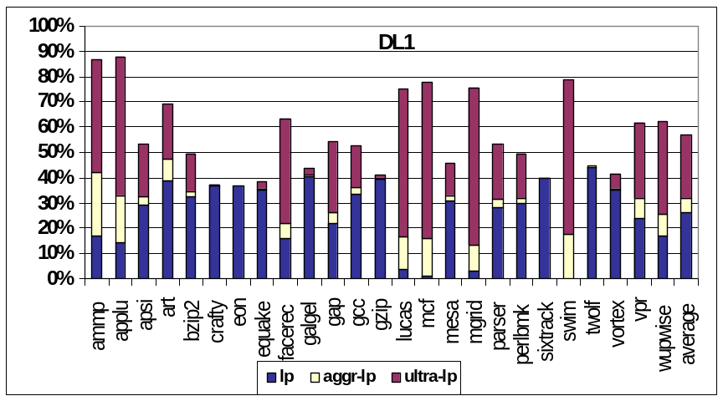
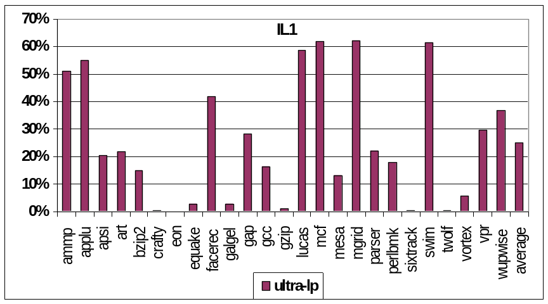
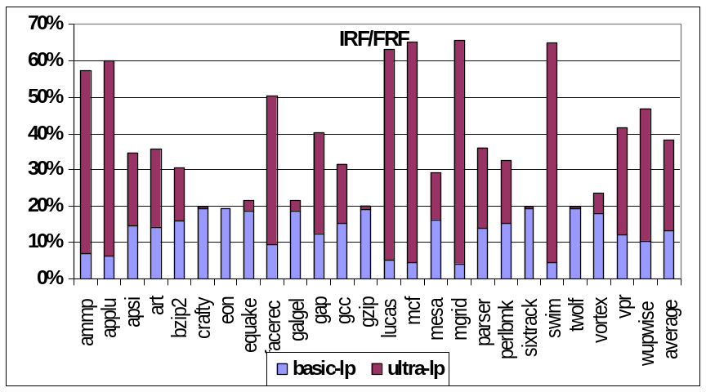
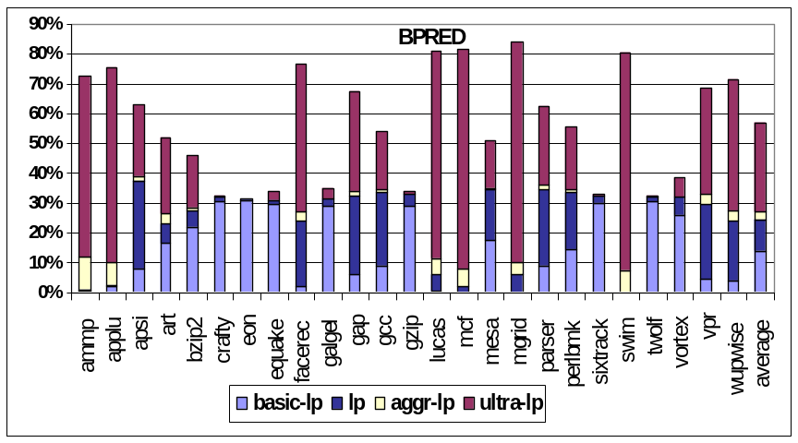
Leakage Power Reduction
Average leakage power reduction of 57% (1.17 watt) for DL1, 25% (0.34 watt) for IL1, 57% (0.07 watt) for Branch Predictor, 38% (0.122 watt) for IRF and 38% (0.151 watt) for FRF.
Notes:
Houman Homayoun

Slide 40
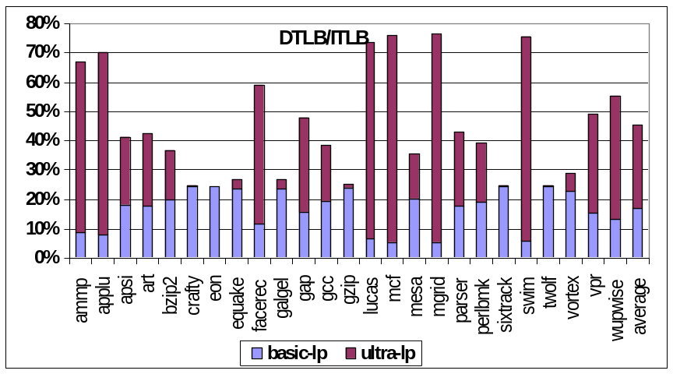
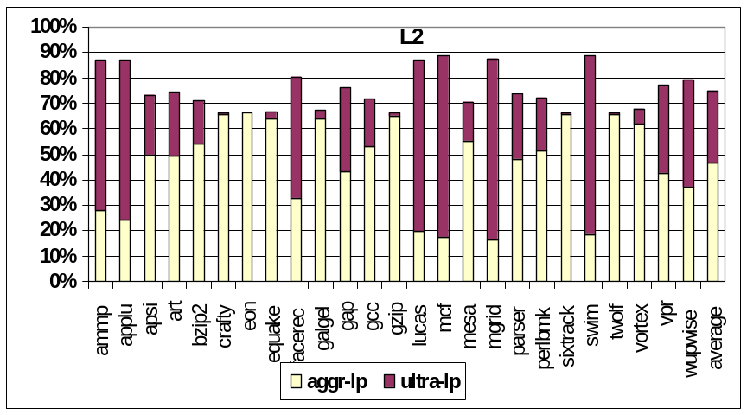
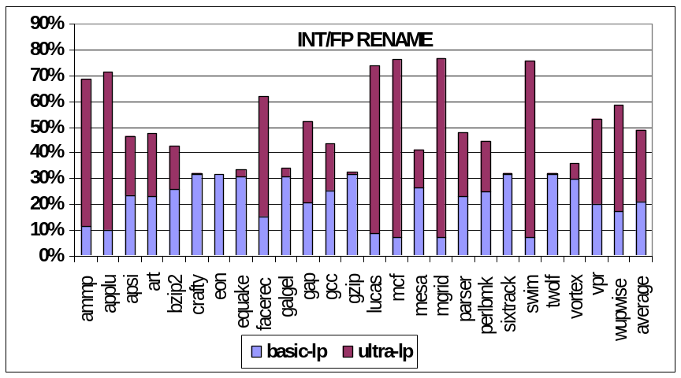
Leakage Power Reduction
Average leakage power reduction of
49% (0.2 watt) for INT/FP Rename,
45% (0.2 watt) for DTLB, 45% (0.31
watt) for ITLB.
The total power reduction is 5.15 watt, translates to 10.86% of processor power dissipation (The studied processor dissipates 47 watt)
Notes:
Houman Homayoun

Slide 41
Some Observations
The maximum leakage power reduction: 75% for L2 cache
  L2 cache is always kept in one of the deep low power modes except when it is accessed.
The instruction cache has the lowest leakage reduction: 25% on average.
  Frequent access
The reduction due to ultra-lp mode is very significant: the highest of all low-leakage modes in many cases.
  All on-chip SRAM units transition to this mode when the processor stalls.
  Large number of stalls + large leakage savings associated with the ultra-lp mode make this mode the major source of leakage reduction.
    most noticeable in benchmarks with a large L2 miss period; ammp, applu, lucas, mcf and swim.
The basic-lp mode makes a relatively small contribution to total leakage power reduction varying from 10 to 20%.
  The basic-lp mode occurs more frequently than the ultra-lp mode, its contribution to total leakage reduction is less than the ultra-lp mode.
    Peripheral leakage reduction of ultra-lp mode is 2 to 3 times that of basic-lp mode
Notes:
Houman Homayoun

Slide 42
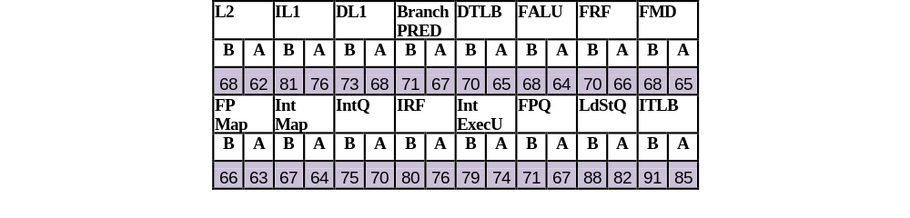

Temperature Impact of Leakage Power Reduction
Average Peak temperature before (B) and after
(A) applying the leakage reduction techniques
Reduction in Steady-State Temperature
Highest average peak temperature reduction in L2 cache: 6.3 ºC
Highest peak temperature reduction across different blocks 10.2 ºC in mcf.
allow higher operating frequency
Notes:
Houman Homayoun

Slide 43
Conclusion
Highlighted the importance of leakage power reduction in on-chip SRAM peripherals
Proposed zig-zag horizontal and vertical sleep transistor share.
Evaluated the delays and area overhead of zig-zag share and its power savings.
extended zig-zag share to enable multiple sleep modes for cache peripherals.
Explored the design space of sleep transistor insertion
Explored an integrated circuit and architectural approach to minimize leakage power dissipation of on-chip SRAMs
Exploits both L1 and L2 cache miss information to decide when to transition on-chip SRAM peripherals to different low-power modes.
Optimized the control algorithm for individual on-chip SRAM-based units depending on their behavior and their ability to hide the wakeup delay associated with various low power modes.

Slide 44
Future Work
Deploy the zig-zag-share technique for L1 and L2 caches in a chip multiprocessor architecture.
  controlling sleep signals can be very challenging for cache hierarchies that are shared between multiple cores.
Explore architectural approach to reduce leakage of on-chip SRAMs peripheral circuits in SMT architecture.
  a shared resource peripheral circuits (register file) can not be simply put into low power mode when an L2 cache miss occurs
Notes:
Houman Homayoun

Slide 45
Future Work
Explore architectural approaches to control the zig-zag share circuit technique at a granularity of a block level in on-chip SRAM.
  current architectural approach turns all blocks peripherals on/off simultaneously.
  a new architectural approach is required to enable controlling block level control (fine grain control).
    potentially improve the leakage power reduction
Apply zig-zag sleep transistor sharing circuit technique in logic structures where inverters are the dominant utilized standard cells.
  on-chip buses and clock tree networks
Utilize the architectural techniques proposed in this work to apply power management in other processor units.
  L1 and L2 cache misses information can be used to guide resource adaptation and core reconfiguration at both inter-core and intra-core level in a CMP architecture to reduce power dissipation.
Notes:
Houman Homayoun

