Slide 1

Dynamic Register File Resizing and Frequency Scaling to Improve Embedded Processor Performance and Energy-Delay Efficiency
Houman Homayoun, Sudeep Pasricha, Mohammad Makhzan, Alex Veidenbaum
Center for Embedded Computer Systems, University of California, Irvine, hhomayou@uci.edu

Slide 2
INTRODUCTION
Technology scaling into the ultra deep submicron allowed hundreds of millions of gates integrated onto a single chip.
  Designers have ample silicon budget to add more processor resources to exploit application parallelism and improve performance.
Restrictions with the power budget and practically achievable operating clock frequencies are limiting factors.
  Increasing register file (RF) size increases its access time, which reduces processor frequency.
Dynamically Resizing RF in tandem with dynamic frequency scaling (DFS) significantly improves the performance.

Slide 3
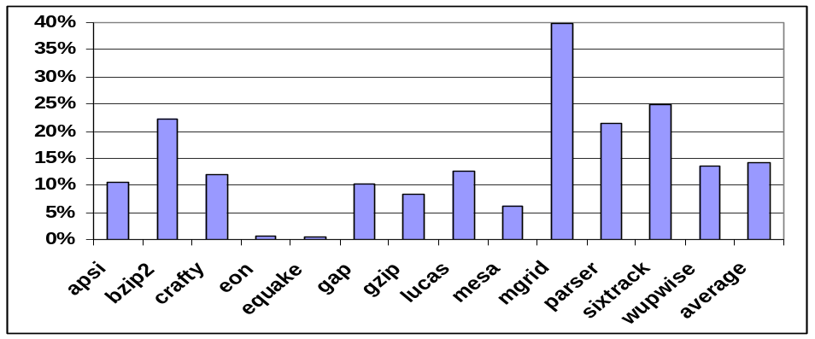
MOTIVATION FOR INCREASING RF SIZE
After a long latency L2 cache miss the processor executes some independent instructions but eventually ends up becoming stalled.
  After L2 cache miss one of ROB, IQ, RF or LQ/SQ fills up and processor stalls until the miss serviced.
With larger resources it is less likely that these resources will fill up completely during the L2 cache miss service time and potentially improve performance.
The sizes of resources have to be scaled up together; otherwise the non-scaled ones would become a performance bottleneck.
Frequency of stalls due to L2 cache misses, in PowerPC 750FX architecture

Slide 4
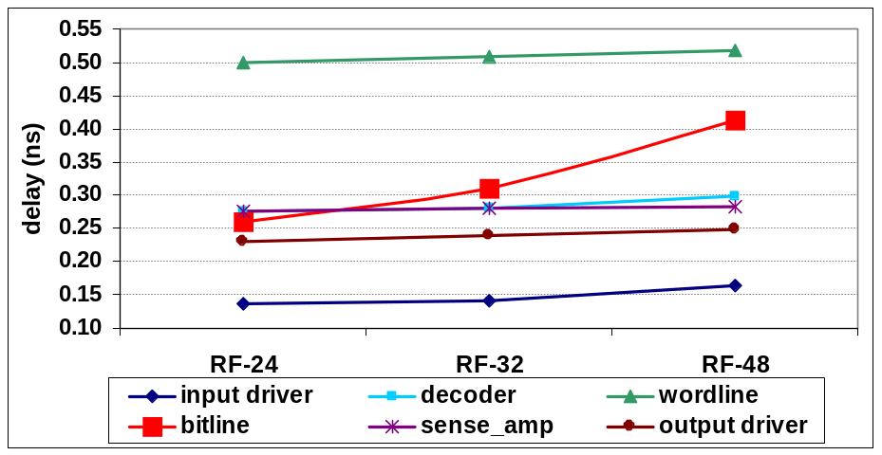
IMPACT OF INCREASING RF SIZE
Increasing the size of RF, (as well as ROB, LQ and IQ)
  can potentially increase processor performance by reducing the occurrences of idle periods,
  has critical impact on the achievable processor operating frequency
RF decide the max achievable operating frequency
significant increase in bitline delay when the size of the RF increases.
Breakdown of RF component delay with increasing size

Slide 5
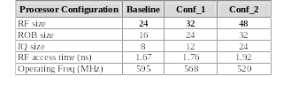
ANALYSIS OF RF COMPONENT ACCESS DELAY
The equivalent capacitance on the bitline is Ceq = N * diffusion capacitance of pass transistors + wire capacitance (usually 10% of total diffusion capacitance) where N is the total number of rows.
As the number of rows increases the equivalent bitline capacitance also increases and therefore the propagation delay increases.
Reduction in clock freq with increasing resource size

Slide 6
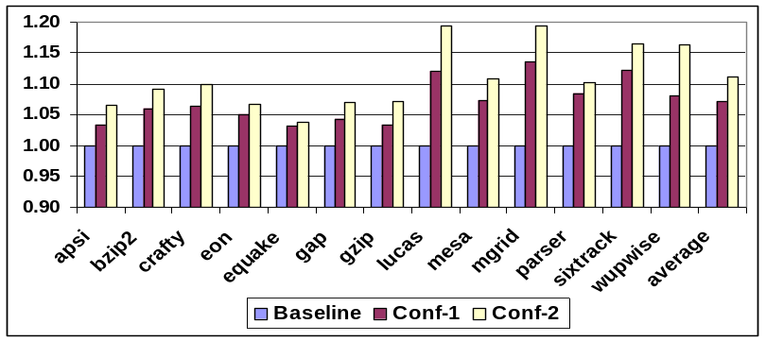
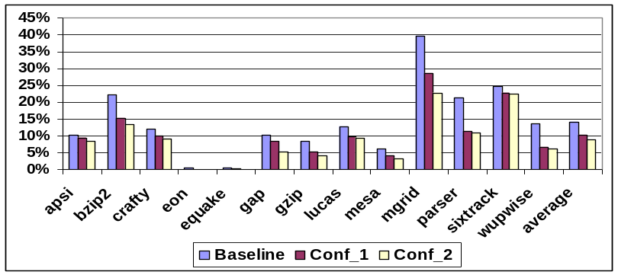
STATIC REGISTER FILE SIZING
Performance in terms of IPC for different configurations
Relative idle period processor stalls due to L2 cache misses for different configurations
Increasing the size of RF
  Increases the IPC
  Reduces relative idle period processor stalls due to L2 cache misses
  Reduces the max achievable operating clock frequency

Slide 7
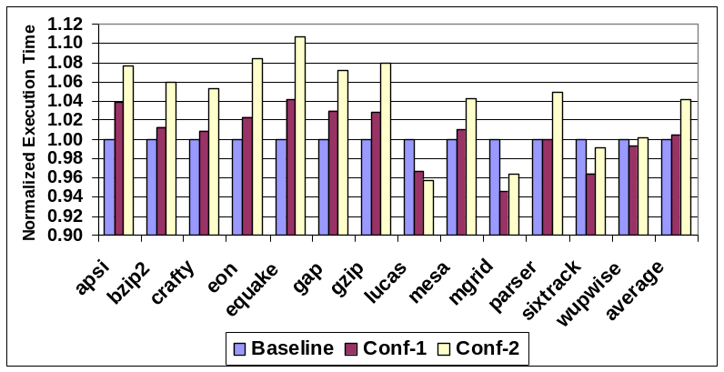
IMPACT ON EXECUTION TIME
The execution time increases with larger resource sizes
Normalized execution time for different configs with reduced operating frequency compared to baseline architecture
trade-off between
  larger resources (and hence reducing the occurrences of idle period) and
  lowering the clock frequency,
the latter becomes more important and plays a major role in deciding the performance in terms of execution time.

Slide 8
DYNAMIC REGISTER FILE RESIZING
dynamic RF scaling based on L2 cache misses
  allows the processor use smaller RF (having a lower access time) during the period when there is no pending L2 cache miss (normal period) and a larger RF (at the cost of having a higher access time) during the L2 cache miss period.
To satisfy accessing the RF in one cycle, reduce the operating clock frequency when we scale up its size
  DFS needs to be done fast, otherwise it impacts the performance benefit
  need to use a PLL architecture capable of applying DFS with the least transition delay.
The studied processor (IBM PowerPC 750) uses a dual PLL architecture which allows fast DFS with effectively zero latency.

Slide 9
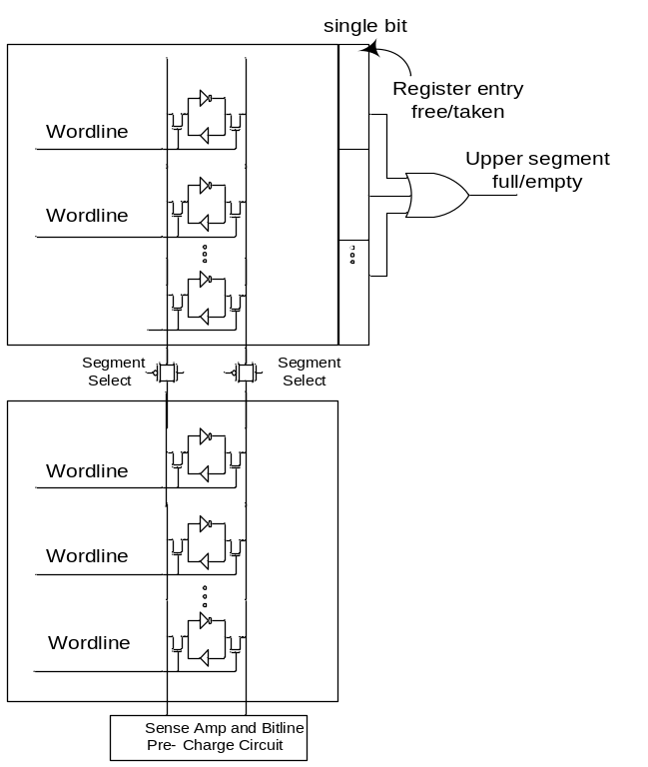

CIRCUIT MODIFICATION
The challenge is to design the RF in such a way that its access time is dynamically being controlled.
Among all RF components, the bitline delay increase is responsible for the majority of RF access time increase.
Dynamically adjust bitline load.
Proposed circuit modification for RF

Slide 10
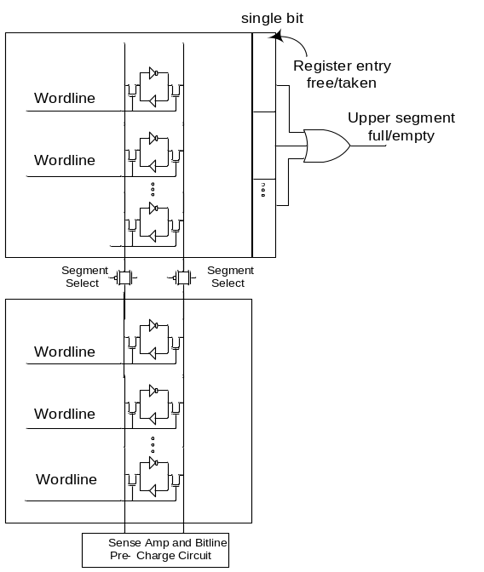

L2 MISS DRIVEN RF SCALING (L2MRFS)
Normal period: the upper segment is power gated and the transmission gate is turned off to isolate the lower bitline segment from the upper bitline segment.
  Only the lower segment bitline is pre-charged during this period.
L2 cache miss period: the transmission gate is turned on and both segments bitlines are pre-charged.
  downsize at the end of cache miss period when the upper segment is empty.
Proposed circuit modification for RF
  Augment the upper segment with one extra bit per entry. Set the entry when a register is taken and reset it when a register is released.
  ORing these bits can detect when the segment is empty.

Slide 11
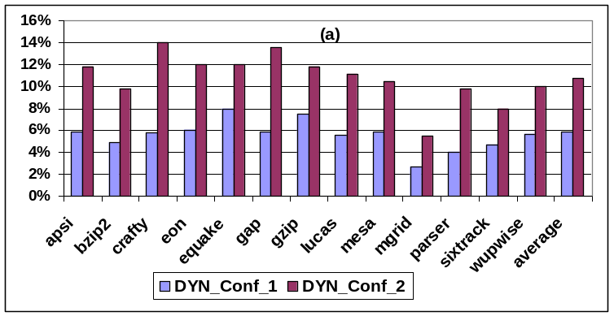
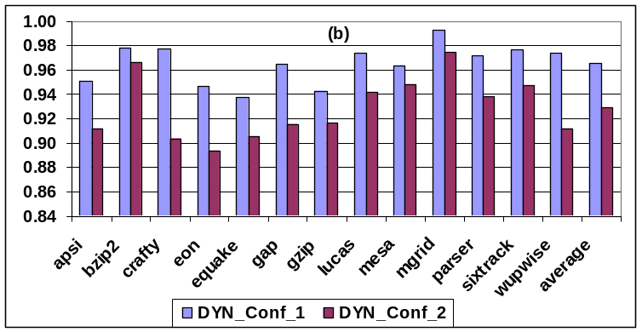
PERFORMANCE AND ENERGY-DELAY
Experimental results: (a) normalized performance improvement for L2MRFS (b) normalized energy-delay product compare to conf_1 and conf_2
Performance improvement 6% and 11%
Energy-delay reduction 3.5% and 7%

Slide 12
CONCLUSION
Technology scaling into the ultra deep submicron allowed hundreds of millions of gates integrated onto a single chip.
Restrictions with the power budget and practically achievable operating clock frequencies are limiting factors.
Increasing register file size, statically, while can increase IPC, reduces the execution time due to the impact on max achievable operating frequency.
Dynamic register file resizing, allows the processor use smaller RF (having a lower access time) during the period when there is no pending L2 cache miss (normal period) and a larger RF (at the cost of having a higher access time) during the L2 cache miss period.
Minimal modification in the register file to be able to adapt its size along with its access time.
Combined dynamic register file resizing with dynamic frequency scaling achieves 11% performance improvement and 7% energy-delay reduction
A similar methodology applied for RF can be applied to other timing constrains resources such as ROB, IQ, LQ/SQ and Caches.

Slide 13
T H A N K S

