Slide 1
FFT-Cache: A Flexible Fault-Tolerant Cache Architecture for Ultra Low Voltage Operation
Houman Homayoun
Houman Homayoun
National Science Foundation Computing Innovation Fellow
Department of Computer Science
University of California San Diego
Notes:
In this work, we propose Flexible Fault-Tolerant Cache (FFT-Cache) that uses a flexible defect map to configure its architecture to achieve significant reduction in energy consumption through aggressive voltage scaling, while maintaining high error reliability.
FFT-Cache uses a portion of faulty cache blocks as redundancy – using block-level or line-level replication within or between sets – to tolerate other faulty caches lines and blocks.
Our configuration algorithm categorizes the cache lines based on degree of conflict of their blocks to reduce the granularity of redundancy replacement.

Slide 2
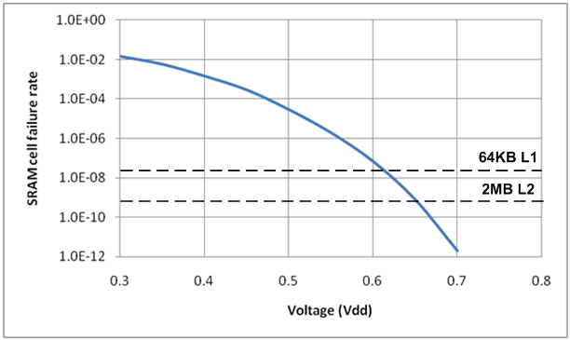
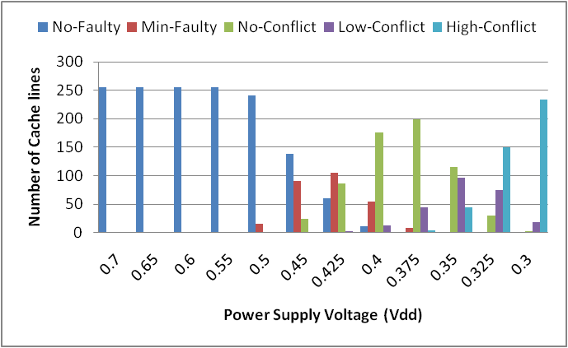
Motivation
The failure rate of an SRAM cell increases exponentially when lowering Vdd
For near threshold voltages almost all of the cache sets and blocks become faulty
High amount of Conflicts between blocks in high bit failure rates
Need an efficient fault-tolerant method that can tolerate faulty blocks for such high fault rates
A 64KB 4-way set associative L1 cache with
64B block size, 8b subblock size
Notes:
the failure rate of an SRAM cell increases exponentially when lowering Vdd
consequently for near threshold voltages the number of faulty cells is very high resulting in almost all of the cache lines and blocks becoming faulty.
by increasing the probability of bit failure, the amount of conflicts between blocks in each cache line will be increased.
by exploiting mechanisms that allow a cache to become inherently resilient to a large number of cell failures, we can operate the cache at a lower Vdd and thus gain significant energy savings.

Slide 3
Related Work: Fault-tolerant Caches
Circuit-level Techniques
8T SRAM, 10T SRAM, ST SRAM, …
Error Detection/Correction Code Methods
SECDED, DECTED, ..
Architecture-level Techniques
Cache-Resizing methods
Yield-Aware Cache
Wilkerson et al.( Word-disable and Bit-fix)
These techniques are not efficient for high fault rates
Notes:
At the system level, a wide range of Error Detection Code (EDC) and Error Correcting codes (ECC) have been used.
Several architectural techniques have also been proposed to improve reliability of on-chip cache by using either redundancy or cache resizing.
Earlier works on fault-tolerant cache design use various cache down-sizing techniques by disabling a faulty line or block of cache

Slide 4
Our Goal
Design a very low power, fault-tolerant cache architecture that can detect and replicate memory faults arising from operation in the near-threshold region ( < 650mV )
Use a portion of faulty cache blocks (global blocks) as redundancy to tolerate other faulty blocks or lines
Categorize the cache lines based on the degree of conflict of their blocks to reduce the granularity of redundancy replacement
Use a flexible defect map with a simple and efficient algorithm to initiate and update it to minimize the non-functional cache area

Slide 5
Base Architecture
Each block is divided into multiple equally sized subblocks
Each subblock is labeled faulty if it has at least one faulty bit
Each block is labeled faulty if it has at least one faulty subblock
Two blocks (lines) have a conflict if they have at least one faulty
subblock (block) in the same position
No_conflict line (within blocks in line)
Bank 1
Line (set)
Block with 4 subblocks
Bank 2
High_conflict line
Way 1
Way 2
Way 3
Way 4
Way 1
Way 2
Way 3
Way 4
block-level conflict
line-level conflict
faulty block
Min_faulty line
Low_conflict line
Maximum Global Block (MGB): threshold for determining minimum faulty line & low conflict line
Notes:
we refer to every physical cache word-line containing a set of blocks as a line or set.
The number of blocks in a line or a set equals the associativity of a cache.
Each block is divided into multiple equally sized subblocks that can be as small as a single bit or as large as an entire block.
Each subblock is labeled faulty if it has at least one faulty bit.
Two blocks (lines) have a conflict if they have at least one faulty subblock (block) in the same position.

Slide 6
FFT-Cache Configuration
FDM Initialization
Run memory BIST to characterize memory faults in low voltage mode
Fill defect map entries based on BIST output
FDM Configuration Algorithm
Categorize the FDM entries based on the degree of conflict:
Min_faulty
No_conflict
Low_conflict
High_conflict
For lines of Min_faulty, set faulty blocks as Global Target block
For lines of No_conflict, set one of its faulty blocks as Local Target block
For lines of Low_conflict, try to find a Global Target block from other bank
For lines of High_conflict, try to find a Global Target line from other bank
Notes:
Initially, a raw defect map is generated at boot time: using the memory Built-In Self Test (BIST) unit, the L1 and L2cache(s) are tested under low voltage conditions.
The output of the BIST is used to initialize the FDM.
we define the Max Global Block (MGB) parameter as the maximum number of blocks in a line that can be set as global (sacrificial) blocks.
FDM configuration algorithm:
- Traverse the faulty rows of FDM and based on the conflicts between faulty blocks in each row, categorize the FDM entries into four groups:
If the number of faulty blocks in a row is below MGB set it in the min_faulty block group.
If there is no conflict between faulty blocks in a row, set the row in the no_conflict group.
If there is only one conflict between one of the blocks with other blocks in the row, set the row in the low_conflict group.
If there is more than one conflict between the blocks within a group, set the row in the high_conflict group.
- For lines in the min_faulty block group set the status of faulty blocks to Global block.
- For lines in the no_conflict group make one of its faulty blocks as Local Target block.
- For the lines in low_conflict group, make the status of the block that has conflict with other blocks as Global and then attempt to find a Global Target block for each line.
- For the lines in high_conflict group, try to find a similar line from other bank to make it as the Global Target line.

Slide 7
Proposed FFT-Cache
Three types of fault replication:
Local Target Block
Global Target Block
Global Target Line
Lines with no conflict between inside blocks
Only 1 functional line
Lines with Low conflict between inside blocks
Lines with High conflict between inside blocks
Bank 1
Bank 2
Way 1
Way 2
Way 3
Way 4
Way 1
Way 2
Way 3
Way 4
Notes:
To replicate the faulty subblocks in a line (called a host line), our scheme tries to find a faulty block in the same line or in another line that has no conflict with other blocks in the host line.
We refer to such a block as a Target block.
If FFT-Cache cannot find a target block for the host line, it tries to find another faulty line (called a target line) that has no conflict with the host line. It then sacrifices the target line to replicate all faulty blocks of the host line.
Thus, based on the earlier discussion, the sacrificial target line (block) could be one of: 1) Local Target block, 2) Global Target block, or 3) Global Target line.

Slide 8
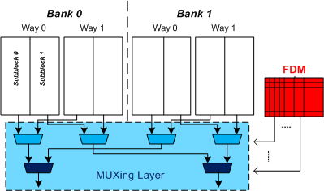
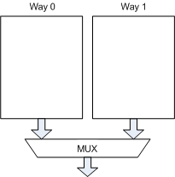
FFT-Cache Architecture
FFT Architecture
Added components:
+ Flexible Defect map (FDM)
+ MUXing layer
Keeps Faulty Locations Info
Same number of lines as banks
Base Architecture
MUXing Layer:
Does the selection between
different subblocks/blocks to
create final fault-free block
Notes:
This Figure shows the architecture of the proposed FFT-Cache.
Let’s assume the cache is divided into two banks, with each bank containing two ways (blocks) that are further divided into 2 subblocks.
The new modules (MUXs and FDM) added to the conventional cache are highlighted in the figure.
Note that two levels of MUXing are added to compose the final fault-free block, based on either multiple blocks within a set or between two or more sets in different banks of data.
The additional multiplexer network would allow us to compose the final fault-free block from any of the subblocks in any of the cache way in either Bank0 or Bank1, based on the FDM data.

Slide 9
Evaluation Methodology
Analytical Model
Estimates the probability of failure of FFT-Cache
Experimental Setup
Baseline Processor
Nehalem-based processor
64KB 4-way set associative L1 cache and 2MB 8-way L2
Monte Carlo Simulation using our FDM configuration algorithm
Identify the Vdd-min and portion of the cache that should be disabled while achieving a 99.9% yield
Notes:
To estimate the probability of failure for the cache, we developed an analytical model of the FFT-Cache.
The architecture was simulated using an extensively modified version of Simplescalar 4.0 using SPEC2K benchmarks.
For a given set of cache parameters (e.g., associativity, subblock size, MGB, etc.), a Monte Carlo simulation with 1000 iterations is performed using our FDM configuration algorithm to identify the portion of the cache that should be disabled while achieving a 99% yield.
Applied to L1 and L2 as shown n bullet

Slide 10
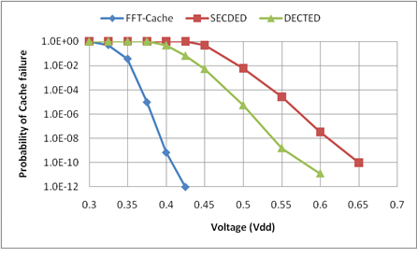
Analytical Model of Cache Failure
99.9% Yield
FFT-Cache can reduce the Vdd below 375mv in comparison with 465mv
and 520mv for DECTED and SECDED methods, respectively
Notes:
We used our analytical models of failure to determine the failure probability of a 64KB L1 FFT-Cache and compared it to SECDED and DECTED methods with equal area overhead.
The results, as shown in this Figure, demonstrate that, at a given voltage, FFT-Cache is the most reliable cache, while SECDED is the least reliable cache.

Slide 11
Experiment 1: Impact of FFT-Cache on Performance
Results of minimum voltage configuration on L1 & L2
(Vdd=375 mV and 16-bit subblock)
Performance drop due to:
increasing in cache access delay (from 2 to 3 cycles for L1 and 20 to 22 cycles for L2)
reduction in cache effective size (less than 25%)
14.0%
12.0%
10.0%
8.0%
IPC loss (%)
6.0%
4.0%
2.0%
art
eon
gap
mcf
vpr
0.0%
apsi
gcc
bzip2
gzip
twolf
applu
crafty
lucas
swim
mesa
galgel
mgrid
ammp
fma3d
parser
vortex
facerec
equake
perlbmk
wupwise
Average
2.2% average performance drop for L1 and 1% for L2
Less than 4% Average Performance drop for both L1 and L2
Impact of extra cycle is more than cache size reduction
L1-L2 Performance degradation due to sacrifice line/blocks
L1-L2 Performance degradation due to extra cycle
Notes:
In this figure, we report the breakdown of performance drop, either due to increasing in cache access delay (from 2 to 3 cycles for L1 and 20 to 22 cycles for L2) or reduction in cache effective size.

Slide 12
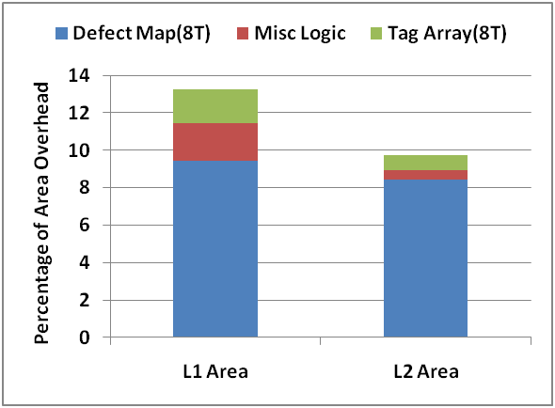
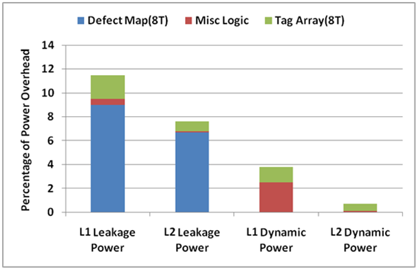
Experiment 2: Area and Power Overheads
FFT implemented on L1 & L2 using operating points earlier
The power overhead is for high-power mode (nominal Vdd)
Using 8T cells to protect the tag and defect map arrays in low-power mode
L2 Overheads < L1 Overheads
Defect Map area is the major component of area overhead for both L1 & L2
Defect Map is the major source of Leakage Power in both L1 & L2
The main source of dynamic power in nominal Vdd relates to bypass MUXs
Notes:
This Figure summarizes the overhead of our scheme for both L1 and L2 caches.
The power overhead in this figure is for high-power mode (nominal Vdd).
We account for the overheads of using 8T SRAM cells for protecting the tag and defect map arrays in low-power mode.
To reduce the effect of leakage and dynamic power consumption of FDM in high-power mode, we assume clock gating and power gating is applied in the FDM array.
The main source of dynamic power in nominal Vdd relates to bypass MUXs

Slide 13
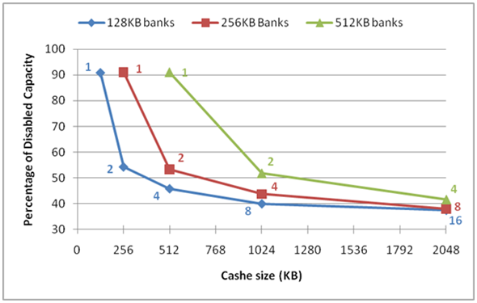
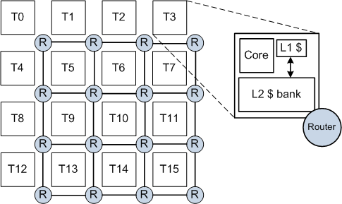
Remapping for Multi-Bank Memory
Impact of voltage scaling induced errors on the available cache capacity
Baseline tiled CMP architecture
The available cache capacity increases with larger number of
banks, since the opportunities for remapping increase

Slide 14
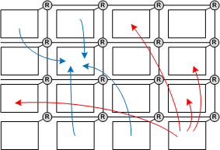
Remapping Policy
Adjacent mapping
Moderate Latency
Moderate Capacity
Moderate Traffic
Global mapping
Maximum Latency
Maximum Capacity
Maximum Traffic
Adjacent mapping
Global mapping

Slide 15
Impact of Network Configuration
Power and performance results for various network configuration
Need for a high performance network as voltage scales down

Slide 16
Conclusion
We proposed FFT-Cache: a fault-tolerant cache architecture that achieves significant power consumption reduction through aggressive voltage scaling
FFT-Cache uses a portion of faulty cache blocks (global blocks) as redundancy to tolerate other faulty blocks or lines
FFT-Cache has a flexible defect map and an efficient configuration algorithm that categorizes the cache lines based on degree of conflict between their blocks
Using our approach:
Operational voltage of memory can be reduced to 375mV in 45 nm Tech
For large CMP architecture we need a high performance network to handle the large traffic induced by remapping.

Slide 17
Thank You!
http://www.ics.uci.edu/~hhomayou/

Slide 18
Comparison with Recent Works
Scheme | Vdd-min (mV) | L1 Cache |  | L2 Cache |  | Norm. IPC
 |  | Area over. (%) | Power over. (%) | Area over. (%) | Power over. (%)
6T cell | 660 | 0 | 0 | 0 | 0 | 1.0
ZerehCache | 430 | 16 | 15 | 8 | 12 | 0.97
Wilkerson | 420 | 15 | 60 | 8 | 20 | 0.89
Ansari | 420 | 14 | 19 | 5 | 4 | 0.95
10T cell | 380 | 66 | 24 | 66 | 24 | 1.0
FFT-Cache | 375 | 13 | 16 | 10 | 8 | 0.95
FFT-Cache achieves the lowest operating voltage (375mv) and
the lowest area and L1 power overhead
Notes:
In this table we present detailed comparison between our scheme and four state-of-the-art works include Wilkerson et al., ZerehCache, 10T SRAM cell, and Ansari et al.

