Slide 1

Adaptive Techniques for Leakage Power Management in L2 Cache Peripheral Circuits
Houman Homayoun Alex Veidenbaum and Jean-Luc Gaudiot
Dept. of Computer Science, UC Irvine
hhomayou@ics.uci.edu

Slide 2
Outline
L2 Cache Power Dissipation
Why Cache Peripheral ?
Study recently proposed static approach to reduce leakage
Propose two adaptive technique to reduce leakage
Present power, performance and energy-delay results

Slide 3
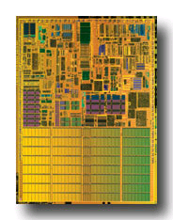
L2 Cache and Power
L2 cache in high-performance processors is large
  2 to 4 MB is common
It is typically accessed relatively infrequently
Thus dissipates most of its power via leakage
  Much of it was in the SRAM cells
    Many architectural techniques proposed to remedy this
Today, there is also significant leakage in the peripheral circuits of an SRAM (cache)
  In part because cell design has been optimized
Pentium M processor die photo
Courtesy of intel.com

Slide 4
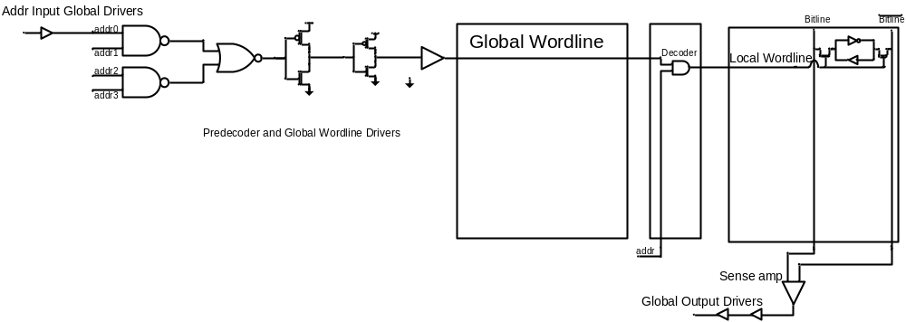
Peripherals ?!
Data Input/Output Driver
Address Input/Output Driver
Row Pre-decoder
Wordline Driver
Row Decoder
Others : sense-amp, bitline pre-charger, memory cells, decoder logic

Slide 5
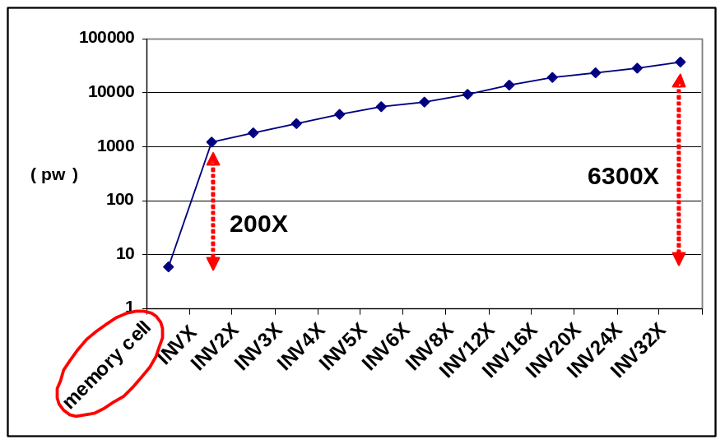
Why Peripherals ?
  Using minimal sized transistor for area considerations in cells and larger, faster and accordingly more leaky transistors to satisfy timing requirements in peripherals
  Using high vt transistors in cells compared with typical threshold voltage transistors in peripherals

Slide 6
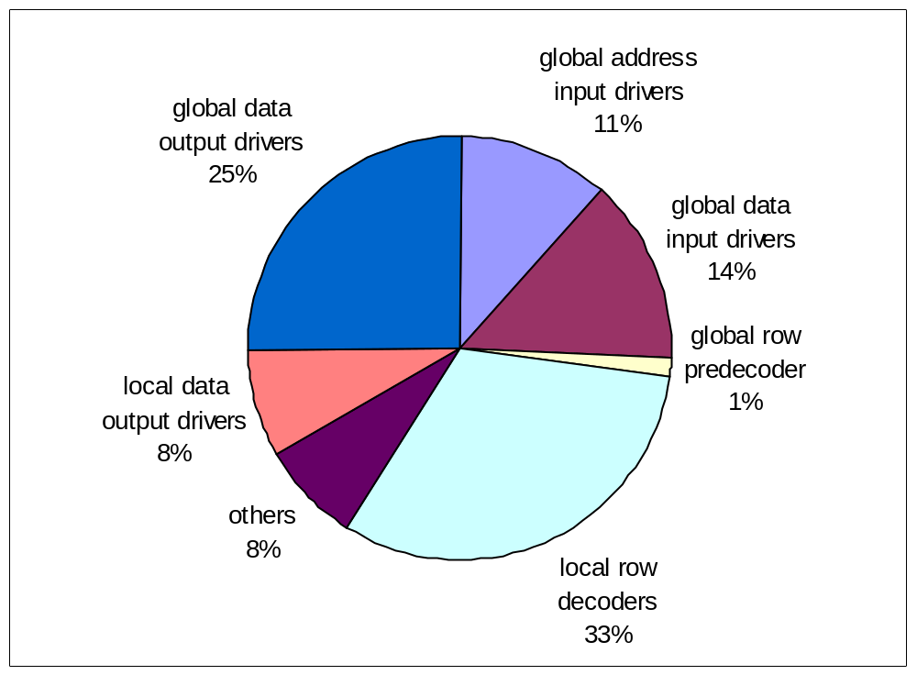
Leakage Power Components of L2 Cache
  SRAM peripheral circuits dissipate more than 90% of the total leakage power

Slide 7
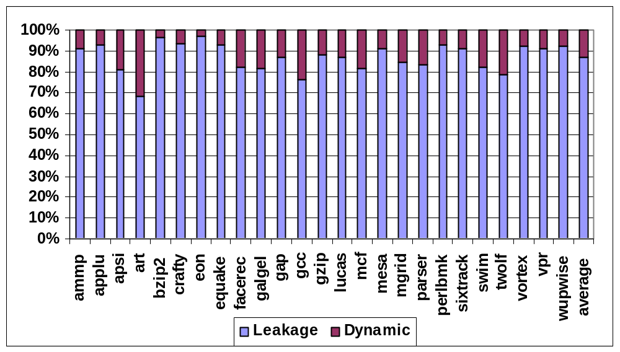
Leakage power as a Fraction of Total L2 Power Dissipation
L2 cache leakage power dominates its dynamic power above 87% of the total

Slide 8
Circuit Techniques Address Leakage in SRAM Cell
Gated-Vdd, Gated-Vss
Voltage Scaling (DVFS)
ABB-MTCMOS
Forward Body Biasing (FBB), RBB
Target SRAM memory cell

Slide 9
Architectural Techniques
Way Prediction, Way Caching, Phased Access
  Predict or cache recently access ways, read tag first
Drowsy Cache
  Keeps cache lines in low-power state, w/ data retention
Cache Decay
  Evict lines not used for a while, then power them down
Applying DVS, Gated Vdd, Gated Vss to memory cell
  Many architectural support to do that.
All target cache SRAM memory cell

Slide 10
Static Architectural Techniques: SM
SM Technique (ICCD’07)
  Asserts the sleep signal by default.
  Wakes up L2 peripherals on an access to the cache
  Keeps the cache in the normal state for J cycles (turn-on period) before returning it to the stand-by mode (SM_J)
    No wakeup penalty during this period
    Larger J leads to lower performance degradation but lower energy savings

Slide 11
Static Architectural Techniques: IM
IM technique (ICCD’07)
  Monitor issue logic and functional units of the processor after L2 cache miss. Asserts the sleep if the issue logic has not issued any instructions and functional units have not executed any instructions for K consecutive cycles (K=10)
  De-asserted the sleep signal M cycles before the miss is serviced
    No performance loss

Slide 12
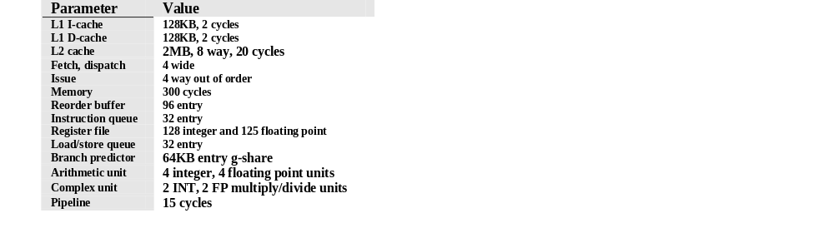
Simulated Processor Architecture
SimpleScalar 4.0
SPEC2K benchmarks
  Compiled with the -O4 flag using the Compaq compiler targeting the Alpha 21264 processor
  fast–forwarded for 3 billion instructions, then fully simulated for 4 billion instructions
    using the reference data sets.

Slide 13
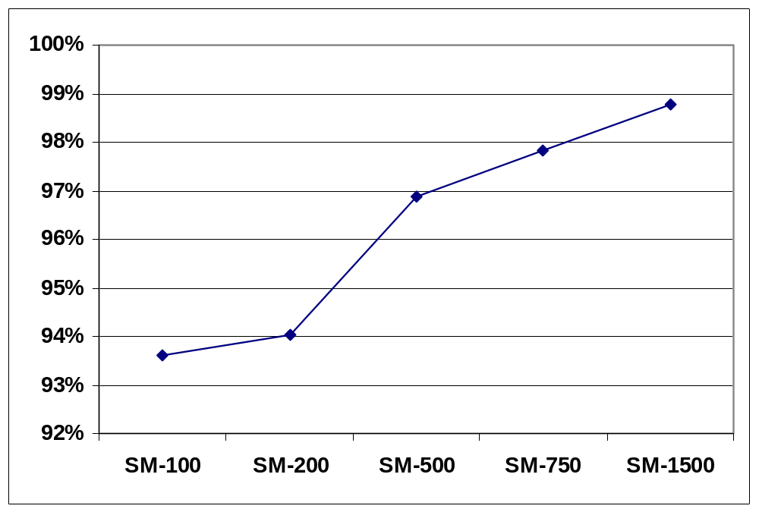
SM Performance Degradation

Slide 14
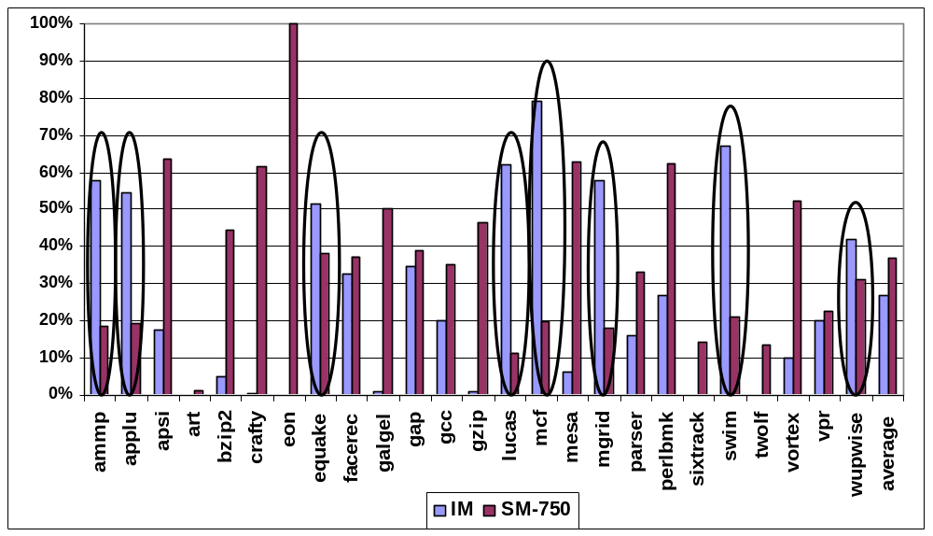
More Insight on SM and IM
Fraction of program execution time during which L2 cache is in low power mode (FLP) using one of IM or SM
  two techniques benefit different benchmarks

Slide 15
More Insight on SM and IM (Cont.)
In almost half of the benchmarks the FLP is negligible and there is no leakage reduction opportunity using IM
  The majority of load instructions satisfied within the cache hierarchy
  The memory accesses are extremely infrequent
  The average FLP period is 26.9%

Slide 16
Some Observations
adaptive technique combining IM and SM has the potential to deliver an even greater power reduction
Some benchmarks SM and IM techniques are both effective facerec, gap, perlbmk and vpr
IM works well in almost half of the benchmarks but is ineffective in the other half
SM work well in about one half of the benchmarks but not the same benchmarks as the IM

Slide 17
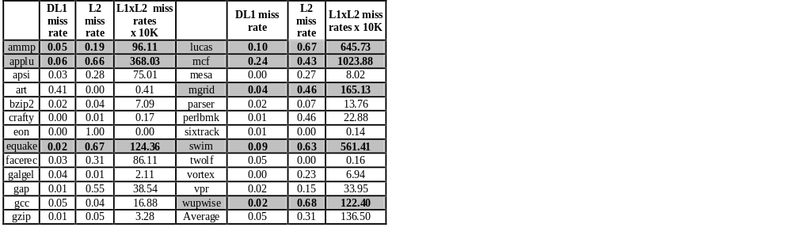
Which Technique Is the Best and When ?
miss rate product (MRP) may be a good indicator of the cache behavior
L2 to be idle
  There are few L1 misses
  Many L2 misses waiting for memory

Slide 18
The Adaptive Techniques
Adaptive Static Mode (ASM)
  MRP measured only once during an initial learning period (the first 100M committed instructions)
    MRP > A ➔ IM (A=90)
    MRP ≤ A ➔ SM_J
    Initial technique ➔ SM_J
Adaptive Dynamic Mode (ADM)
  MRP measured continuously over a K cycle period (K is 10M) choose IM or the SM, for the next 10M cycles
    MRP > A ➔ IM (A=100)
    A ≥ MRP > B ➔ SM_N (B=200)
    otherwise ➔ SM_P

Slide 19
More Insight on ASM and ADM
ASM attempts to find the more effective static technique per benchmark by profiling a small subset of a program
ADM is more complex and attempts to find the more effective static technique at a finer granularity of every 10M cycles intervals based on profiling the previous timing interval

Slide 20
ASM Results
80%
100%
70%
99%
98%
60%
97%
50%
96%
40%
95%
94%
30%
93%
20%
92%
J=100
J=200
J=500
J=750
J=1500
J=100
J=200
J=500
J=750
J=1500
FLP Period
Performance Loss
ASM_750 makes a good power-performance trade-off with
a 44% FLP and an approximately 2% performance loss

Slide 21
Compare ASM with IM and SM
100%
90%
80%
70%
60%
50%
40%
30%
a small subset of program can be used to identify L2 cache behavior, whether it is accessed very infrequently or it is idle since processor is idle
20%
10%
0%
ammp
applu
apsi
art
bzip2
crafty
eon
galgel
gap
gcc
gzip
lucas
mcf
mesa
mgrid
parser
swim
twolf
vortex
vpr
equake
facerec
perlbmk
sixtrack
wupwise
average
ASM-IM
ASM-SM
fraction of IM and SM contribution for ASM_750
Most benchmarks ASM correctly selects the more effective static technique
  Exception: equake

Slide 22
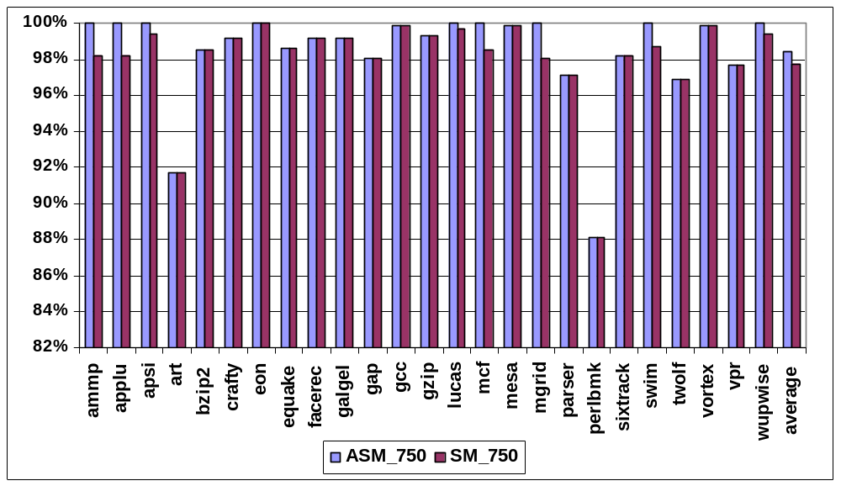
ASM and SM Performance
2X more leakage power reduction
and less performance loss
compare to static approaches
No Performance Loss
  ammp, applu, lucas, mcf, mgird, swim and wupwise

Slide 23
ADM Results
100%
100%
90%
98%
80%
70%
96%
60%
94%
50%
92%
40%
90%
30%
88%
20%
10%
86%
0%
apsi
art
eon
gap
gcc
gzip
mcf
twolf
vpr
84%
ammp
applu
bzip2
crafty
galgel
lucas
mesa
mgrid
parser
swim
vortex
apsi
art
eon
gap
gcc
gzip
mcf
vpr
facerec
sixtrack
equake
perlbmk
average
bzip2
crafty
lucas
mesa
swim
twolf
wupwise
ammp
applu
galgel
mgrid
parser
vortex
facerec
sixtrack
equake
perlbmk
average
wupwise
ADM_IM
ADM_SM
Many benchmarks both IM and SM make a noticeable contribution
  ADM is effective in combining the IM and SM
Some benchmarks either IM or SM contribution is negligible
  ADM selects the best static technique

Slide 24
Power Measurement Approach
CACTI-5
  Peripheral circuits account for 90% of all the leakage power
  The power reduction is 88%.
Total dynamic power : N*Eaccess/Texec
  N is the total number of accesses (obtained from simulation)
  Eaccess is the single access energy from CACTI-5
  Texec is the program execution time
Leakage energy is dissipated on every cycle

Slide 25

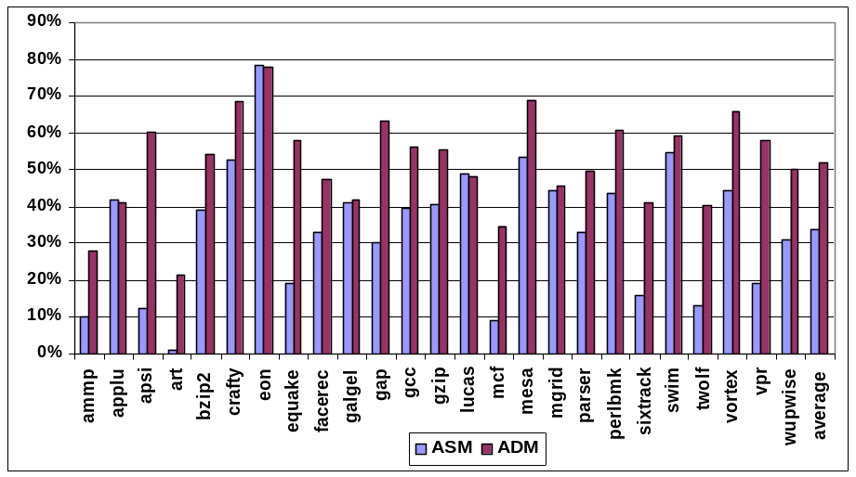
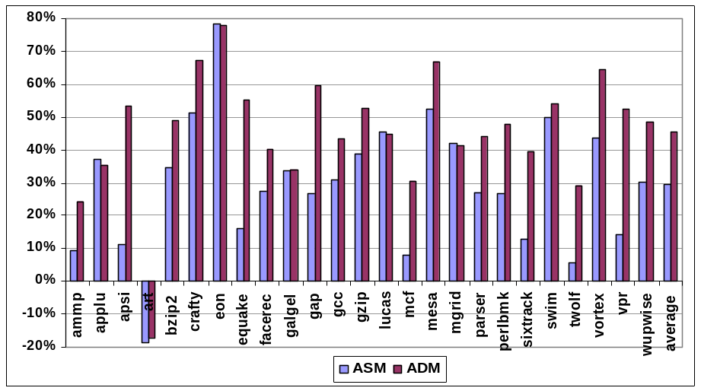
Power Results
2~3 X more leakage power reduction
and less performance loss compare to
static approaches
leakage power savings
total energy delay reduction
leakage reduction using ASM and ADM is 34% and 52% respectively
The overall energy delay reduction is 29.4 and 45.5%
respectively, using the ASM and ADM.

Slide 26
Conclusion
Study break down of leakage in L2 cache components, show peripheral circuit leaking considerably
Study recently proposed IM and SM approach
Propose a metric (cache miss rate product) to differentiate the benchmarks works well with each of static approach
Propose two adaptive technique to select the best static approach dynamically
Present power, performance and energy-delay results
  2 to 3 X improvement over recently proposed static techniques

