Slide 1

Reducing Leakage Power in Peripheral Circuits of L2 Caches
Houman Homayoun and Alex Veidenbaum
Dept. of Computer Science, UC Irvine
{hhomayou, alexv}@ics.uci.edu
ICCD 2007

Slide 2
L2 Caches and Power
L2 caches in high-performance processors are large
  2 to 4 MB is common
They are typically accessed relatively infrequently
Thus L2 cache dissipates most of its power via leakage
  Much of it was in the SRAM cells
    Many architectural techniques proposed to remedy this
Today, there is also significant leakage in the peripheral circuits of an SRAM (cache)
  In part because cell design has been optimized

Slide 3
The problem
How to reduce power dissipation in the peripheral circuits of the L2 cache?
  Seek an architectural solution with a circuit assist
Approach:
  Reduce peripheral leakage when circuits are unused
    By applying “sleep transistor” techniques
  Use architectural techniques to minimize “wakeup” time
    During an L2 miss service, for instance
Will assume that an SRAM cell design is already optimized and will attempt to save power in cells

Slide 4
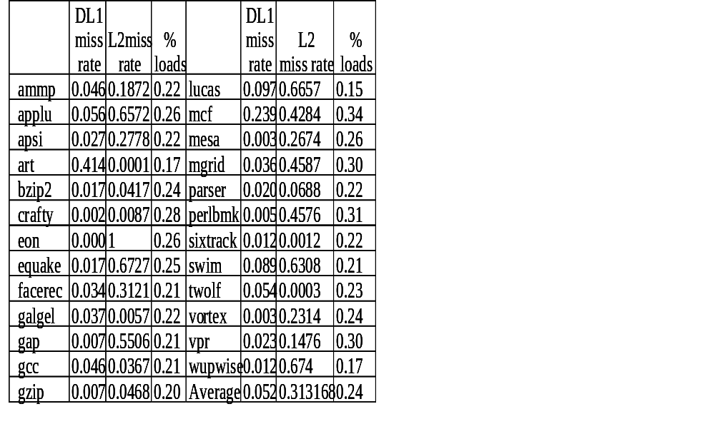
Miss rates and load frequencies
SPEC2K benchmarks
128KB L1 cache
5% average L1 miss rate,
Loads are 25% of instr.
In many benchmarks the L2 is mostly idle
In some L1 miss rate is high
  Much waiting for data
    L2 and CPU idle?

Slide 5
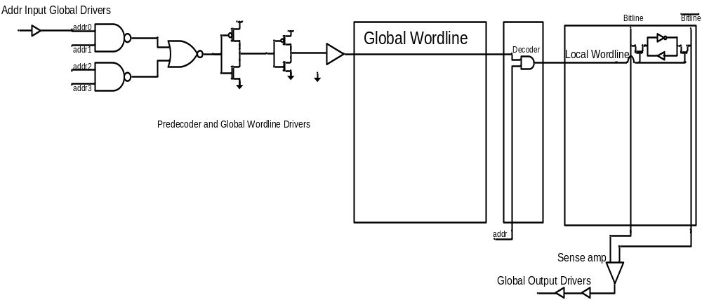
SRAM Leakage Sources
SRAM cell
Sense Amps
Multiplexers
Local and Global Drivers (including the wordline driver)
Address decoder

Slide 6
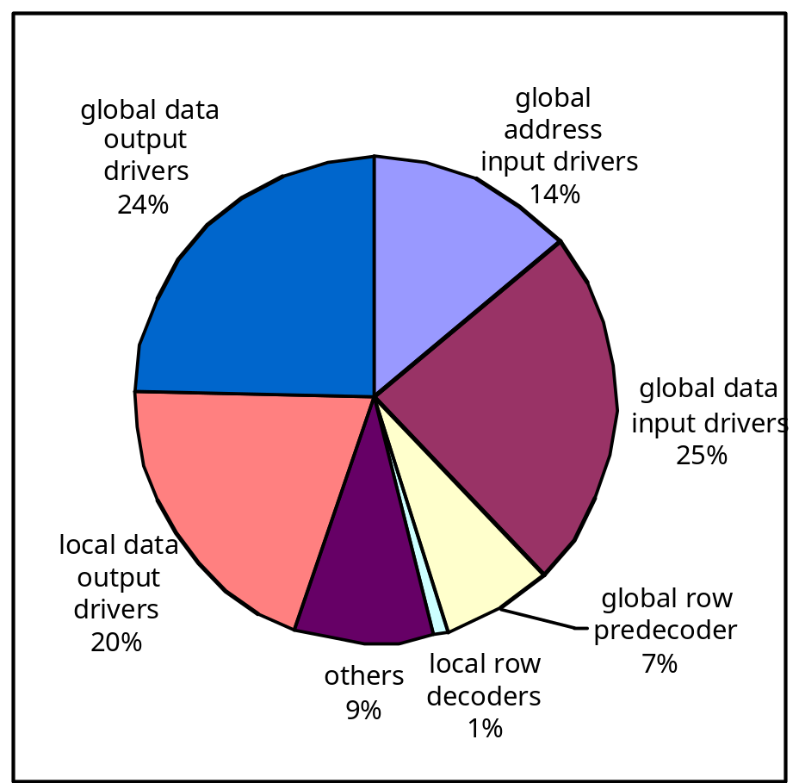
Leakage Energy Break Down in L2 Cache
Large, more leaky transistors used in peripheral circuits
High Vth, less leaky transistors in memory cells

Slide 7
Circuit Techniques for Leakage Reduction
Gated-Vdd, Gated-Vss
Voltage Scaling (DVFS)
ABB-MTCMOS
  Forward Body Biasing (FBB), RBB
Typically target cache SRAM cell design
  But are also applicable to peripheral circuits

Slide 8
Architectural Techniques
Way Prediction, Way Caching, Phased Access
  Predict or cache recently access ways, read tag first
Drowsy Cache
  Keeps cache lines in low-power state, w/ data retention
Cache Decay
  Evict lines not used for a while, then power them down
Applying DVS, Gated Vdd, Gated Vss to memory cell
  Many architectural support to do that.
All target cache SRAM memory cell

Slide 9
What else can be done?
Architectural Motivation:
  A load miss in the L2 cache takes a long time to service
    prevents dependent instructions from being issued
dispatch
issue

Slide 10
When dependent instructions cannot issue
  After a number of cycles the instruction window is full
    ROB, Instruction Queue, Store Queue
The processor issue stalls and performance is lost
At the same time, energy is lost as well!
  This is an opportunity to save energy

Slide 11
IPC during an L2 miss
Cumulative over the L2 miss service time for a program
  Decreases significantly compared to program average
Issue Rate
3.25
3
mesa
sixtrack
crafty
eon
galgel
2.75
vortex
2.5
bzip2
average issue rate during cache miss period
2.25
apsi
gzip
program average issue rate
2
facerec
gcc
1.75
art
gap
parser
twolf
Average
perlbmk
wupwise
1.5
1.25
vpr
1
applu
equake
mgrid
0.75
ammp
lucas
swim
0.5
apsi
bzip2
crafty
galgel
gzip
mesa
sixtrack
vortex
Average
facerec
mgrid
vpr
0.25
applu
art
eon
equake
gcc
mcf
swim
wupwise
ammp
gap
lucas
mcf
parser
perlbmk
twolf
0

Slide 12
A New Technique
Idle time Management (IM)
  Assert an L2 sleep signal (SLP) after an L2 cache miss
    Puts L2 peripheral circuits into a low-power state
    L2 cannot be accessed while in this state
  De-assert SLP when the cache miss completes
Can also apply to the CPU
  Use SLP for DVFS, for instance
  But L2 idle time is only 200 to 300 clocks
    It currently takes longer than that for DVFS

Slide 13
A Problem
Disabling the L2 as soon as the miss is detected
  Prevents the issue of independent instructions
  In particular, of loads that may hit or miss in the L2
  This may impact the performance significantly
    Up to a 50% performance loss
Percentage (%)
60
50
lucas
40
mcf
applu
swim
30
mgrid
20
apsi
equake
10
vpr
Average
bzip2
facerec
mesa
perlbmk
twolf
wupwise
0
ammp
art
crafty
gap
gcc
gzip
parser
sixtrack
vortex
eon
galgel

Slide 14
What are independent instructions?
Independent instructions do not depend on a load miss
  Or any other miss occuring during the L2 miss service
  Independent instructions can execute during miss service
Logarithmic Percentages (log %)
100
mcf
swim
applu
lucas
mgrid
equake
wupwise
10
facerec
vpr
Average
apsi
gap
gcc
perlbmk
vortex
1
ammp
bzip2
mesa
parser
gzip
0.1
galgel
crafty
sixtrack
twolf
0.01
art
0.001
eon

Slide 15
Two Idle Mode Algorithms
Static algorithm (SA)
  put L2 in stand-by mode N cycles after a cache miss occurs
  enable it again M cycles before the miss is expected to compete
  Independent instructions execute during the L2 miss service
  L2 can be accesses during the N+M cycles
    L1 misses are buffered in an L2 buffer during stand-by
Adaptive algorithm (AA)
  Monitor the issue logic and functional units of the processor
    after an L2 miss
  Put the L2 into stand-by mode if no instructions are issued AND
  functional units have not executed any instructions in K cycles
    The algorithm attempts to detect that there are no more instructions that may access the L2

Slide 16
A Second Leakage Reduction Technique
Sometimes the L2 is not accessed much and is mostly idle
In this case it is best to use the Stand-By Mode (SM)
  Start the L2 cache in stand-by, low-power mode
  “Wake it up” on an L1 cache miss and service the miss
Return the L2 to stand-by mode right after the L2 access
  However, this is likely to lead to performance loss
    L1 misses are often clustered, there is a wake-up delay…
A better solution:
  Keep the L2 awake for J cycles after it was turned on
    increases energy consumption, but improves performance

Slide 17
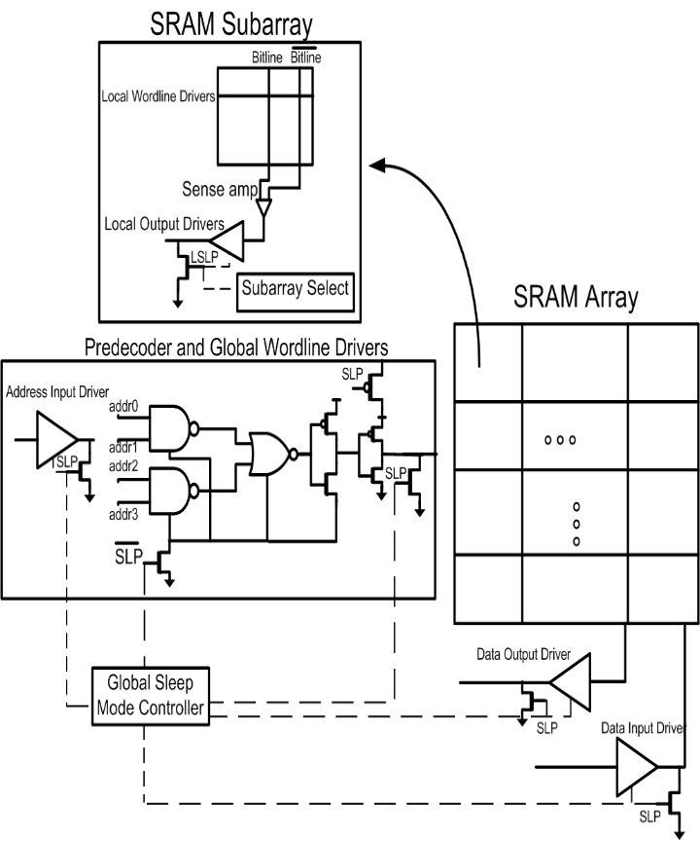
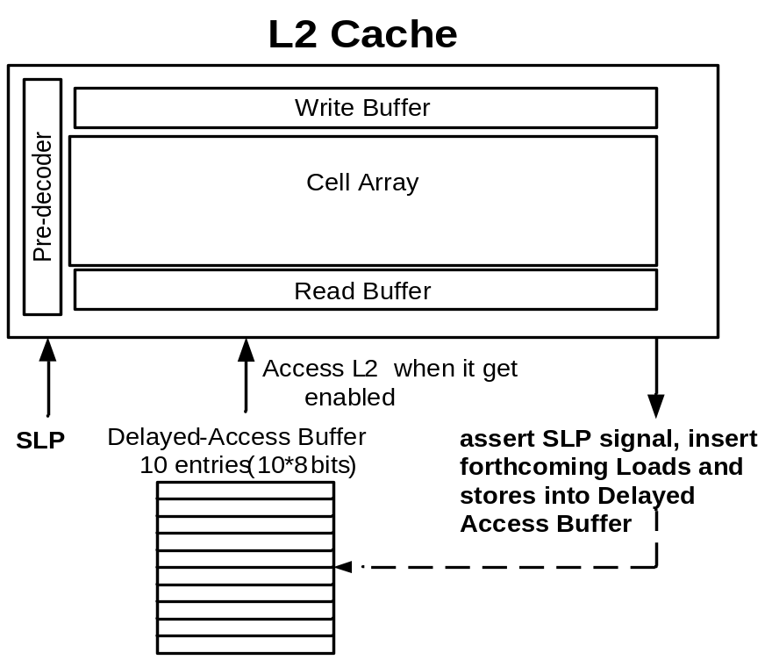
Hardware Support
Add appropriately sized sleep transistors in global drivers
Add delayed-access buffer to L2
  allows L1 misses to be issued and stored in this buffer at L2

Slide 18
System Description
L1 I-cache | 128KB, 64 byte/line, 2 cycles
L1 D-cache | 128KB, 64 byte/line, 2 cycles, 2 R/W ports
L2 cache | 4MB, 8 way, 64 byte/line, 20 cycles
issue | 4 way out of order
Branch predictor | 64KB entry g-share,4K-entry BTB
Reorder buffer | 96 entry
Instruction queue | 64 entry (32 INT and 32 FP)
Register file | 128 integer and 128 floating point
Load/store queue | 32 entry load and 32 entry store
Arithmetic unit | 4 integer, 4 floating point units
Complex unit | 2 INT, 2 FP multiply/divide units
Pipeline | 15 cycles (some stages are multi-cycles)

Slide 19
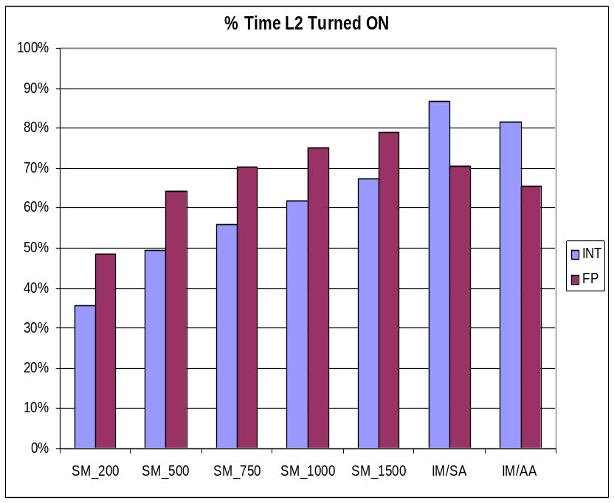
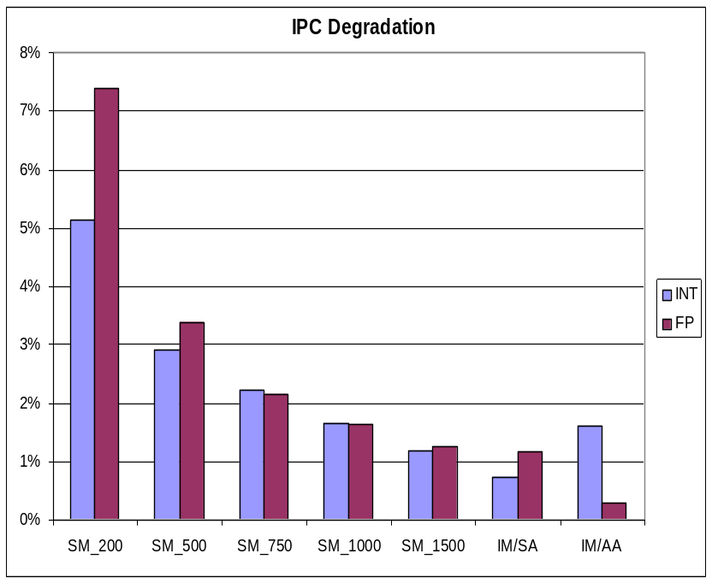
Performance Evaluation
Fraction of total execution time
L2 cache was active using IM & SM
IPC loss due to L2 not being
accessible under IM & SM

Slide 20
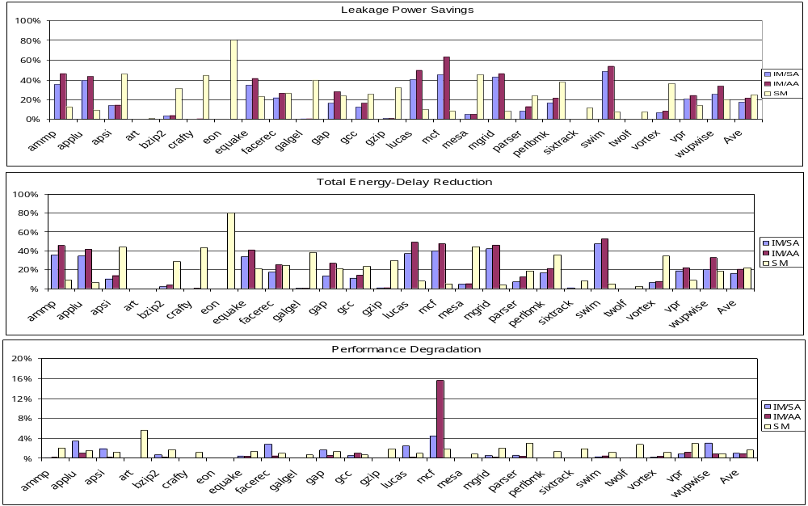
Power-Performance Trade Off
(IM): 18 to 22% leakage power reduction with 1% performance loss
(SM) : 25% leakage power reduction with 2% performance loss

Slide 21
Conclusions
Study break down of leakage in L2 cache components, show peripheral circuit leaking considerably.
Architectural techniques address reducing leakage in memory cell.
Present an architectural study on what is happening after an L2 cache miss occurred.
Present two architectural techniques to reduce leakage in the L2 peripheral circuits; IM and SM. (IM) achieves 18 or 22% average leakage power reduction, with a 1% average IPC reduction. (SM) achieves a 25% average savings with a 2% average IPC reduction.
  two techniques benefit different benchmarks, indicates a possibility adaptively selecting the best technique. This is subject of our ongoing research

