Slide 1


Power, Temperature, Reliability and Performance - Aware Optimizations in On-Chip SRAMs
Houman Homayoun
PhD Candidate
Dept. of Computer Science, UC Irvine

Slide 2

Outline
Past Research
  Low Power Design
    Power Management in Cache Peripheral Circuits (CASES-2008, ICCD-2008,ICCD-2007, TVLSI, CF-2010)
    Clock Tree Leakage Power Management (ISQED-2010)
  Thermal-Aware Design
    Thermal Management in Register File (HiPEAC-2010)
  Reliability-Aware Design
    Process Variation Aware Cache Architecture for Aggressive Voltage-Frequency Scaling (DATE-2009, CASES-2009)
  Performance Evaluation and Improvement
    Adaptive Resource Resizing for Improving Performance in Embedded Processor (DAC-2008, LCTES-2008)

Slide 3
Outline
Current Research
  Inter-core Selective Resource Pooling in 3D Chip Multiprocessor
  Extend Previous Work (for Journal Publication!!)

Slide 4
Leakage Power Management in Cache Peripheral Circuits

Slide 5
Outline: Leakage Power in Cache Peripherals
L2 cache power dissipation
Why cache peripheral?
Circuit techniques to reduce leakage in Peripheral (ICCD-08, TVLSI)
Study static approach to reduce leakage in L2 cache (ICCD-07)
Study adaptive techniques to reduce leakage in L2 cache (ICCD-08)
Reducing Leakage in L1 cache (CASES-2008)

Slide 6
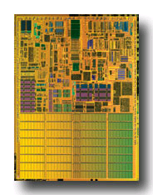
On-chip Caches and Power
On-chip caches in high-performance processors are large
  more than 60% of chip budget
Dissipate significant portion of power via leakage
  Much of it was in the SRAM cells
    Many architectural techniques proposed to remedy this
Today, there is also significant leakage in the peripheral circuits of an SRAM (cache)
  In part because cell design has been optimized
Pentium M processor die photo
Courtesy of intel.com

Slide 7
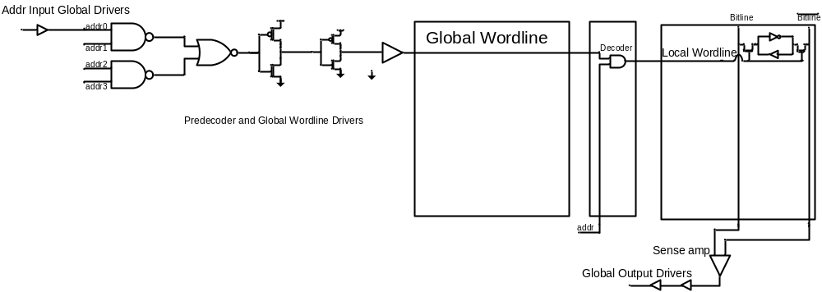
Peripherals ?
Data Input/Output Driver
Address Input/Output Driver
Row Pre-decoder
Wordline Driver
Row Decoder
Others : sense-amp, bitline pre-charger, memory cells, decoder logic

Slide 8
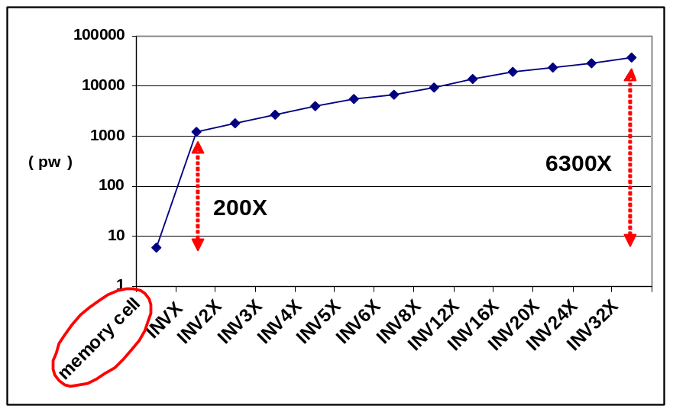
Why Peripherals ?
  Using minimal sized transistor for area considerations in cells and larger, faster and accordingly more leaky transistors to satisfy timing requirements in peripherals.
  Using high vt transistors in cells compared with typical threshold voltage transistors in peripherals

Slide 9
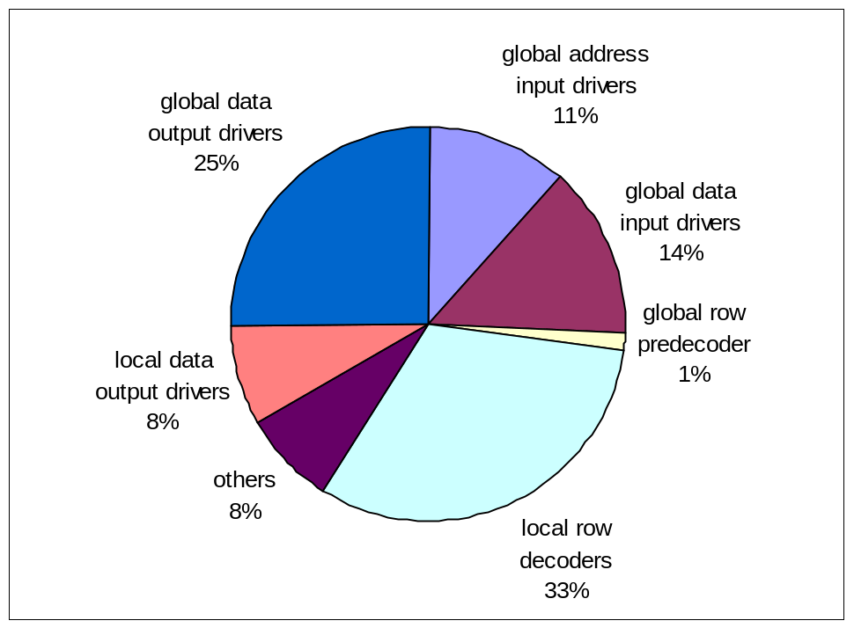
Leakage Power Components of L2 Cache
  SRAM peripheral circuits dissipate more than 90% of the total leakage power

Slide 10
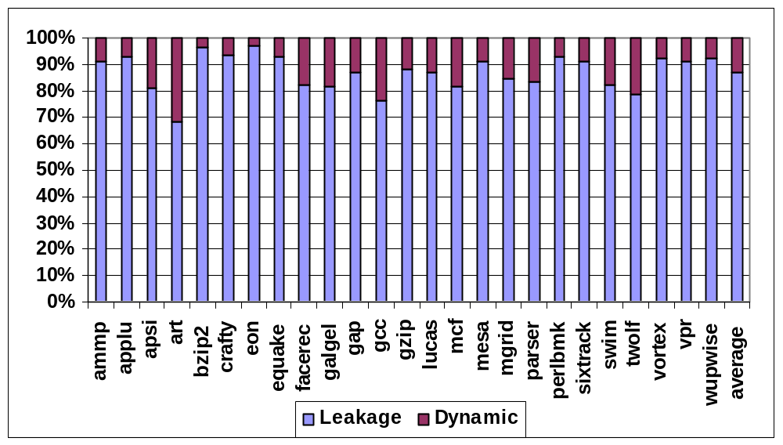
Leakage power as a Fraction of L2 Power Dissipation
L2 cache leakage power dominates its dynamic power above 87% of the total

Slide 11
Circuit Techniques Address Leakage in SRAM Cell
Gated-Vdd, Gated-Vss
Voltage Scaling (DVFS)
ABB-MTCMOS
Forward Body Biasing (FBB), RBB
Sleepy Stack
Sleepy Keeper
Target SRAM memory cell

Slide 12
Architectural Techniques
Way Prediction, Way Caching, Phased Access
  Predict or cache recently access ways, read tag first
Drowsy Cache
  Keeps cache lines in low-power state, w/ data retention
Cache Decay
  Evict lines not used for a while, then power them down
Applying DVS, Gated Vdd, Gated Vss to memory cell
  Many architectural support to do that.
All target cache SRAM memory cell

Slide 13
Multiple Sleep Mode Zig-Zag Horizontal and Vertical Sleep Transistor Sharing

Slide 14
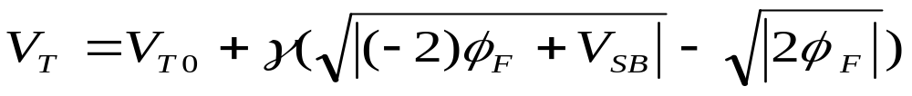
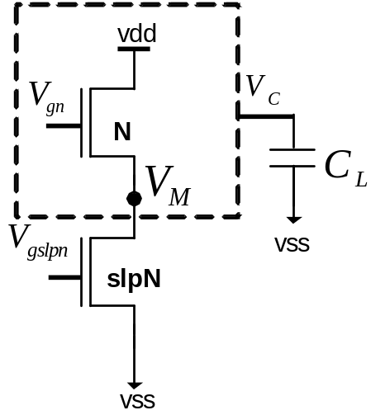
Sleep Transistor Stacking Effect
Subthreshold current: inverse exponential function of threshold voltage
Stacking transistor N with slpN:
  The source to body voltage (VM ) of
  transistor N increases, reduces its
  subthreshold leakage current, when
  both transistors are off
Drawback : rise time, fall time, wakeup delay, area, dynamic power, instability

Slide 15
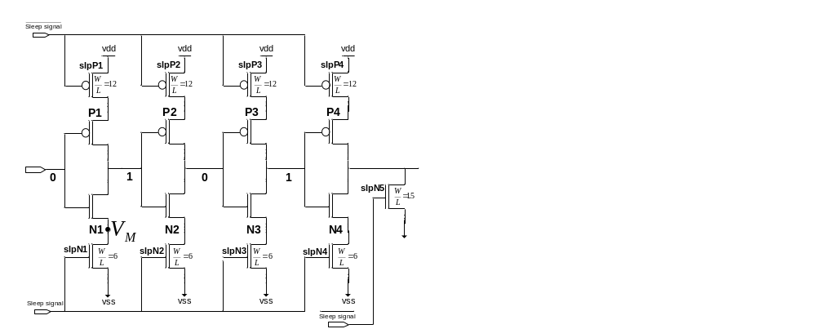
A Redundant Circuit Approach
Drawback impact on wordline driver output
rise time, fall time and propagation delay

Slide 16
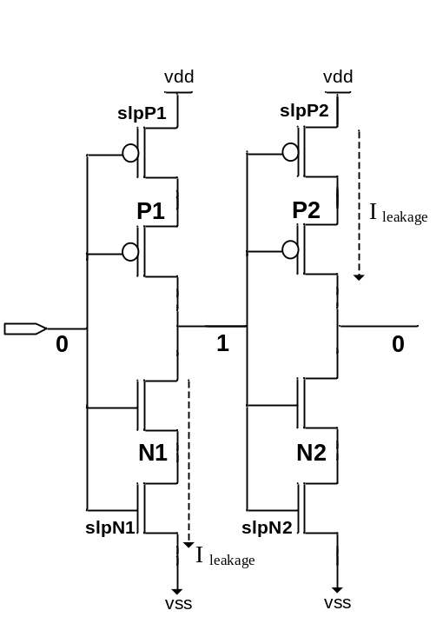
Impact on Rise Time and Fall Time
The rise time and fall time of the output of an inverter is proportional to the
R_{peq} * C_{L} and R_{neq} * C_{L}
Inserting the sleep transistors increases both R_{neq} and R_{peq}
Increasing in rise time
Impact on performance
Increasing in fall time
Impact on memory functionality

Slide 17
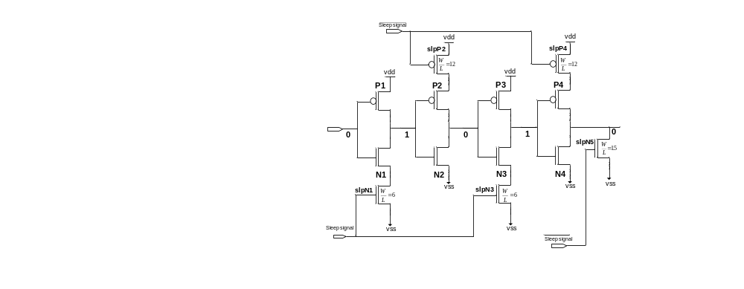
A Zig-Zag Circuit
R_{peq} for the first and third inverters and R_{neq} for the second and fourth inverters doesn’t change.
  Fall time of the circuit does not change

Slide 18
A Zig-Zag Share Circuit
To improve leakage reduction and area-efficiency of the zig-zag scheme, using one set of sleep transistors shared between multiple stages of inverters
  Zig-Zag Horizontal Sharing
  Zig-Zag Horizontal and Vertical Sharing

Slide 19
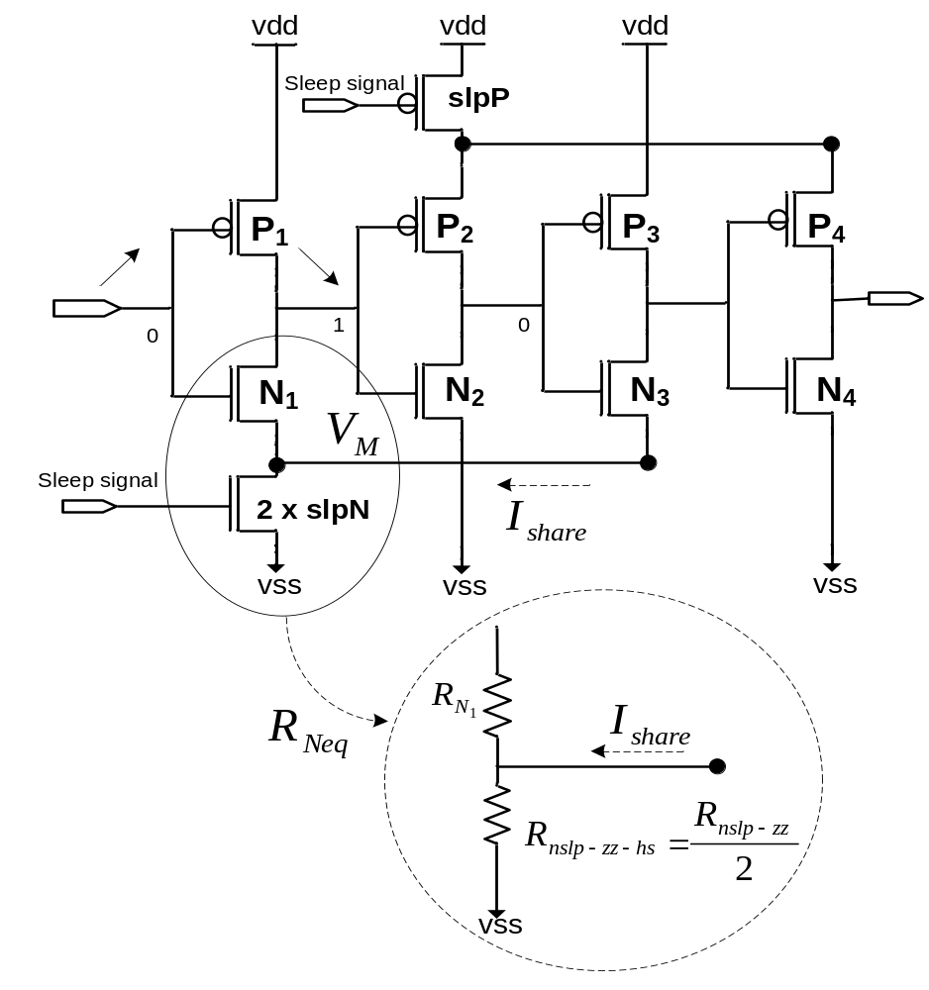
Zig-Zag Horizontal Sharing
Comparing zz-hs with zigzag scheme, with the same area overhead
  Zz-hs less impact on rise time
  Both reduce leakage almost the same

Slide 20

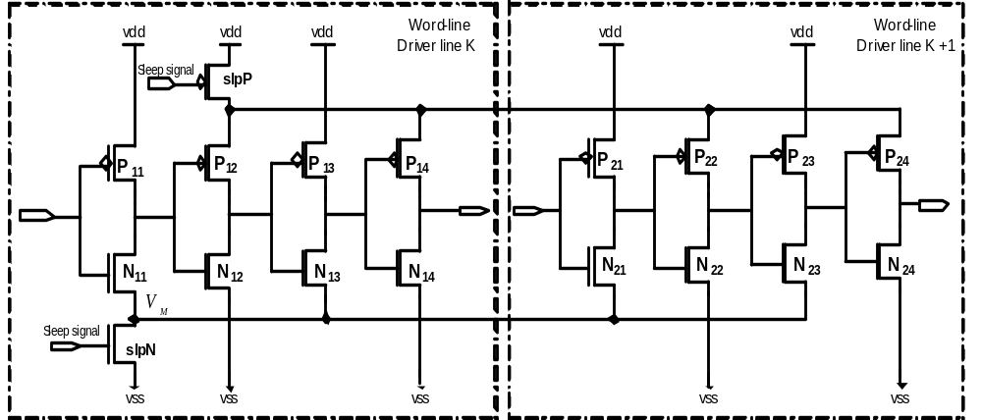
Zig-Zag Horizontal and Vertical Sharing

Slide 21
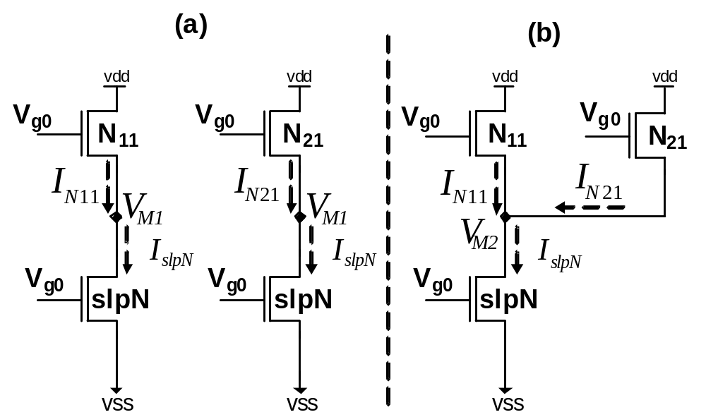

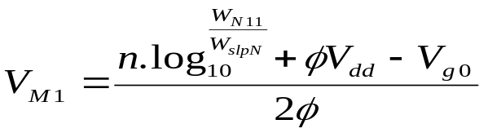
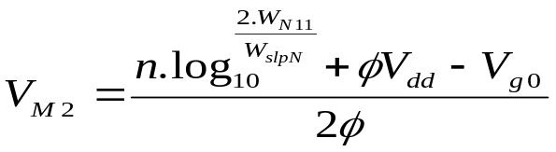
Leakage Reduction of ZZ Horizontal and Vertical Sharing
Increase in virtual ground voltage increase leakage reduction

Slide 22
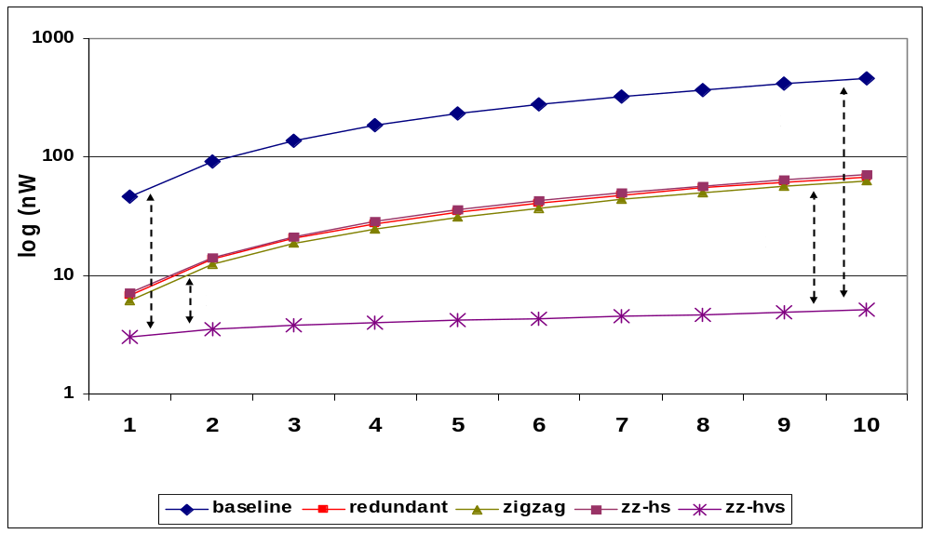
ZZ-HVS Evaluation : Power Result
Increasing the number of wordline rows share sleep transistors increases the leakage reduction and reduces the area overhead
Leakage power reduction varies form a 10X to a 100X when 1 to 10 wordline shares the same sleep transistors
  2~10X more leakage reduction, compare to the zig-zag scheme

Slide 23
Wakeup Latency
To benefit the most from the leakage savings of stacking sleep transistors
  keep the bias voltage of NMOS sleep transistor as low as possible (and for PMOS as high as possible)
Drawback: impact on the wakeup latency of wordline drivers
Control the gate voltage of the sleep transistors
  Increasing the gate voltage of footer sleep transistor reduces the virtual ground voltage (VM)
reduction in leakage power savings
reduction in the circuit wakeup delay overhead

Slide 24
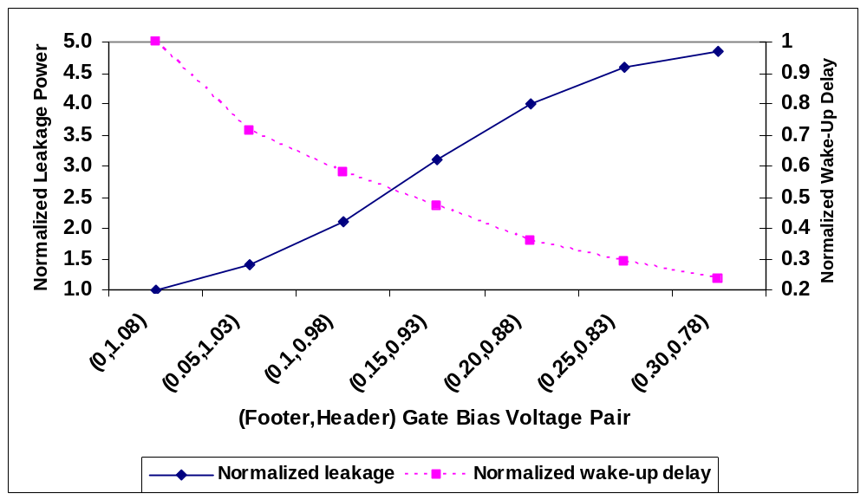
Wakeup Delay vs. Leakage Power Reduction
trade-off between the
wakeup overhead
and leakage power saving
Increasing the bias voltage increases the leakage power while decreases the wakeup delay overhead

Slide 25
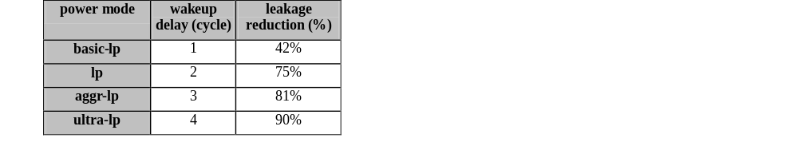
Multiple Sleep Modes
Power overhead of waking up peripheral circuits
  Almost equivalent to the switching power of sleep transistors
  Sharing a set of sleep transistors horizontally and vertically for multiple stages of a (wordline) driver makes the power overhead even smaller

Slide 26
Reducing Leakage in L2 Cache Peripheral Circuits Using Zig-Zag Share Circuit Technique

Slide 27
Static Architectural Techniques: SM
SM Technique (ICCD’07)
  Asserts the sleep signal by default.
  Wakes up L2 peripherals on an access to the cache
  Keeps the cache in the normal state for J cycles (turn-on period) before returning it to the stand-by mode (SM_J)
    No wakeup penalty during this period
    Larger J leads to lower performance degradation but lower energy savings

Slide 28
Static Architectural Techniques: IM
IM technique (ICCD’07)
  Monitor issue logic and functional units of the processor after L2 cache miss. Asserts the sleep if the issue logic has not issued any instructions and functional units have not executed any instructions for K consecutive cycles (K=10)
  De-asserted the sleep signal M cycles before the miss is serviced
    No performance loss

Slide 29
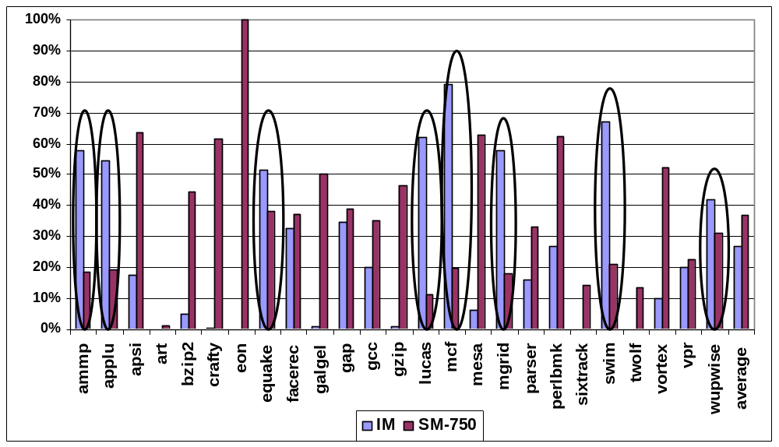
More Insight on SM and IM
adaptive technique combining IM and SM has the potential to deliver an even greater power reduction
Some benchmarks SM and IM techniques are both effective facerec, gap, perlbmk and vpr
IM works well in almost half of the benchmarks but is ineffective in the other half
SM work well in about one half of the benchmarks but not the same benchmarks as the IM

Slide 30
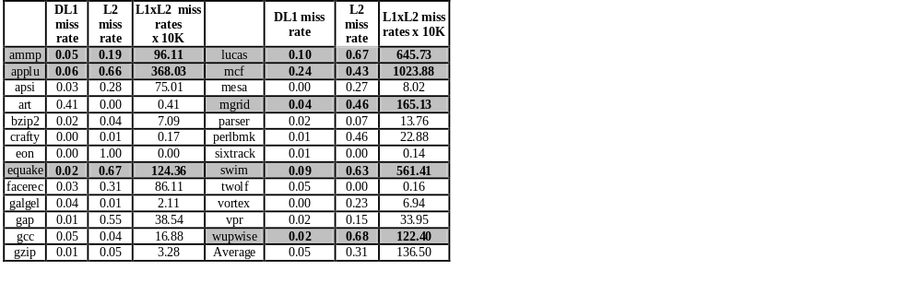
Which Technique Is the Best and When ?
miss rate product (MRP) may be a good indicator of the cache behavior
L2 to be idle
  There are few L1 misses
  Many L2 misses waiting for memory

Slide 31
The Adaptive Techniques
Adaptive Static Mode (ASM)
  MRP measured only once during an initial learning period (the first 100M committed instructions)
    MRP > A ➔ IM (A=90)
    MRP ≤ A ➔ SM_J
    Initial technique ➔ SM_J
Adaptive Dynamic Mode (ADM)
  MRP measured continuously over a K cycle period (K is 10M) choose IM or the SM, for the next 10M cycles
    MRP > A ➔ IM (A=100)
    A ≥ MRP > B ➔ SM_N (B=200)
    otherwise ➔ SM_P

Slide 32
More Insight on ASM and ADM
ASM attempts to find the more effective static technique per benchmark by profiling a small subset of a program
ADM is more complex and attempts to find the more effective static technique at a finer granularity of every 10M cycles intervals based on profiling the previous timing interval

Slide 33
Compare ASM with IM and SM
100%
90%
80%
70%
60%
50%
40%
30%
a small subset of program can be used to identify L2 cache behavior, whether it is accessed very infrequently or it is idle since processor is idle
20%
10%
0%
ammp
applu
apsi
art
bzip2
crafty
eon
galgel
gap
gcc
gzip
lucas
mcf
mesa
mgrid
parser
swim
twolf
vortex
vpr
equake
facerec
perlbmk
sixtrack
wupwise
average
ASM-IM
ASM-SM
fraction of IM and SM contribution for ASM_750
Most benchmarks ASM correctly selects the more effective static technique
  Exception: equake

Slide 34
ADM Results
100%
90%
80%
70%
60%
50%
40%
30%
20%
10%
0%
ammp
applu
apsi
art
bzip2
crafty
eon
galgel
gap
gcc
gzip
lucas
mcf
mesa
mgrid
parser
swim
twolf
vortex
vpr
equake
facerec
perlbmk
sixtrack
average
wupwise
ADM_IM
ADM_SM
Many benchmarks both IM and SM make a noticeable contribution
  ADM is effective in combining the IM and SM
Some benchmarks either IM or SM contribution is negligible
  ADM selects the best static technique

Slide 35
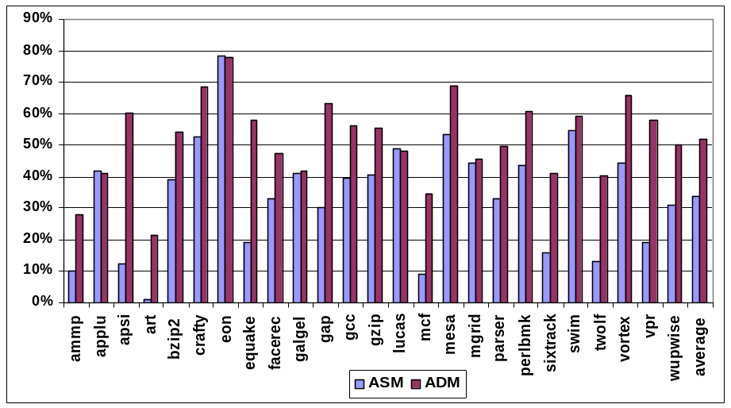
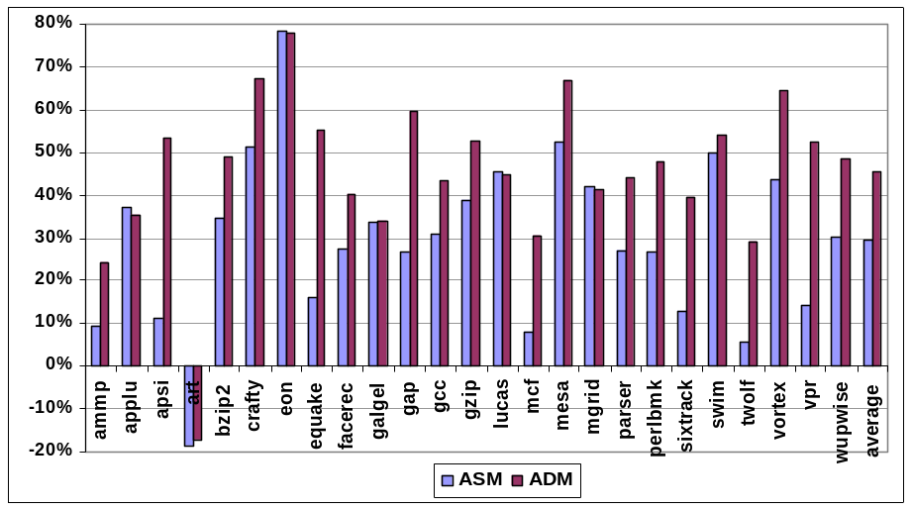
Power Results
2~3 X more leakage power reduction
and less performance loss compare to
static approaches
leakage power savings
total energy delay reduction
leakage reduction using ASM and ADM is 34% and 52% respectively
The overall energy delay reduction is 29.4 and 45.5%
respectively, using the ASM and ADM.

Slide 36
RELOCATE: Register File Local Access Pattern Redistribution Mechanism for Power and Thermal Management in Out-of-Order Embedded Processor

Slide 37
Outline
Motivation
Background study
Study of Register file Underutilization
Study of Register file default access patterns
Access concentration and activity redistribution to relocate register file access patterns
Results

Slide 38
Why Register File?
RF is one of the hottest units in a processor
  A small, heavily multi-ported SRAM
  Accessed very frequently
Example: IBM PowerPC 750FX

Slide 39
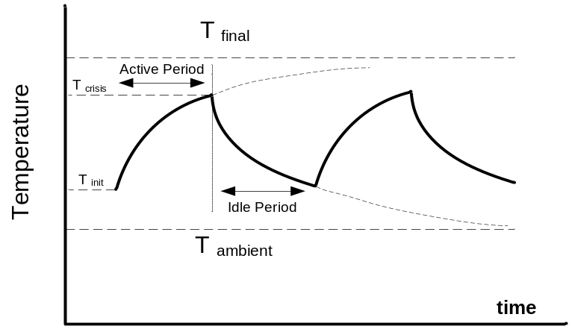
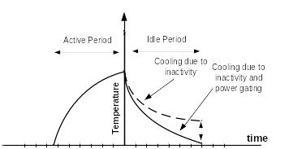
Prior Work: Activity Migration
Reduces temperature by migrating the activity to a replicated unit.
  requires a replicated unit
    large area overhead
  leads to a large performance degradation
AM
AM+PG
Notes:
Figures for illustration only, show trends. AM - activity migration. PG - Power Gating

Slide 40
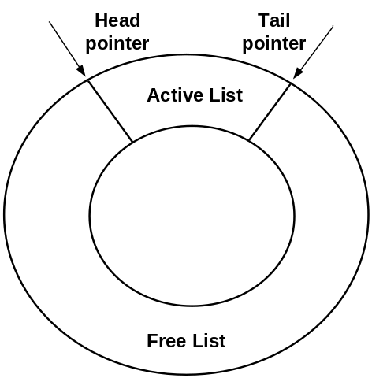

Conventional Register Renaming
Register Renamer
Register allocation-release
Physical registers are allocated/released in a somewhat random order
Notes:
Renamer with lists of free and used regs. Registers are not in any order
Example assumes branch taken.

Slide 41
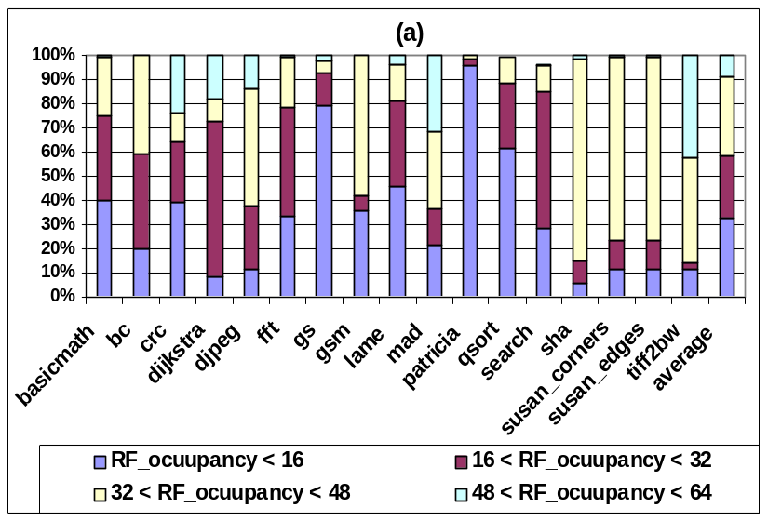
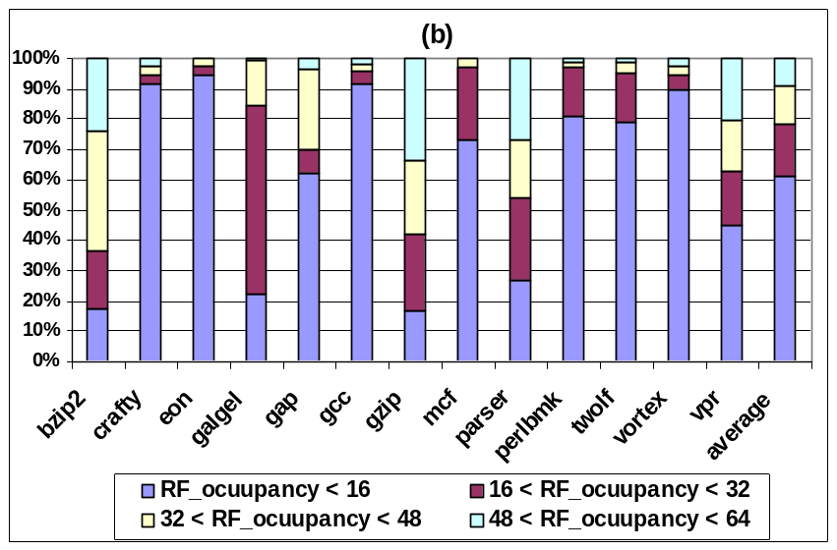
Analysis of Register File Operation
  Register File Occupancy
MiBench
SPECint2K
Notes:
Many unused registers

Slide 42
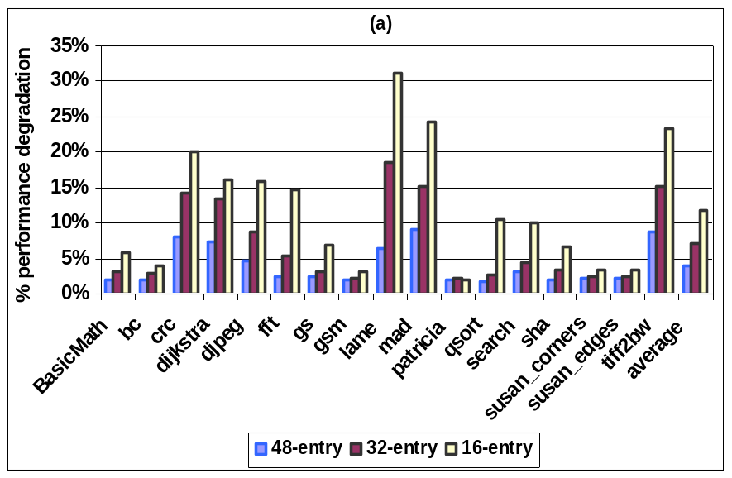
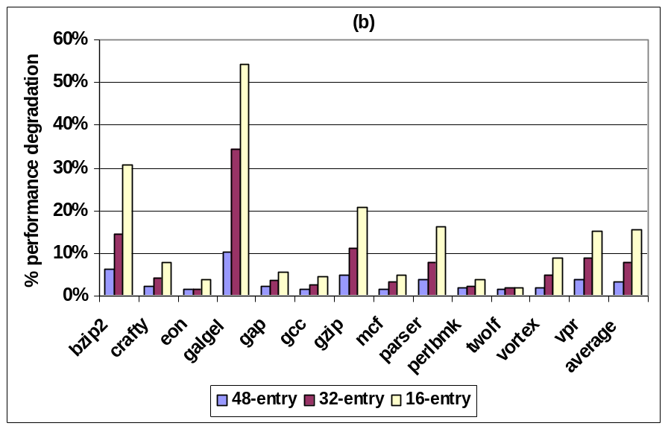
Performance Degradation with a Smaller RF
MiBench
SPECint2K
Notes:
Many unused registers, but cannot reduce RF size to reduce leakage/temp because performance will degrade

Slide 43
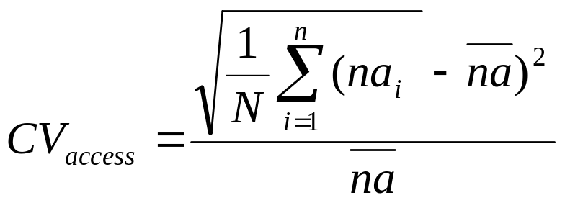
Analysis of Register File Operation
Register File Access Distribution
  Coefficient of variation (CV) shows a “deviation” from average # of accesses for individual physical registers.
    na_{i} is the number of accesses to a physical register i during a specific period (10K cycles). na is the average
    N, the total number of physical registers

Slide 44
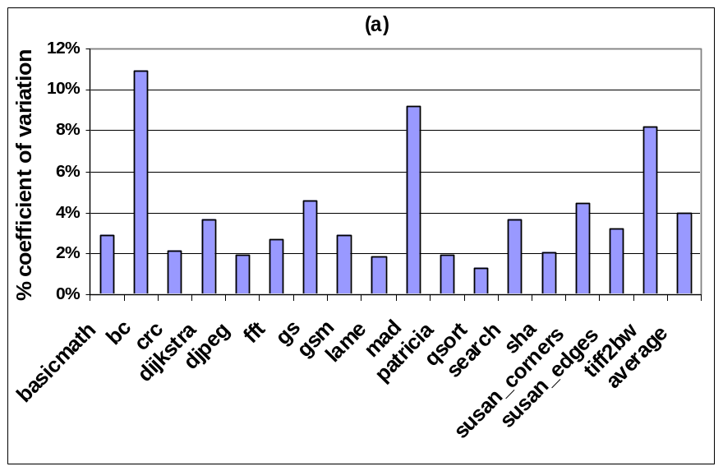
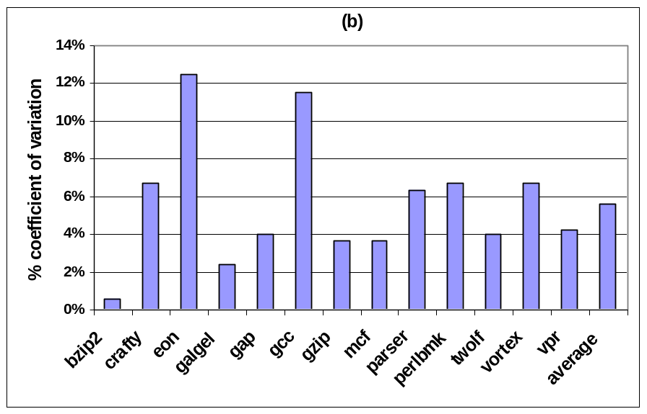
Coefficient of Variation
MiBench
SPEC2K
Notes:
Shows non-uniformity, ie some regs accessed more frequently than others

Slide 45
Register File Operation
Underutilization which is distributed uniformly
while only a small number of registers are occupied at any given time, the total accesses are uniformly distributed over the entire physical register file during the course of execution

Slide 46
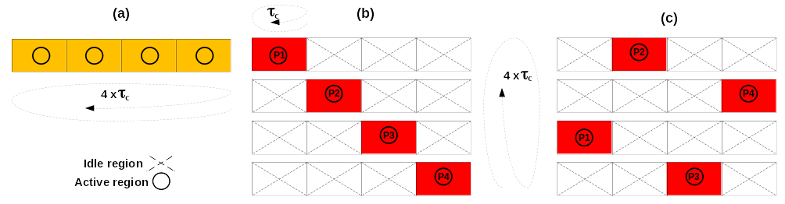
RELOCATE: Access Redistribution within a Register File
The goal is to “concentrate” accesses within a partition of a RF (region)
  Some regions will be idle (for 10K cycles)
    Can power-gate them and allow to cool down
register activity (a) baseline, (b) in-order (c) distant patterns
Notes:
10K cycles is a time scale for temperature change.
Baseline has random access patern, so all regions are active. b) vs c) - adjacent regions heat each other up, so c) is better

Slide 47
An Architectural Mechanism for Access Redistribution
Active partition: a register renamer partition currently used in register renaming
Idle partition: a register renamer partition which does not participate in renaming
Active region: a region of the register file corresponding to a register renamer partition (whether active or idle) which has live registers
Idle region: a region of the register file corresponding to a register renamer partition (whether active or idle) which has no live registers

Slide 48
Activity Migration without Replication
An access concentration mechanism allocates registers from only one partition
This default active partition (DAP) may run out of free registers before the 10K cycle “convergence period” is over
  another partition (according to some algorithm) is then activated (referred to as additional active partitions or AAP )
  To facilitate physical register concentration in DAP, if two or more partitions are active and have free registers, allocation is performed in the same order in which partitions were activated.

Slide 49
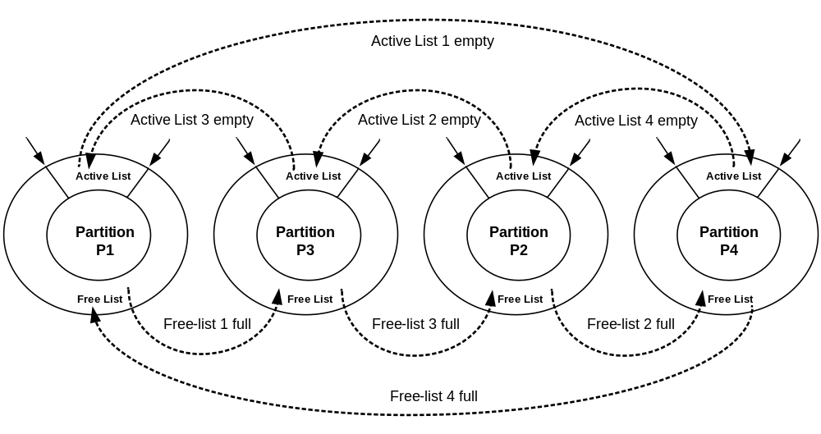
The Access Concentration Mechanism
Partition activation order is 1-3-2-4

Slide 50
The Redistribution Mechanism
The default active partition is changed once every N cycles to redistribute the activity within the register file (according to some algorithm)
  Once a new default partition (NDP) is selected, all active partitions (DAP+AAP) become idle.
The idle partitions do not participate in register renaming, but their corresponding RF regions may have to be kept active (powered up)
  A physical register in an idle partition may be live
An idle RF region is power gated when its active list becomes empty.

Slide 51
Performance Impact?
There is a two-cycle delay to wakeup a power gated physical register region
The register renaming occurs in the front end of the microprocessor pipeline whereas the register access occurs in the back end.
  There is a delay of at least two pipeline stages between renaming and accessing a physical register file
  Can wake up the requested region in time
Can wake up a required register file region
without incurring a performance penalty
at the time of access

Slide 52
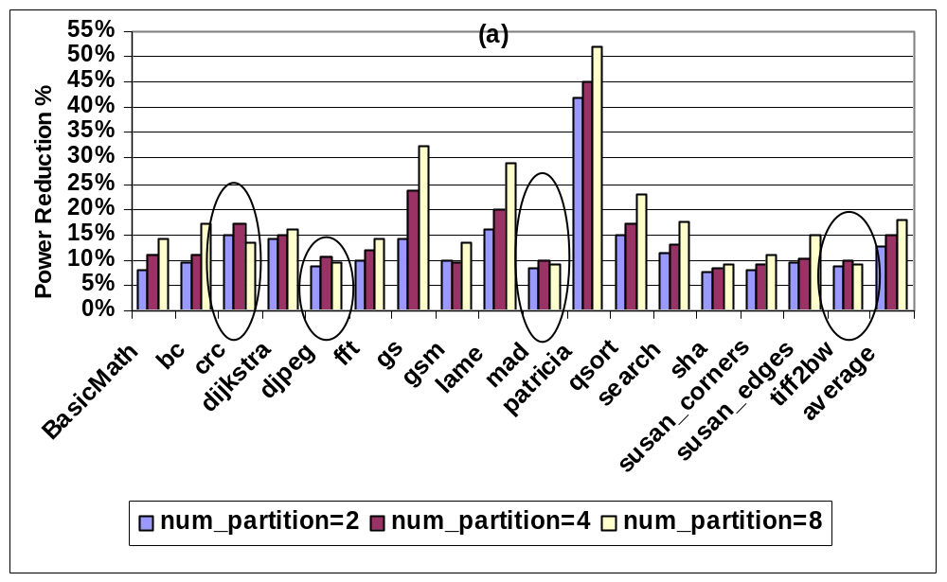
Results: Mibench RF power reduction
Notes:
From power gating idle regions

Slide 53
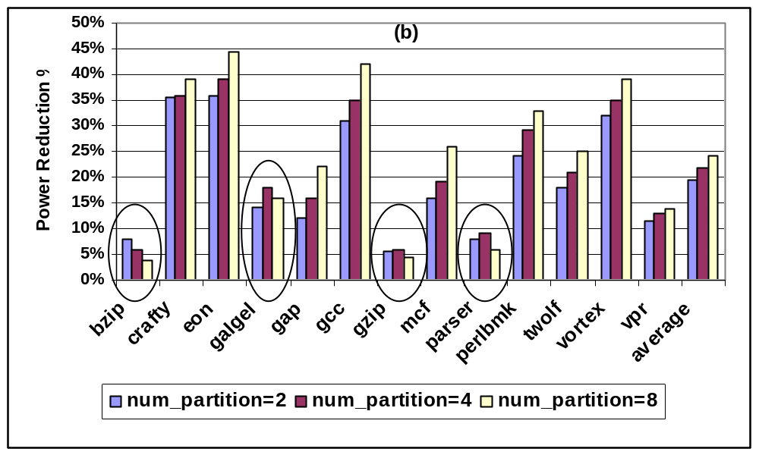
Results: SPEC2K RF power reduction

Slide 54
Analysis of Power Reduction
Increasing the number of RF partitions provides more opportunity to capture and cluster unmapped registers to a partition
  Indicates that wakeup overhead is amortized for a larger number of partitions.
Some exceptions
  the overall power overhead associated with waking up an idle region becomes larger as the number of partition increases.
  frequent but ineffective power gating and its overhead as the number of partition increases

Slide 55
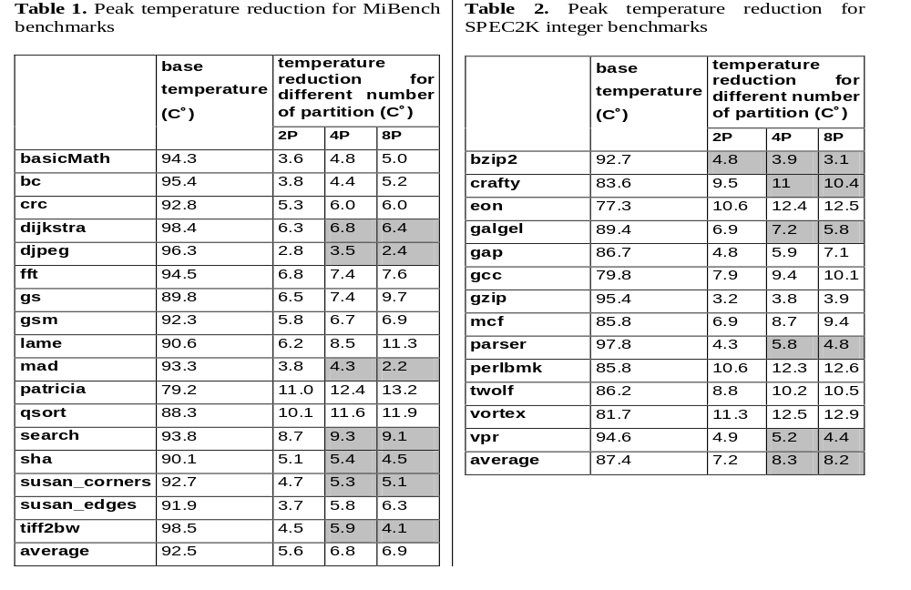
Peak Temperature Reduction
Notes:
4 partitions is best

Slide 56
Analysis of Temperature Reduction
Increasing the number of partitions results in larger power density in each partition because RF access activity is concentrated in a smaller partition
  While capturing more idle partitions and power gating them may potentially result in higher power reduction, larger power density due to smaller partition size results in overall higher temperature

Slide 57
Adaptive Resource Resizing for Improving Performance in Embedded Processor

Slide 58
Introduction
Technology scaling into the ultra deep submicron allowed hundreds of millions of gates integrated onto a single chip.
  Designers have ample silicon budget to add more processor resources to exploit application parallelism and improve performance.
Restrictions with the power budget and practically achievable operating clock frequencies are limiting factors.
  Increasing register file (RF) size increases its access time, which reduces processor frequency.
Dynamically Resizing RF in tandem with dynamic frequency scaling (DFS) significantly improves the performance.

Slide 59
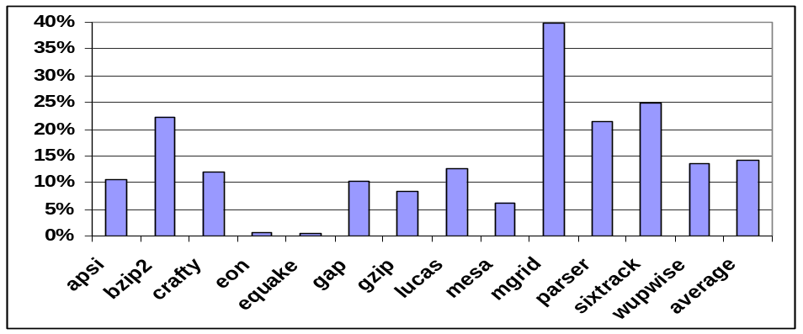
Motivation for Increasing RF Size
After a long latency L2 cache miss the processor executes some independent instructions but eventually ends up becoming stalled.
  After L2 cache miss one of ROB, IQ, RF or LQ/SQ fills up and processor stalls until the miss serviced.
With larger resources it is less likely that these resources will fill up completely during the L2 cache miss service time and potentially improve performance.
The sizes of resources have to be scaled up together; otherwise the non-scaled ones would become a performance bottleneck.
Frequency of stalls due to L2 cache misses, in PowerPC 750FX architecture

Slide 60
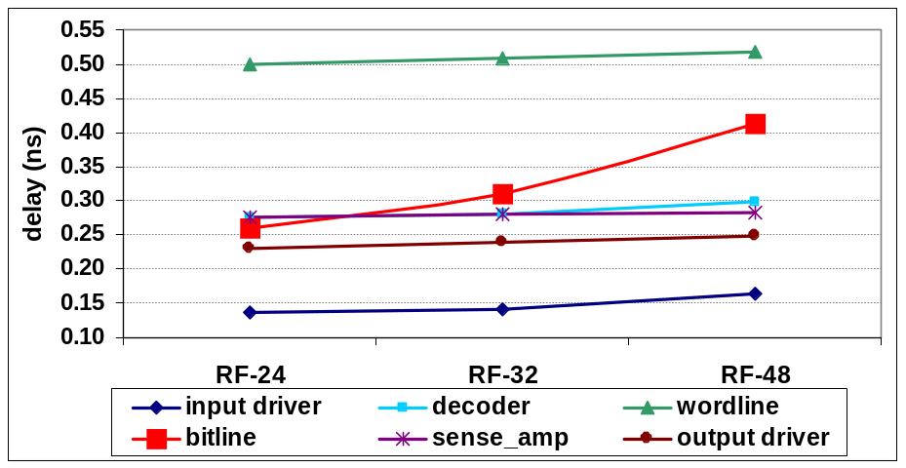
Impact of Increasing RF Size
Increasing the size of RF, (as well as ROB, LQ and IQ)
  can potentially increase processor performance by reducing the occurrences of idle periods,
  has critical impact on the achievable processor operating frequency
RF decide the max achievable operating frequency
significant increase in bitline delay when the size of the RF increases.
Breakdown of RF component delay with increasing size

Slide 61
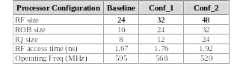
Analysis of RF Component Access Delay
The equivalent capacitance on the bitline is Ceq = N * diffusion capacitance of pass transistors + wire capacitance (usually 10% of total diffusion capacitance) where N is the total number of rows.
As the number of rows increases the equivalent bitline capacitance also increases and therefore the propagation delay increases.
Reduction in clock freq with increasing resource size

Slide 62
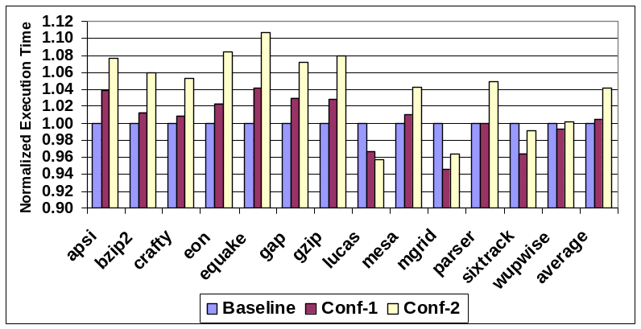
Impact on Execution Time
The execution time increases with larger resource sizes
Normalized execution time for different configs with reduced operating frequency compared to baseline architecture
Trade-off between
  larger resources (and hence reducing the occurrences of idle period) and
  lowering the clock frequency,
The latter becomes more important and plays a major role in deciding the performance in terms of execution time.

Slide 63
Dynamic Register File Resizing
Dynamic RF scaling based on L2 cache misses
  allows the processor use smaller RF (having a lower access time) during the period when there is no pending L2 cache miss (normal period) and a larger RF (at the cost of having a higher access time) during the L2 cache miss period.
To satisfy accessing the RF in one cycle, reduce the operating clock frequency when we scale up its size
  DFS needs to be done fast, otherwise it impacts the performance benefit
  need to use a PLL architecture capable of applying DFS with the least transition delay.
The studied processor (IBM PowerPC 750) uses a dual PLL architecture which allows fast DFS with effectively zero latency.

Slide 64
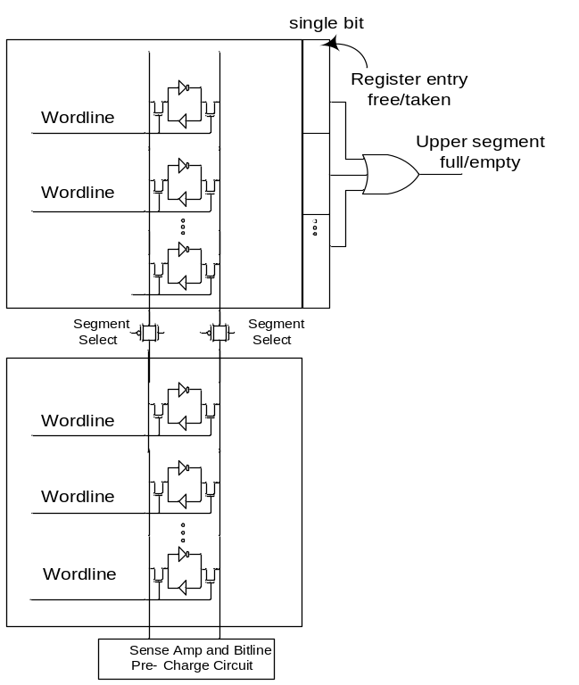
Circuit Modification
The challenge is to design the RF in such a way that its access time is dynamically being controlled.
Among all RF components, the bitline delay increase is responsible for the majority of RF access time increase.
Dynamically adjust bitline load.
Proposed circuit modification for RF

Slide 65
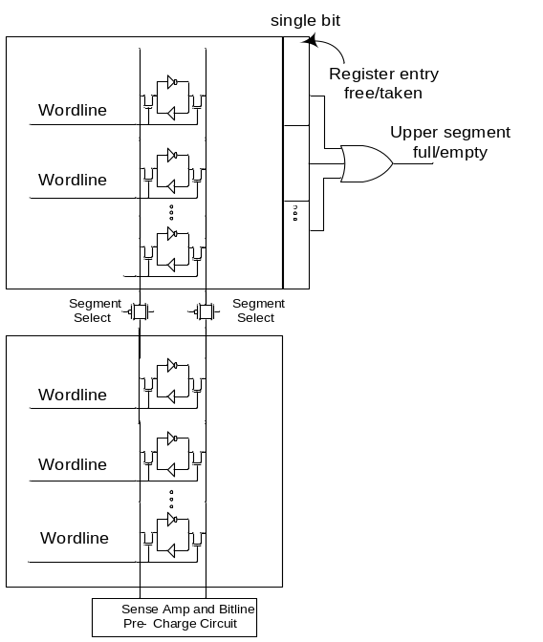
L2 Miss Driven RF Scaling (L2MRFS)
Normal period: the upper segment is power gated and the transmission gate is turned off to isolate the lower bitline segment from the upper bitline segment.
  Only the lower segment bitline is pre-charged during this period.
L2 cache miss period: the transmission gate is turned on and both segments bitlines are pre-charged.
  downsize at the end of cache miss period when the upper segment is empty.
Proposed circuit modification for RF
  Augment the upper segment with one extra bit per entry. Set the entry when a register is taken and reset it when a register is released.
  ORing these bits can detect when the segment is empty.

Slide 66
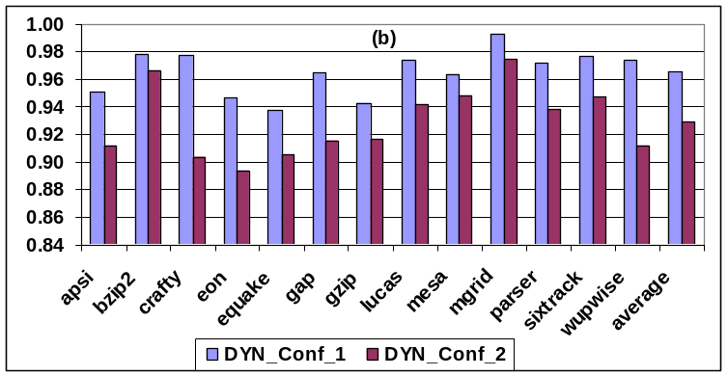
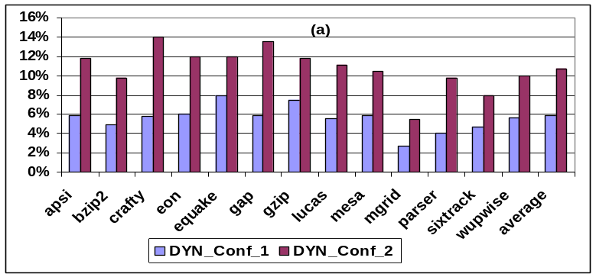
Performance and Energy-delay
Experimental results: (a) normalized performance improvement for L2MRFS (b) normalized energy-delay product compare to conf_1 and conf_2
Performance improvement 6% and 11%
Energy-delay reduction 3.5% and 7%

Slide 67
Inter-core Selective Resource Pooling in 3D Chip Multiprocessor

Slide 68
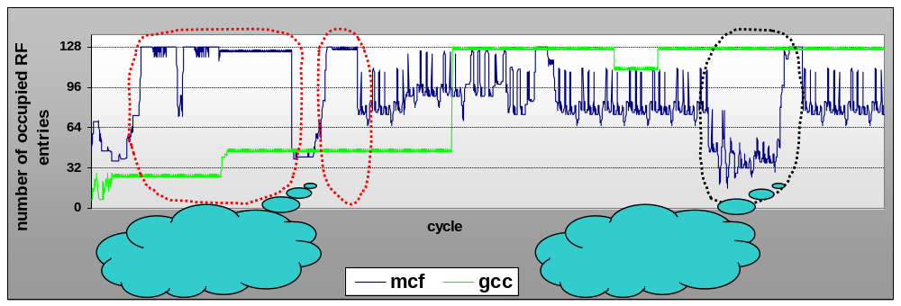
An Example!
An example of register file utilization for different cores in a dual core CMP

Slide 69
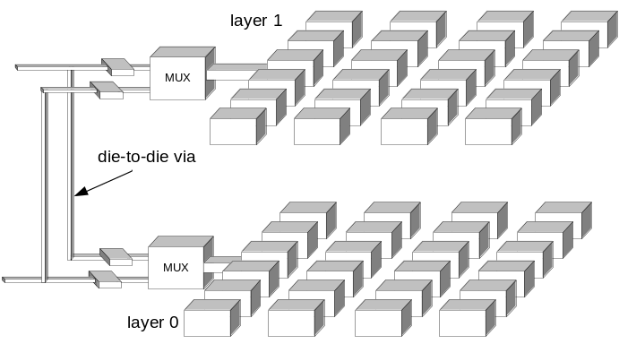
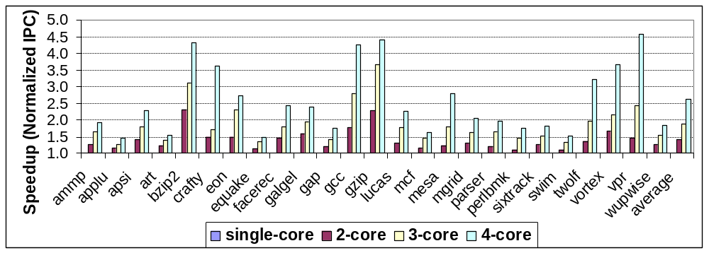
Preliminary Results for Register File Pooling
Register files participating in resource pooling
The normalized IPC of resource pooling

Slide 70
Challenges
The level of resource sharing
  “loose pooling”: HELPER gets a higher priority in accessing to the pooled resource
  “tight pooling”: the priority is given to the GREADY core
The granularity of resource sharing
  number of entries
  number of ports
The level of confidence in predicting the resource utilizations
  avoid starving the HELPER core
  avoiding over provisioning for the GREADY core
A new floorplanning
  put identical resources as close to each other
  can incurs additional thermal and power burden on a currently power hungry and thermal critical resources

Slide 71
Conclusion
Power-Thermal-Reliability aware High Performance Design Through
Inter-Disciplinary Approach
T H A N K S

Slide 72
Reducing Leakage in L2 Cache Peripheral Circuits Using Multiple Sleep Mode Technique

Slide 73
Multiple Sleep Modes
Power overhead of waking up peripheral circuits
  Almost equivalent to the switching power of sleep transistors
  Sharing a set of sleep transistors horizontally and vertically for multiple stages of a (wordline) driver makes the power overhead even smaller

Slide 74
Reducing Leakage in L1 Data Cache
Maximize the leakage reduction in DL1 cache
  put DL1 peripheral into ultra low power mode
  adds 4 cycles to the DL1 latency
    significantly reduces performance
Minimize Performance Degradation
  put DL1 peripherals into the basic low power mode
  requires only one cycle to wakeup and
  hide this latency during address computation stage thus not degrading performance
    Not noticeable leakage power reduction

Slide 75
Motivation for Dynamically Controlling Sleep Mode
dynamically adjust
peripheral circuit
sleep power mode
large leakage reduction benefit
  Ultra and aggressive low power modes
low performance impact benefit
  Basic-lp mode
Periods of frequent access
  Basic-lp mode
Periods of infrequent access
  Ultra and aggressive low power modes

Slide 76
Reducing DL1 Wakeup Delay
Can determine whether an instruction is load or a store at least one cycle prior cache access
  Accessing DL1 while its peripherals are in basic-lp mode doesn’t require an extra cycle
  wake up DL1 peripherals one cycle prior to access
One cycle of wakeup delay can be hidden for all other low-power modes
  Reducing the wakeup delay by one cycle
Put DL1 in basic-lp mode by default

Slide 77
Architectural Motivations
Architectural Motivation
  A load miss in L1/L2 caches takes a long time to service
    prevents dependent instructions from being issued
When dependent instructions cannot issue
  performance is lost
At the same time, energy is lost as well!
  This is an opportunity to save energy

Slide 78
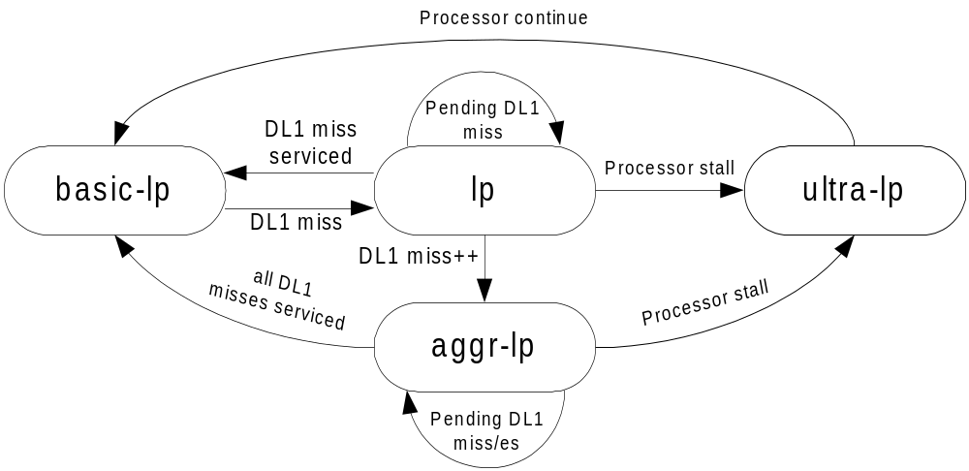
Low-end Architecture
Given the miss service time of 30 cycles
  likely that processor stalls during the miss service period
  Occurrence of additional cache misses while one DL1 cache miss is already pending further increases the chance of pipeline stall

Slide 79
Low Power Modes in a 2KB DL1 Cache
100%
90%
80%
70%
60%
50%
40%
30%
20%
10%
0%
bc
crc
dijkstra
djpeg
fft
gs
gsm
lame
mad
patricia
pgp
qsort
rijndael
search
sha
tiff2bw
average
basicmath
susan_edges
susan_corners
hp
trivial-lp
lp
aggr-lp
ultra-lp
Fraction of total execution time DL1 cache spends in each of the power mode
85% of the time DL1 peripherals put into low power modes
  Most of the time spent in the basic-lp mode (58% of total execution time)

Slide 80
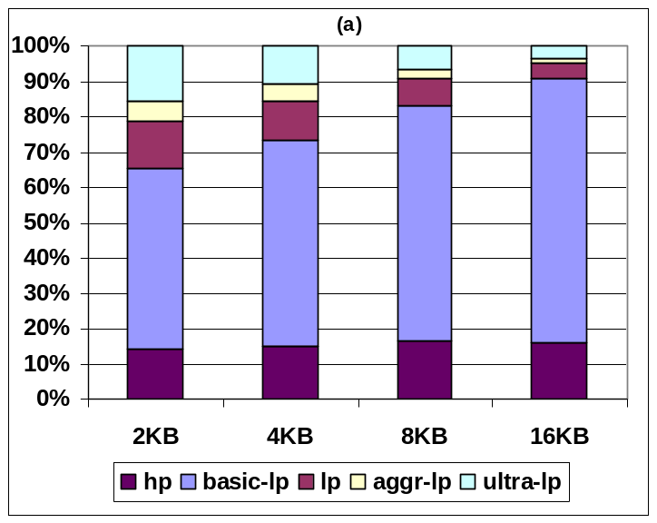
Low Power Modes in Low-End Architecture
10%
9%
8%
7%
6%
5%
4%
3%
2%
1%
0%
bc
crc
djpeg
fft
gs
gsm
lame
mad
pgp
qsort
search
sha
tiff2bw
basicmath
dijkstra
patricia
rijndael
average
susan_edges
susan_corners
2KB
4KB
8KB
16KB
Performance degradation
Frequency of different low power mode
Increasing the cache size reduces DL1 cache miss rate
  Reduces opportunities to put the cache into more aggressive low power modes
  Reduces performance degradation for larger DL1 cache

Slide 81

High-end Architecture
DL1 transitions to ultra-lp mode right after an L2 miss occurs
  Given a long L2 cache miss service time (80 cycles) the processor will stall waiting for memory
DL1 returns to the basic-lp mode once the L2 miss is serviced

Slide 82
Low Power Modes in 4KB Cache
100%
90%
80%
70%
60%
50%
40%
30%
20%
10%
0%
ammp
applu
apsi
art
bzip2
crafty
eon
facerec
galgel
gap
gcc
gzip
lucas
mcf
mesa
mgrid
parser
swim
twolf
vortex
vpr
equake
perlbmk
wupwise
average
hp
trivial-lp
lp
ultra-lp
Many benchmarks the ultra-lp mode has a considerable contribution
  These benchmarks have high L2 miss rate which triggers transition to ultra low power mode

Slide 83


Low Power Modes in High-End Architecture
Performance degradation
Frequency of different low power mode
Increasing the cache size reduces DL1 cache miss rate
  Reduces opportunities to put the cache into more aggressive low power modes
  Reduces performance degradation

Slide 84
Leakage Power Reduction: Low-End Architecture
80%
70%
60%
50%
40%
30%
20%
10%
0%
basicmath
bc
crc
dijkstra
djpeg
fft
gs
gsm
lame
mad
patricia
pgp
qsort
rijndael
search
sha
tiff2bw
average
susan_edges
susan_corners
trivial-lp
lp
aggr-lp
ultra-lp
DL1 leakage is reduced by 50%
While ultra-lp mode occurs much less frequently compared to basic-lp mode, its leakage reduction is comparable to the basic-lp mode.
  in ultra-lp mode the peripheral leakage is reduced by 90%, almost twice that of basic-lp mode.

Slide 85
Leakage Power Reduction: High-End Architecture
90%
80%
70%
60%
50%
40%
30%
20%
10%
0%
ammp
applu
apsi
art
bzip2
crafty
eon
facerec
galgel
gap
gcc
gzip
lucas
mcf
mesa
mgrid
parser
swim
twolf
vortex
vpr
equake
perlbmk
wupwise
average
trivial-lp
lp
ultra-lp
The average leakage reduction is almost 50%

