Slide 1


RELOCATE
Register File Local Access Pattern Redistribution Mechanism for Power and Thermal Management in Out-of-Order Embedded Processor
Houman Homayoun, Aseem Gupta, Avesta Sasan, Alex Veidenbaum, Nikil Dutt, Fadi Kurdahi
University of California Irvine

Slide 2
Outline
Motivation
Background study
Study of Register file Underutilization
Study of Register file default access patterns
Access concentration and activity redistribution to relocate register file access patterns
Results

Slide 3
Why Register File?
RF is one of the hottest units in a processor
  A small, heavily multi-ported SRAM
  Accessed very frequently
Example: IBM PowerPC 750FX

Slide 4
Why Temperature?
Higher power densities (Watt per mm2) lead to higher operating temperatures, which
  (i) Increase the probability of timing violations
  (ii) Reduce IC lifetime
  (iii) Lower operating frequency
  (iv) Increase leakage power
  (v) Require expensive cooling mechanisms
  (vi) Overall increase in design effort and cost

Slide 5
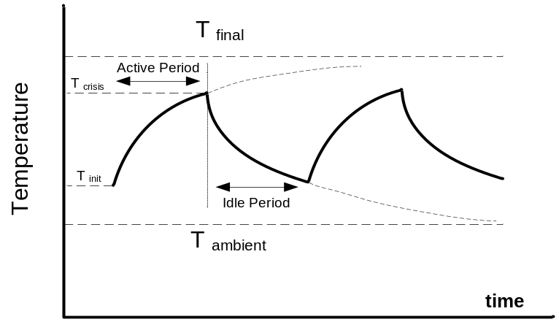
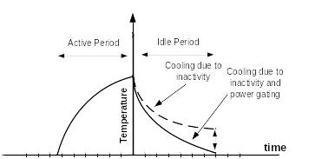
Prior Work: Activity Migration
Reduces temperature by migrating the activity to a replicated unit.
  requires a replicated unit
    large area overhead
  leads to a large performance degradation
AM
AM+PG
Notes:
Figures for illustration only, show trends. AM - activity migration. PG - Power Gating

Slide 6
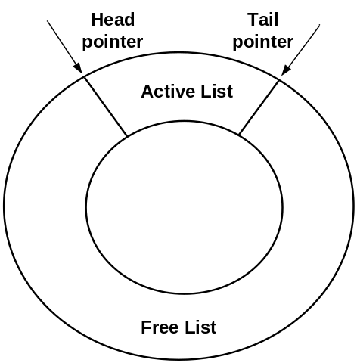

Conventional Register Renaming
Register Renamer
Register allocation-release
Physical registers are allocated/released in a somewhat random order
Notes:
Renamer with lists of free and used regs. Registers are not in any order
Example assumes branch taken.

Slide 7
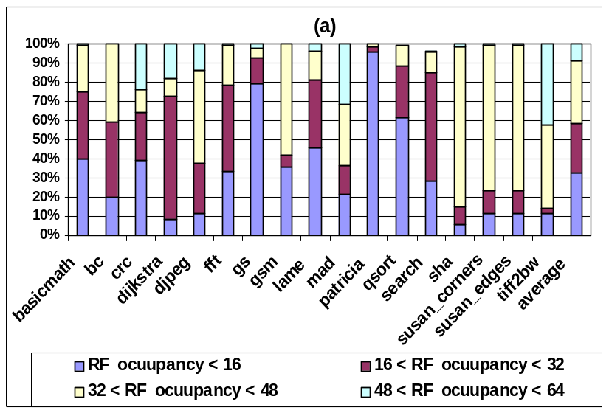
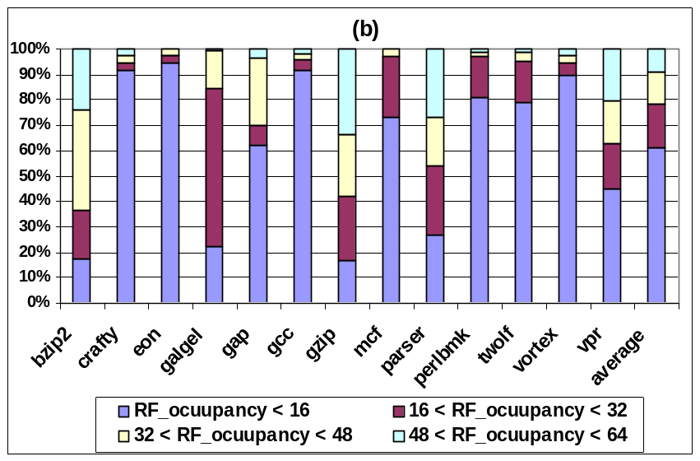
Analysis of Register File Operation
  Register File Occupancy
MiBench
SPECint2K
Notes:
Many unused registers

Slide 8
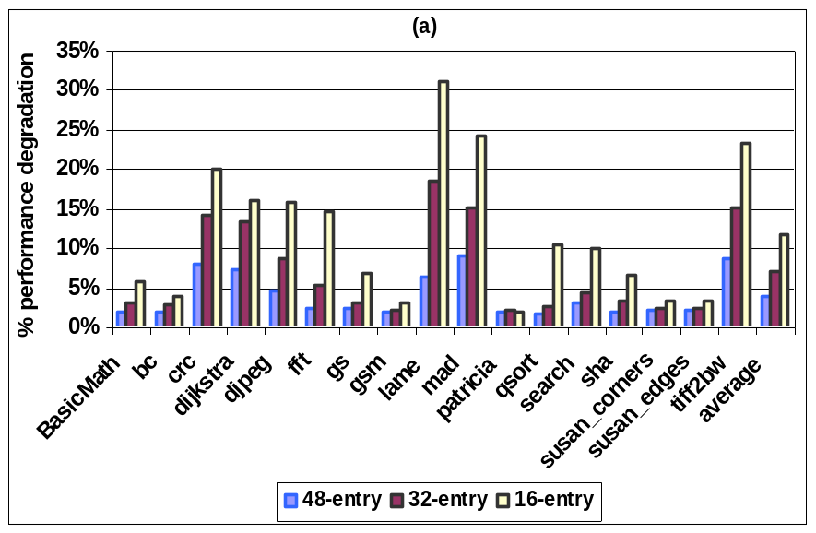
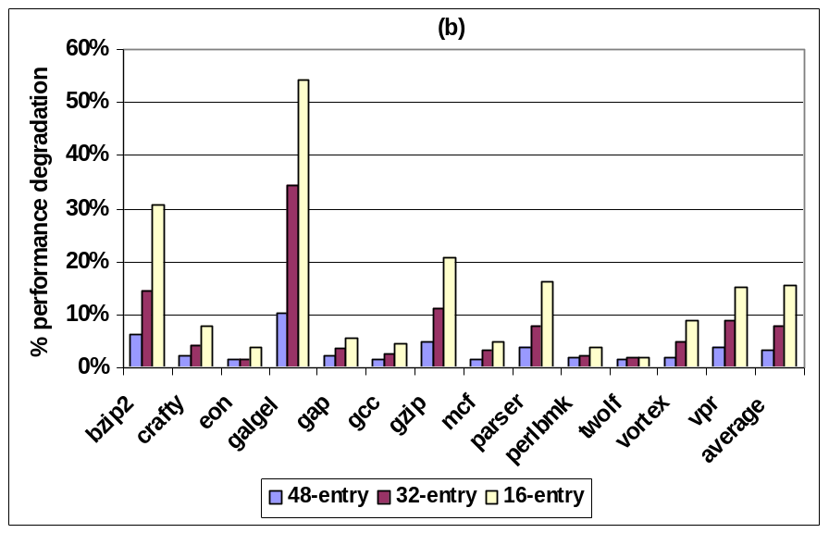
Performance Degradation with a
Smaller Register File
MiBench
SPECint2K
Notes:
Many unused registers, but cannot reduce RF size to reduce leakage/temp because performance will degrade

Slide 9
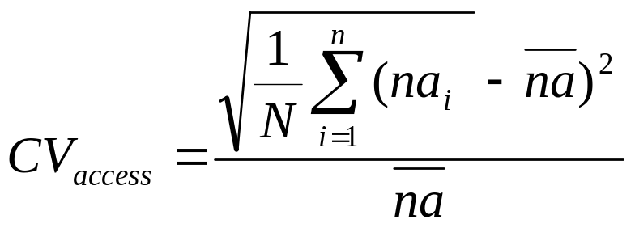
Analysis of Register File Operation
2. Register File Access Distribution
  Coefficient of variation (CV) shows a “deviation” from average # of accesses for individual physical registers.
    na_{i} is the number of accesses to a physical register i during a specific period (10K cycles). na is the average
    N, the total number of physical registers

Slide 10
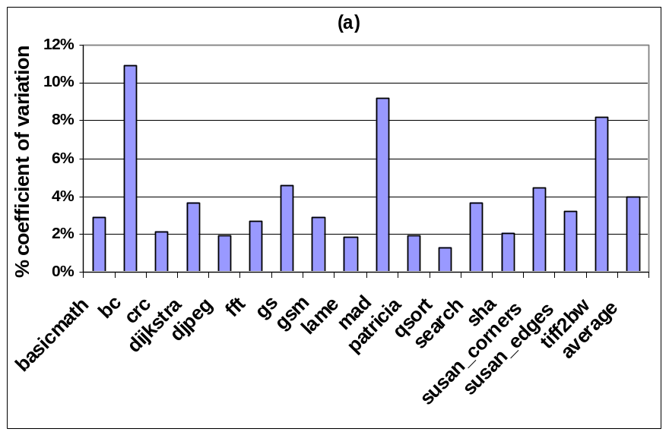
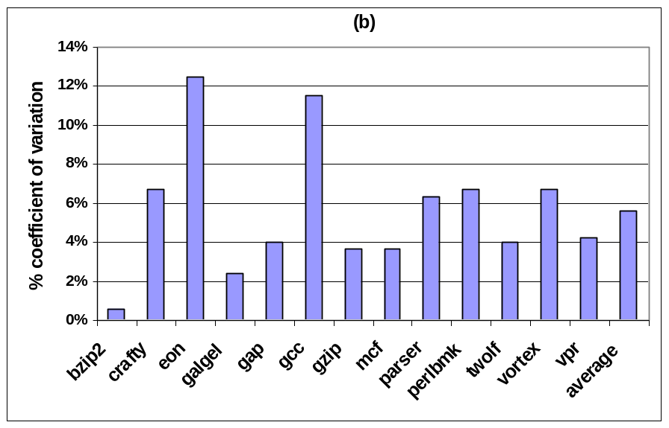
Coefficient of Variation
MiBench
SPEC2K
Notes:
Shows non-uniformity, ie some regs accessed more frequently than others

Slide 11
Register File Operation
Underutilization which is distributed uniformly
while only a small number of registers are occupied at any given time, the total accesses are uniformly distributed over the entire physical register file during the course of execution

Slide 12
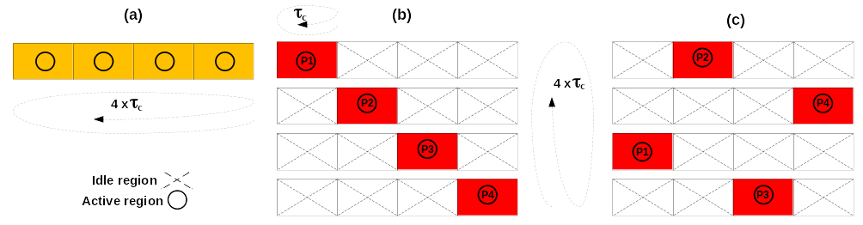
RELOCATE: Access Redistribution within a Register File
The goal is to “concentrate” accesses within a partition of a RF (region)
  Some regions will be idle (for 10K cycles)
    Can power-gate them and allow to cool down
register activity (a) baseline, (b) in-order (c) distant patterns
Notes:
10K cycles is a time scale for temperature change.
Baseline has random access patern, so all regions are active. b) vs c) - adjacent regions heat each other up, so c) is better

Slide 13
An Architectural Mechanism to Support Access Redistribution
Active partition: a register renamer partition currently used in register renaming
Idle partition: a register renamer partition which does not participate in renaming
Active region: a region of the register file corresponding to a register renamer partition (whether active or idle) which has live registers
Idle region: a region of the register file corresponding to a register renamer partition (whether active or idle) which has no live registers

Slide 14
Activity Migration without Replication
An access concentration mechanism allocates registers from only one partition
This default active partition (DAP) may run out of free registers before the 10K cycle “convergence period” is over
  another partition (according to some algorithm) is then activated (referred to as additional active partitions or AAP )
  To facilitate physical register concentration in DAP, if two or more partitions are active and have free registers, allocation is performed in the same order in which partitions were activated.

Slide 15
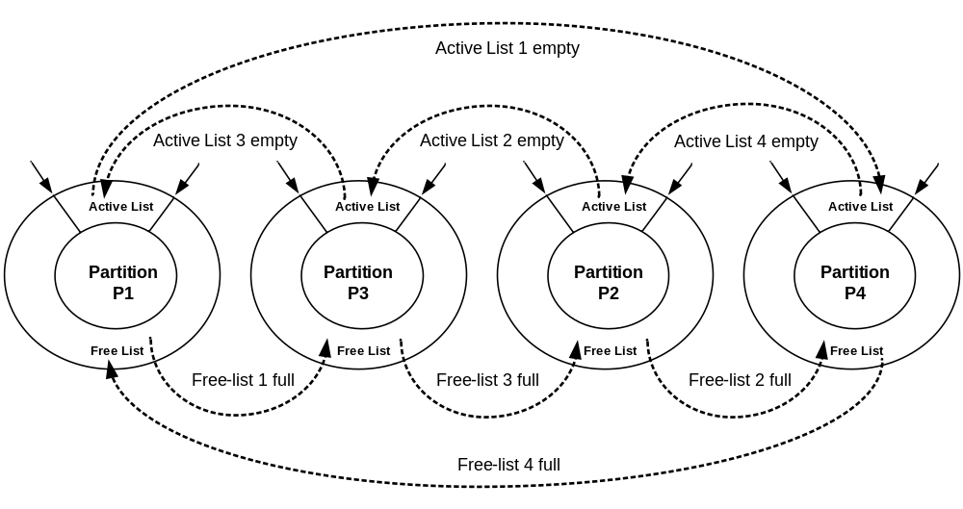
The Access Concentration Mechanism
Partition activation order is 1-3-2-4

Slide 16
The redistribution mechanism
The default active partition is changed once every N cycles to redistribute the activity within the register file (according to some algorithm)
  Once a new default partition (NDP) is selected, all active partitions (DAP+AAP) become idle.
The idle partitions do not participate in register renaming, but their corresponding RF regions may have to be kept active (powered up)
  A physical register in an idle partition may be live
An idle RF region is power gated when its active list becomes empty.

Slide 17
The redistribution mechanism

Slide 18
Performance Impact?
There is a two-cycle delay to wakeup a power gated physical register region
The register renaming occurs in the front end of the microprocessor pipeline whereas the register access occurs in the back end.
  There is a delay of at least two pipeline stages between renaming and accessing a physical register file
  Can wake up the requested region in time
Can wake up a required register file region
without incurring a performance penalty
at the time of access

Slide 19
Experimental setup
MASE (SimpleScalar 4.0)
  Model MIPS-74K processor, 800 MHz
MiBench and SPECint2K benchmarks compiled with Compaq compiler, -O4 flag
Industrial memory compiler used
  64-entry, 64bit single-ended SRAM memory in TSMC 45nm technology
HotSpot to estimate thermal profiles

Slide 20
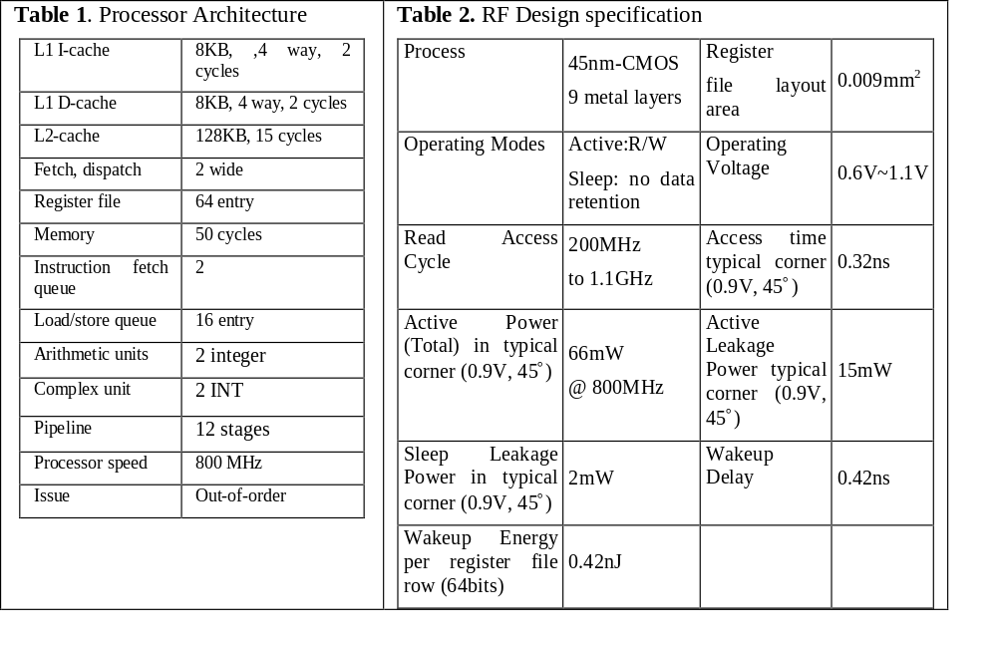

Slide 21
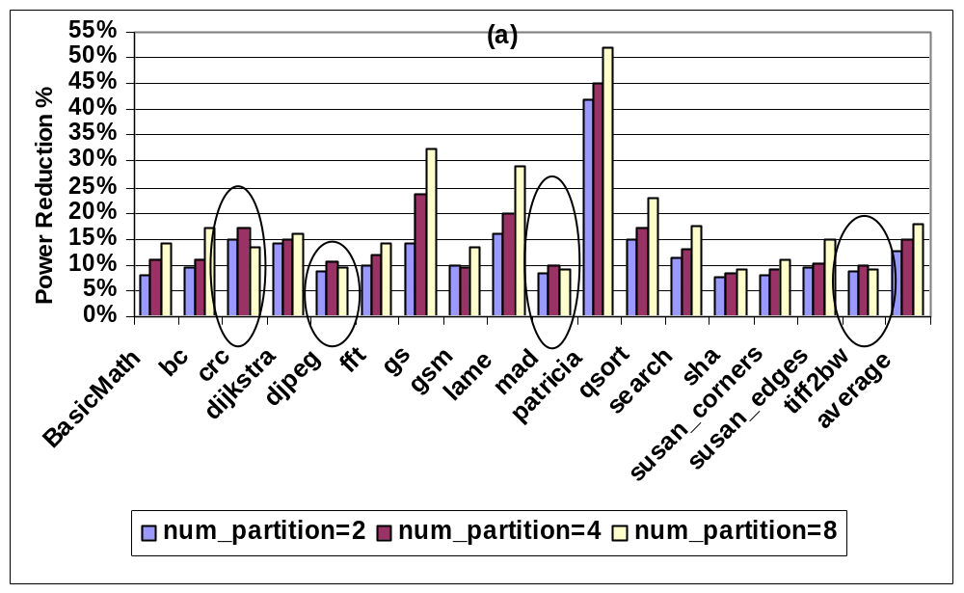
Results
Mibench RF power reduction
Notes:
From power gating idle regions

Slide 22
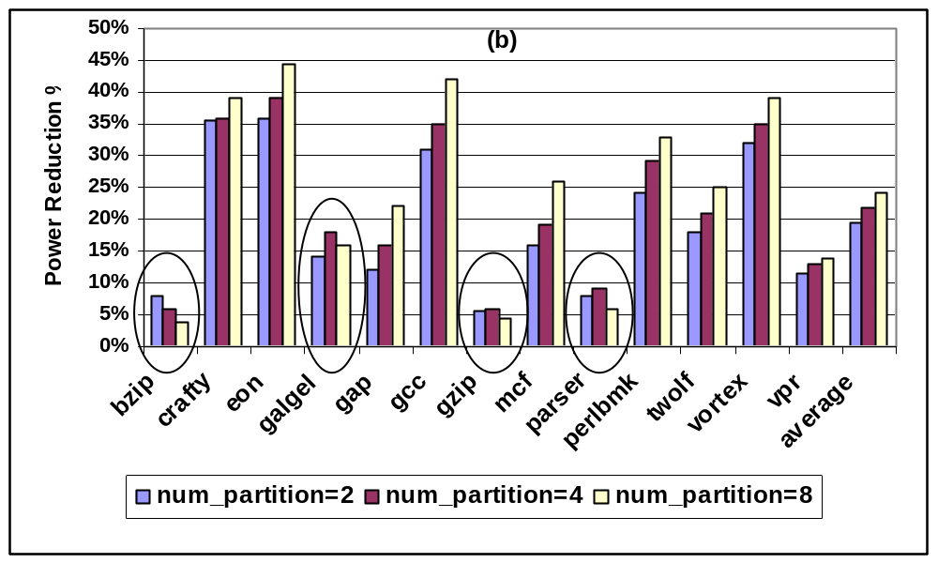
SPEC2K RF power reduction

Slide 23
Analysis of Power Reduction
Increasing the number of RF partitions provides more opportunity to capture and cluster unmapped registers to a partition
  Indicates that wakeup overhead is amortized for a larger number of partitions.
Some exceptions
  the overall power overhead associated with waking up an idle region becomes larger as the number of partition increases.
  frequent but ineffective power gating and its overhead as the number of partition increases

Slide 24
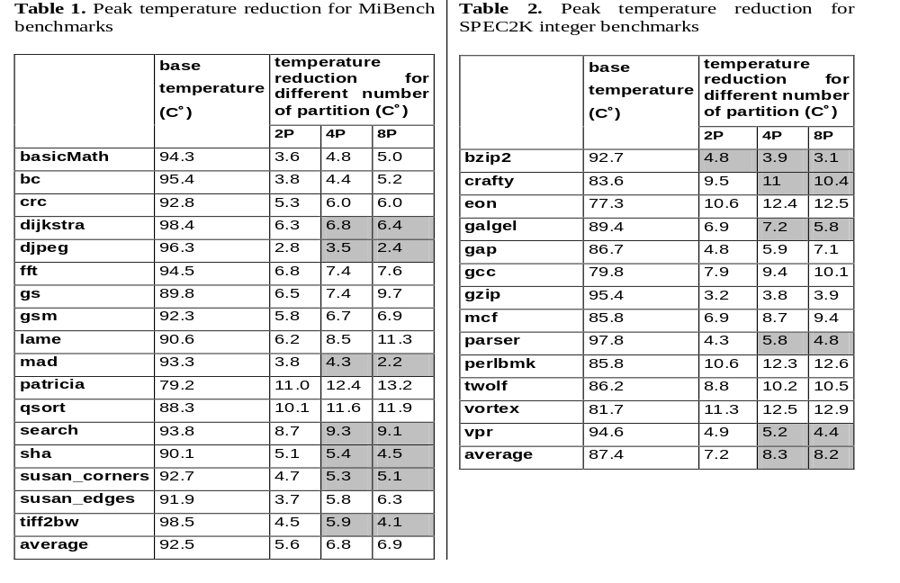
Peak Temperature Reduction
Notes:
4 partitions is best

Slide 25
Analysis of Temperature Reduction
Increasing the number of partitions results in larger power density in each partition because RF access activity is concentrated in a smaller partition
  While capturing more idle partitions and power gating them may potentially result in higher power reduction, larger power density due to smaller partition size results in overall higher temperature

Slide 26
Conclusions
Showed Register File Underutilization
Studied Register file default access patterns
Propose access concentration and activity redistribution to relocate register file accesses
Results show a noticeable power and temperature reduction in the RF
RELOCATE technique can be applied when units are underutilized
  as opposed to activity migration, which requires replication

