Slide 1

A Centralized Cache Miss Driven Technique to Improve Processor Power Dissipation
Houman Homayoun, Avesta Makhzan, Jean-Luc Gaudiot, Alex Veidenbaum
University of California Irvine
hhomayou@uci.edu
IC-SAMOS 2008

Slide 2
Outline
Introduction: why an IQ, ROB, RF major power dissipators?
Study processor resources utilization during L2/multiple L1 misses service time
Architectural approach on dynamically adjusting the size of resources during cache miss period for power conservation
Hardware modification + circuit assists to implement the approach
Experimental results
Conclusions

Slide 3
Superscalar Architecture
Fetch
Fetch
Physical
Register
File
Physical
Register
File
Logical
Register
File
Decode
Logical
Register
File
Decode
Rename
Rename
ROB
ROB
Reservation Station
Reservation Station
Dispatch
Dispatch
Instruction Queue
Instruction Queue
Load Store
Queue
Issue
Load Store
Queue
Issue
Write-Back
Write-Back
Execute
Execute
F.U.
F.U.
F.U.
F.U.
F.U.
F.U.
F.U.
F.U.

Slide 4
Instruction Queue
The Instruction Queue is a CAM-like structure which holds instructions until they can be issued.
  Set entries for new dispatched instructions
  Read entries to issue instructions to functional units
  Wakeup instructions waiting in the IQ once a result is ready
  Select instructions for issue when the number of instructions available exceed the processor issue limit (Issue Width).
Main Complexity: Wakeup Logic

Slide 5
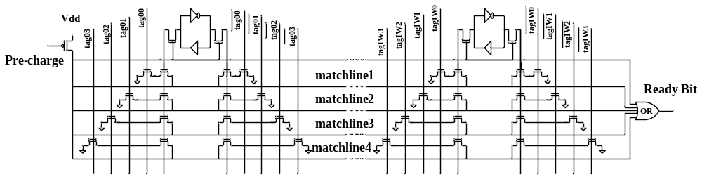
Circuit Implementation of Instruction Queue
At each cycle, the match lines are pre-charged high
  To allow the individual bits associated with an instruction tag to be compared with the results broadcasted on the taglines.
Upon a mismatch, the corresponding matchline is discharged. Otherwise, the match line stays at Vdd, which indicates a tag match.
At each cycle, up to 4 instructions broadcasted on the taglines,
  four sets of one-bit comparators for each one-bit cell are needed.
All four matchlines must be ORed together to detect a match on any of the broadcasted tags. The result of the OR sets the ready bit of instruction source operand
No Need to always have such aggressive wakeup/issue width!

Slide 6
Instruction Queue Matchline Power Dissipation
Matchline discharge is the major energy consumption activity responsible for more than 58% of the energy consumption in the instruction queue
  As the matchlines must go across the entire width of the instruction queue, it has a large wire capacitance. Adding the one-bit comparators diffusion capacitance makes the equivalent capacitance of matchline large
  Pre-charging and discharging this large capacitor is responsible for the majority of power in the instruction queue
a broadcasted tag has on average one dependent instruction in the instruction queue
  Discharging other matchlines cause significant
  power dissipation in the instruction queue

Slide 7
ROB and Register File
The ROB and the register file are multi-ported SRAM structures with several functionalities:
  Setting entries for up to IW instructions in each cycle,
  Releasing up to IW entries during commit stage in a cycle, and
  Flushing entries during the branch recovery.

Slide 8
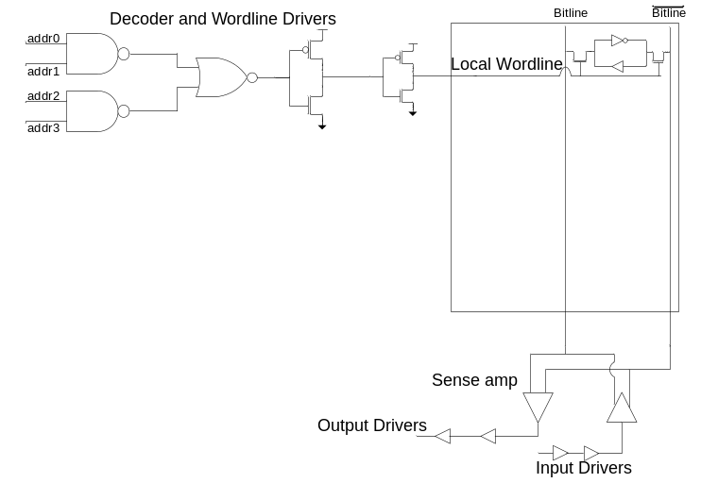
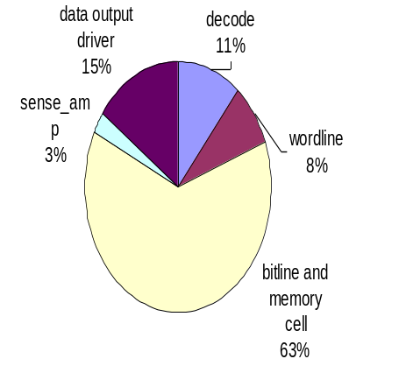
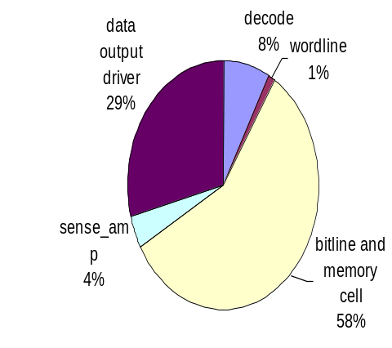
Circuit level implementation of an SRAM ROB and Register File
The majority of power (both leakage and dynamic) is dissipated in the bitline (and memory cells)
  Bitline leakage is accumulated with the memory cell leakage which flow through two off pass transistors
  Bitline dynamic power is decided by its equivalent capacitance which is N * diffusion capacitance of pass transistors + wire capacitance (usually 10% of total diffusion capacitance) where N is the total number of rows
Dynamic Power
Leakage Power
Bitline is the major power dissipator
58% of dynamic power and 63% of leakage power

Slide 9
System Description
L1 I-cache | 128KB, 64 byte/line, 2 cycles
L1 D-cache | 128KB, 64 byte/line, 2 cycles, 2 R/W ports
L2 cache | 4MB, 8 way, 64 byte/line, 20 cycles
issue | 4 way out of order
Branch predictor | 64KB entry g-share, 4K-entry BTB
Reorder buffer | 96 entries
Instruction queue | 64 entry (32 INT and 32 FP)
Register file | 128 integer and 128 floating point
Load/store queue | 32 entry load and 32 entry store
Arithmetic unit | 4 Integer, 4 Floating Point units
Complex unit | 2 INT, 2 FP multiply/divide units
Pipeline | 15 cycles (some stages are multi-cycles)

Slide 10
Simulation Environment
The clock frequency of the processor is 2GHz
SPEC2K benchmarks were using the Compaq compiler for the Alpha 21264 processor
  compiled with the -O4 flag
  executed with reference data sets
The architecture was simulated using an extensively modified version of SimpleScalar 4.0 (sim-mase)
The benchmarks were fast–forwarded for 2 billion instructions, then fully simulated for 2 billion instructions
A modified version of Cacti4 was used for estimating power in the ROB and the Register files in 65nm technology
The power in the Instruction Queue was evaluated using Spice and the TSMC 65nm technology
  Vdd at 1.08 volts

Slide 11
Architectural Motivations
Architectural Motivation:
  A load miss in L1/L2 caches takes a long time to service
    prevents dependent instructions from being issued
When dependent instructions cannot issue
  After a number of cycles the instruction window is full
    ROB, Instruction Queue, Store Queue, Register Files
The processor issue stalls and performance is lost
At the same time, energy is lost as well!
  This is an opportunity to save energy
  Scenario I: L2 cache miss period
  Scenario II: three or more pending DL1 cache misses

Slide 12
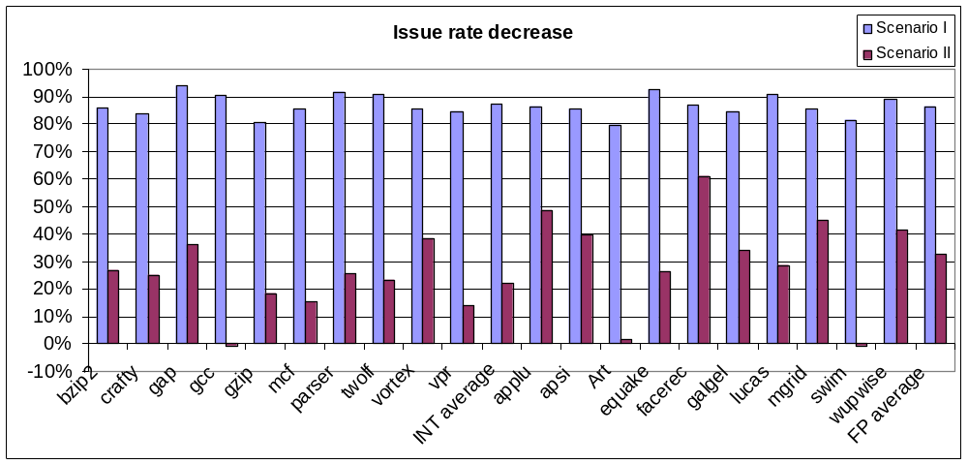
How Architecture can help reducing power in ROB, Register File and Instruction Queue
Scenario I: The issue rate drops by more than 80%
Scenario II: The issue rate drops is 22% for integer benchmarks and 32.6% for floating-point benchmarks.
  Significant issue width decrease!

Slide 13
How Architecture can help reducing power in ROB, Register File and Instruction Queue
ROB occupancy grows significantly during scenario I and II for integer benchmarks: 98% and 61% on average
The increase in ROB occupancy for floating point benchmarks is less, 30% and 25% on average for scenario I and II.
Benchmark | Scenario I | Scenario II | Benchmark | Scenario I | Scenario II
bzip2 | 165.0 | 88.6 | applu | 13.8 | -4.9
crafty | 179.6 | 63.6 | apsi | 46.6 | 18.2
gap | 6.6 | 61.7 | Art | 31.7 | 56.9
gcc | 97.7 | 43.9 | equake | 49.8 | 38.1
gzip | 152.9 | 41.0 | facerec | 87.9 | 14.1
mcf | 42.2 | 40.6 | galgel | 30.9 | 34.4
parser | 31.3 | 102.3 | lucas | -0.7 | 54.0
twolf | 81.8 | 58.8 | mgrid | 8.8 | 5.6
vortex | 118.7 | 57.8 | swim | -4.3 | 11.4
vpr | 96.6 | 55.7 | wupwise | 40.2 | 24.4
INT average | 98.2 | 61.4 | FP average | 30.5 | 25.2

Slide 14
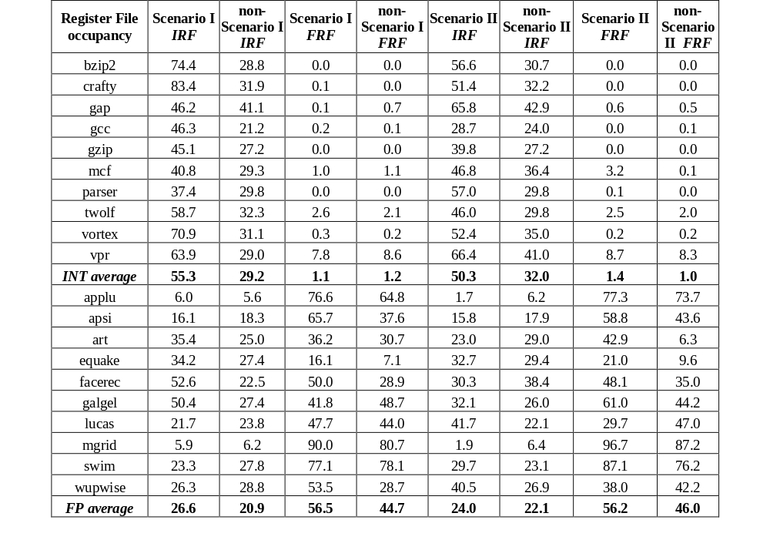
How Architecture can help reducing power in ROB, Register File and Instruction Queue
IRF occupancy always grows for both scenarios when experimenting with integer benchmarks. a similar case is for FRF when running floating-point benchmarks and only during scenario II

Slide 15

Proposed Architectural Approach
Adaptive resource resizing during cache miss period
  Reduce the issue and the wakeup width of the processor during L2 miss service time.
  Increase the size of ROB during L2 miss service time or when at least three DL1 misses are pending
  Reduce IRF size when running floating-point benchmarks. Similarly reduce FRF size when running integer benchmarks. The same algorithm applied to ROB is being applied for IRF when running integer benchmarks and FRF when running floating point benchmarks.
simple resizing scheme: reduce to half size. not necessarily optimized for individual units, but a simple scheme to implement

Slide 16
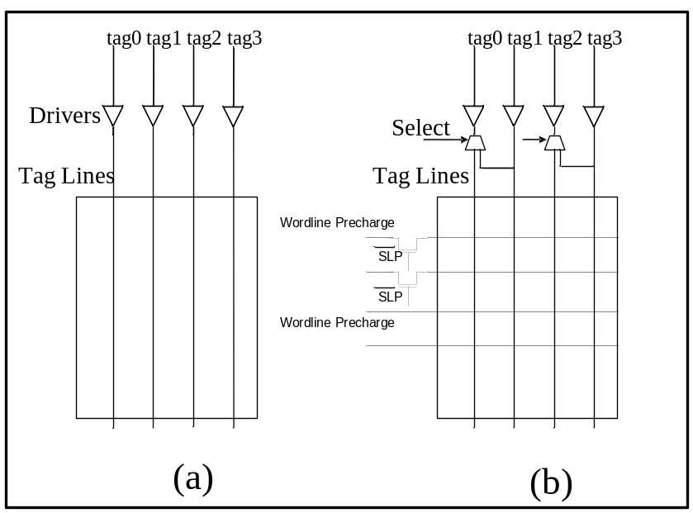
Reducing issue/wakeup width
avoid pre-charging half of matchlines during L2 cache miss service time
worse case scenario: more than half of taglines are broadcasting
tags during L2 miss period where only half of matchlines are active
Small 8 entries auxiliary broadcast buffer

Slide 17
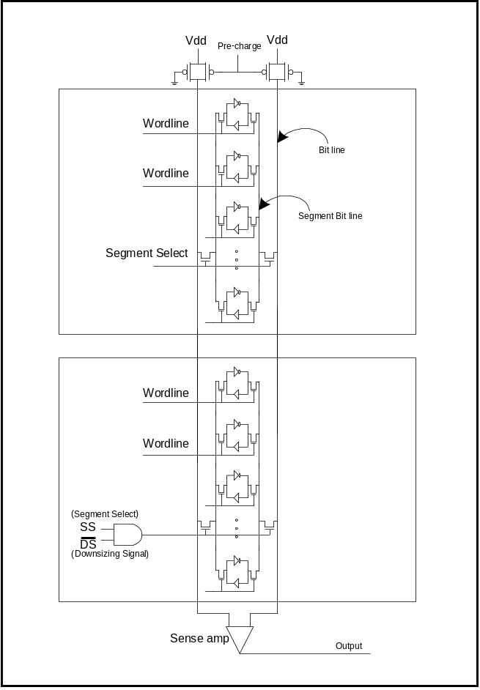
Reducing ROB and Register File size
Using the divide bit line technique which has been proposed for SRAM memory design and attempt to reduce the bit line capacitance and hence its dynamic power.
  Bitline cap = N * diffusion capacitance of pass transistors + wire capacitance
  Divided Bitline cap = M * diffusion capacitance + wire capacitance
Turning of the entire partition by applying gated-vdd technique to the partition memory cell and wordline driver parts.

Slide 18
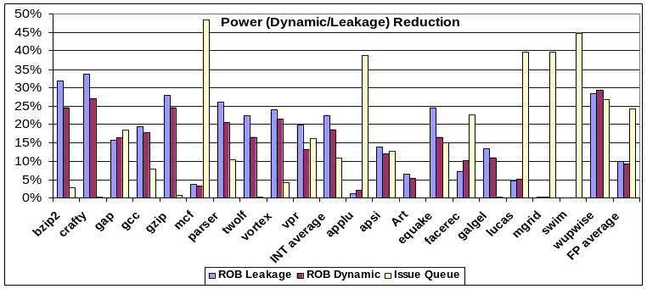
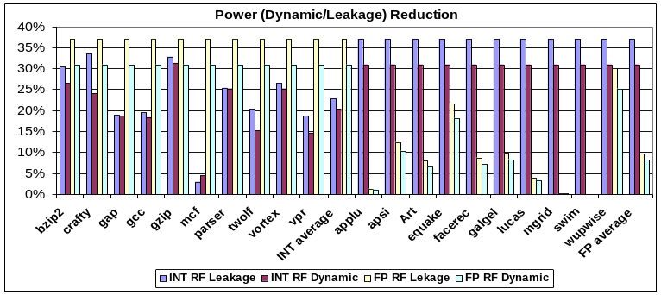
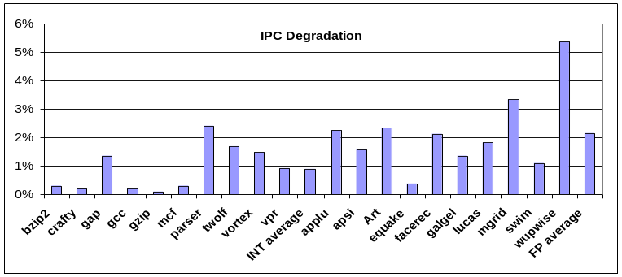
Simulation Results
Performance loss 0.9% for integer benchmarks and 2.2% for floating-point benchmarks.
The average dynamic and leakage power savings for IRF is 26% and 30% respectively and 20% and 24% for FRF.
24% dynamic power reduction in instruction queue for FP benchmarks and 11% reduction in integer benchmarks.
19% dynamic power reduction and 23% leakage power savings for ROB.

Slide 19
Conclusions
Reducing L2 Cache Leakage Power
  Architectural study during L2 cache miss service time
  Study the break down of leakage in L2 cache show the peripheral circuits leaking considerably
  Architectural approach on when to turn on/off L2 cache for reducing leakage power while conserving performance, 20+% Power savings while 2-% performance degradation
  Circuit assist, minimal modifications and transition overhead
Reducing Reorder Buffer, Instruction Queue and Register File Power
  Study processor resources utilization during L2/multiple L1 misses service time
  Architectural approach on dynamically adjust the size of resources during cache miss period for power conservation
  Hardware modification + circuit assists to implement the approach
Applying similar adaptive techniques to other energy hungry resources in the processor

