Slide 1
Power Management in High Performance Processors through Dynamic Resource Adaptation and Multiple Sleep Mode Assignments
Houman Homayoun
National Science Foundation Computing Innovation Fellow
Department of Computer Science
University of California San Diego

Slide 2
Outline – Multiple Sleep Mode
Brief overview of state-of-art superscalar processor
Introducing the idea of multiple sleep modes design
Architectural control of multiple sleep modes
Results
Conclusions

Slide 3
Superscalar Architecture
Fetch
Fetch
Physical
Register
File
Physical
Register
File
Logical
Register
File
Decode
Logical
Register
File
Decode
Rename
Rename
ROB
ROB
Reservation Station
Reservation Station
Dispatch
Dispatch
Instruction Queue
Instruction Queue
Load Store
Queue
Issue
Load Store
Queue
Issue
Write-Back
Write-Back
Execute
Execute
F.U.
F.U.
F.U.
F.U.
F.U.
F.U.
F.U.
F.U.

Slide 4
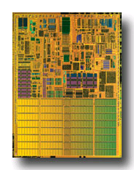
On-chip SRAMs+CAMs and Power
On-chip SRAMs+CAMs in high-performance processors are large
  Branch Predictor
  Reorder Buffer
  Instruction Queue
  Instruction/Data TLB
  Load and Store Queue
  L1 Data Cache
  L1 Instruction Cache
  L2 Cache
    more than 60% of chip budget
Dissipate significant portion of power via leakage
Pentium M processor die photo
Courtesy of intel.com

Slide 5
Techniques Address Leakage in SRAM+CAM
Gated-Vdd, Gated-Vss
Voltage Scaling (DVFS)
ABB-MTCMOS
Forward Body Biasing (FBB), RBB
Sleepy Stack
Sleepy Keeper
Circuit
Way Prediction, Way Caching, Phased Access
  Predict or cache recently access ways, read tag first
Drowsy Cache
  Keeps cache lines in low-power state, w/ data retention
Cache Decay
  Evict lines not used for a while, then power them down
Applying DVS, Gated Vdd, Gated Vss to memory cell
  Many architectural support to do that.
Architecture

Slide 6
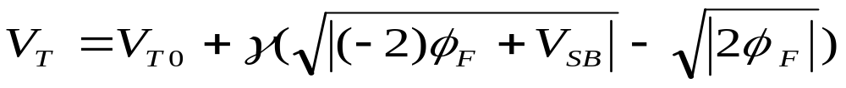
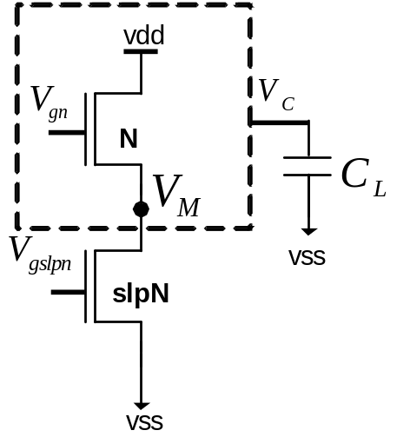
Sleep Transistor Stacking Effect
Subthreshold current: inverse exponential function of threshold voltage
Stacking transistor N with slpN:
  The source to body voltage (VM ) of
  transistor N increases, reduces its
  subthreshold leakage current, when
  both transistors are off
Drawback : rise time, fall time, wakeup delay, area, dynamic power, instability

Slide 7
Wakeup Latency
To benefit the most from the leakage savings of stacking sleep transistors
  keep the bias voltage of NMOS sleep transistor as low as possible (and for PMOS as high as possible)
Drawback: impact on the wakeup latency (sleep transistor wakeup delay + sleep signal propagation delay) of the circuit
Control the gate voltage of the sleep transistors
  Increasing the gate voltage of footer sleep transistor reduces the virtual ground voltage (VM)
reduction in leakage power savings
reduction in the circuit wakeup delay overhead

Slide 8
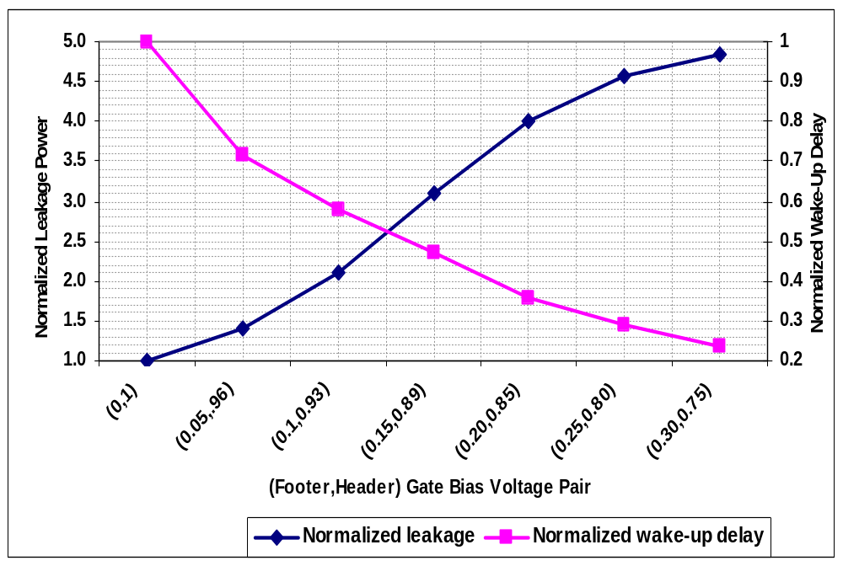
Wakeup Delay vs. Leakage Power Reduction
trade-off between the
wakeup overhead
and leakage power saving
Increasing the bias voltage increases the leakage power while decreases the wakeup delay overhead

Slide 9
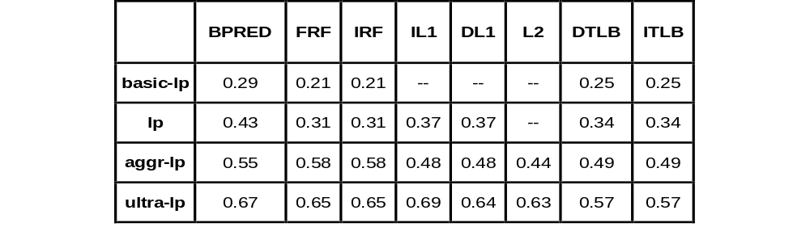
Multiple Sleep Modes Specifications
On-chip SRAM multiple sleep mode normalized leakage power savings
Wakeup Delay varies from 1~more than 10 processor cycles (2.2GHz).
Large wakeup power overhead for large SRAMs.
  Need to find Period of Infrequent Access

Slide 10
Reducing Leakage in SRAM Peripherals
Maximize the leakage reduction
  put SRAM into ultra low power mode
  adds few cycles to the SRAM access latency
    significantly reduces performance
Minimize Performance Degradation
  put SRAM into the basic low power mode
  requires near zero wakeup overhead
    Not noticeable leakage power reduction

Slide 11
Motivation for Dynamically Controlling Sleep Mode
dynamically adjust
sleep power mode
large leakage reduction benefit
  Ultra and aggressive low power modes
low performance impact benefit
  Basic-lp mode
Periods of frequent access
  Basic-lp mode
Periods of infrequent access
  Ultra and aggressive low power modes

Slide 12
Architectural Motivations
Architectural Motivation
  A load miss in L1/L2 caches takes a long time to service
    prevents dependent instructions from being issued
When dependent instructions cannot issue
  performance is lost
At the same time, energy is lost as well!
  This is an opportunity to save energy

Slide 13
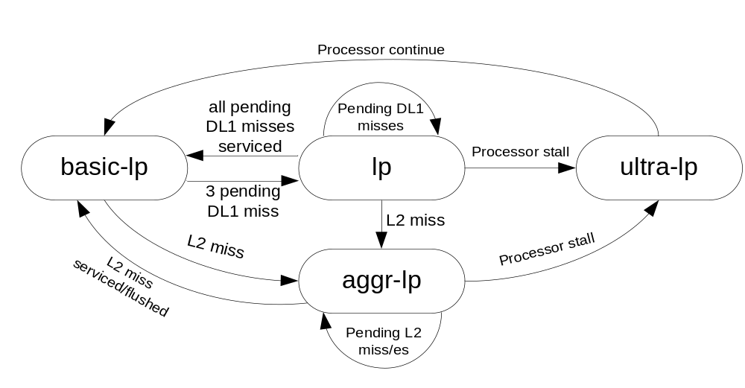
Multiple Sleep Mode Control Mechanism
General state machine to control power mode transitions
L2 cache miss or multiple DL1 misses triggers power mode transitioning.
The general algorithm may not deliver optimal results for all units.
  modified the algorithm for individual on-chip SRAM-based units to maximize the leakage reduction at NO performance cost.

Slide 14

Branch Predictor
1 out of every 9 fetched instructions in integer benchmarks and out of 63 fetched instructions in floating point benchmarks accesses the branch predictor
  always put branch predictor in deep low power modes (lp, ultra-lp or aggr-lp) and waking up on access.
    noticeable performance degradation for some benchmarks.

Slide 15
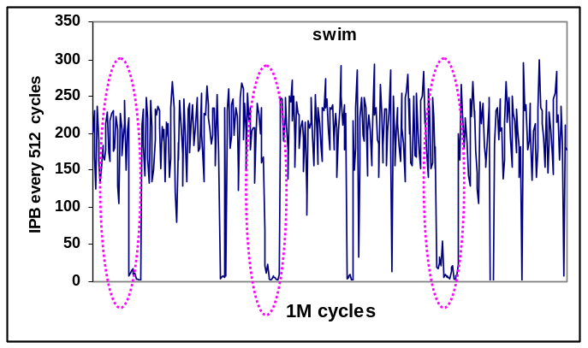
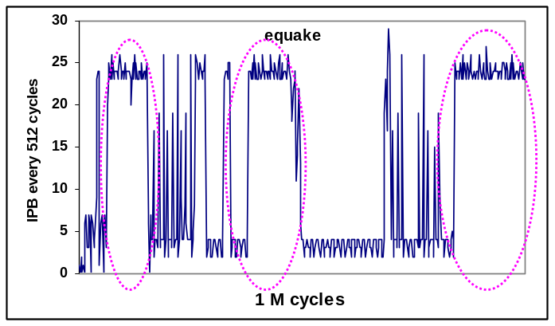
Observation: Branch Predictor Access Pattern
Distribution of the number of branches per 512-instruction interval (over 1M cycles)
Within a benchmark there is significant variation in Instructions Per Branch (IPB).
    once the IPB drops (increases) significantly it may remain low (high) for a long period of time.

Slide 16
Branch Predictor Peripherals Leakage Control
Can identify the high IPB period, once the first low IPB period is detected.
  The number of fetched branches is counted every 512 cycles, once the number of branches is found to be less than a certain threshold (24 in this work) a high IPB period identified. The IPB is then predicted to remain high for the next twenty 512 cycles intervals (10K cycles).
Branch predictor peripherals transition from basic-lp mode to lp mode when a high IPB period is identified.
During pre-stall and stall periods the branch predictor peripherals transition to aggr-lp and ultra-lp mode, respectively.

Slide 17
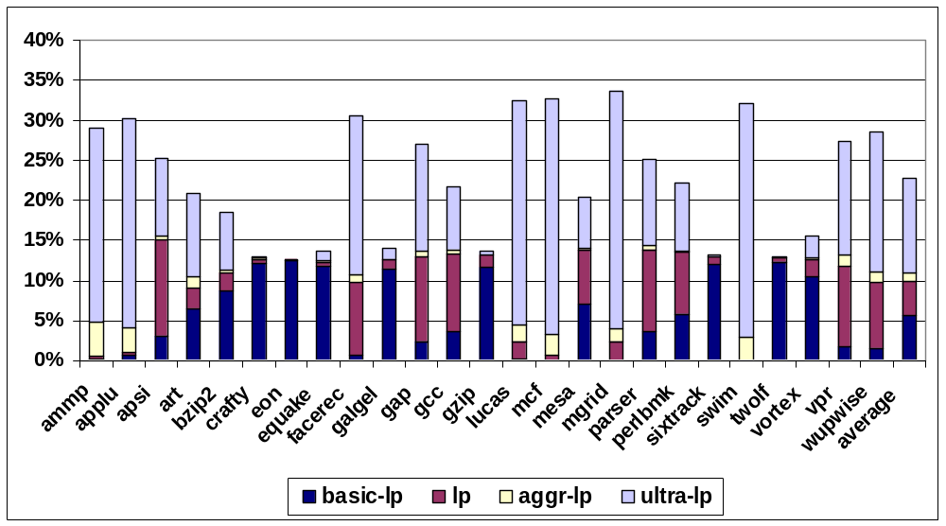
Leakage Power Reduction
Noticeable Contribution of Ultra and Basic low power mode

Slide 18
Outline – Resource Adaptation
why an IQ, ROB, RF major power dissipators?
Study processor resources utilization during L2/multiple L1 misses service time
Architectural approach on dynamically adjusting the size of resources during cache miss period for power conservation
Results
Conclusions

Slide 19
Instruction Queue
The Instruction Queue is a CAM-like structure which holds instructions until they can be issued.
  Set entries for new dispatched instructions
  Read entries to issue instructions to functional units
  Wakeup instructions waiting in the IQ once a result is ready
  Select instructions for issue when the number of instructions available exceed the processor issue limit (Issue Width).
Main Complexity: Wakeup Logic

Slide 20
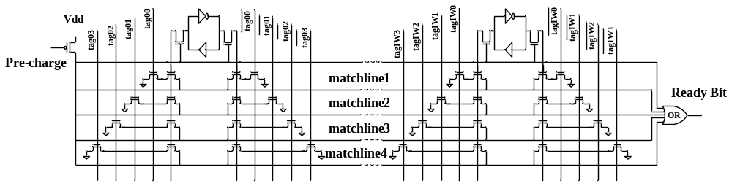
Logical View of Instruction Queue
At each cycle, the match lines are pre-charged high
  To allow the individual bits associated with an instruction tag to be compared with the results broadcasted on the taglines.
Upon a mismatch, the corresponding matchline is discharged. Otherwise, the match line stays at Vdd, which indicates a tag match.
At each cycle, up to 4 instructions broadcasted on the taglines,
  four sets of one-bit comparators for each one-bit cell are needed.
All four matchlines must be ORed together to detect a match on any of the broadcasted tags. The result of the OR sets the ready bit of instruction source operand
No Need to always have such aggressive wakeup/issue width!

Slide 21
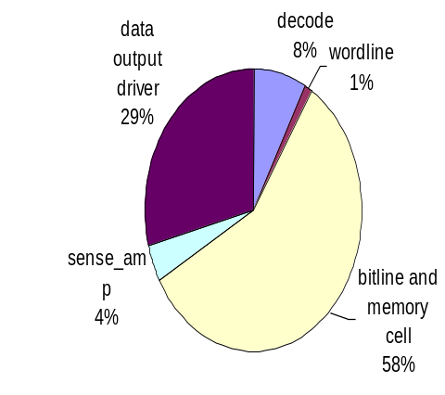
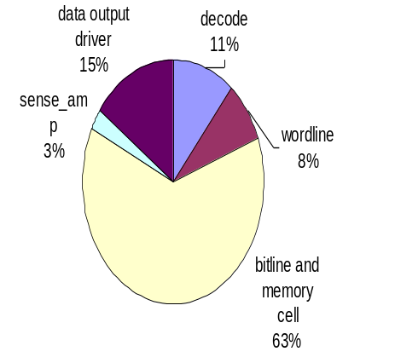
ROB and Register File
The ROB and the register file are multi-ported SRAM structures with several functionalities:
  Setting entries for up to IW instructions in each cycle,
  Releasing up to IW entries during commit stage in a cycle, and
  Flushing entries during the branch recovery.
Dynamic Power
Leakage Power

Slide 22
Architectural Motivations
Architectural Motivation:
  A load miss in L1/L2 caches takes a long time to service
    prevents dependent instructions from being issued
When dependent instructions cannot issue
  After a number of cycles the instruction window is full
    ROB, Instruction Queue, Store Queue, Register Files
The processor issue stalls and performance is lost
At the same time, energy is lost as well!
  This is an opportunity to save energy
  Scenario I: L2 cache miss period
  Scenario II: three or more pending DL1 cache misses

Slide 23
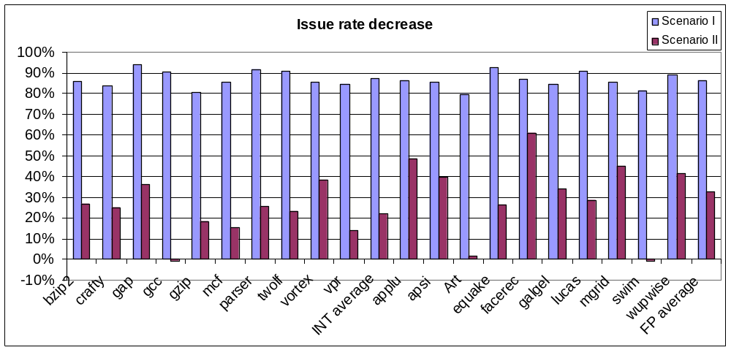
How Architecture can help reducing power in ROB, Register File and Instruction Queue
Scenario I: The issue rate drops by more than 80%
Scenario II: The issue rate drops is 22% for integer benchmarks and 32.6% for floating-point benchmarks.
  Significant issue width decrease!

Slide 24
How Architecture can help reducing power in ROB, Register File and Instruction Queue
ROB occupancy grows significantly during scenario I and II for integer benchmarks: 98% and 61% on average
The increase in ROB occupancy for floating point benchmarks is less, 30% and 25% on average for scenario I and II.
Benchmark | Scenario I | Scenario II | Benchmark | Scenario I | Scenario II
bzip2 | 165.0 | 88.6 | applu | 13.8 | -4.9
crafty | 179.6 | 63.6 | apsi | 46.6 | 18.2
gap | 6.6 | 61.7 | Art | 31.7 | 56.9
gcc | 97.7 | 43.9 | equake | 49.8 | 38.1
gzip | 152.9 | 41.0 | facerec | 87.9 | 14.1
mcf | 42.2 | 40.6 | galgel | 30.9 | 34.4
parser | 31.3 | 102.3 | lucas | -0.7 | 54.0
twolf | 81.8 | 58.8 | mgrid | 8.8 | 5.6
vortex | 118.7 | 57.8 | swim | -4.3 | 11.4
vpr | 96.6 | 55.7 | wupwise | 40.2 | 24.4
INT average | 98.2 | 61.4 | FP average | 30.5 | 25.2

Slide 25
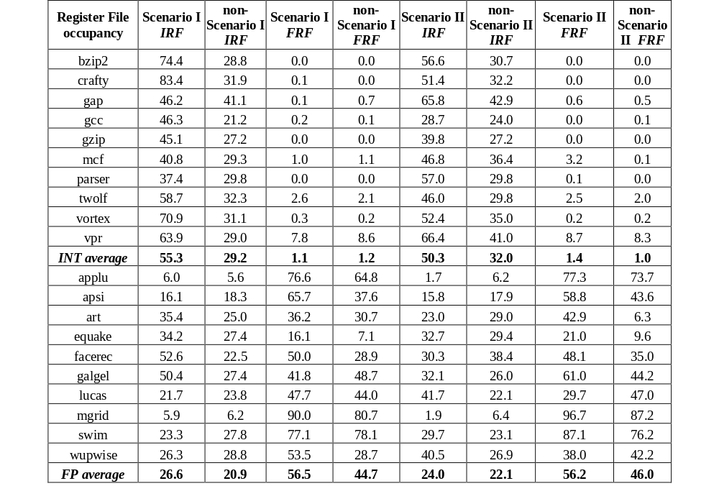
How Architecture can help reducing power in ROB, Register File and Instruction Queue
IRF occupancy always grows for both scenarios when experimenting with integer benchmarks. a similar case is for FRF when running floating-point benchmarks and only during scenario II

Slide 26

Proposed Architectural Approach
Adaptive resource resizing during cache miss period
  Reduce the issue and the wakeup width of the processor during L2 miss service time.
  Increase the size of ROB and RF during L2 miss service time or when at least three DL1 misses are pending
simple resizing scheme: reduce to half size. not necessarily optimized for individual units, but a simple scheme to implement at circuit!

Slide 27
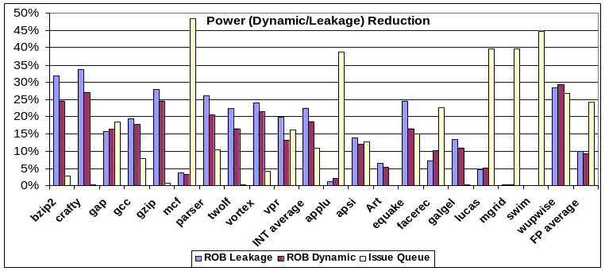
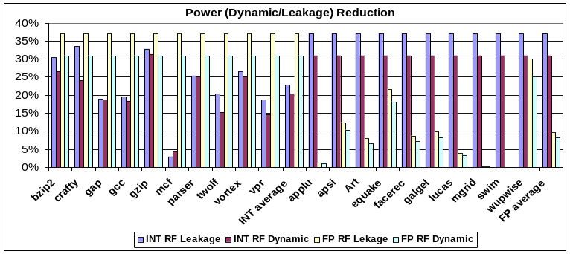
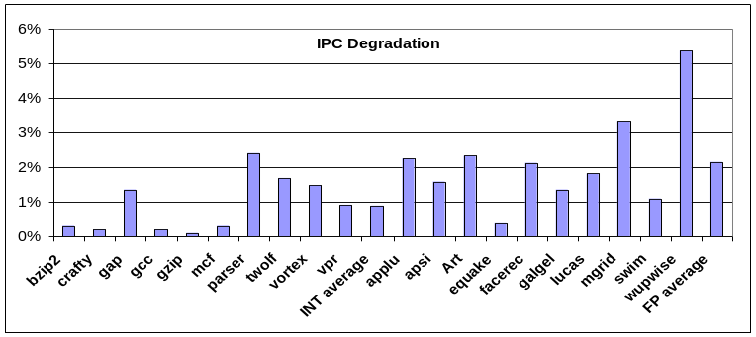
Results
Small Performance loss~1%
15~30% dynamic and leakage power reduction

Slide 28
Conclusions
Introducing the idea of multiple sleep mode design
Apply multiple sleep mode to on-chip SRAMs
  Find period of low activity for state transition
Introduce the idea of resource adaptation
Apply resource adaptation to on-chip SRAMs+CAMs
  Find period of low activity for state transition
Applying similar adaptive techniques to other energy hungry resources in the processor
  Multiple sleep mode functional units

