Slide 1

Graduate Seminar
Using Lazy Instruction Prediction to Reduce Processor Wakeup Power Dissipation
Houman Homayoun
April 2005

Slide 2
Why Low Power ?
Embedded Space: Limited Battery Life
  Energy battery will not grow drastically in the near future
High Performance Space: Heat Dissipation
  Very expensive cooling systems for power dissipation beyond 50^{watt}
  Failure mechanism such as thermal runaway gate dielectric, junction fatigue and etc. become significantly worse as temperature increases.

Slide 3
Ways To Reduce Processor Power
Shutting down inactive elements
Caching of already done work
Smart reduction of some of the work
✓

Slide 4
Smart reduction of some of the work
Past design not pay attention to power, preferred simplicity.
Information moved and re-written redundantly
Avoid Unnecessary Information Transfer

Slide 5
Superscalar Architecture
Fetch
Physical
Register
File
Decode
Logical
Register
File
Rename
ROB
Reservation Station
Dispatch
Instruction Queue
Issue
Load Store
Queue
Write-Back
Execute
F.U.
F.U.
F.U.
F.U.

Slide 6
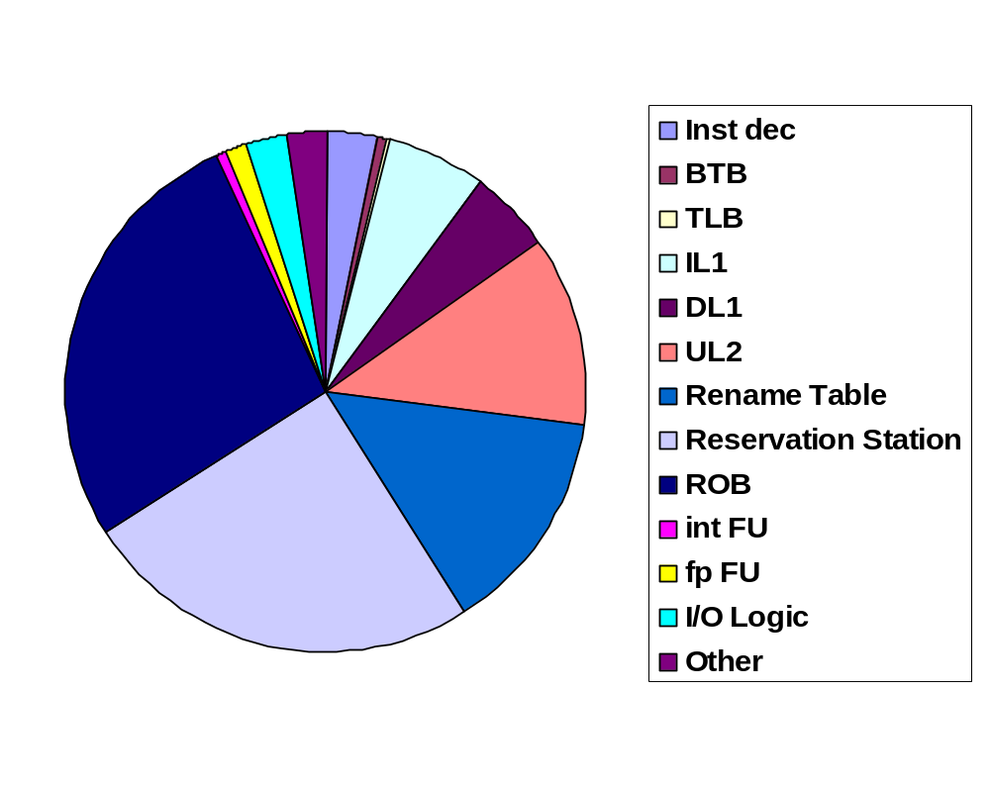
Power Consumption in superscalar processor
UL2: 12%
ROB: 25%
Rename Table: 14%
Reservation Station: 27%

Slide 7
Instruction Queue: Why a Major Power Consumer?
Tasks involved in instruction queue
  Set an entry for a new dispatched instruction
  Read an entry to issue instructions to functional unit
  Wakeup instructions waiting in IQ once a result is produced by a functional unit
  Select instructions for issue when more ready instructions than issue width are available
✓

Slide 8
Instruction Queue: A Power Hungry Structure
TagIW-1
Tag0
=
=
OR
OR
=
=
Instruction 0
RdyL
TagL
TagR
RdyR
Instruction (IQsize -1)
RdyL
TagL
TagR
RdyR

Slide 9
Wakeup: Major Power Consumer Activity
Wakeup is the major power consumer
  Long wires to broadcast result tag from F.U. to all instruction waiting in instruction queue
  2 * IW * IQ_{size} * log (IQ_{size}) Comparators
  2 * IQ_{size} OR logic
e.g.
  2*8*128*log(128) = 14336 Comparators
  2*128 = 248 OR logic

Slide 10
Low Power Instruction Queue Design
Eliminating the unnecessary wakeup
  Many instructions wait in instruction queue for long periods. During this long period processor attempts to wakeup them every cycle.
  Example: Instruction encounter a cache miss
Not Necessary!

Slide 11
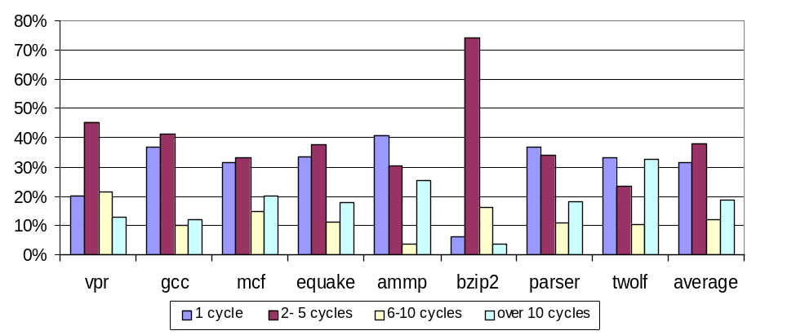
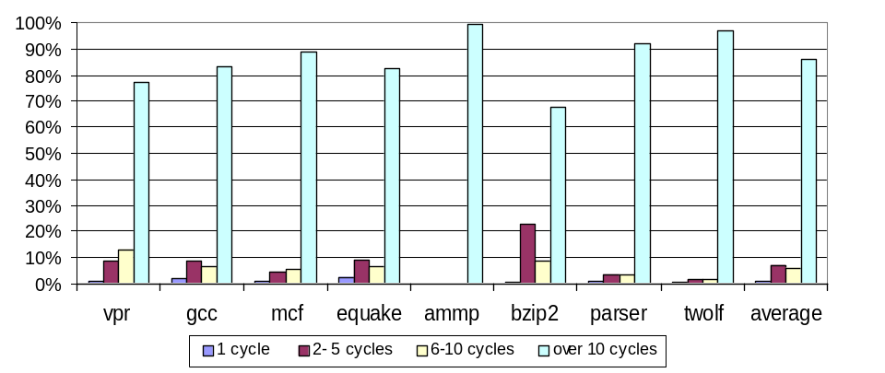
Instruction Issue Delay and Their Participation in Wakeup
lazy instructions, despite their relatively low frequency, account for more than 85% of the total wakeup activity
Instruction Issue Delay Distribution
Identify Lazy Instructions
Early Enough to Avoid
Unnecessary Wakeup
Wakeup Activity Distribution

Slide 12
Identify Lazy
Instruction
Fetch Unit
PC
Instruction Cache
Accuracy: 50%
Effectiveness: 30%
(one third of all lazy instructions are identified)
Decode
Register
Renaming
Dispatch
Instruction
Queue
IID
Issue
Integer
Registers
Data
Cache
64 entries
PC-index
table
F.U.
F.U.
F.U.
F.U.
F.U.
F.U.
Write-Back
If IID<11
Remove PC
If IID>=10
Store PC
Commit

Slide 13
Optimizations to Reduce Wakeup Activity
Selective Instruction Wakeup
  Wakeup A predicted Lazy instruction every two cycles, instead of every cycle
Selective Fetch Slowdown
  If there are already many lazy instructions waiting in the pipeline, avoid adding more instructions.

Slide 14
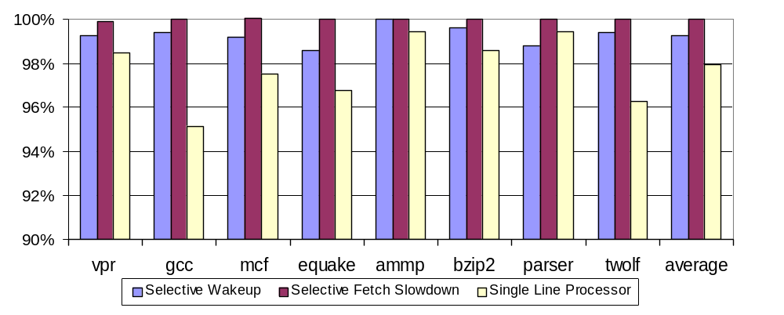
Performance Degradation
The Goal: Power-Efficient Design
  Save Power with no or small performance cost

Slide 15
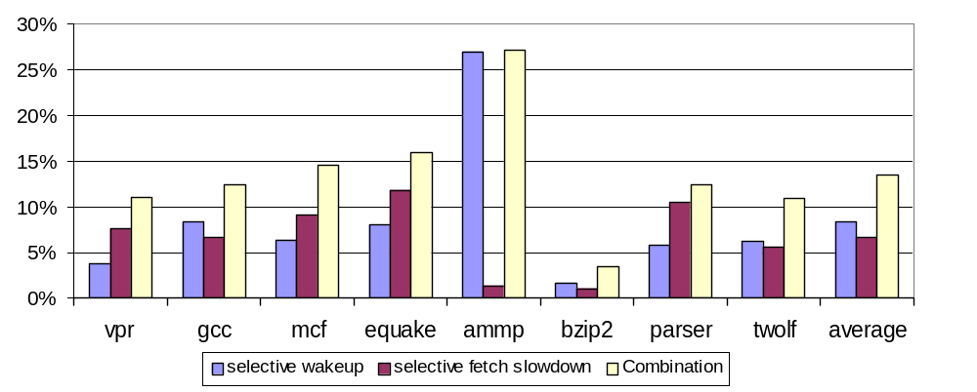
Power Savings
Average Power Saving: 14%
  Across most benchmarks power savings is more than 10%

Slide 16
Conclusion
Power is going to be the most critical issue in processor design
Instruction queue is on of the major power consumer.
Selective Fetch Slow Down and Selective Wakeup: Reduce Instruction queue power up to 27% (average: 14%)

Slide 17
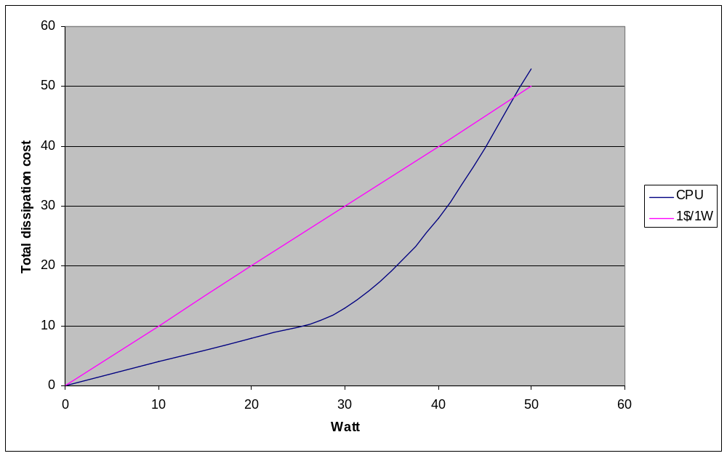
Thermal and Power dissipation costs

Slide 18
Why Low Power ?
High performance microprocessors
  PowerPC704 consumes 85 Watt
  Alpha 21364 consume 100 Watt
Growing demand of multimedia functionalities needs more computing power
Increase Power Consumption

Slide 19
Effectiveness and Accuracy
Statistics gathered after runing a program:
  All instructions: 20
  Lazy instructions: 10
  Effectiveness:30% ➔ 3 lazy instructions identified correctly
  Accuracy:50% ➔ 6 instructions are predicted to be lazy

Slide 20
Result tag1
Result tag2
Result tag3
Result tag4
V_{cc}
Clk/2
1
MUX
Lazy controller
Comparator
Comparator
Comparator
Comparator
Source Operand Tag
V_{cc}
Clk/2
1
MUX
Lazy controller
Comparator
Comparator
Comparator
Comparator
Source Operand Tag
V_{cc}
Clk/2
1
MUX
Lazy controller
Comparator
Comparator
Comparator
Comparator
Source Operand Tag
Broadcast Buffer

Slide 21
Overhead : CAM
MUX:2 transistors, Comparator: 3 transistors
  Overhead: 128*2+128 = 128*3 = 384
  Total Number of Comparator transistors:
    3*total number of comparator = 3*128*2*8*log(128)
    = 43008

Slide 22
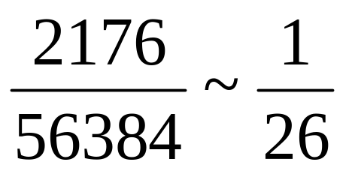
Overhead : 64 entry PC-index Table
Branch Prediction Logic Size:
  8000*(4+1) + 512 * 32 = 56384
  Power Consumption : 7% of total processor power consumption
64 entry PC-Index Table:
  64 *32 + 64 * 2 = 2176

Slide 23
Lazy Threshold

10

Monitor Performance
loss and Power
Savings
Negligible Performance Loss, Significant Power Savings

Slide 24
Future Work
Fast Instruction Prediction
Configuration Sensitive Analysis
ROB Power savings
Register Renaming Power Savings
Select Logic Power Savings

