Slide 1
202unsold
B-MAT-400

Slide 2
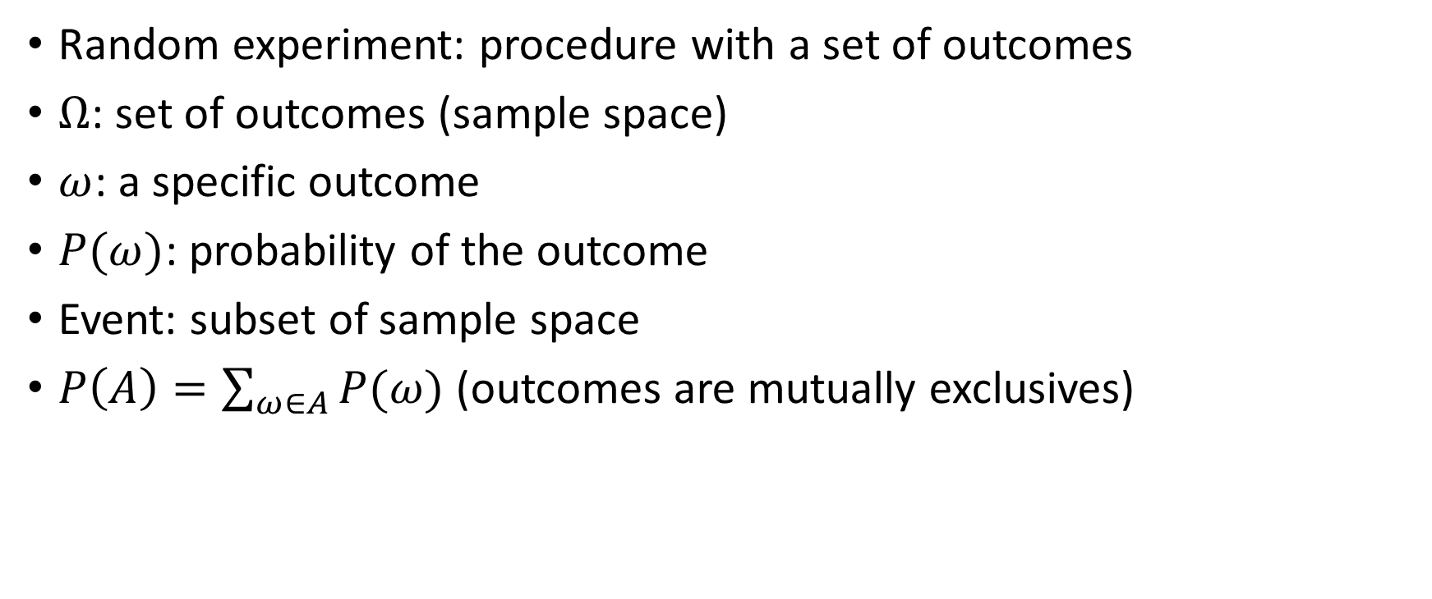
Previously: random experiments
Random experiment: procedure with a set of outcomes
$Ω$: set of outcomes (sample space)
$ω$: a specific outcome
$P(ω)$: probability of the outcome
Event: subset of sample space
$P\left(A\right)=\sum_{ω∈A}{P(ω)}$ (outcomes are mutually exclusives)

Slide 3
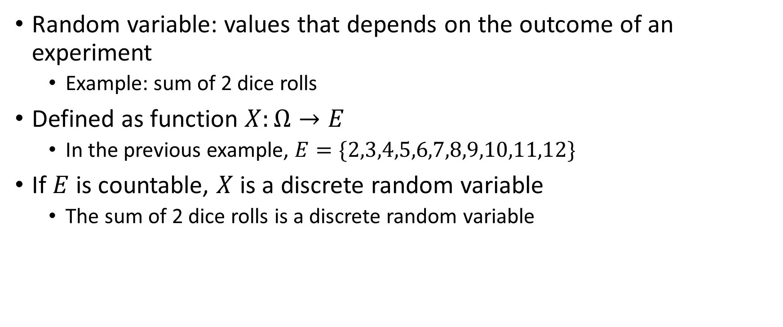
Discrete random variables
Random variable: values that depends on the outcome of an experiment
Example: sum of 2 dice rolls
Defined as function $X:Ω→E$
In the previous example, $E=\{2,3,4,5,6,7,8,9,10,11,12\}$
If $E$ is countable, $X$ is a discrete random variable
The sum of 2 dice rolls is a discrete random variable

Slide 4
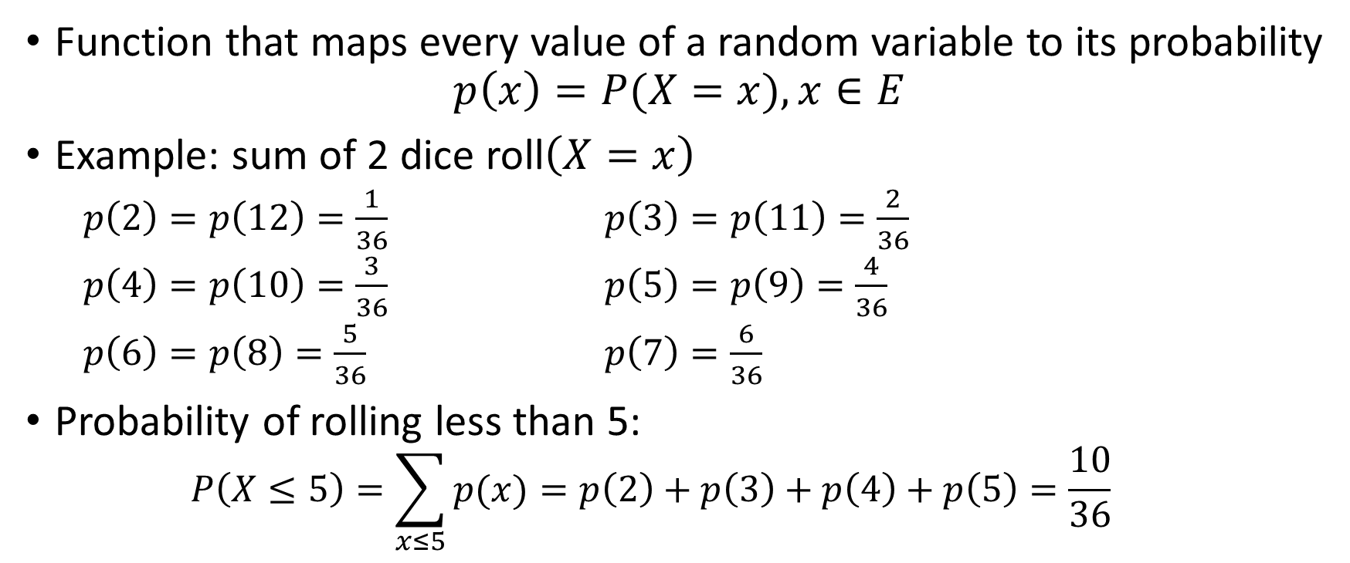
Probability distribution (law)
Function that maps every value of a random variable to its probability
$$p\left(x\right)=P(X=x), x∈E$$
Example: sum of 2 dice roll$\left(X=x\right)$
$p\left(2\right)=p\left(12\right)=\frac{1}{36}$ $p\left(3\right)=p\left(11\right)=\frac{2}{36}$
$p\left(4\right)=p\left(10\right)=\frac{3}{36}$ $p\left(5\right)=p\left(9\right)=\frac{4}{36}$
$p\left(6\right)=p\left(8\right)=\frac{5}{36}$ $p\left(7\right)=\frac{6}{36}$
Probability of rolling less than 5:
$$P\left(X≤5\right)=\sum_{x≤5}{p(x)}=p\left(2\right)+p\left(3\right)+p\left(4\right)+p\left(5\right)=\frac{10}{36}$$

Slide 5
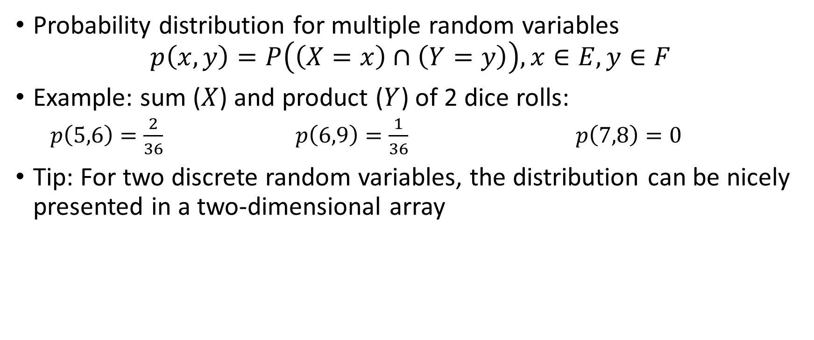
Joint probability distribution (joint law)
Probability distribution for multiple random variables
$$p\left(x,y\right)=P\left(\left(X=x\right)∩\left(Y=y\right)\right), x∈E, y∈F$$
Example: sum ($X$) and product ($Y$) of 2 dice rolls:
$p\left(5,6\right)=\frac{2}{36}$ $p\left(6,9\right)=\frac{1}{36}$ $p\left(7,8\right)=0$
Tip: For two discrete random variables, the distribution can be nicely presented in a two-dimensional array

Slide 6
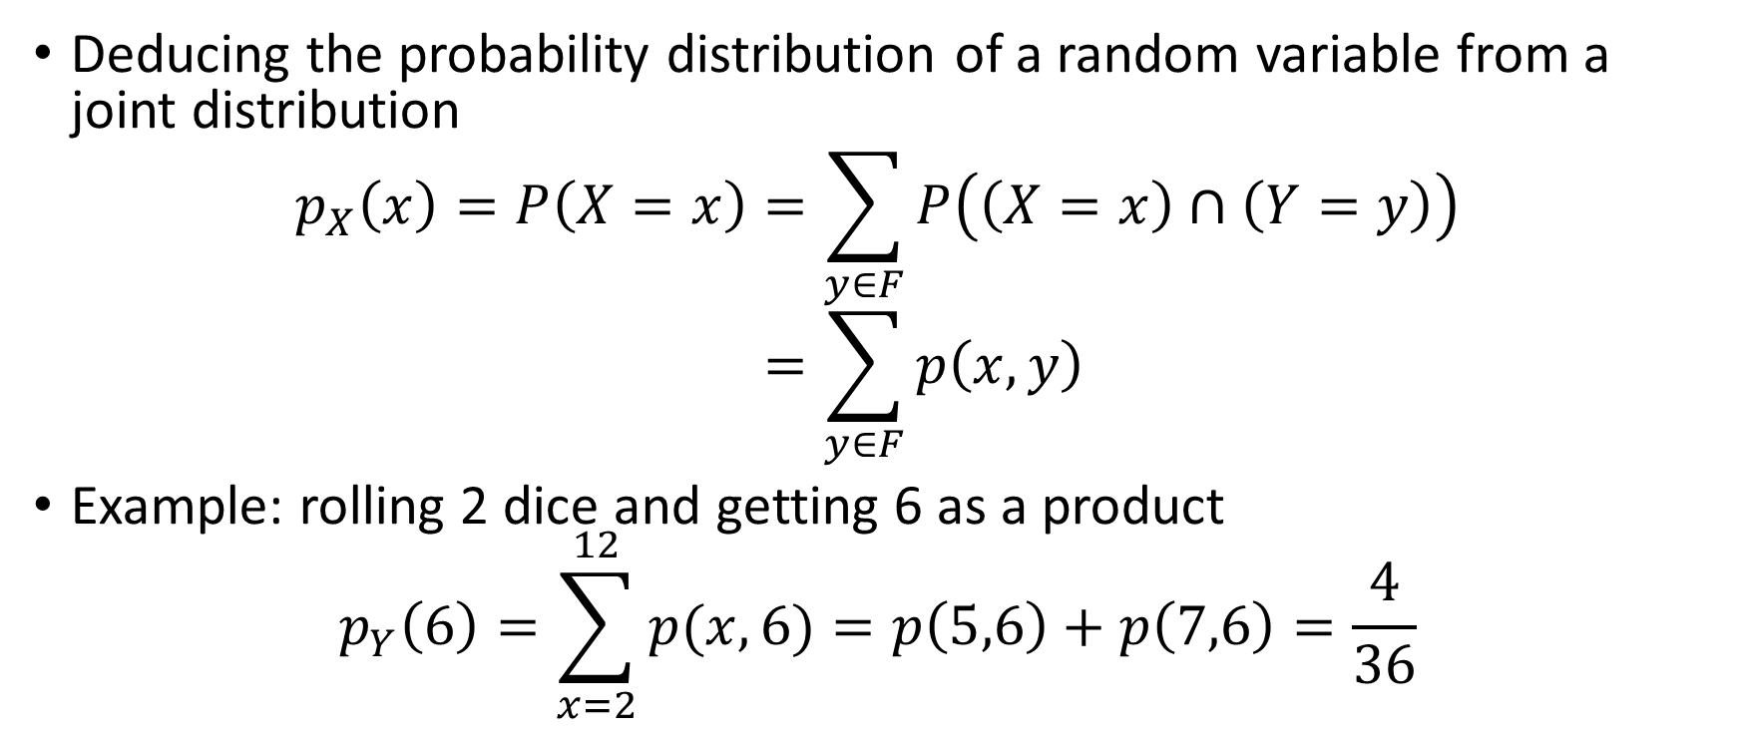
Marginal distribution (marginal law)
Deducing the probability distribution of a random variable from a joint distribution
$$p_{X}\left(x\right)=P\left(X=x\right)=\sum_{y∈F}{P\left(\left(X=x\right)∩\left(Y=y\right)\right)} \\ =\sum_{y∈F}{p\left(x,y\right)}$$
Example: rolling 2 dice and getting 6 as a product
$$p_{Y}\left(6\right)=\sum_{x=2}^{12}{p(x,6)}=p\left(5,6\right)+p\left(7,6\right)=\frac{4}{36}$$

Slide 7
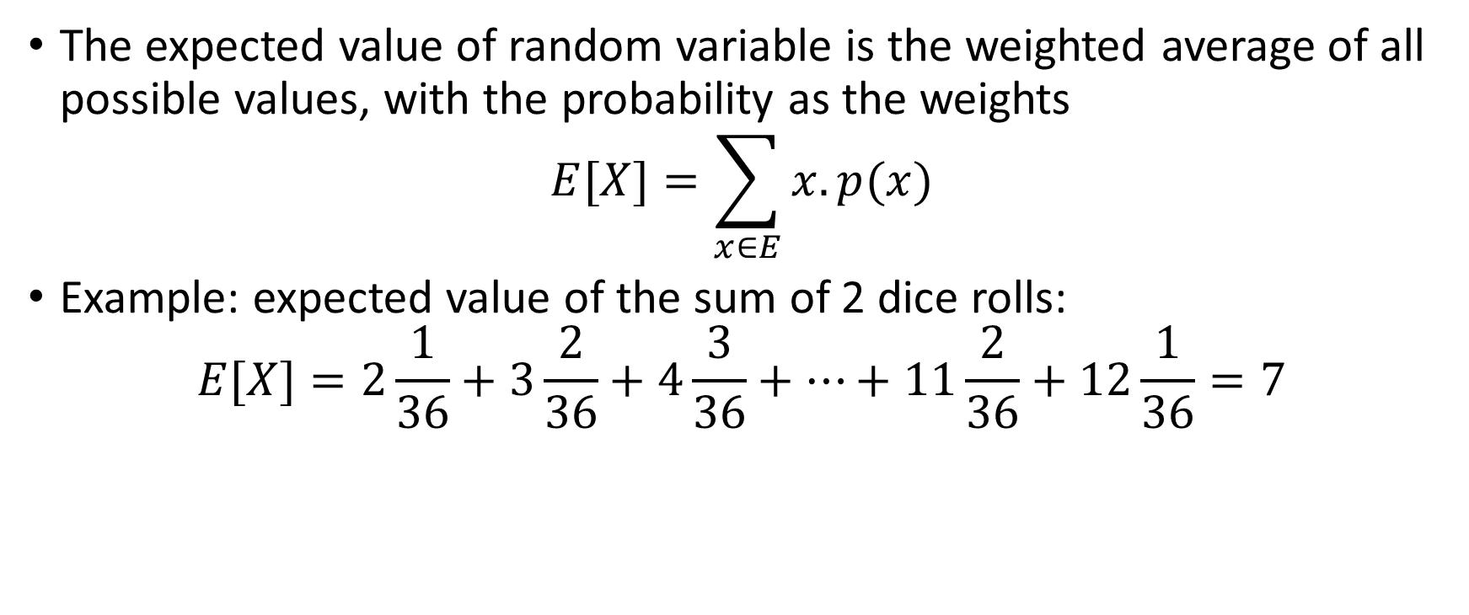
Expected value
The expected value of random variable is the weighted average of all possible values, with the probability as the weights
$$E[X]=\sum_{x∈E}{x.p(x)}$$
Example: expected value of the sum of 2 dice rolls:
$$E[X]=2\frac{1}{36}+3\frac{2}{36}+4\frac{3}{36}+…+11\frac{2}{36}+12\frac{1}{36}=7$$

Slide 8
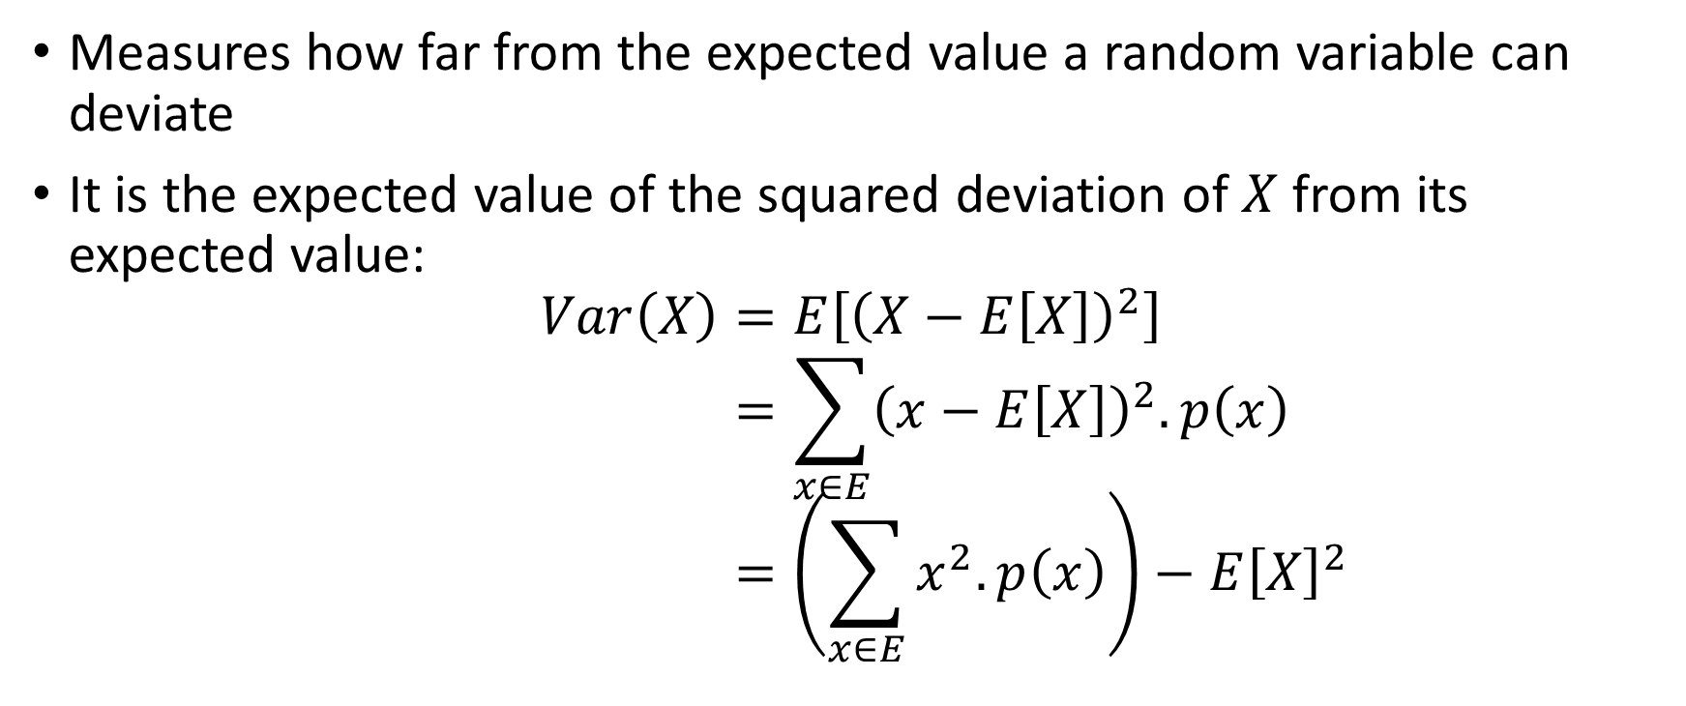
Variance
Measures how far from the expected value a random variable can deviate
It is the expected value of the squared deviation of $X$ from its expected value:
$$Var\left(X\right)=E\left[{\left(X−E\left[X\right]\right)}^{2}\right] \\ =\sum_{x∈E}{{\left(x−E\left[X\right]\right)}^{2}.p\left(x\right)} \\ =\left(\sum_{x∈E}{x^{2}.p\left(x\right)}\right)−E{\left[X\right]}^{2}$$

Slide 9
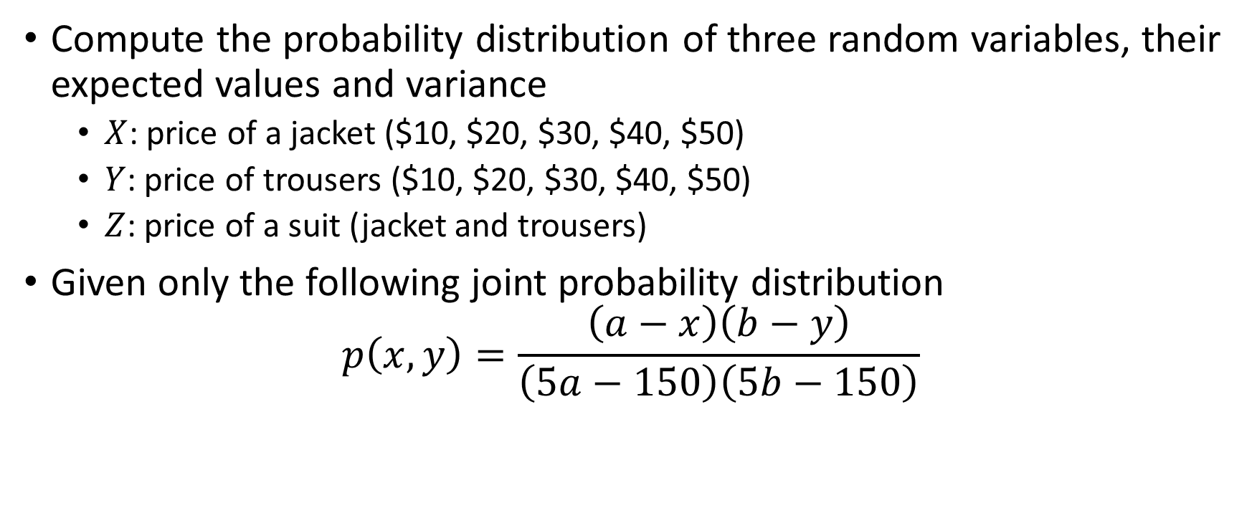
202unsold
Compute the probability distribution of three random variables, their expected values and variance
$X$: price of a jacket ($10, $20, $30, $40, $50)
$Y$: price of trousers ($10, $20, $30, $40, $50)
$Z$: price of a suit (jacket and trousers)
Given only the following joint probability distribution
$$p\left(x,y\right)=\frac{\left(a−x\right)\left(b−y\right)}{\left(5a−150\right)\left(5b−150\right)}$$

Slide 10
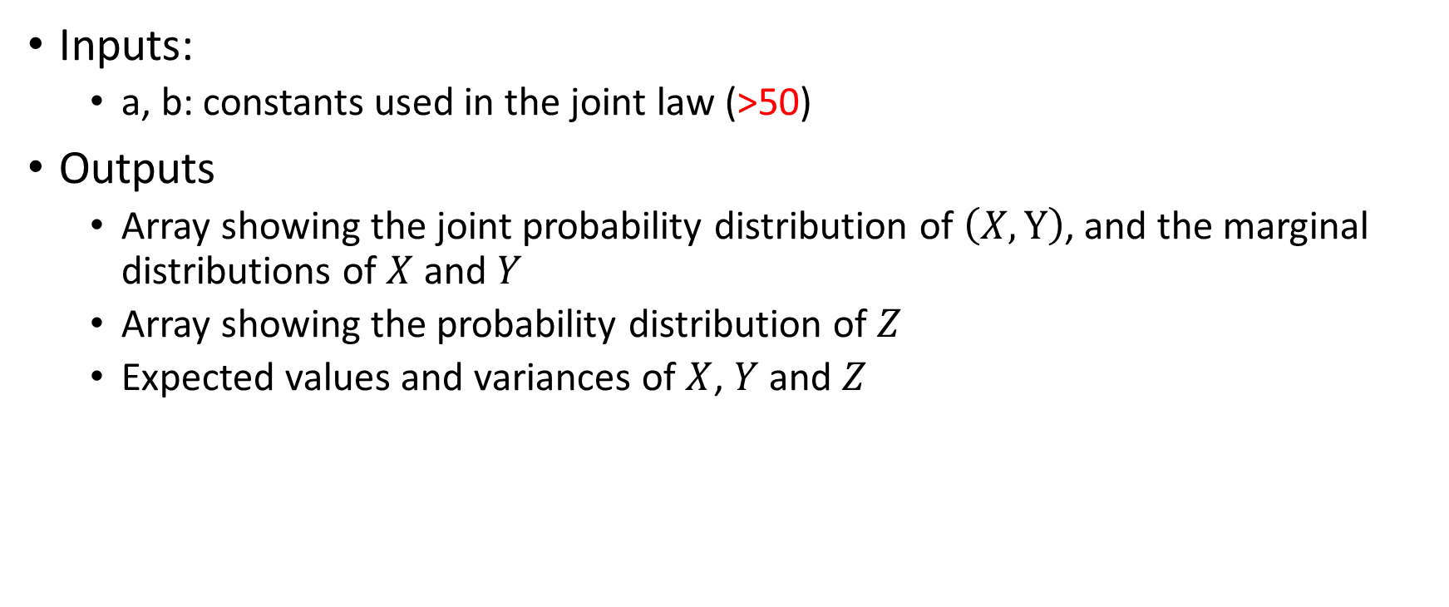
202unsold
Inputs:
a, b: constants used in the joint law (>50)
Outputs
Array showing the joint probability distribution of $\left(X,Y\right)$, and the marginal distributions of $X$ and $Y$
Array showing the probability distribution of $Z$
Expected values and variances of $X$, $Y$ and $Z$

