Slide 1
204ducks
B-MAT-400

Slide 2
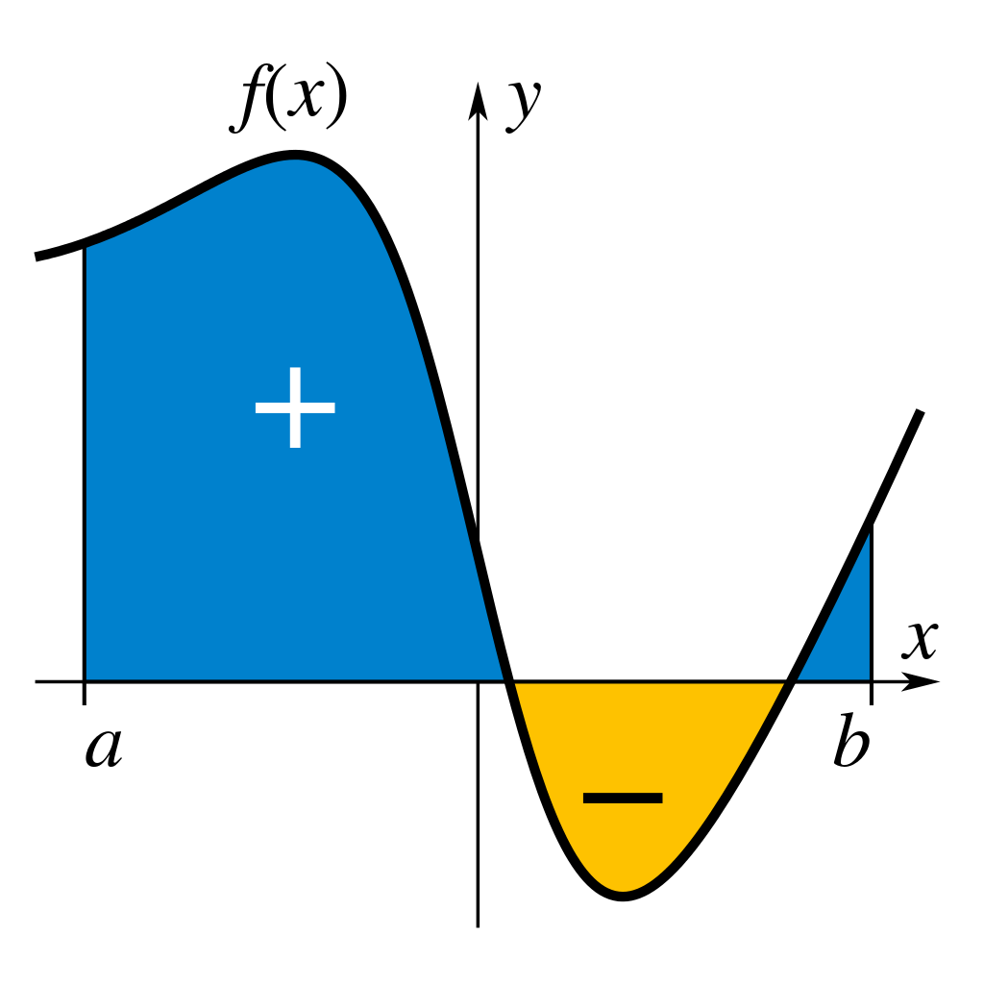
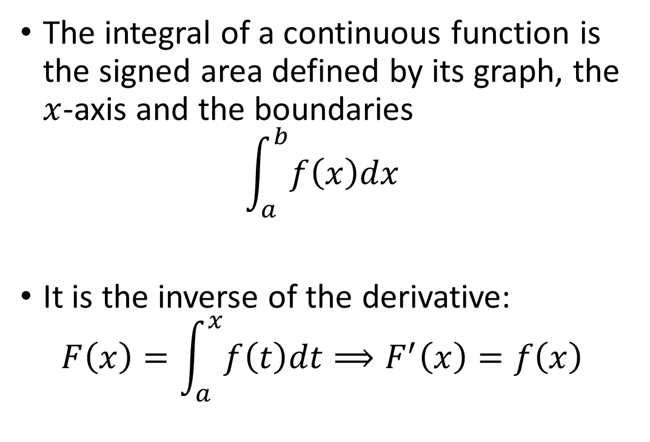
Reminder: integrals
The integral of a continuous function is the signed area defined by its graph, the $x$-axis and the boundaries
$$\int_{a}^{b}{f\left(x\right)dx}$$
It is the inverse of the derivative:
$$F\left(x\right)=\int_{a}^{x}{f\left(t\right)dt}⟹F^{′}\left(x\right)=f\left(x\right)$$

Slide 3
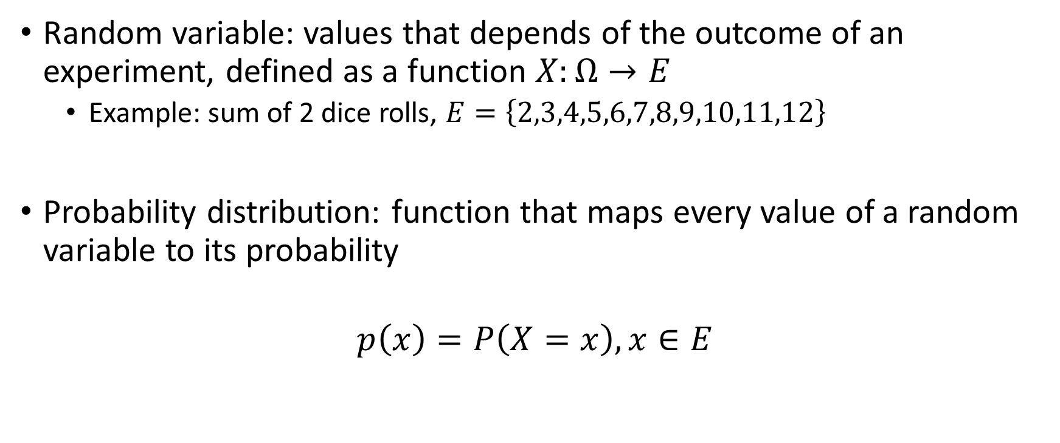
Previously: random variables and distributions
Random variable: values that depends of the outcome of an experiment, defined as a function $X:Ω→E$
Example: sum of 2 dice rolls, $E=\left\{2,3,4,5,6,7,8,9,10,11,12\right\}$
Probability distribution: function that maps every value of a random variable to its probability
$$p\left(x\right)=P\left(X=x\right), x∈E$$

Slide 4
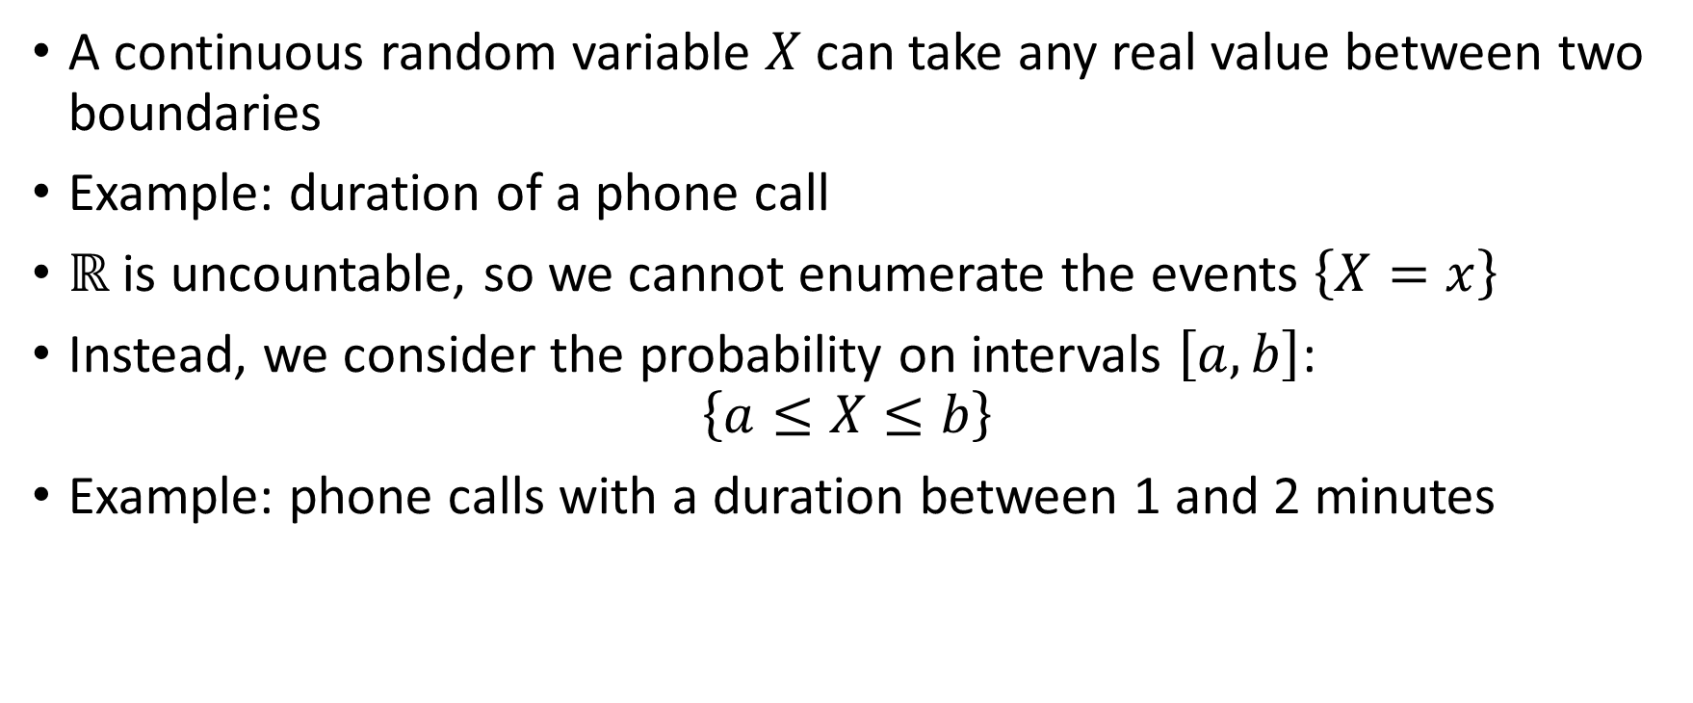
Continuous random variables
A continuous random variable $X$can take any real value between two boundaries
Example: duration of a phone call
$ℝ$ is uncountable, so we cannot enumerate the events $\left\{X=x\right\}$
Instead, we consider the probability on intervals $\left[a,b\right]$:
$$\left\{a≤X≤b\right\}$$
Example: phone calls with a duration between 1 and 2 minutes

Slide 5
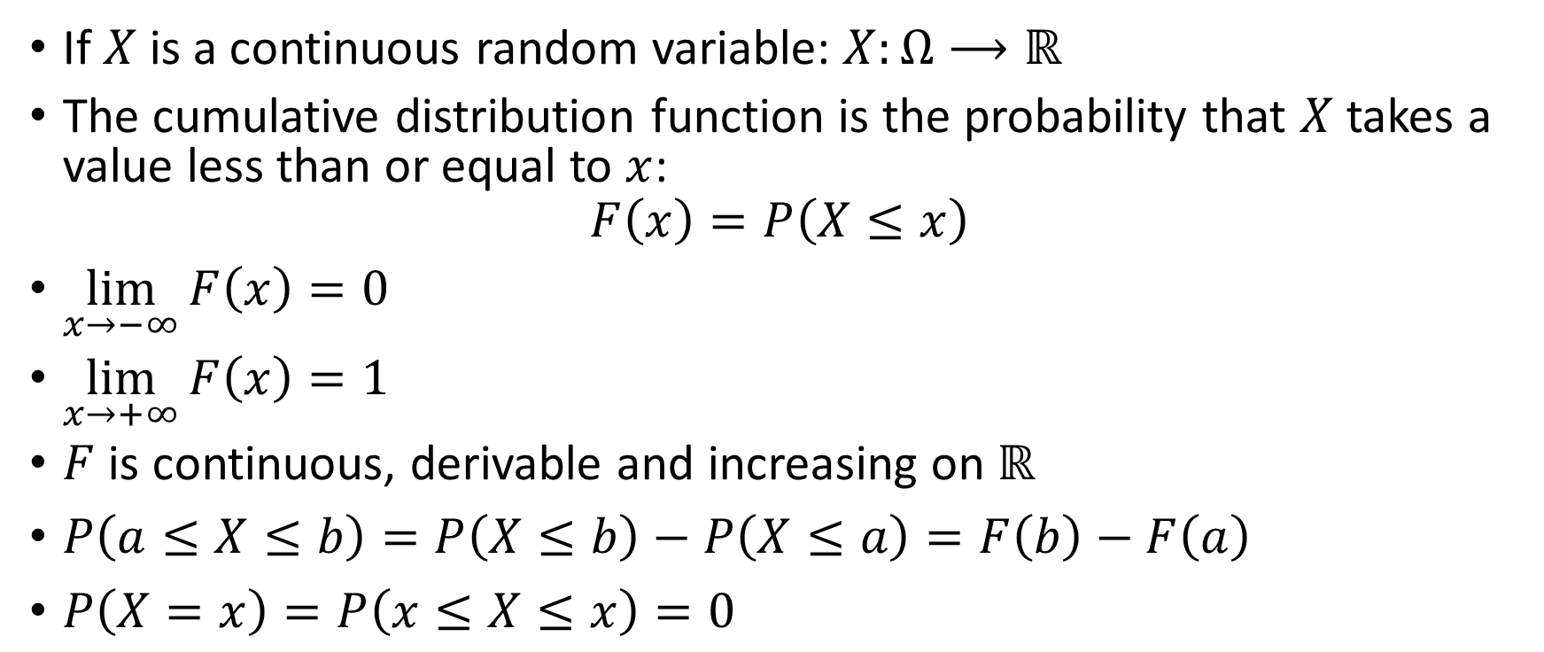
Cumulative distribution function
If $X$ is a continuous random variable: $X:Ω⟶ℝ$
The cumulative distribution function is the probability that $X$ takes a value less than or equal to $x$:
$$F\left(x\right)=P\left(X≤x\right)$$
$\lim_{x→−∞}{F\left(x\right)=0}$
$\lim_{x→+∞}{F\left(x\right)}=1$
$F$ is continuous, derivable and increasing on $ℝ$
$P\left(a≤X≤b\right)=P\left(X≤b\right)−P\left(X≤a\right)=F\left(b\right)−F\left(a\right)$
$P\left(X=x\right)=P\left(x≤X≤x\right)=0$

Slide 6
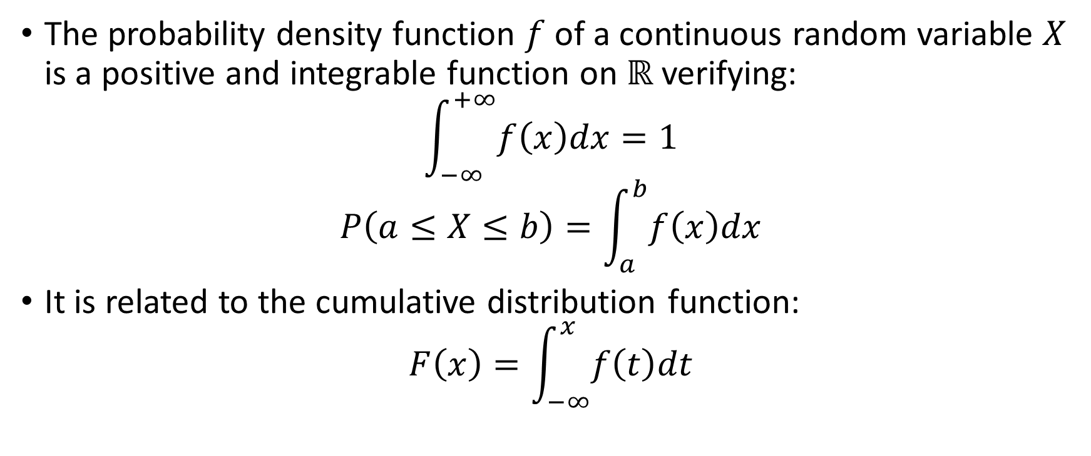
Probability density function
The probability density function $f$ of a continuous random variable $X$ is a positive and integrable function on $ℝ$ verifying:
$$\int_{−∞}^{+∞}{f\left(x\right)dx}=1$$
$$P\left(a≤X≤b\right)=\int_{a}^{b}{f\left(x\right)dx}$$
It is related to the cumulative distribution function:
$$F\left(x\right)=\int_{−∞}^{x}{f\left(t\right)dt}$$

Slide 7
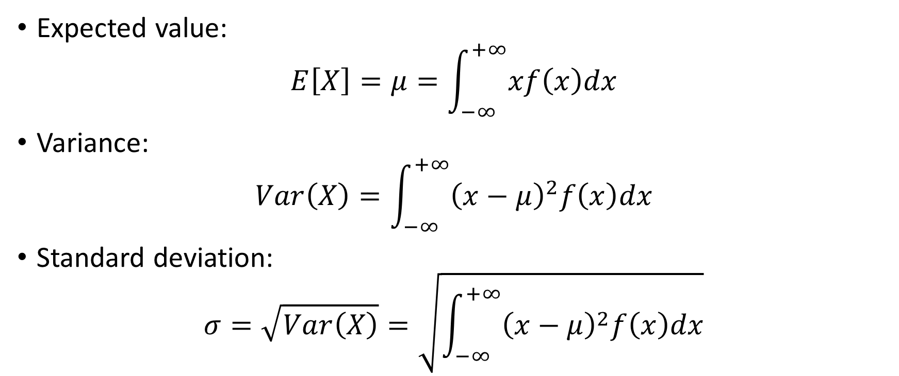
Expected value and standard deviation
Expected value:
$$E\left[X\right]=μ=\int_{−∞}^{+∞}{xf\left(x\right)dx}$$
Variance:
$$Var\left(X\right)=\int_{−∞}^{+∞}{{\left(x−μ\right)}^{2}f\left(x\right)dx}$$
Standard deviation:
$$σ=\sqrt{Var\left(X\right)}=\sqrt{\int_{−∞}^{+∞}{{\left(x−μ\right)}^{2}f\left(x\right)dx}}$$

Slide 8
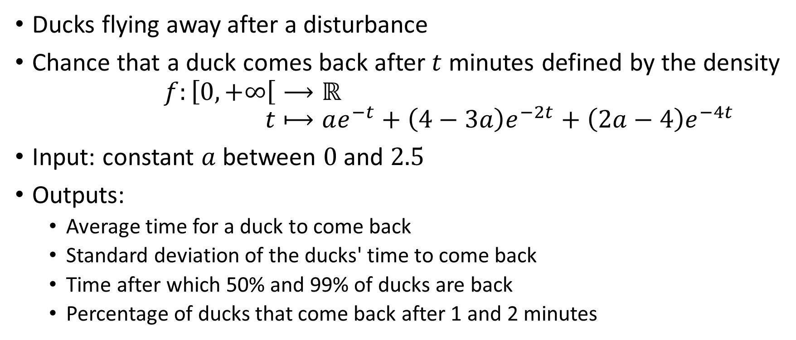
204ducks
Ducks flying away after a disturbance
Chance that a duck comes back after $t$ minutes defined by the density
$$f:\left[0,+∞\right[⟶ℝ \\ t⟼ae^{−t}+\left(4−3a\right)e^{−2t}+\left(2a−4\right)e^{−4t}$$
Input: constant $a$ between $0$ and $2.5$
Outputs:
Average time for a duck to come back
Standard deviation of the ducks' time to come back
Time after which 50% and 99% of ducks are back
Percentage of ducks that come back after 1 and 2 minutes

Slide 9
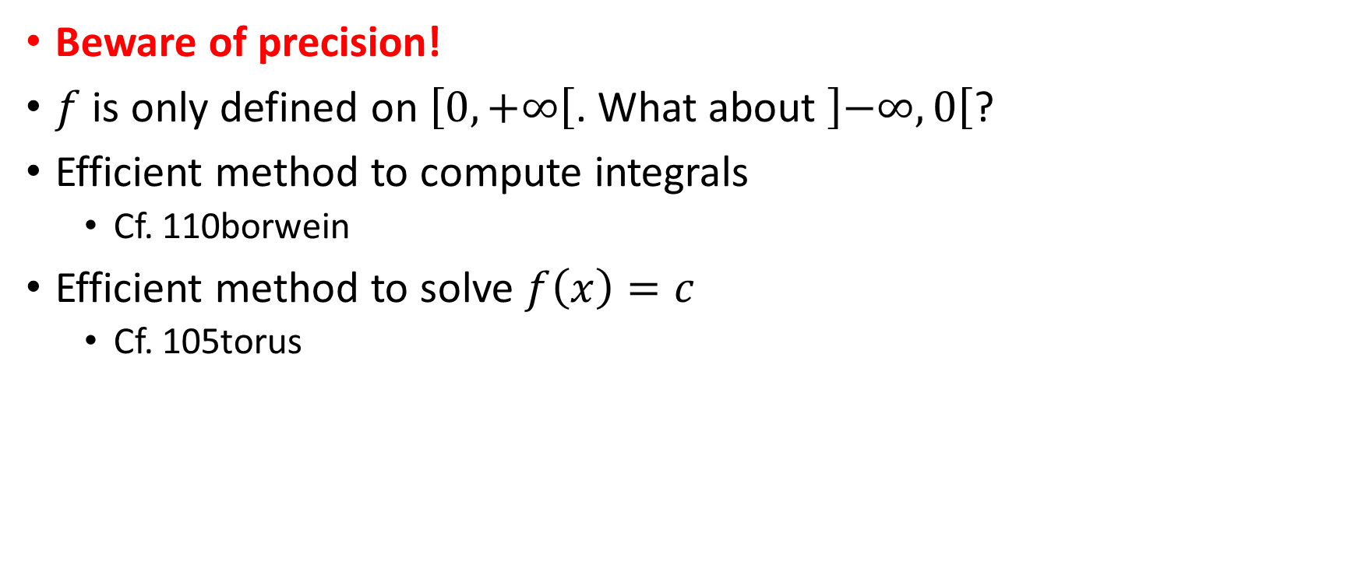
Points of attention
Beware of precision!
$f$ is only defined on $\left[0,+∞\right[$. What about $\left]−∞,0\right[$?
Efficient method to compute integrals
Cf. 110borwein
Efficient method to solve $f\left(x\right)=c$
Cf. 105torus

