Slide 1
206neutrinos
B-MAT-400

Slide 2
Descriptive statistics
Science that quantitatively describes and analyses features of a collection of data points
The goal is to summarize a sample, rather than inferring information on a larger population it may represent
Applications everywhere
Industry (reliability, projections…)
Social sciences (census, polls…)
Economy (market analysis…)

Slide 3
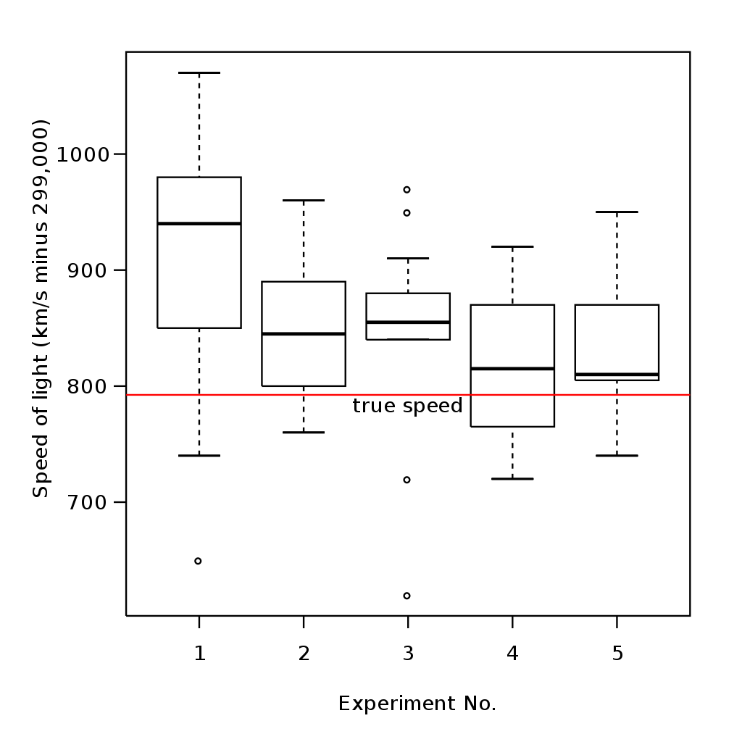

Descriptive statistics
Given a data set $(x_{0},x_{1},…,x_{n})$, we can describe the observations using measures such as:
Central tendency (ex: mean)
Dispersion (ex: variance)

Slide 4
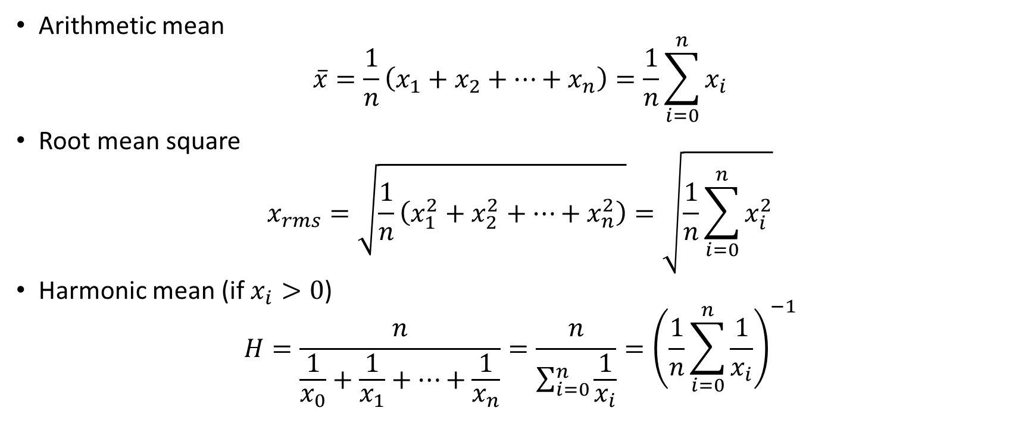
Central tendency measures
Arithmetic mean
$$\overline{x}=\frac{1}{n}\left(x_{1}+x_{2}+…+x_{n}\right)=\frac{1}{n}\sum_{i=0}^{n}{x_{i}}$$
Root mean square
$$x_{rms}=\sqrt{\frac{1}{n}\left(x_{1}^{2}+x_{2}^{2}+…+x_{n}^{2}\right)}=\sqrt{\frac{1}{n}\sum_{i=0}^{n}{x_{i}^{2}}}$$
Harmonic mean (if $x_{i}>0$)
$$H=\frac{n}{\frac{1}{x_{0}}+\frac{1}{x_{1}}+…+\frac{1}{x_{n}}}=\frac{n}{\sum_{i=0}^{n}{\frac{1}{x_{i}}}}={\left(\frac{1}{n}\sum_{i=0}^{n}{\frac{1}{x_{i}}}\right)}^{−1}$$

Slide 5
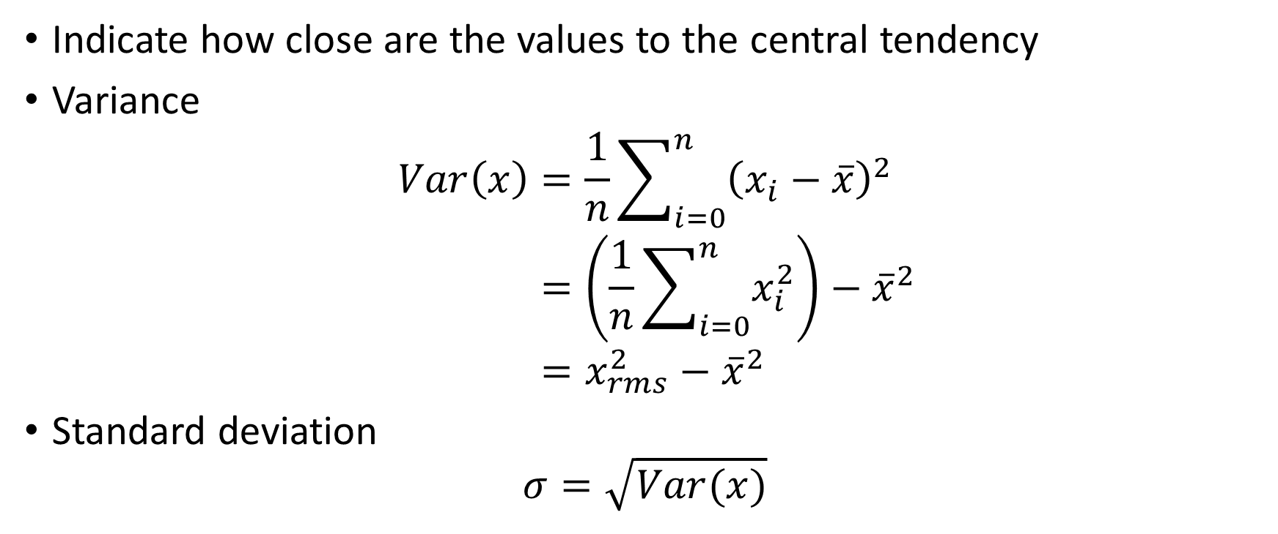
Dispersion measures
Indicate how close are the values to the central tendency
Variance
$$Var\left(x\right)=\frac{1}{n}\sum_{i=0}^{n}{{\left(x_{i}−\overline{x}\right)}^{2}} \\ =\left(\frac{1}{n}\sum_{i=0}^{n}{x_{i}^{2}}\right)−{\overline{x}}^{2} \\ =x_{rms}^{2}−{\overline{x}}^{2}$$
Standard deviation
$$σ=\sqrt{Var(x)}$$

Slide 6
206neutrinos
Goal: Compute central tendency and dispersion measures for a data set evolving with time
Inputs: n a h sd
n: number of values already in the set
a: current arithmetic mean
h: current harmonic mean
sd: current standard deviation
When started, the program asks the user to enter a new value

Slide 7
206neutrinos
If a new value is entered:
Display the number of recorded values
Display the arithmetic mean
Display the root mean square
Display the harmonic mean
Display the standard deviation
Asks the user for another value
If the keyword ‘END’ is entered, the program stops

