Slide 1
209poll
B-MAT-400

Slide 2
Sampling
Selection of a subset (a sample) of individuals among a population to estimate characteristics of the whole population
Different methods of sampling:
Simple random sampling
Each individual has an equal probability of selection
With or without replacement
Stratified sampling
Quotas sampling
…

Slide 3
Parameter vs statistic
A parameter describes the entire population
A statistic describes the sample
Examples:
Mean
Standard deviation
Variance
Proportion
…
The statistic is used to approximate the parameter

Slide 4
Sampling distribution
A statistic changes with the sample
The statistic can be considered as a random variable
The sampling distribution of a statistic is the distribution of the statistic for all possible samples of the same size
Example: The proportion of defective pieces in a sample of 100

Slide 5

Sampling in a finite population
If we consider a population of size $N$
The number of samples of size $n$ in the population is
$$C_{N}^{n}=\frac{N!}{n!\left(N−n\right)!}$$

Slide 6
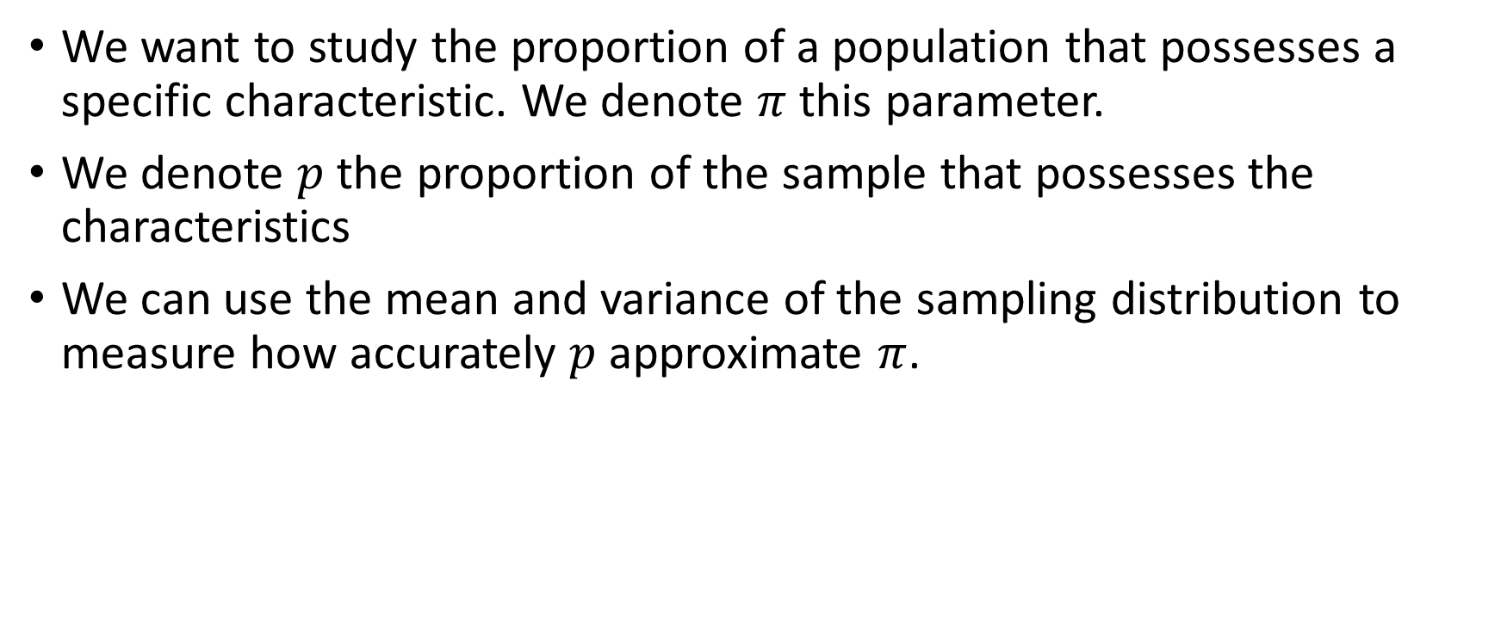
Sample proportion
We want to study the proportion of a population that possesses a specific characteristic. We denote $π$ this parameter.
We denote $p$ the proportion of the sample that possesses the characteristics
We can use the mean and variance of the sampling distribution to measure how accurately $p$ approximate $π$.

Slide 7
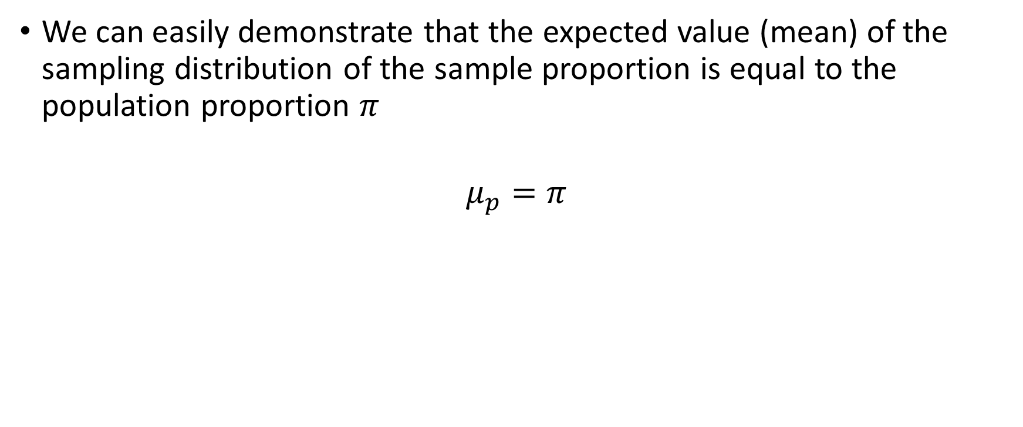
Mean of the sampling distribution
We can easily demonstrate that the expected value (mean) of the sampling distribution of the sample proportion is equal to the population proportion $π$
$$μ_{p}=π$$

Slide 8
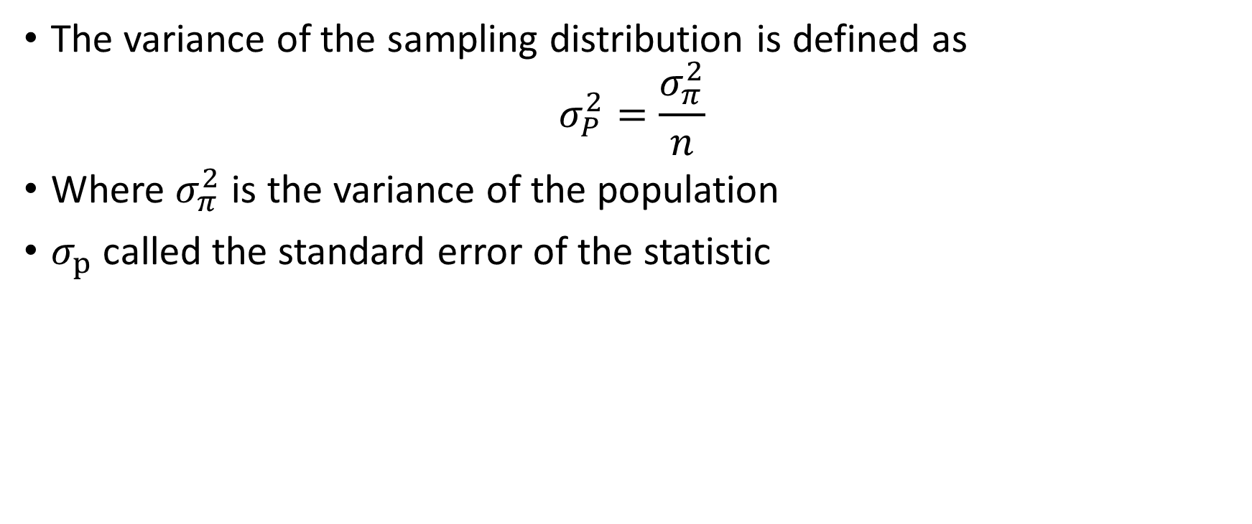
Variance of the sampling distribution
The variance of the sampling distribution is defined as
$$σ_{P}^{2}=\frac{σ_{π}^{2}}{n}$$
Where $σ_{π}^{2}$ is the variance of the population
$σ_{p}$ called the standard error of the statistic

Slide 9
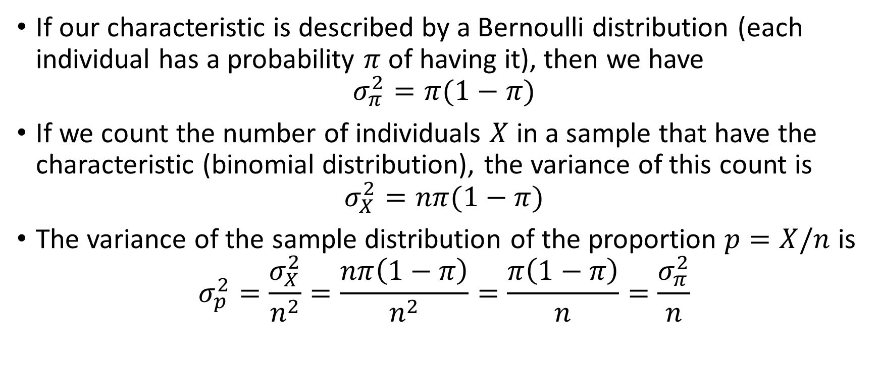
Example
If our characteristic is described by a Bernoulli distribution (each individual has a probability $π$ of having it), then we have
$$σ_{π}^{2}=π(1−π)$$
If we count the number of individuals $X$ in a sample that have the characteristic (binomial distribution), the variance of this count is
$$σ_{X}^{2}=nπ(1−π)$$
The variance of the sample distribution of the proportion $p=X/n$ is
$$σ_{p}^{2}=\frac{σ_{X}^{2}}{n^{2}}=\frac{nπ\left(1−π\right)}{n^{2}}=\frac{π\left(1−π\right)}{n}=\frac{σ_{π}^{2}}{n}$$

Slide 10
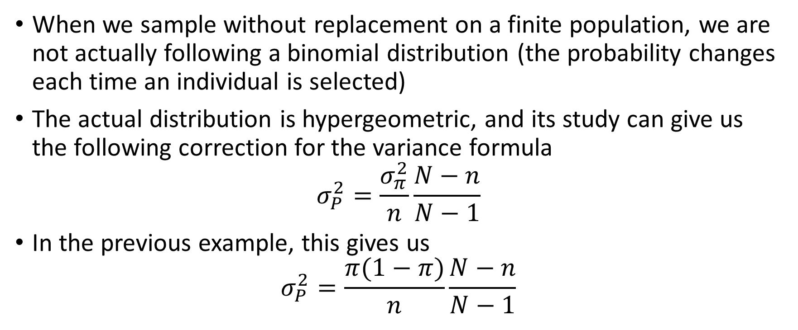
Finite population correction
When we sample without replacement on a finite population, we are not actually following a binomial distribution (the probability changes each time an individual is selected)
The actual distribution is hypergeometric, and its study can give us the following correction for the variance formula
$$σ_{P}^{2}=\frac{σ_{π}^{2}}{n}\frac{N−n}{N−1}$$
In the previous example, this gives us
$$σ_{P}^{2}=\frac{π(1−π)}{n}\frac{N−n}{N−1}$$

Slide 11
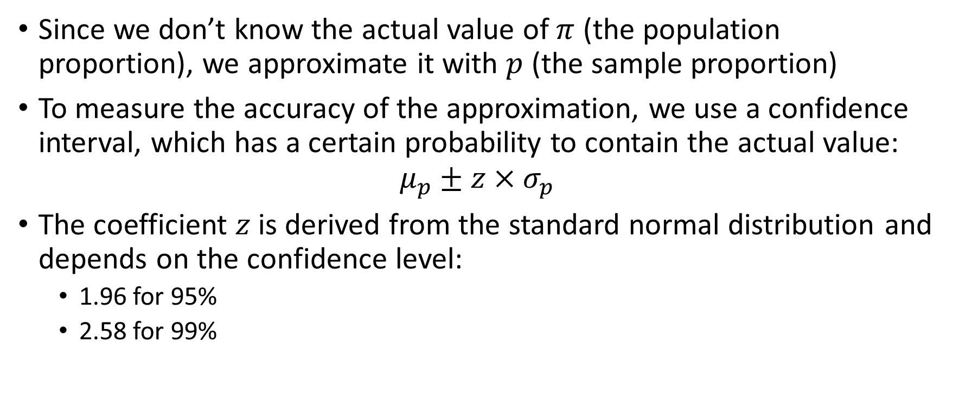
Confidence interval
Since we don’t know the actual value of $π$ (the population proportion), we approximate it with $p$ (the sample proportion)
To measure the accuracy of the approximation, we use a confidence interval, which has a certain probability to contain the actual value:
$$μ_{p}±z×σ_{p}$$
The coefficient $z$ is derived from the standard normal distribution and depends on the confidence level:
1.96 for 95%
2.58 for 99%

Slide 12
209poll
Goal: Compute confidence intervals for polls
Inputs:
size of population
size of the poll sample
Percentage of voting intention
Outputs:
Variance of the sample proportion
95% confidence interval
99% confidence interval

