Slide 1
PLATOS HEALTH ANALYTICS REPORT
User Engagement &
Health Outcomes
Analysis
Evaluate user activation, retention, engagement patterns,
and associated health outcomes.
App Events
(User Behavior)
User Profiles
(Demographics)
Health Outcomes
(Weight & Body)
Tools: Python | SQL | Power BI

Slide 2
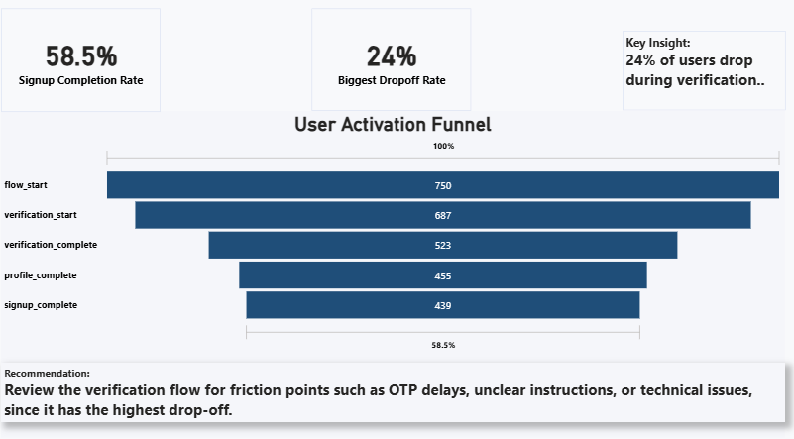
User Activation Funnel
Slide 1 of 5
750 (100%)
Key Insights
750 users initiated signup
439 users completed (≈59%)
Largest drop-off (~24%) at verification step
570 (76%)
490 (65%)
439 (58%)
Completion Rate: 59% | Biggest Drop-off: Verification Step (~24%)

Slide 3
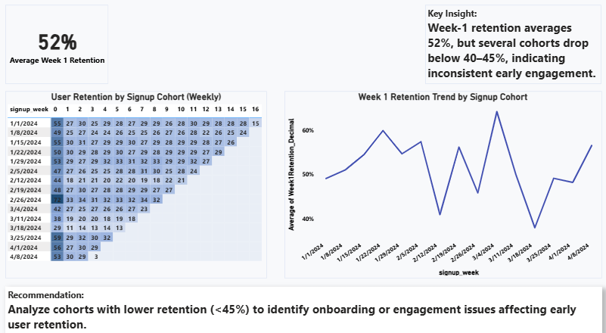
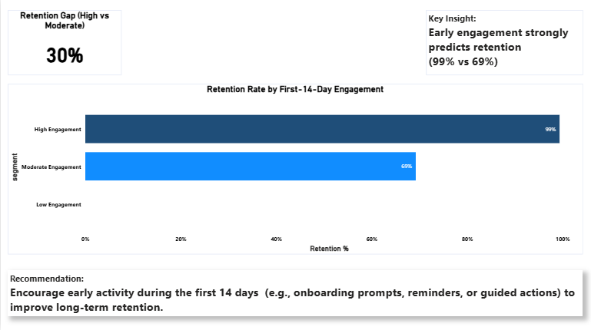
Retention & Early Engagement
Slide 2 of 5
~52%
Avg Week 1
Retention
~30%
Retention Gap
Nearly half of new users do not return within the first week, early engagement is the single strongest predictor of long-term user retention.

Slide 4
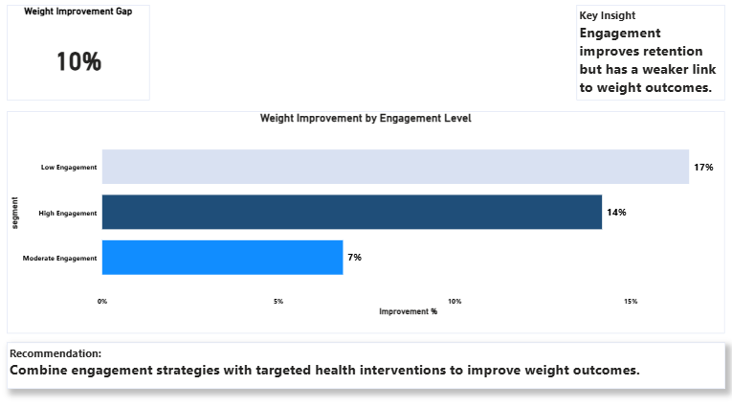
Health Outcomes & Behaviors Pattern
Slide 3 of 5
~10%
Weight Improvement Gap
Key Points
1
Weight and body composition were tracked for up to 12 weeks where data was available.
2
A 5% weight reduction was used as the threshold for meaningful improvement.
3
Body fat data is only available for users with connected devices, so those findings represent a smaller group of users.
Weight improvement observed across ALL engagement segments
Improvement patterns vary, but consistent data logging appears linked to better outcomes.

Slide 5
AI Health Insight Review
Slide 4 of 5
Each message assessed for accuracy, clarity, tone, and safety. Ratings: Pass | Needs Edit | Fail
Issue & Rating
Improved Version
A
Needs Edit
Positive but slightly misleading — "keep up whatever you're doing" is vague and could imply medical advice.
Your blood pressure decreased from 145/92 to 138/88 this week. Continuing healthy habits and following guidance from your healthcare provider may help support further improvement.
B
Fail
A 0.4% body fat change is very small and may reflect normal variation. Suggesting a metabolic issue could unnecessarily worry users.
Your body fat increased slightly. Small changes can occur due to normal variation — it may be helpful to continue tracking over time.
C
Needs Edit
Comparing the user to "most users" may feel discouraging and does not provide helpful context.
You logged 4 meals this week. Logging more consistently can help us provide more accurate insights about your nutrition patterns.
D
Pass
Message clearly explains the improvement, links it to specific behaviours (steps, sleep). Tone is encouraging and informative.
No changes needed — message is clear, positive, and supported by data.
E
Needs Edit
Message may feel slightly negative or discouraging when no data has been recorded.
We didn't see any new data recorded this week. Logging your activity tomorrow can help keep your progress up to date.
AI health messages should balance encouragement with caution — avoid implying medical guidance from small or ambiguous data changes.

Slide 6
Recommendations & Next Steps
Slide 5 of 5
Product Recommendations
With More Time or Data
01
Streamline Verification
Segmented Engagement Analysis
1
Simplify verification to reduce onboarding drop-off and improve activation rates.
Explore how engagement patterns vary across markets, subscription tiers, or referral sources to identify highest-value user segments.
02
Drive Early Engagement
Encourage engagement in the first 14 days via reminders or guided actions.
2
Long-Term Retention & Outcomes
A longer observation period would allow deeper analysis of retention curves beyond Week 1 and more robust health outcome measurement.
03
Promote Device & Logging
Push device connections and health logging at onboarding to improve data completeness.
3
Expanded Behavioural Signals
04
Refine AI Insights
Education content usage, meal logging patterns, and coach interactions could reveal what truly drives long-term user success.
Continuously refine AI-generated insights to keep them accurate, supportive, and safe.
Acting on these recommendations now, while building toward deeper analysis, will drive sustainable improvements in user outcomes.

