Slide 1
Module 5 Homework 1
Creating your own website hosted on GitHub Pages

Slide 2
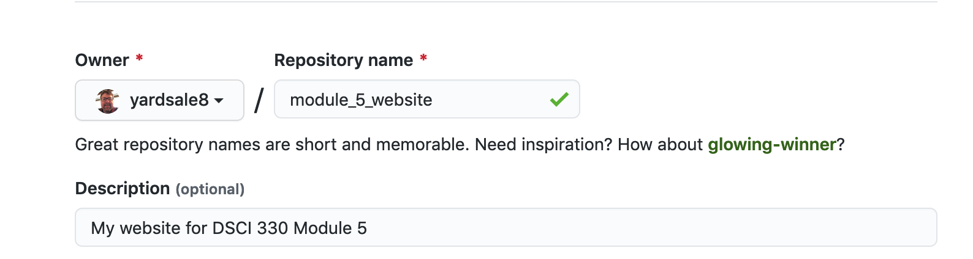
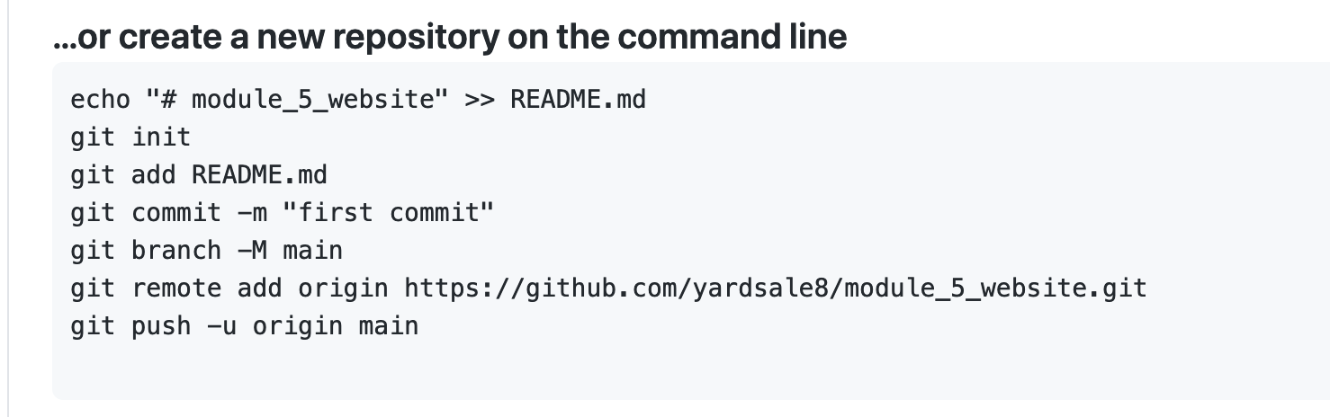
Step 1 Create a GitHub repo and initialize locally

Slide 3
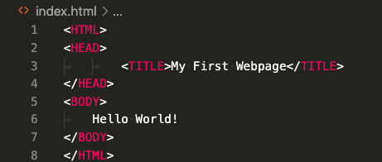
Step 2 Create a dummy website
Task. Create a text file named index.html in the repository root directory with the following (filler) content. Commit and push to GitHub.

Slide 4
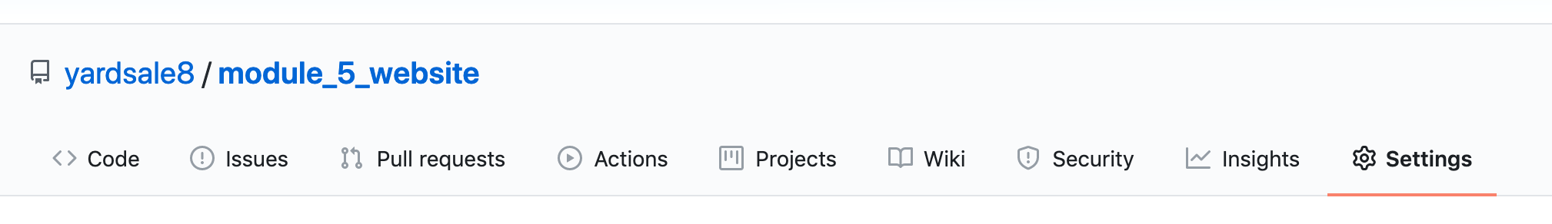
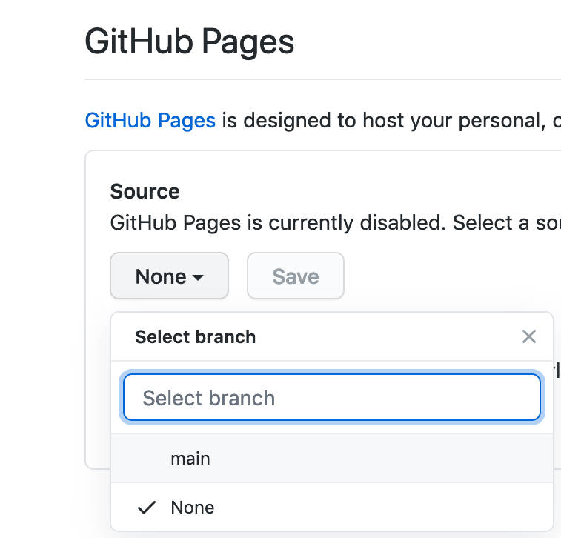
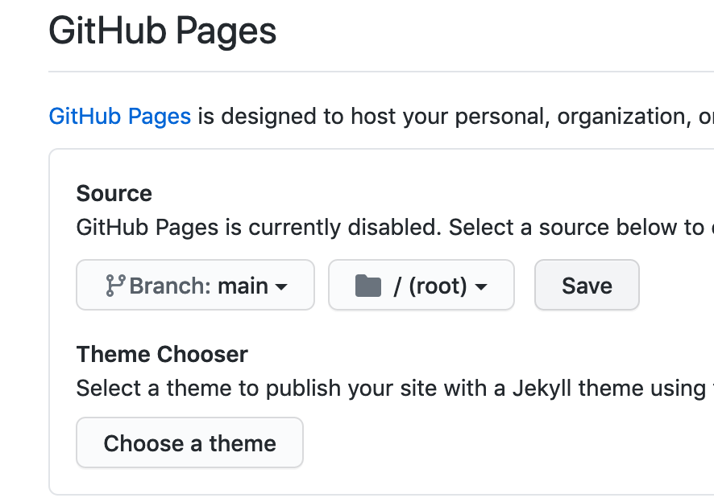
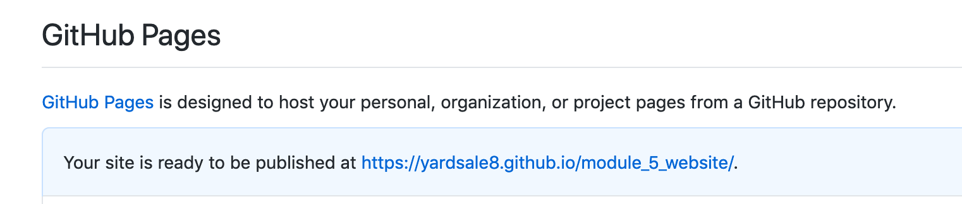
Step 3 Set up GitHub Pages
Verify this is your dummy website

Slide 5
Step 3 Additional assignment tasks
Personalize your website!
All the information needs to be about you.
Must contain
Few lines of text
Some formatting (e.g., bold, underline, colors, size)
At least one image
At least one working link
At least one list (either number list or bullet point list)
A HTML table
Additional elements
Additional more advanced elements
Interesting visual design
Publish your site to GitHub repo.

